Slide 1
RISK
120
D1 · DEFENSE & AEROSPACE · CRITICAL NOW
Mission Readiness &
Predictive Maintenance Copilot
Turning HUMS sensor drift into an explainable, prioritized maintenance plan — before the mission window closes.
[Team Name : Predators] · Bobathon 2026 · Powered by IBM Bob

Slide 2
PROBLEM
Readiness decisions are made on a calendar, not on evidence.
$90B/yr
Weeks
25%
spent on military maintenance in the US alone
of recovery time after an unexpected platform failure
of our sample fleet showed a failure signature sensors already had
Maintenance runs on fixed schedules regardless of actual condition. HUMS sensor data that could predict failures weeks in advance sits unanalysed — until it's too late and a platform fails right before it's needed.
The question no one answers today:
“What will break before we need it next?”
MISSION READINESS COPILOT · D1 · IBM BOB
02

Slide 3
SOLUTION
A three-stage pipeline: classify, predict, explain.
01
02
03
Readiness Classifier
Failure Predictor
Explainable Plan
Rule-based thresholds on vibration, temperature, pressure drift + overdue service records.
Linear trend extrapolation estimates days-to-failure per component, not just current state.
Ranked by risk, every asset gets plain-English reasons and a recommended action.
Result, on our sample fleet:
AST-003 Comms Equipment — NOT MISSION READY
Predicted temperature failure in 5.9 days. Next mission in 6 days. The system catches this before the calendar schedule ever would.
Validated: all 5 injected failure signatures were correctly surfaced as the top 5 highest-risk assets.
MISSION READINESS COPILOT · D1 · IBM BOB
03

Slide 4
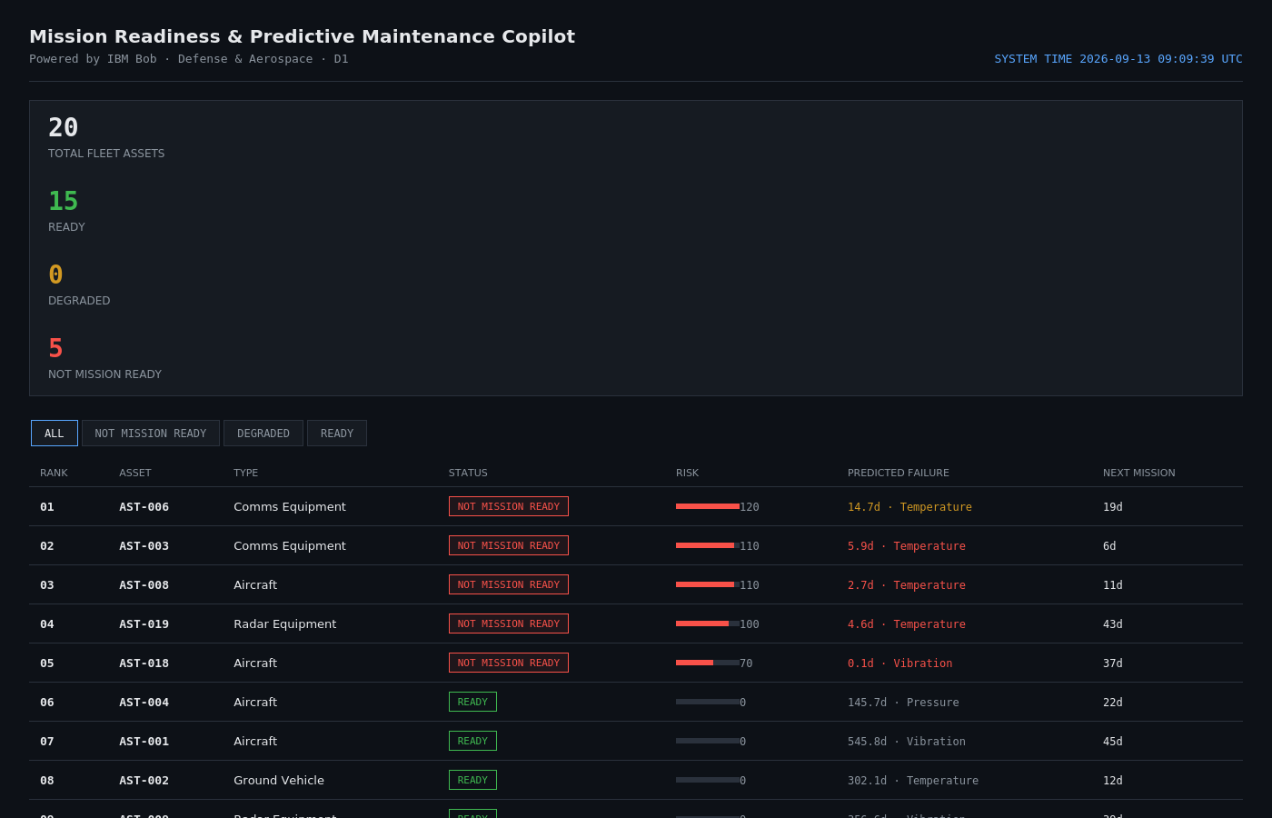
DEMO & ARCHITECTURE
From sensor drift to a commander's answer.
HUMS Sensor Logs + Service Records
↓
Analysis Engine (analyze.py)
↓
MCP Server (4 live tools)
↓
IBM Bob (Agent / Ask mode)
↓
Natural-Language Briefing
Dashboard shown: live fleet readiness board, ranked by risk, filterable by status.
MISSION READINESS COPILOT · D1 · IBM BOB
04

Slide 5
IBM BOB INTEGRATION
Bob calls live tools. Nothing is pre-scripted.
MCP TOOLS EXPOSED TO BOB
EXAMPLE PROMPT
get_fleet_summary()
“Give me today's mission readiness briefing. Tell me which assets will fail before their next mission.”
Status counts + single highest-risk asset
get_prioritized_maintenance_plan()
Full ranked fleet by risk score
get_asset_detail(asset_id)
Deep dive on one asset
WHY THIS IS LOAD-BEARING
get_assets_at_risk_before_mission()
Every tool call re-runs the actual analysis pipeline. Bob isn't reading a hardcoded string for the demo — it gets real numbers back and writes the explanation itself. Swap in a live HUMS feed later and nothing on Bob's side changes.
Assets that fail before their mission
MISSION READINESS COPILOT · D1 · IBM BOB
05

Slide 6
IMPACT
Beyond the hackathon.
TODAY
NEXT
AT SCALE
• Synthetic sensor data (with real injected failure patterns)
• Swap CSVs for a live HUMS feed — zero changes to Bob's side
• Fleet-wide readiness command centers across bases
• Rule-based classifier, chosen for explainability
• Calibrate thresholds against real fleet failure history
• Automated crew pre-positioning tied to predicted failures
• Standalone dashboard + working MCP integration
• Add non-linear degradation modeling per component type
• A fraction of the $90B/yr maintenance spend redirected to prevention
Thank you.
Mission Readiness & Predictive Maintenance Copilot · [Your Team Name]
MISSION READINESS COPILOT · D1 · IBM BOB
06

