Slide 1

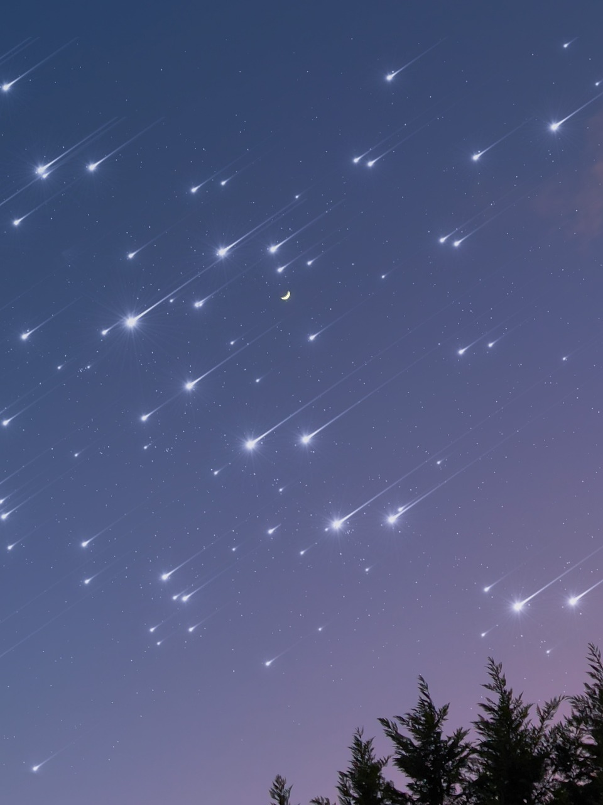

The Cosmos: A Space Knowledge Website
Enrollment No :- 23002171210051
Name :- Naitik Harshadbhai Khaniya
Roll No :- 191
Sem - III

Slide 2
Website Overview
Purpose
Topics
Technologies
Educating users about space
Cosmic Chronicles
HTML: Structure
Theories & Planets
Tailwind CSS: Design
Black Holes
JavaScript: Interactivity

Slide 3
Key Topic
1
JWST: Deep Space Exploration
3
Big Bang Theory: Origin Of The Universe
2
Gravastar: Alternative Theory To Black Holes
Theoretical Cosmology: String Theory, Dark Matter, ΛCDM Cosmology & Many More
4

Slide 4




Advantages Of Website
Accurate & Up-to-date
Enhances Scientific Awareness
Interactive Content
Learning Hub

Slide 5
Future Scope
AI Chatbot
1
For Q&A
Live Space News
2
Updates & Researches
3D Visualizations
3
Space Simulations
API Integration
4
NASA, ISRO & Many More

Slide 6
Thank You

