Slide 1
Detection of Malicious Handover in Mobile Networks Using Dead-reckoning
Tianchang Yang (tianchang.yang@psu.edu)
Yilu Dong (yiludong@psu.edu)

Slide 2
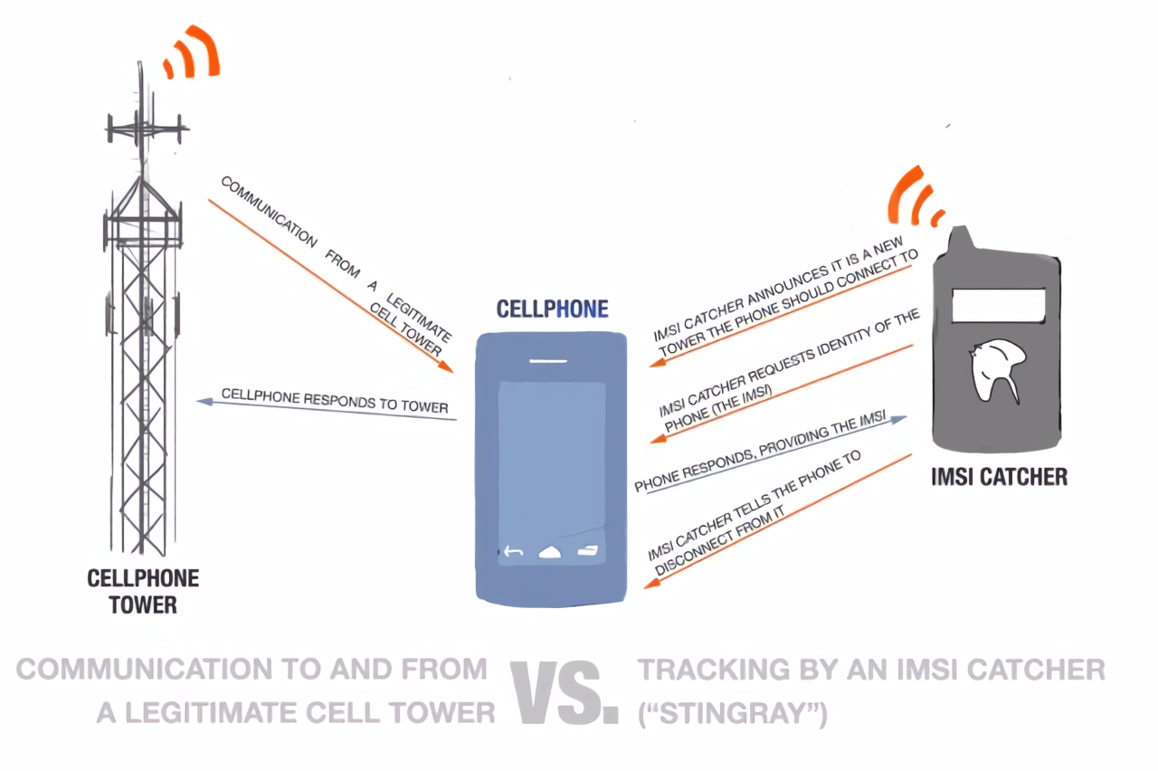
FBS attacks (IMSI Catcher)
Unique Identifier
No or optional encryption
Track user location

Slide 3
Identify Malicious Handover
FBSs usually use high transmitting power to attract phones -> Signal Strength
FBSs will behave differently than a normal base station (i.e., send slightly different RRC control messages) -> analyze RRC control messages
Usually, the handover will occur when the user moved from one cell to another -> detect user movement
All the above can be done on a phone

Slide 4
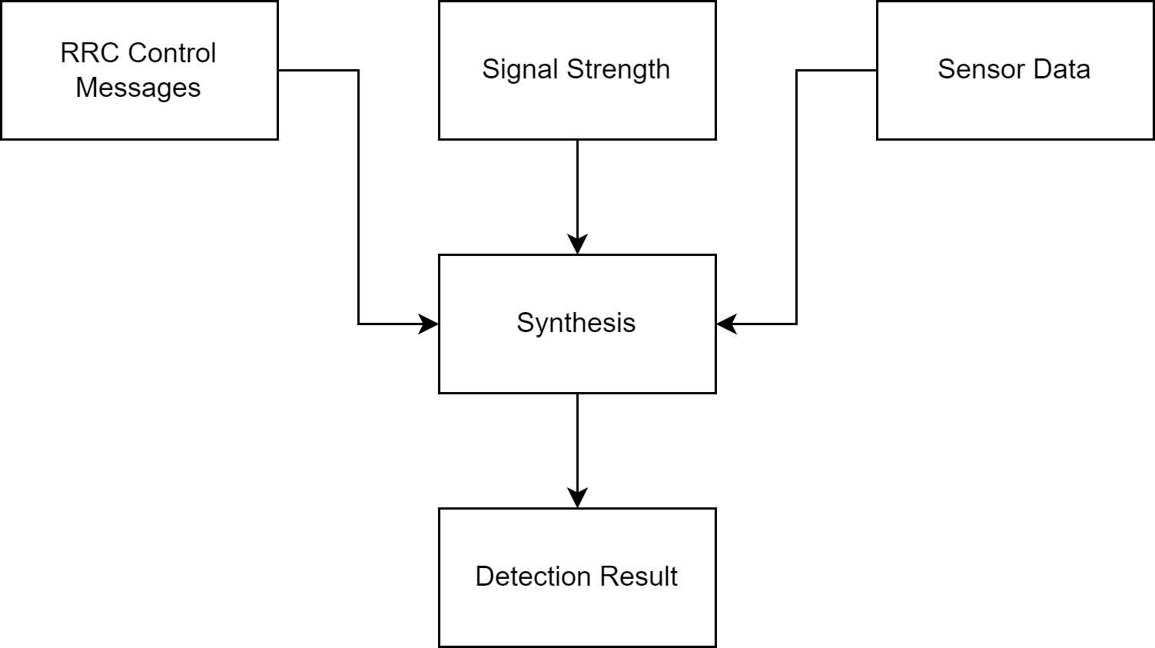
Idea Overview

Slide 5
Why Dead-Reckoning?
Collecting GPS information requires special permission, which pose privacy concerns.
Work for indoor locations
We don’t require a very precise location estimate to achieve our goal.

Slide 6
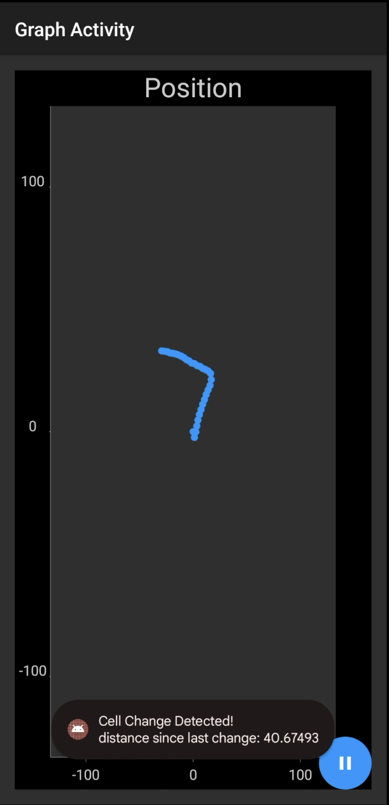
Evaluation
Pixel 6 and Pixel 7 pro running Android 12
Sensor data:
Accelerometer: steps
Gyroscope: heading information
Magnetometer: translate direction to global frame
Cell information

Slide 7
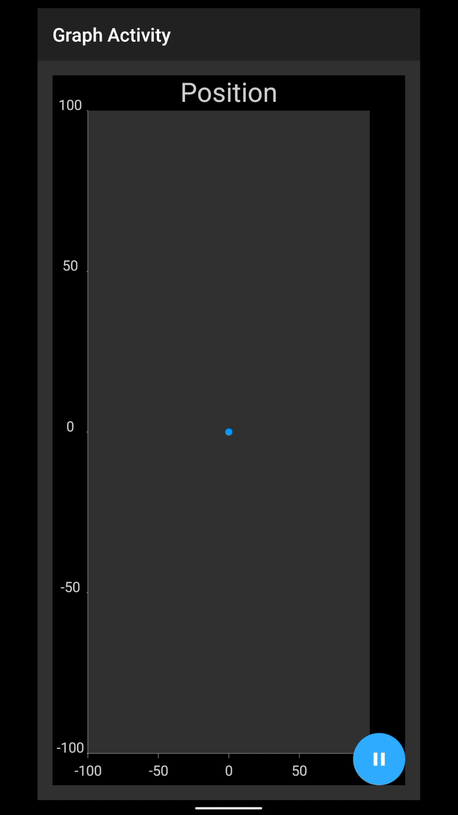
Demo

Slide 8
Evaluation
error (m)
Distance (m)

Slide 9
Future Work
Take more information into consideration
E.g., Handover commands, signal strength, messaging sequences
Take into consideration more movement patterns
Biking, running, etc.
Using machine learning techniques to raise malicious handover alerts

Slide 10
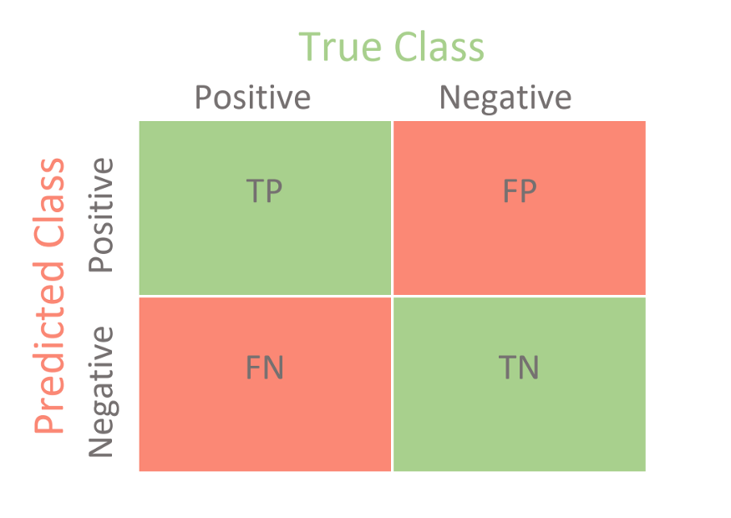
Future Evaluations
The positive rate for
identifying fake base station

Slide 11
References
A. Dabrowski, N. Pianta, T. Klepp, M. Mulazzani, and E. Weippl, “IMSI-catch me if you can,” Proceedings of the 30th Annual Computer Security Applications Conference, 2014.
H. Wang, S. Sen, A. Elgohary, M. Farid, M. Youssef, and R. R. Choudhury, “No need to war-drive: unsupervised indoor localization,” Proceedings of the 10th international conference on Mobile systems, applications, and services - MobiSys '12, 2012.
Nisargnp, “NISARGNP/deadreckoning: Real-time localization on Android phones using inertial sensors (accelerometer, Compass, gyro),” GitHub. [Online]. Available: https://github.com/nisargnp/DeadReckoning. [Accessed: 14-Dec-2022].

Slide 12
Thanks! Questions?

