Slide 1
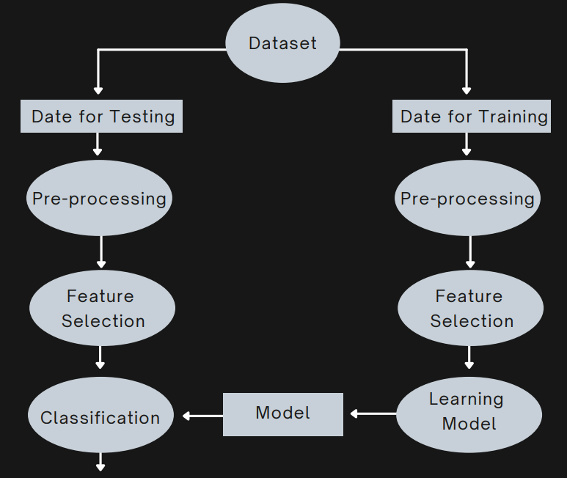
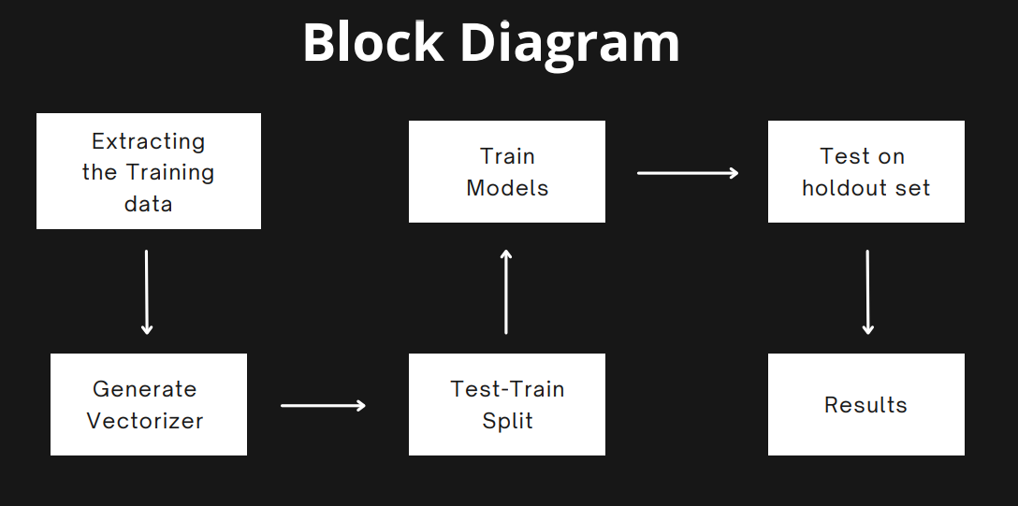
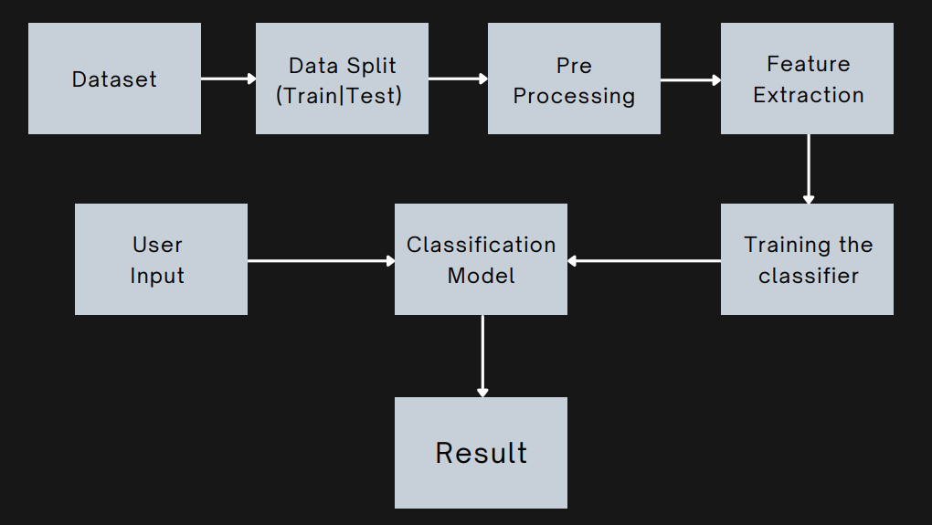
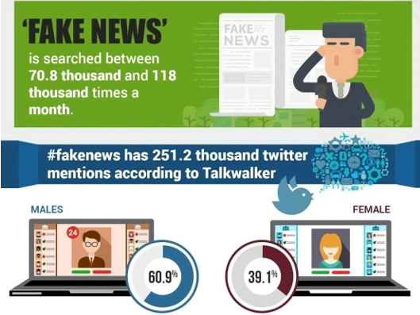
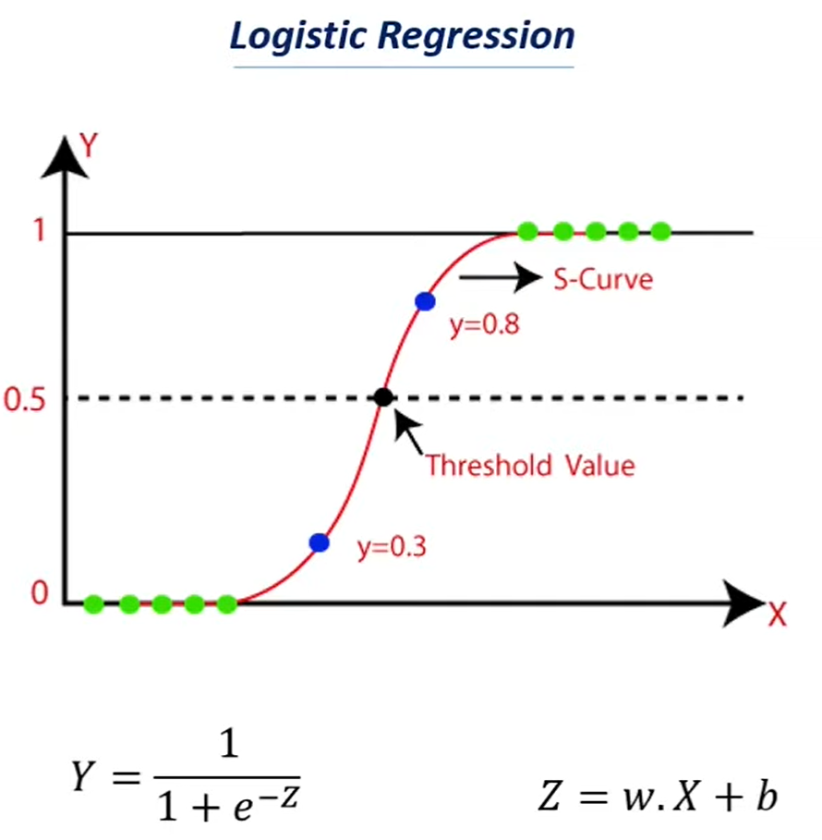



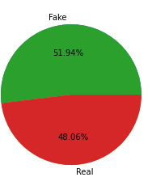
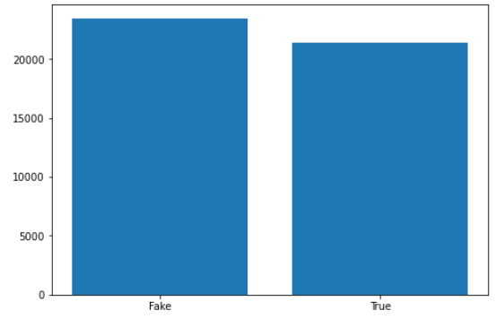
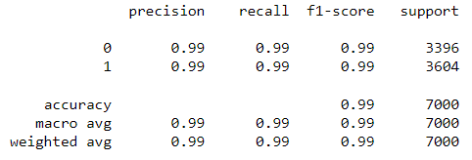
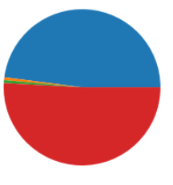
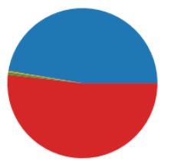
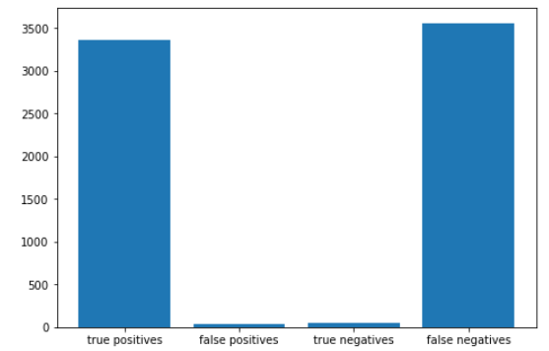
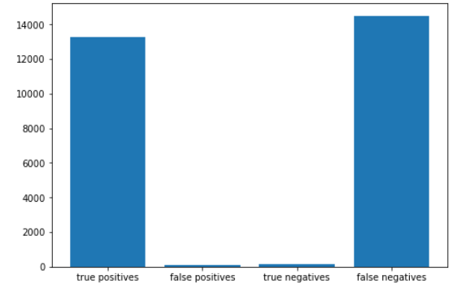
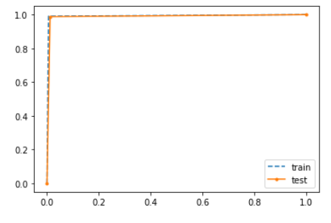
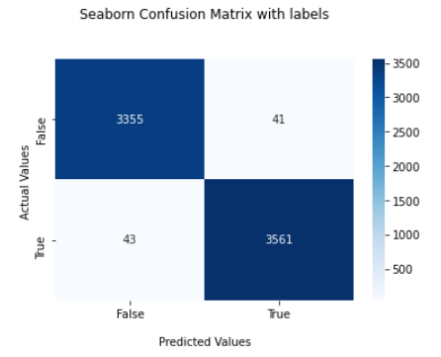
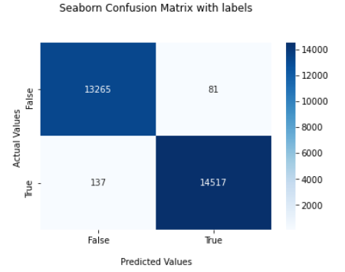
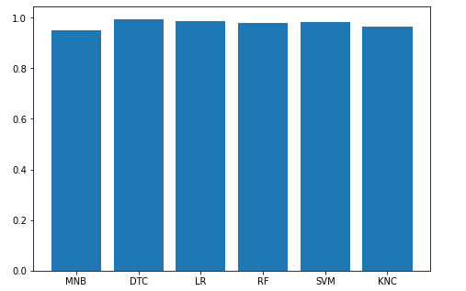
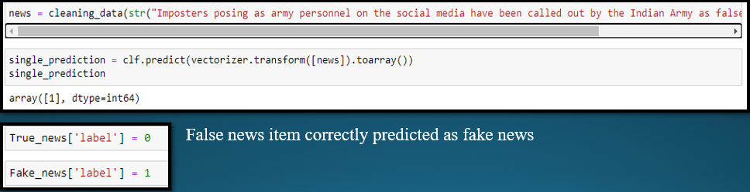
Fake News Detector
Naivedya Rai | Mithil Kashid
Introduction and Need of Study
Methodology adopted / Algorithm Used and resources used
Fake news has the ability to present a weapon like no other. Although the existence of fake news is nothing new, fake news has recently gained much attention, due to the enormous amount of misinformation surrounding the novel coronavirus, falsification of news in politics, the current Ukraine-Russia conflict, Elon Musk's takeover of twitter etc. to name a few.
The fake news on social media and various other media is wide spreading and is a matter of serious concern due to its ability to cause a lot of social and national damage with destructive impacts. A lot of research is already focused on detecting it.
The world is changing rapidly. There is no doubt that we have a number of advantages of this digital world but it also has its disadvantages. There are different issues in this digital world. One of them is fake news. Someone can easily spread fake news. Fake news is spread to harm the reputation of a person or an organization. It can be a propaganda against someone that can be a political party or an organization. There are different online platforms where someone can spread fake news. Such as Facebook, Twitter, Reddit, Instagram etc. Machine learning is an integral part of artificial intelligence that helps in making the systems that can learn and perform different actions.
The aim of this project is to create a fake news detector which will be capable of detecting fake news with a high level of accuracy. We will be creating a machine learning model using python and several other libraries along with NLP in order to successfully detect fake news.
Algorithm:
Logistic Regression classifier
Multinomial Naive Bayes
Resources & Tools:
Jupyter Notebook
Google Colaboratory
Kaggle
Natural Language Processing
Natural Language Toolkit Library
Excel
Scikit Learn Library
NumPy
Pandas
Matplotlib
Seaborn
Medium
W3Schools
Importing the required tools and libraries etc.
Start by obtaining a good data set from Kaggle
Exploration, cleaning and analysis of the data
Training, testing and splitting the data
Initializing a Vectorizer
6. Initializing and running a Classifier
7. Running multiple classifiers on the data
8. Running the accuracy checks and final tests
9. Obtaining the most suitable classifier
10. Evaluating the result
Observations and Result
Conclusion:
We have successfully deployed and implemented a fake news detector
which predicts whether an item is True or Fake and have yielded
satisfactory accuracy results.
We used python, machine learning, NLP and several other libraries to
build our model and visualize the data obtained from it. We obtained
our data set from Kaggle and deployed several classifiers to determine
the best one. Our main algorithm, Logistic regression classifier yielded
an accuracy of 98%. Our results were seen to be more accurate than
several other news detectors and we were able to train and test the
model well on a good sample size of data.
To further improve the accuracy of our detector and optimize it in the
future we can make use of ensemble learning. We aim to improve the
model as much as we can and attain the highest accuracy possible in
order to detect fake news effectively.
Department of Computer Science and Engineering

