Slide 1

Inomancy Health Care Inc.
Organization Overview, Enterprise Architecture, and Current Network
Team 1:
Naiya Whitley
Olivia Odugba
Olivia Barr
Sam Naim Anthony Azuogalanya
Josiah Williams

Slide 2

Inomancy's Vision
"To provide the people of North Carolina the services they deserve and more. With quality health care that they can trust, their optimal health is just within reach. Inomancy Home Care, Inc. is here for life, thus we are here for you."

Slide 3
Organization Overview
Business: Inomancy Home Health Care
Provides medical supplies including wheelchairs, electric beds, canes, walkers, gloves, hand sanitizer, and more
Serves clients who receive monthly drop-offs of necessities like diapers and medical drinks
Delivers larger items such as wheelchairs when needed
Operates a medical store offering a range of products including scrubs, casts, and crutches
6 offices spanning across Eastern Carolina

Slide 4
Scope
Scope: Assessing Inomancy Health Care’s network architecture risk
Objective: Ensure security of confidential client and employee information
Methods:
Adding VPNs
Implementing two-factor authentication
Limiting access to certain employees
Evaluating user permissions and access through the client portal
Focus area: Analyzing the company’s network throughout the OSI model, specifically layer 3 (Network)

Slide 5
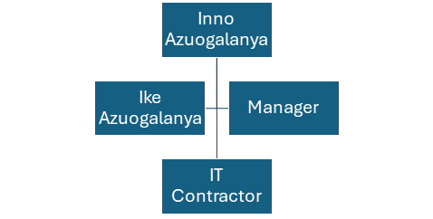
IT Governance
Ownership: Family-owned business
Owner: Inno Azuogalanya
Son: Ike Azuogalanya, involved in operational work
Decision Making:
Financial decisions and strategic directions: Inno Azuogalanya
Day-to-day operational decisions: Ike Azuogalanya
Management:
Manager oversees staff and operations during work hours
IT Support:
IT analyst works as a contractor to handle IT needs

Slide 6
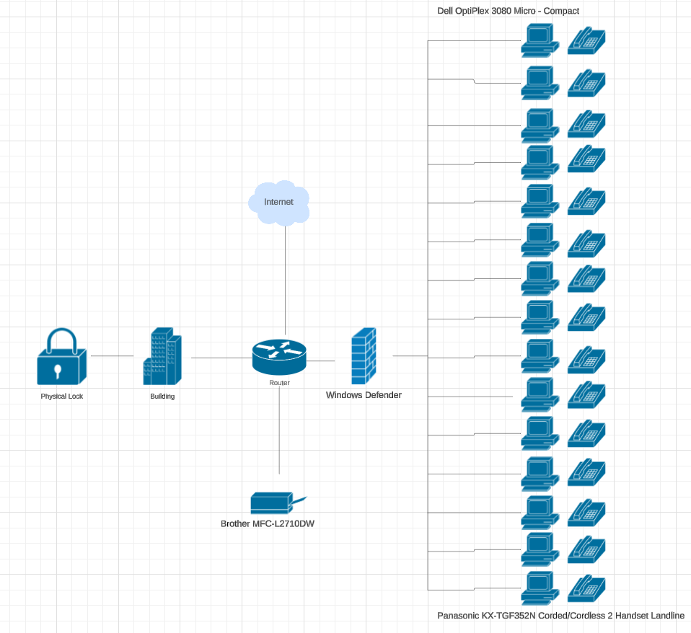
Current Enterprise Architecture
Network Setup:
Basic Local Area Network (LAN)
15 desktop computers connected through wired connections
Devices connected to the internet via a modem and router
No additional network switch
Peripheral Devices:
Telephone system
Fax machine
Multi-function office printer
No VOIP phones or specialized network hardware
Current Limitations:
VPN unsupported
Lacks file restrictions
No ACL's in place
Lack of support for remote or secure access protocols

Slide 7
Current Infrastructure Cost
Hardware/Sofware Model: | Quantity: | Cost:
Dell OptiPlex 3080 Micro | 15 | $12,000
TP-Link Archer C1200 | 1 | $100
Brother MFC-L2710DW | 1 | $350
Panasonic KX-TGF352N | 15 | $1,500
Office Productivity Suite | 15/annual | $2,250
Total Cost: | $16,200

Slide 8
Needs Assessment
Network Security Enhancement Recommendations:
FortiGate Firewall:
Comprehensive protection
VPN capabilities
Intrusion prevention
Advanced threat detection
Duo Security:
Two Factor Authentication
Server and Security Infrastructure Upgrades:
Deploy a Dell PowerEdge T40 server
Centralize data management
Cisco 2960-X
Efficient data traffic management
HP EliteDesk 800
Provide more powerful computer environment
Aruba AP22
Secure and reliable wireless access
MAC Filtering
Only authorized devices: Reduces risk of data breaches

Slide 9
Risk Assessment
Measurement Criteria
Financial Impact:
Evaluation of loss resulting from cybersecurity incidents
Reputational Impact:
Assesses effect of security incidents on organization's reputation
Operational Impact:
Measures IT security threats
Legal and Compliance Impact:
Considers legal ramifications relating to compliance with industry regulations

Slide 10
Risk Assessment Scenario
Risk Factor | Description | Impact Level | Likelihood
Lack of VPN | The network does not support Virtual Private Networks (VPNs), making remote work less secure. | High | Medium
Minimal Access Controls | Without sophisticated access controls, all users have similar network access levels, increasing the risk of unauthorized data access. | High | High
No Network Switch | The absence of a network switch limits the ability to segment traffic, leading to potential performance bottlenecks and security risks. | Medium | High
Unrestricted File Access | The lack of file restrictions means sensitive information may be accessible to all users, increasing the risk of data breaches. | High | Medium
Basic Antivirus Protection | Reliance on Windows Defender without additional antivirus measures may not fully protect against advanced threats, though it provides basic security. | Medium | Medium
Limited Hardware Security | The simple modem/router setup and absence of specialized network hardware suggest limited security capabilities, increasing vulnerability to cyber-attacks. | High | High

Slide 11
Target Network
Physical Networks
Logical Networks
Server: Dell PowerEdge T340 Tower Server
Network Switch: Cisco SG250-26 Smart Switch
Firewall: Fortinet FortiGate 60F
Wireless Access Points: Ubiquiti UniFi AP-AC Pro
Uninterruptible Power supply: APC Smart-UPS 1500VA
Firewall: Fortinet FortiGate Next-Generation Firewall
Switches: Cisco Catalyst 2960-X Series
Wireless Access Points: Ubiquiti UniFi AP-AC Pro
VPN
Two-Factor-Authentication
VLANs: Management, employee access, and guest access

Slide 12
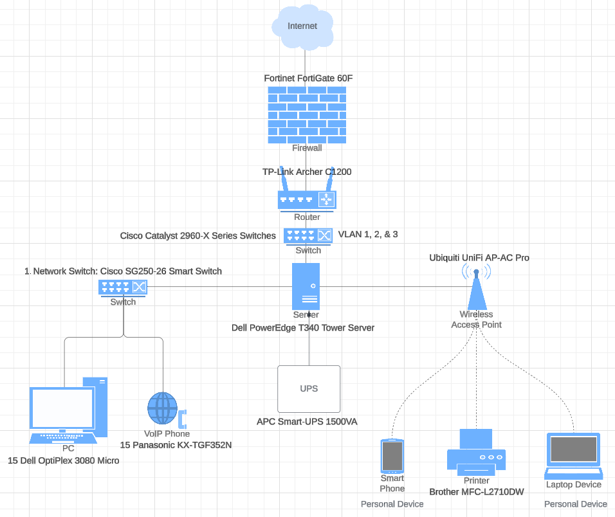
Target Physical & Logical Network

Slide 13
Target Infrastructure Cost
Hardware/Sofware Model: | Quantity: | Cost:
Server: Dell PowerEdge T340 Tower Server | 1 | $1,200
Network Switch: Cisco SG250-26 Smart Switch | 1 | $300
Firewall: Fortinet FortiGate 60F | 1 | $700
Cisco Catalyst 2960-X Series Switch | 1 | $850
Firewall: Fortinet FortiGate Next-Generation Firewall Software | 1/annual | $1,500
Wireless Access Points: Ubiquiti UniFi AP-AC Pro | 3 | $450
UPS (Uninterruptible Power Supply): APC Smart-UPS 1500VA | 1 | $500
Two-factor Authentication: Duo | 18/annual | $54
DHCP & DNS Services: Windows Server 2019 | 1/annual | $972
Total Cost: | $6,526

Slide 14
Migration Overview
Phase 1
Planning & Procurement
Objective: Lay the groundwork for the migration by establishing a detailed project plan and procuring necessary hardware.
Phase 2
Infrastructure Setup
Objective: Establish the foundational network infrastructure for enhanced security and performance.

Slide 15
Migration Overview
Phase 3
Network Services Configuration
Objective: Configure critical network services and security features to support organizational operations and secure data handling.
Phase 4
Wireless Network Deployment
Objective: Expand network accessibility while maintaining security through a robust wireless network.

Slide 16
Migration Overview
Phase 5
Testing & Optimization
Objective: Ensure the new network meets all operational requirements and optimizes performance.
Phase 6
Training & Documentation
Objective: Equip staff with the knowledge to effectively use the new network infrastructure and maintain security practices.

Slide 17
Migration Overview
Phase 7
Go Live & Monitoring
Objective: Officially transition to the new network infrastructure and implement monitoring for continuous improvement.

Slide 18
Identify Threats: Phishing
Criteria | Details
Threat | Phishing Attacks
Description | Malicious actors trick employees into revealing sensitive data by masquerading as trustworthy entities through emails or fake websites.
Likelihood | High
Vulnerability | Employee susceptibility to social engineering tactics due to lack of awareness.
Impact | High
Mitigation | Implement regular security awareness training focusing on recognizing phishing tactics. Utilize email security solutions that filter out phishing emails.
Impact Area | Financial, Reputation
Risk Score | 6/10 (Medium likelihood x high impact)
Adequacy of Existing Controls | Fortinet FortiGate 60F provides email filtering capabilities. Ongoing employee training programs are in place to combat phishing.

Slide 19
Identify Threats: Ransomware
Criteria | Details
Threat | Ransomware Infection
Description | Malware encrypts files, demanding ransom for decryption. It often infiltrates through malicious downloads or email attachments.
Likelihood | Medium
Vulnerability | Insufficient endpoint protection and awareness regarding malicious attachments.
Impact | High
Mitigation | Use Windows Defender for endpoint protection with real-time scanning. Conduct data backups regularly. Educate employees on safe browsing and email habits.
Impact Area | Operational, Financial
Risk Score | 6 (Medium likelihood x High impact)
Adequacy of Existing Controls | Enhanced endpoint security with Windows Defender and backup solutions. Ongoing cybersecurity awareness training.

Slide 20
Conclusion
Implementation of the new network infrastructure provides:
Overall enhanced security
Greater scalability
Improved performance
Efficient migration leads to:
Foundational support for future technological advancements
Optimal performance in the healthcare industry
Opportunity for future expansion

