Slide 1
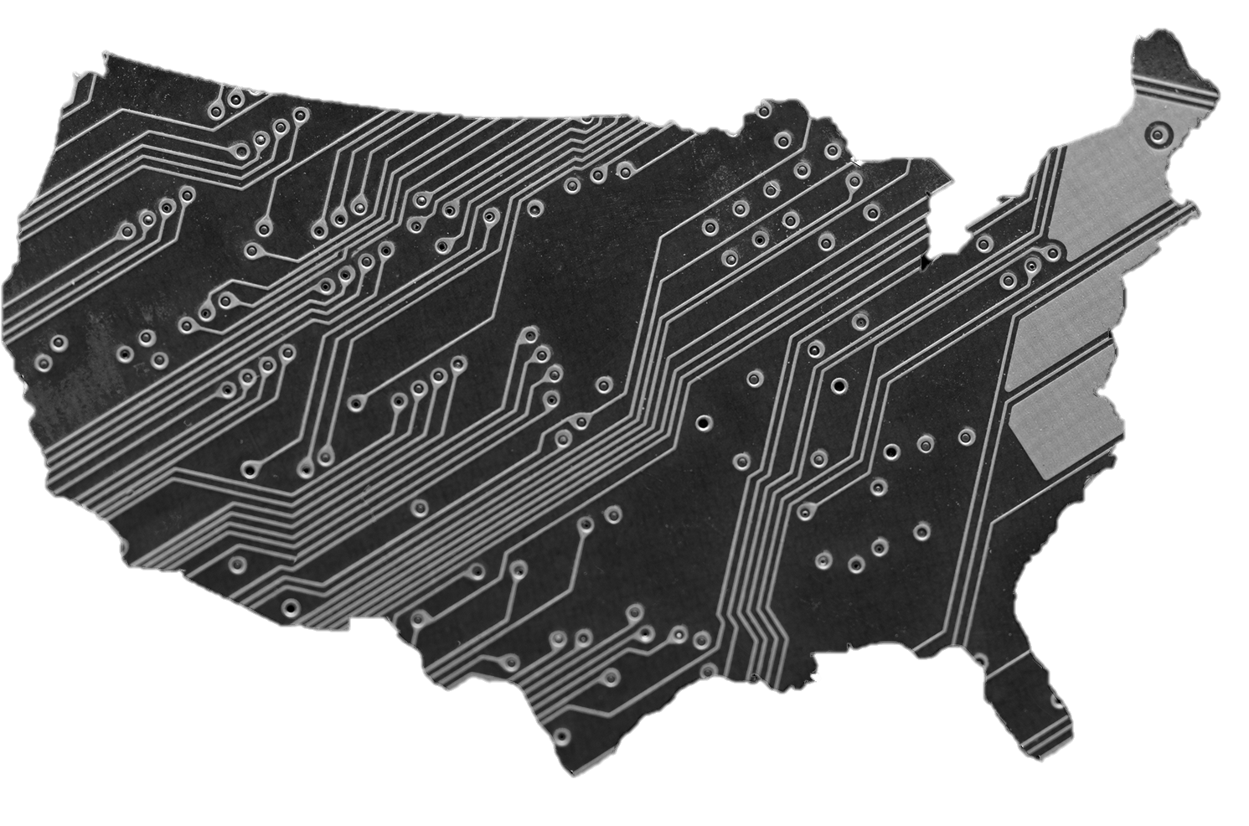
#TechSpaces
Connecting tech organizers to seed space.
2015 CNT Urban Sustainability Apps Competition

Slide 2
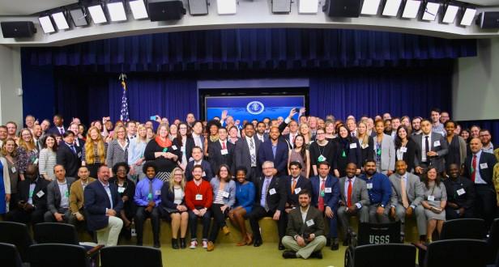

Slide 3
Concept | Prototype | Sustainability
WHY
TechHire + White House Tech Meetup
Growing the ecosystem of talented Americans
Encourage local tech leaders to connect with people of all genders, ages (especially youth), and backgrounds
Megan Smith, US Chief Technology Officer

Slide 4
Concept | Prototype | Sustainability
WHAT
Connect tech organizers to seed space.
Web-based search tool that streamlines venues for tech meetups that are low cost and accessible.
Overlays neighborhood indicators of youth, career changers, and poverty to identify high potential impact areas.

Slide 5
Concept | Prototype | Sustainability
HOW
Identify Underused Innovation Spaces and Civic Assets
Optimize Indicators of Potential Impact
Foster Collaboration among Community Organizers
Develop Diverse Tech Applicant Pool

Slide 6
Concept | Prototype | Sustainability
DEMO
TEST CASE:
Chicago (25,000 interest points)
DATA SOURCES:
Google Maps
Tech MeetUp Events
Crunch Base
Illinois Science and Technology Coalition CitySDK

Slide 7
Concept | Prototype | Sustainability
BUSINESS STRATEGY
Social enterprise
Freemium (free to post, pay to promote)
Low-cost, low-maintenance, integrated data platform
Novel partnerships with potential employers to source diverse talent

Slide 8
Concept | Prototype | Sustainability
VIABILITY
Industry partnerships, ongoing revenue
Technology and innovation grants
Grant Funding Examples:
POWER Implementation Grants, DOC, $35M
TechHire Initiative, WH, $100M

Slide 9
Concept | Prototype | Sustainability
ADOPTION
Integration into existing grassroot networks (Civic Tech Training Class)
SMS user enrollment, social media (Twitter, FB, Instagram)
Endorsement from partners (MeetUp)
Google adwords non-profits grants, $10k/ month

Slide 10
Concept | Prototype | Sustainability
VALUE
Creating the next generation of America’s technology professionals
One-stop shop for organizers
No need to create a booking system to use civic space
Kickstarter to develop or convert existing spaces

Slide 11
Concept | Prototype | Sustainability
EVOLUTION
Feature Generation Pipeline
Crowdsource data
Venue booking
MeetUp push
User demand density
SMS
Scalable, open source

Slide 12





PARTNERS

Slide 13
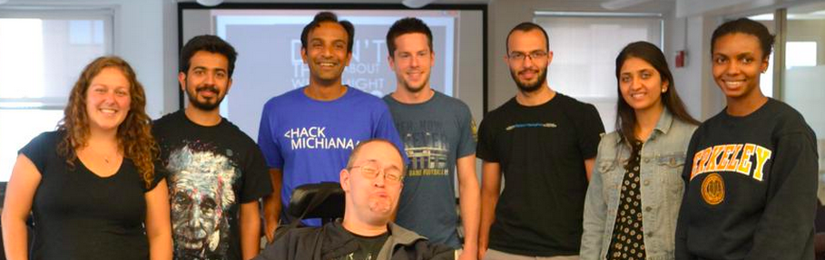


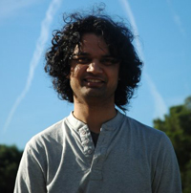
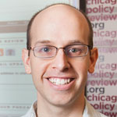
CONTRIBUTORS
Core Team
Avinash Ahuja
Rashida Brown
Amy Hepner
Reid Johnson
Talia Kaufman
Benedict Kuester
Hemank Lambda
Esha Maharishi
Mahdi Moqri
Eric Chandler
Steven Luker
Advisors
Matt Gee, Jeff Meisel

Slide 14
THANK YOU
#TechSpaces
#hackforchange
@datasciencefellows
@citySDK

