Slide 1
Cook County Land Bank Data Collaborative
Cook County Land Bank Authority
Data & Analytics Committee
July 11, 2013
<number>

Slide 2
The problem of vacant properties has many dimensions
Demand for housing
Transportation & infrastructure
Jobs & education
Planning & zoning
Public safety
Taxation & public policy
...
<number>

Slide 3
There’s lots of data out there
Real estate transactions
Foreclosures & vacancy
Zoning laws
Demographics & income
Crime & service requests
Transportation & social services
...
<number>

Slide 4
How do we use it?
<number>

Slide 5
Step 1
Create a master regional data “hub”
Housing
Environmental
Crime
Transportation
Population
Schools
<number>

Slide 6
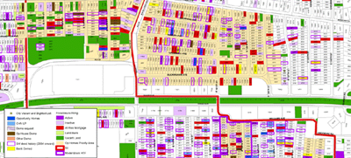
Step 2
Make it accessible to organizations like the CCLB with a well-defined interface (“API”)
NEO CANDO (Case Western Reserve University)
<number>

Slide 7
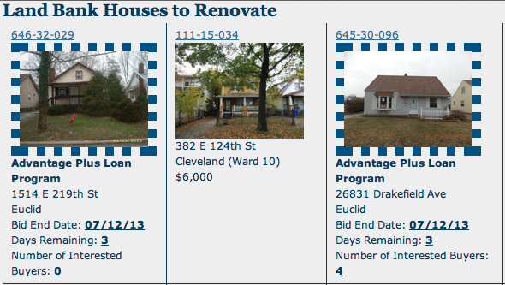
Step 3
Build CCLB-specific tools for management and decision-making
Cuyahoga County Land Bank web portal
<number>

Slide 8
How do we get there?
Gather the data.
Define a way to talk to the database.
Build some prototype tools.
Start work on all of these in parallel.
<number>

Slide 9
Prototype CCLB tool: Interface for accessing property data
Data at the parcel level.
Provides community context.
Searchable, filterable, and sortable.
Tailored to CCLB’s strategy and needs.
Under development this summer.
<number>

Slide 10

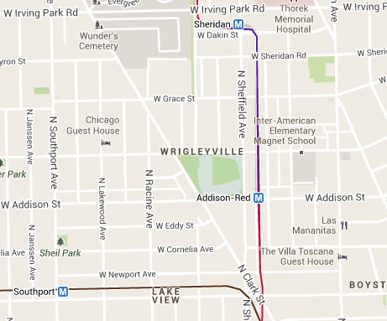
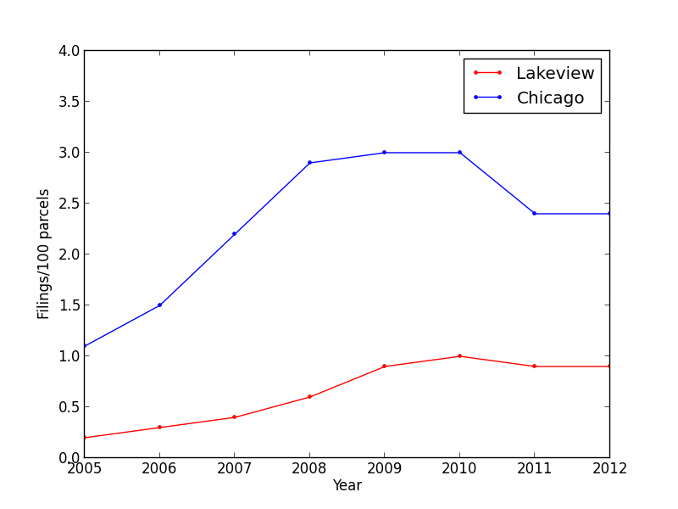
Property info
Type: Commercial/industrial
Owner: Tom Ricketts
Zoning: PD 958
Assessed value: $900,000,000
Jurisdiction: Chicago, ward 44
Last sold: January 2009
Search by:
PIN
Address
1060 W Addison
Community information By: Municipality Ward Census tract
By community area: Lakeview
Housing stock
4% Single Family
42% Condominium
16% Two to four unit multifamily
37% Five+ unit multifamily
Foreclosure filings per 100 parcels
EXAMPLE

Slide 11
Goals
Provide context.
Set foundation for systematic decision-making.
Help assess success and failure.
Once land bank strategy for a given area is determined, assign scores to each parcel.
<number>

Slide 12
Ideas so far
Vacancy rates
Foreclosure trends
Cash-financed and low-value transactions
Price trends
Income and demographic data
Proximity to jobs and transit
Development activity
...suggestions?
<number>

Slide 13
Some examples of what we’ve been looking at
<number>

Slide 14
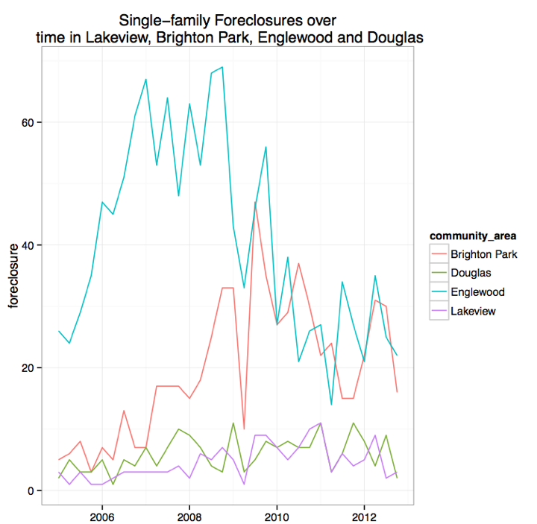
How the foreclosure crisis affected different areas

Slide 15
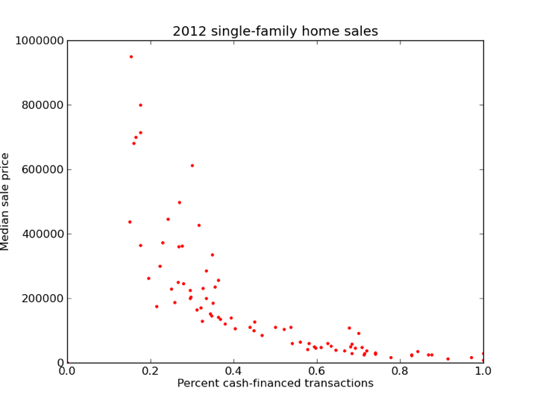
Correlations in the data

Slide 16
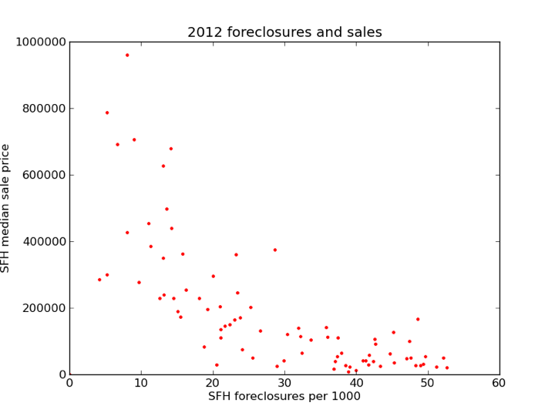
Communities that behave unusually
Kenwood
Chinatown
Oakland
Hegewisch

Slide 17
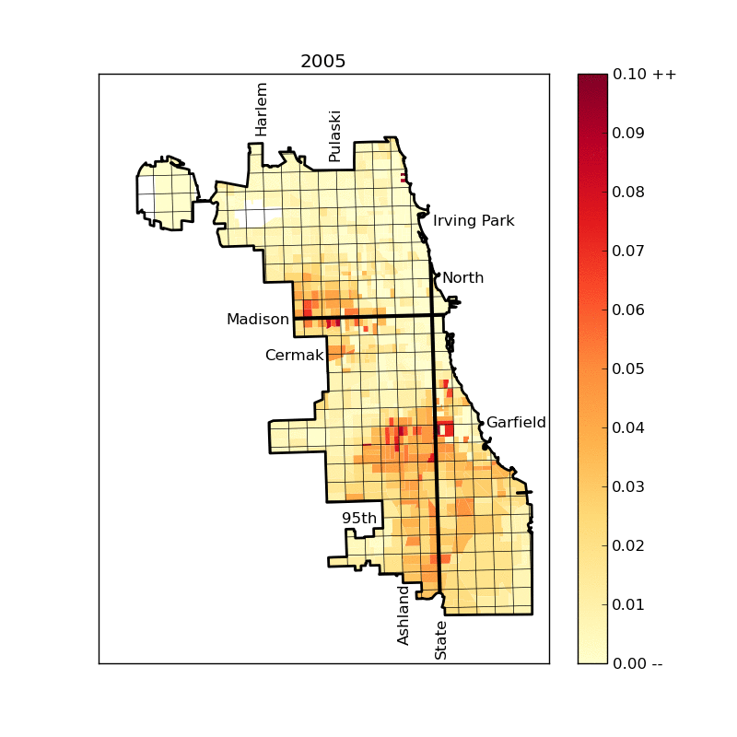
Single-family homes: Yearly foreclosure filing rate by census tract

Slide 18
Timeline
June: Build a database and do some data exploration (mostly done)
July: Database API and web app prototype (underway)
August: Additional analytics tools
In parallel: look for leading trends in historical data to help inform land bank strategy.
<number>

Slide 19
Possible Strategies
<number>

Slide 20
Cuyahoga Strategy
Properties have liabilities due to taxes, and upkeep.
Local authorities have the right to levy fines if a property is not kept up to code.
The costs of this upkeep is more expensive than the value of the property.
Banks in Cuyahoga County (the Cleveland area) give the land bank the title and money to demolish the building to extinguish their liabilities.
<number>

Slide 21
Cuyahoga Strategy
Demolishing vacant buildings helps to bring the supply of housing stock in a neighborhood in line with economic demand (not necessarily human demand).
It also tends to reduce crime in that area (“The Broken Window Effect”).
<number>

Slide 22
The NSP Strategy
The NSP (Neighborhood Stabilization Program) is a federal program that funds non-profits who acquire vacant properties in neighborhoods that have a strong existing neighborhood community and other important amenities such as proximity to public transportation.
The organization uses community input to choose which properties to acquire and how to rehab them.
Chicago has received $170 million for NSP.
<number>

Slide 23
The NSP Strategy
Evaluate NSP effectiveness because it’s cost-effectiveness is unclear.
Specifically, the NSP needed to work with government procurement rules, from which the land bank is exempt.
“We haven’t done any full-blown analysis or evaluation, but the assumptions we started with didn’t hold”-NSP Chicago
<number>

