Slide 1

Predictive Insights for Apple Sales Data
Presented by Anthony Klein
Najah Bell
IST 718: Big Data Analytics

Slide 2
Project Overview:
In this project we analyzed and predicted key business outcomes using LLM generated Apple’s historical sales data.
We investigated the three following questions:
Are there specific months in which product launches historically perform better in terms of sales?
Which store locations demonstrate the strongest sales performance, and are there locations that consistently underperform?
Can future sales and profit be forecasted for the upcoming month at the store or country level?

Slide 3
Predictions, Inferences, and Other Goals
Prediction: Forecast sales trends by product, region, and time
Inference: Understand factors driving sales:
Seasonality
Product categories
Regional performance
Actionable insights:
Optimize promotional timing
Inform store placement strategies
Support inventory and marketing decisions

Slide 4
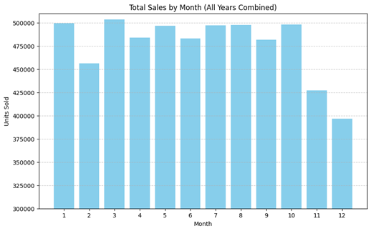
Exploratory Data Analysis:
Bar plot and aggregate analyses showed peaks and troughs in sales that aligned with seasonal patterns.
The highest performing sales months are January, March, and then a tie between July, August, and October. Surprisingly, the lowest sales are in months you'd assume would be the highest, November (Black Friday) and December (Christmas season), but since this is synthetic data, it does not reflect those real-life sales trends.
After comparing primary months (January, May, June) further EDA revealed release months that may be more optimal among the different products.
Data is from January 2020 through November 2024.

Slide 5
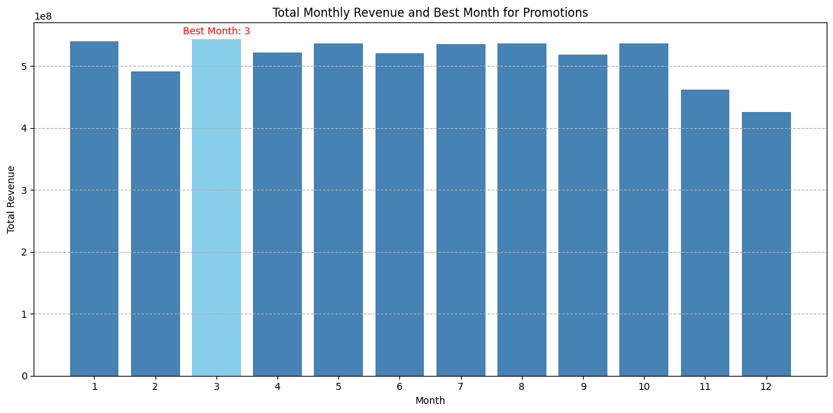
Exploratory Data Analysis:
The bar plot of total_monthly_revenue shows the general seasonal pattern of sales across all months. Month 3 (March) generally has the highest revenue, while months 11 (November) and 12 (December) show a dip.
Months with historically high overall revenue (e.g., March) can be targeted for increased inventory, marketing efforts, and staffing to maximize sales. Marketing and promotional campaigns can be tailored to individual product seasonality. For products that perform well in specific months, targeted promotions during those periods could be highly effective.
The seasonality insights can guide the allocation of marketing budgets, focusing spending on months and products that show the most potential for growth or maintaining strong performance.

Slide 6
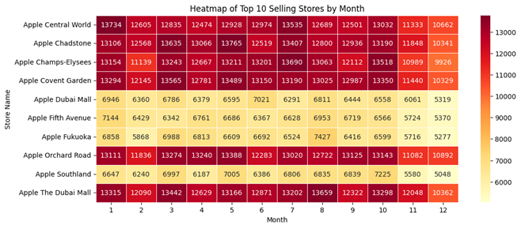
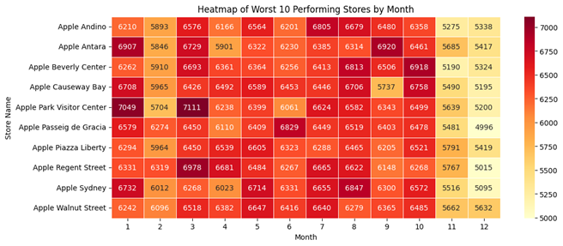
Exploratory Data Analysis:
Aggregating sales by store and month revealed the top ten performing stores and the bottom ten performing stores.
With the US being the highest performing country, you’d expect them to have more of the highest performing stores, however only one store on the list is in the United States.
However, four of the lowest performing stores are in the United States.
'Apple Central World' consistently generates high revenue throughout the year.

Slide 7
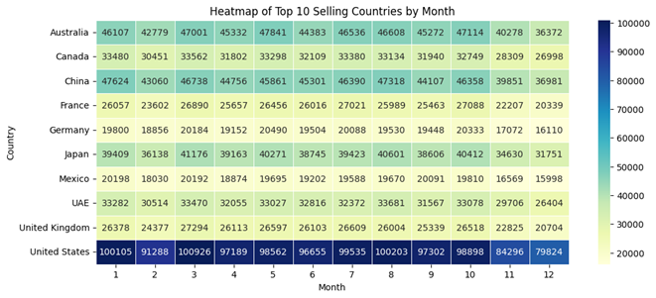
Exploratory Data Analysis:
United States has the highest selling country throughout the entire list by a big margin.
Australia has the 2nd highest selling country due to high disposable income, strong iMessage network effects, and excellent customer loyalty.
China is the 3rd highest selling country on the list, but it's heavily relied on because of its manufacturing and supply chains.

Slide 8
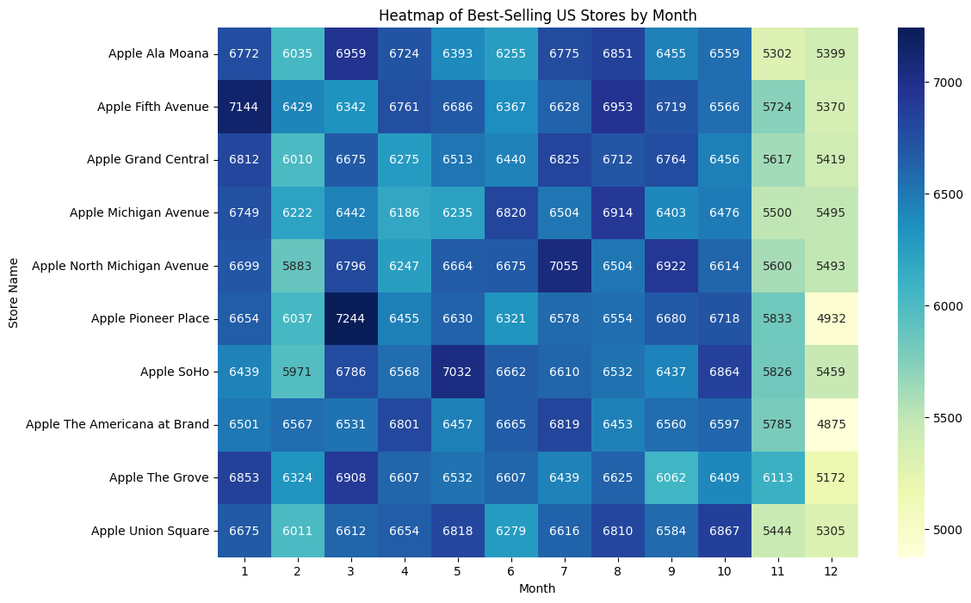
Exploratory Data Analysis:
The analysis focused on sales data from stores located in the United States.
Monthly sales quantities were calculated for each US store.
The top 10 best-selling US stores were identified based on total quantity sold.
A heatmap was generated visualizing the monthly sales quantity for the top 10 US stores.

Slide 9
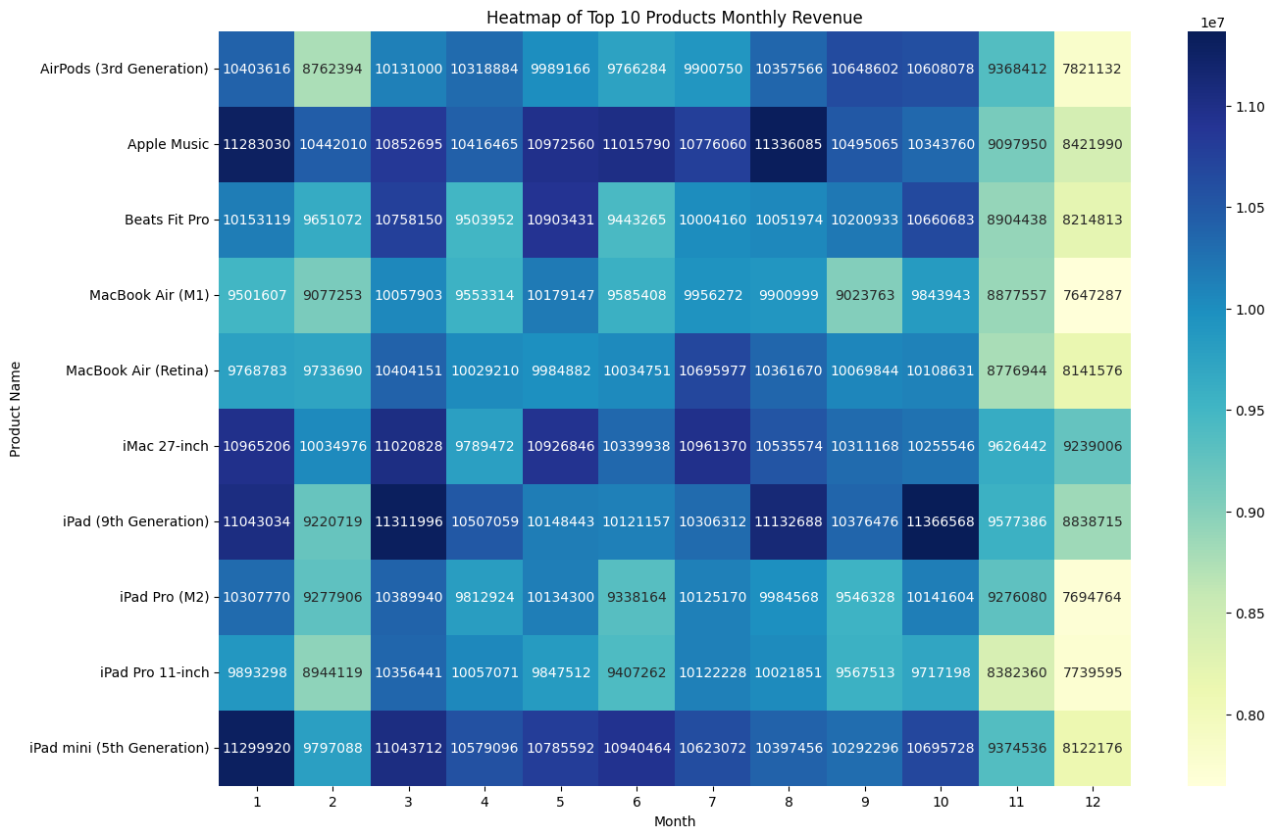
Exploratory Data Analysis:
Key product findings include accessories, laptops, smartphones, and tablets peak in March; Smart speakers in April; Desktops in May; Subscription services in August; Audio products and wearables in October; and streaming devices in December.
Next steps involve investigating factors driving seasonality and developing time-series forecasting models to improve revenue and demand predictions.
Additional visuals that support these claims can be found in our project code.

Slide 10
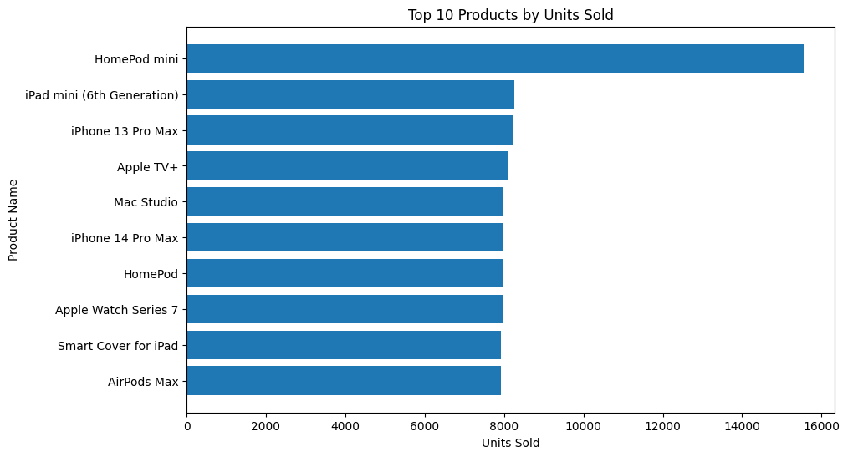
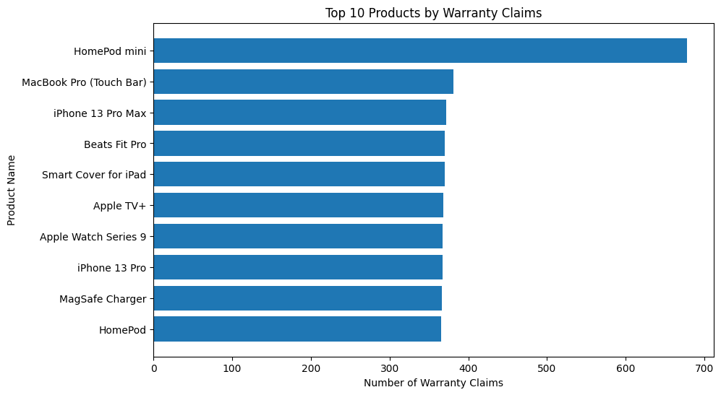
Interesting Findings
US has higher sales by year, but only has one top selling store, and four of the worst.
Some plots are show very strong patterns (like highest selling products and most warranty claims)
The uniformity of plots may be due to the dataset being generate using LLM’s, so it is not as noisy as real-world data would be

Slide 11
Methods used for ML Models
Question: Can future sales and profit be forecasted for the upcoming month at the store or country level?
Target: Next-month sales by country
Models:
Random Forest Regressor
Linear Regression
Features:
Lagged Sales
Cyclical Month Encoding
Evaluation Metrics
Root Mean Square Error

Slide 12
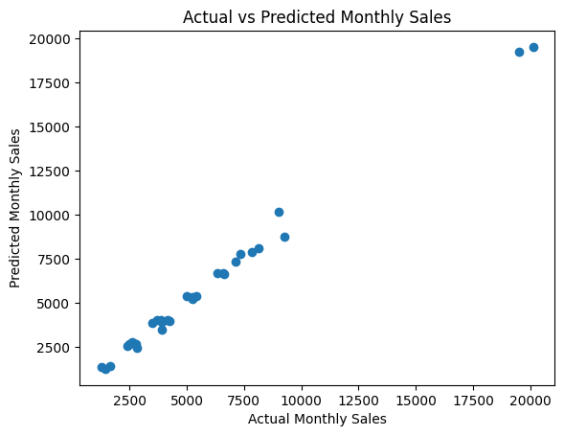
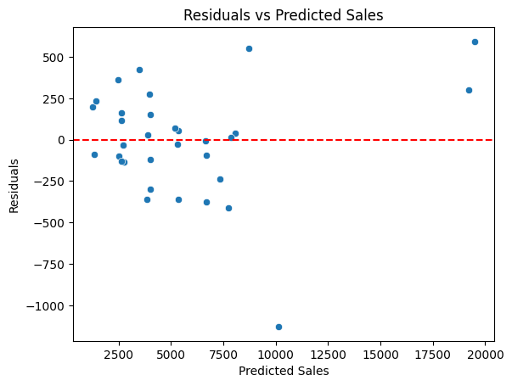
Results Summary
Random Forest RMSE: 841 units (16.5%)
Linear Regression RMSE: 717 units (14.1%)

Slide 13
Problems Encountered
Synthetic data simplifies patterns
Limited real-world variability
Missing operational cost and location data
Some challenges with aggregation and storage

Slide 14
Overall Goal Achievement and Conclusion
Successfully identified seasonality
Built reliable forecasting models
Generated actionable insights
Demonstrated scalable analytics workflow

