Slide 1
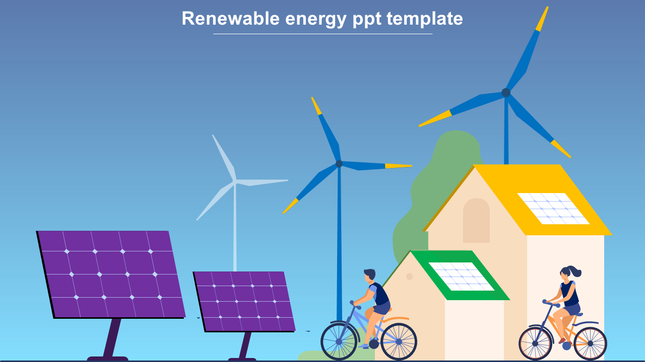

ALL INDIA DISCOMS ASSOCIATION
Public Hearing on CERC Proposal
“Determination of X-Value under DSM (2024 Regulations)”
Public Hearing – 03 December 2025

Slide 2
CERC proposes trajectory for determination of value “X” for Wind & Solar sellers under DSM Regulations 2024. AIDA submitted its responses (vide letter no. RA-11/AIDA-2025 on 3rd October, 2025)
AIDA’s submission
CERC Proposal
For existing WS Projects: 5-year trajectory for reduction of X-Factor to zero (01.04.2026 to 31.03.2031)
For New WS Projects: Treated at par with General Sellers on or after 01.04.2026.
No payment for over injection at or above system frequency of 50.05 Hz.
AIDA Submission
Consider 3-year trajectory (01.04.2026 to 31.03.2029)
Agreed.
Tighten step-wise frequency band to 50.02 Hz.

Slide 3
X - Impact: Karnataka Example
Study for Apr 2024 to Mar 2025 (%age Deviation)
Actual deviation is more than double
No financial impact on WS sellers and hence not much initiative by developers
Impacts grid security
Requires additional TRAS
 | DAM |  | Intra-Day
 | Available Capacity | Scheduled Capacity | Available Capacity | Scheduled Capacity
Wind | 26.77 | 60.64 | 6.82 | 37.27
Solar | 2.62 | 37.52 | 0.97 | 33.21
Hybrid WS | 19.38 | 67.55 | 4.47 | 45.76

Slide 4
Rapid Improvement in Weather Forecasting
A Statement given by Hon’ble Union Minister of State (Independent Charge) for Science & Technology and Earth Science in Rajya Sabha on 5th Dec 2024
There has been 40 to 50 percent improvement in the forecast accuracy of all weather events
Ministry continuously enhances and upgrades meteorological observations, communications, modelling tools, and forecasting systems
IMD uses latest tools and technologies to predict severe weather events

Slide 5
MSEDCL: Demand forecasting & the Grid
Demand forecasting too depends on weather data
Deviation limit: 0.83 % (Peak Demand= 30GW; Deviation Volume limit= 250MW)
Forecasting Accuracy Level for Apr 23 to Mar 24:
Tolerance Band: +/- 10% (Solar); +/-15% (Wind)
Accuracy level below 10%:
Solar average: 73.5%
Wind average: 67.5%
With same set of weather data, if Discoms are required to forecast below 1% error, the WS also should do
The mismatch creates difficulties for Discoms in load forecasting, planning resource adequacy, scheduling and maintaining grid security at state level
Ramping up and down of thermal stations
Curtailment of own RE sources
Higher incremental cost
With technology availability, accuracy level is enhancing at rapid pace

Slide 6
A Dominant player with Matured technology

Slide 7
Aggregation at Pooling station by WS Sellers
Grid India Study on Aggregation of WS Sellers at a Pooling Station through Qualified Co-ordination Agency (QCA) ( period: 16.09.24 to 29.06.25)
Reduced Deviation
Reduced payable DSM Charges
More plants joining will further reduce DSM charges
RE Type | Plants Nos | Savings at X=100 | Savings at X=0
Solar | 2 | 25.84 % | 21.13 %
 | 5 | 67 % | 49 %
Wind | 2 | 19.95 % | 8.30%

Slide 8
Summary
Weather forecasting is NOT dependent on age of the plants but forecasting technology available and used
Enough time given to the developers: being discussed since 2017
Adds cost to Discoms and thus end consumers
Larger relaxation means more AS need
Marginal AS providers are costlier
A grown-up & matured technology should be allowed to walk and compete
With rising RE penetration, Grid is at Risk
Make DSM provisions for WS at par with Conventional plants
Push for better forecasting technology
Push to more aggregation through QCA

Slide 9
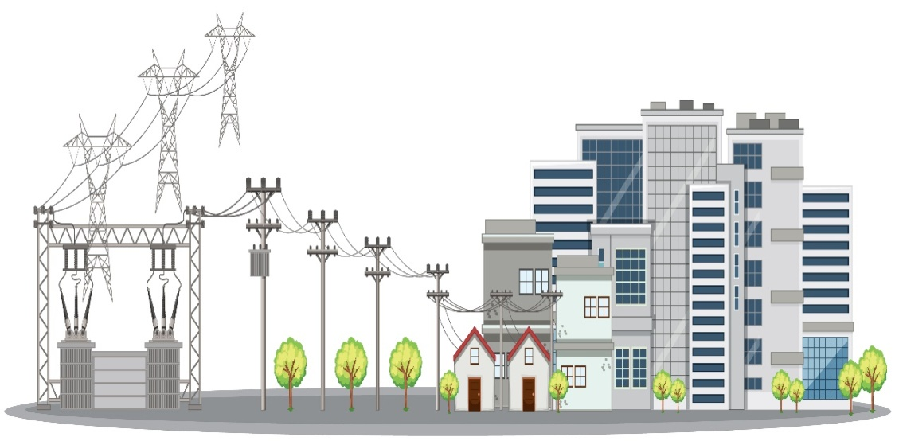
THANK YOU
ALL INDIA DISCOMS ASSOCIATION
CBIP Building, Malcha Marg, Chanakyapuri, New Delhi-110021
Reach us at:
www.aida-india.org

