Slide 1

Patient Readmission Prediction

Slide 2
Agenda
Introduction
Objective
Methodology
Analysis
Conclusion and Recommendations
QA

Slide 3
Introduction
About me
Najat El Ouafi
Currently a stay-at-home mom
Bachelor Degree in Biology and Master Degree in Ecology
Work experience : Sales Trainer
Medical Devices
Cosmetics Products
Currently living in Virginia

Slide 4
Objective
01
Identify Data Issues: Resolve structural inconsistencies during the exploratory phase.
02
Isolate High-Risk Groups: Highlight patient cohorts with elevated readmission rates.
03
Establish Baseline Metrics: Build the data foundation necessary to predict and reduce future readmissions.

Slide 5
Methodology & Tools
Total Study Population: 71,518 patient records
101,766 unique patient encounter records (Rows).
50 distinct clinical and administrative tracking variables (Columns).

Slide 6
Missing Values
Column Name | Missing values
weight | 98569
max_glu_serum | 96420
A1Cresult | 84748
medical_specialty | 49949
payer_code | 40256
admission_source | 6781
admission_type | 5291
discharge_disposition | 3691
race | 2273
diag_3 | 1423
diag_2 | 358
diag_1 | 21

Slide 7
Methodology & Tools
Microsoft Excel: Initial screening and manual spelling validation of specialty lists and Data Mapping
Python: (Pandas and NumPy) Standardizing corrupted age strings and handling missing data values.
SQL : Back-end data aggregation, filtering and categorical grouping.
Tableau: Building interactive Business Intelligence dashboards

Slide 8

Analysis

Slide 9
Demographics vs. Care Continuity
Caucasian patients comprise the vast majority of the dataset with 76,099 encounters nearly four times the volume of the next largest group, African American patients

Slide 10
Admission Distribution
The Emergency Gate: Over 53% of all patients enter the hospital directly through the Emergency Room. Because emergency entries happen quickly and bypass standard insurance pre-approvals, they represent the main area where resource leaks

Slide 11
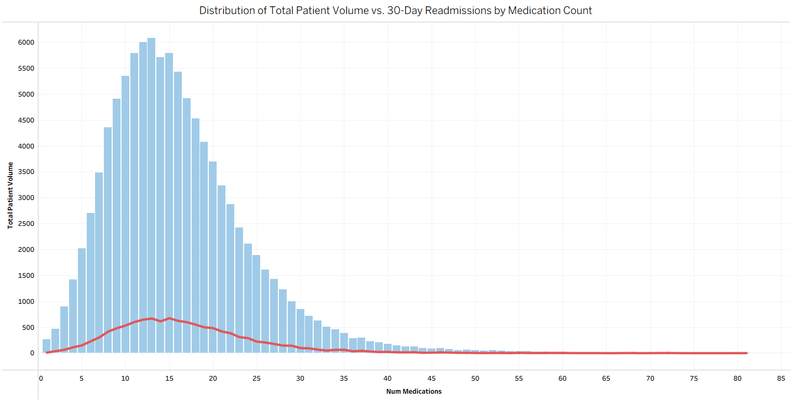
The Medication Burden & Treatment Changes
While the average patient is prescribed around 15 drugs, the chart shows an extreme tail stretching up to 80+ distinct medications for a single visit
Most readmitted patients belong to the 10-to-20 medication group

Slide 12
The Medication Burden & Treatment Changes
High Therapeutic Volatility: Over 46% of all patients have their critical medications actively changed or adjusted during their stay.

Slide 13
Age vs. Care Continuity
The demographic data suggests that AGE is a stronger predictor of readmission volume than gender until age 80.

Slide 14
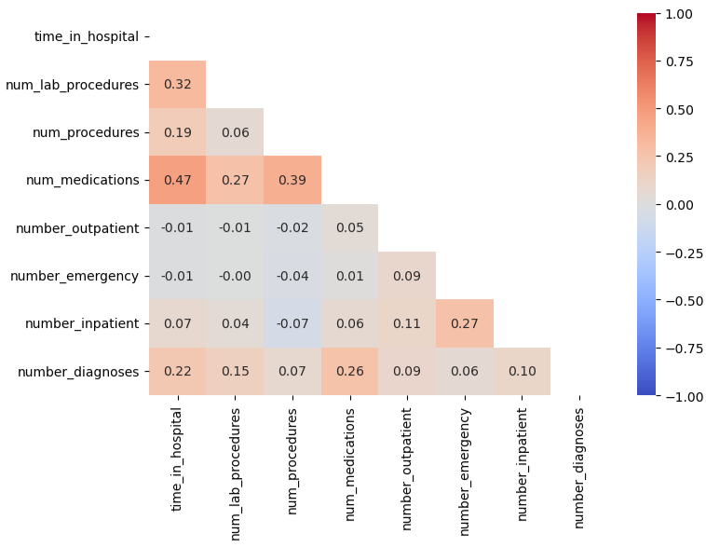
Clinical Correlations

Slide 15
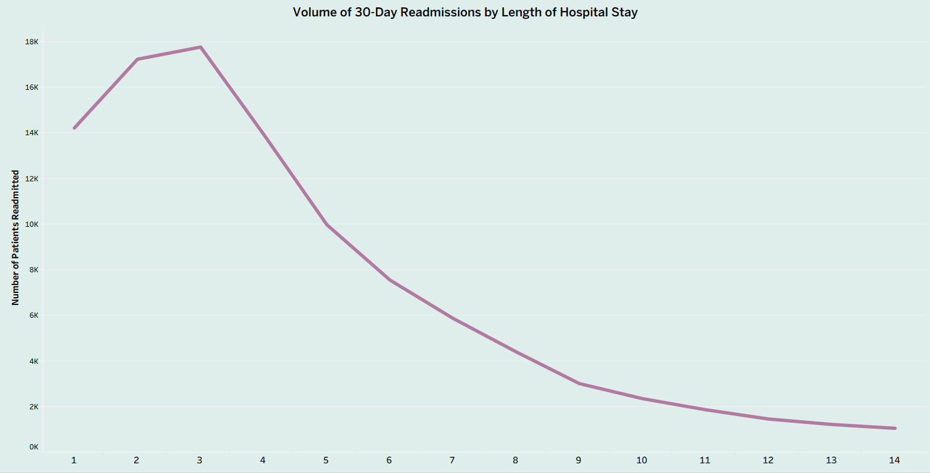
Readmission Volume by Stay Duration
This pattern shows that our highest volume of readmissions comes from short-stay patients.
This is likely because the largest overall group of hospital admissions consists of quick, 2-to-3 day stays

Slide 16
Findings and Conclusion
The Emergency Room Bottleneck: More than half of all patients enter through the emergency pipeline. This lack of pre-scheduled coordination puts immense pressure on hospital resources and limits up-front administrative checks.
The Medication Safety Gap: Nearly half of all patients experience sudden medication changes right before discharge, creating a clear operational gap where errors can happen once the patient leaves the facility
When a patient is sent home with a massive list of drugs that were just modified, their risk of confusion or non-adherence spikes dramatically.
Extreme Data Imbalance: Caucasian patient encounters (76,099) represent the overwhelming majority of the dataset, outnumbering the next largest group (African American patients) by nearly four to one
Readmission Volume Trend: The absolute volume of 30-day readmissions peaks sharply for patients with a short 2-to-3 day stay (nearly 18,000 patients) and then drops rapidly and steadily as the duration of the stay increases, flattening out completely by day 10
The High-Risk Peak Window: The absolute highest volume of 30-day readmissions occurs in the [70-80) age bracket, followed closely by the [60-70) and [80-90) brackets. This confirms that elderly patients represent the primary core of hospital return volume

Slide 17
Strategic Recommendations
Implement Demographic Stratification in Risk Screening
Clinical screening tools must adjust for baseline population imbalances so that risk factors unique to minority patient groups are not overshadowed by majority demographic trends. This ensures equitable care monitoring across all patient populations.
Automate Immediate ER Screenings: Deploy digital administrative flags directly into the Emergency Department intake workflow to catch missing patient data and documentation gaps at the exact moment of entry
Standardize Short-Stay Protocols: Create specialized, efficient discharge checklists for patients on rapid 2-to-3 day inpatient stays, as this window generates the highest absolute volume of system-wide readmissions
Standardize Post-Discharge Follow-Ups for Last-Minute Medication Changes
Patients who experience sudden medication adjustments within 48 hours of discharge face a high risk of confusion and non-adherence. The hospital should mandate a final pharmacy reconciliation and schedule a mandatory clinical follow-up call within 48 hours of going home.
Build Targeted Safety Nets for Seniors
Focus transitional care resources on the high-volume 60–80 age bracket, since they face the highest complexity and readmission rates.

Slide 18
Contact : n.elouafi12@gmail.com
Any questions ?

