Slide 1


GuideMeLebanon

Slide 2


Our Team
Najat Assaad
Awny Zhivaky
Imad Haydar
Web Developer student
Web Developer student
Web Developer student
2

Slide 3
Table of Contents
01
02
03
04
Introduction
Swot Analysis
ER Diagramm
Project Demo
3

Slide 4
Introduction
GuideMeLebanon offers the clients several services that will improve their tourism experience in Lebanon
Tailor-made trips: Visitors can choose from an extensive range of tailor-made trips and experiences to suit their interests and preferences.
Car Rental: Tourists can conveniently reserve cars online giving them the flexibility and freedom to explore Lebanon.
Optional Driver Service: For more convenience, we have experienced drivers Who can ensure that visitors get a comfortable and trouble-free trip.
guide bookings: Our website also allows clients to reserve tour guides that provide a fascinating insight into Lebanon's history and culture.
4

Slide 5
Swot Analysis
S
W
O
T
Strengths
Weaknesses
Opportunities
Threats
5

Slide 6
Swot Analysis
Unique Services: Offering a comprehensive platform for trip planning, including reservations, cars, drivers, and tour guides, sets the website apart.
Local Expertise: Specializing in Lebanon allows for in-depth knowledge of local destinations and culture.
S
Strengths
5

Slide 7
Swot Analysis
S
W
O
T
Strengths
Weaknesses
Opportunities
Threats
5

Slide 8
Swot Analysis
Limited Reach: Focusing solely on Lebanon may limit the website's potential customer base compared to global travel platforms.
Language Barriers: Serving a diverse range of customers who speak different languages may pose communication challenges and require multilingual support.
W
Weaknesses
5

Slide 9
Swot Analysis
S
W
O
T
Strengths
Weaknesses
Opportunities
Threats
5

Slide 10
Swot Analysis
A mild and attractive climate: Lebanon's mild climate makes it an attractive destination for tourists throughout the year, making the site always active.
Culture and diversity of attractions: Lebanon has great cultural and historical diversity, allowing the project to review a wide range of attractions, from archaeological sites to landscapes...
O
Opportunities
5

Slide 11
Swot Analysis
S
W
O
T
Strengths
Weaknesses
Opportunities
Threats
5

Slide 12
Swot Analysis
Local ,regional and economic crisis tensions can affect trips plans making the situation unstable.
Requiring cash-only payments can be problematic as most people prefer online payments.
T
Threats
5

Slide 13
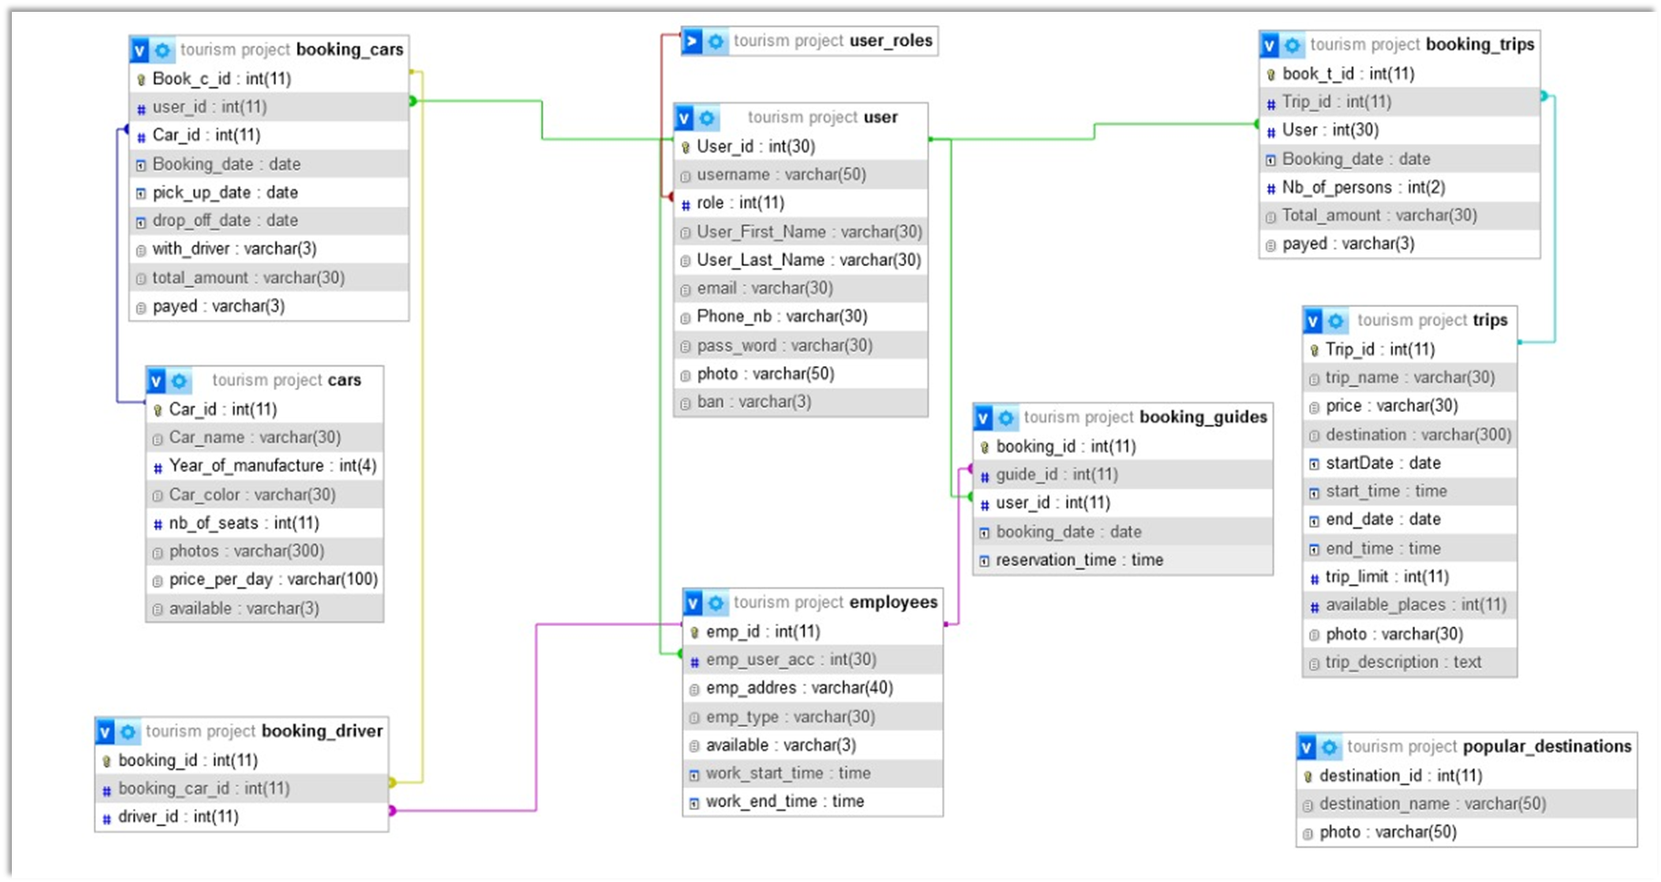
ER Diagramm
6

Slide 15

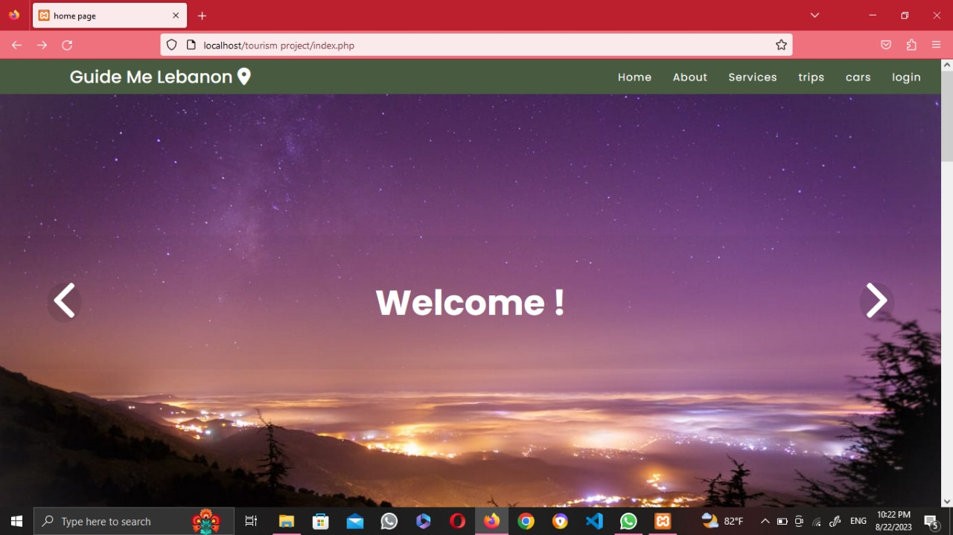
Project Demo
7

Slide 16
Thanks

