Slide 1

Tokens vs. Lexemes
CSA1402 COMPILER DESIGN
Guided by
Dr. N.DEEPA
Presented by:
AL NAJEEB 192424325

Slide 2


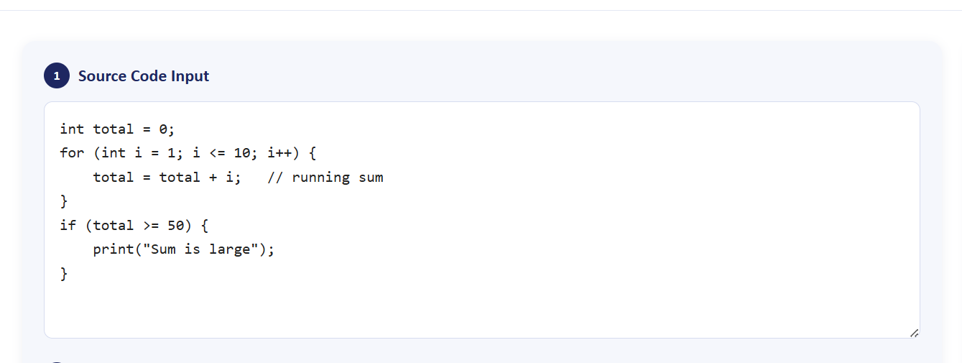
UNDERSTANDING TOKENS
A token is an abstract category representing a class of similar
lexical units in the source code.
Each token has a type and an optional attribute value, e.g.
<id, "count"> for an identifier.
Lexical analysis converts source code into tokens, which the
parser then uses to build the syntax tree.
Grouping characters into tokens reduces complexity for the
syntax and semantic analysis phases.

Slide 3
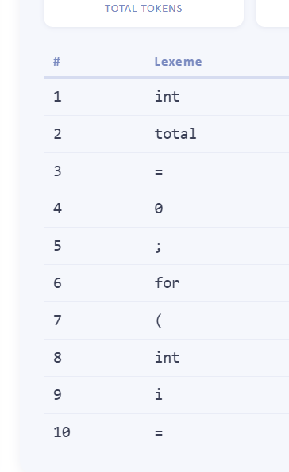
UNDERSTANDING LEXEMES
A lexeme is the actual sequence of characters in the source code
that matches a token's pattern.
Strings such as "total", "sum", and "count" are all lexemes
matching the identifier token.
Every lexeme belongs to a token class, but many different
lexemes can map to one token type.
The lexical analyzer scans source text and extracts lexemes
using predefined patterns.

Slide 4
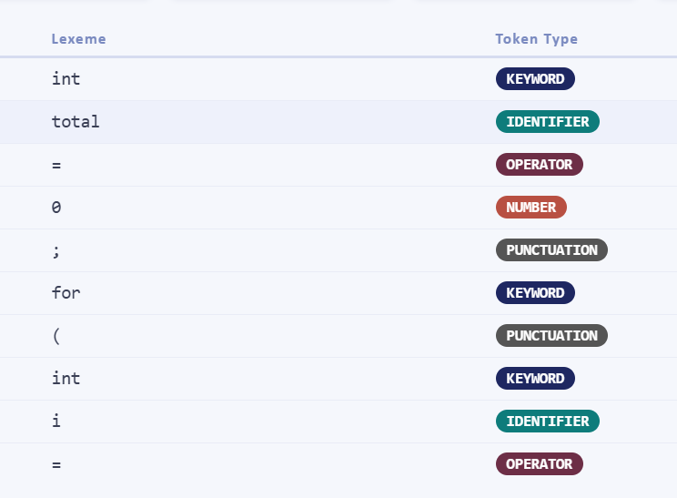
TOKENS VS LEXEMES
A token is a category, while a lexeme is the concrete instance
appearing in the code.
One token type can correspond to many different lexemes
across a single program.
Token: keyword paired with lexeme 'if'; token: number paired
with lexeme '42'.
Parsers operate on tokens; lexemes are retained for symbol
tables and error messages.

Slide 5
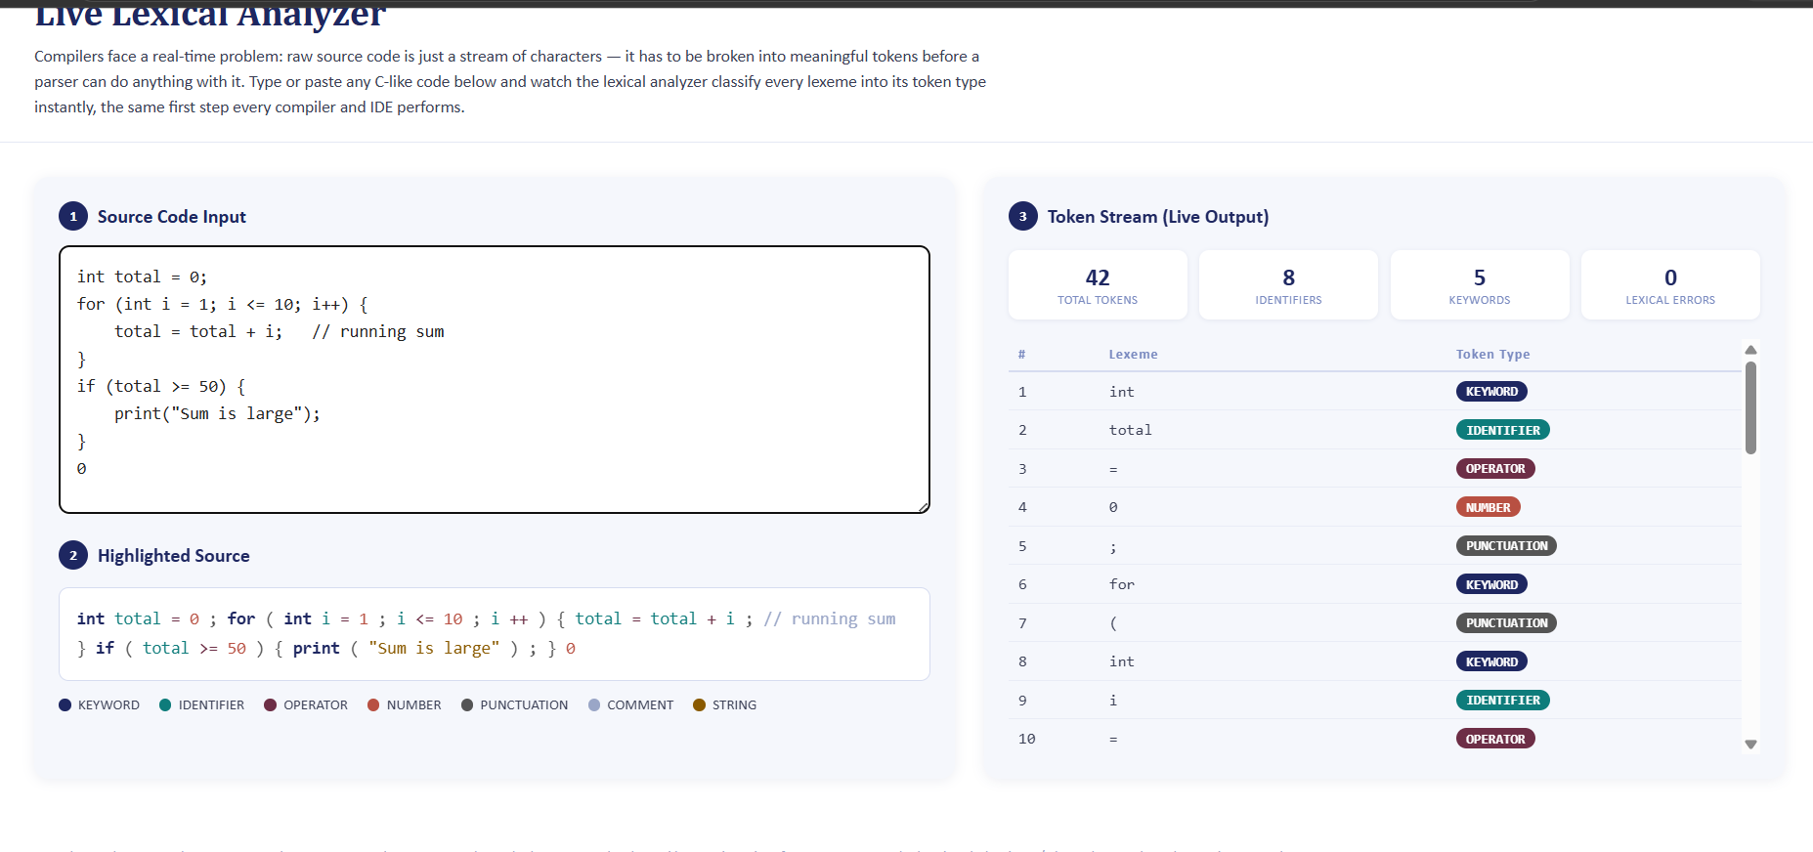
SIMULATION RESULTS

Slide 6
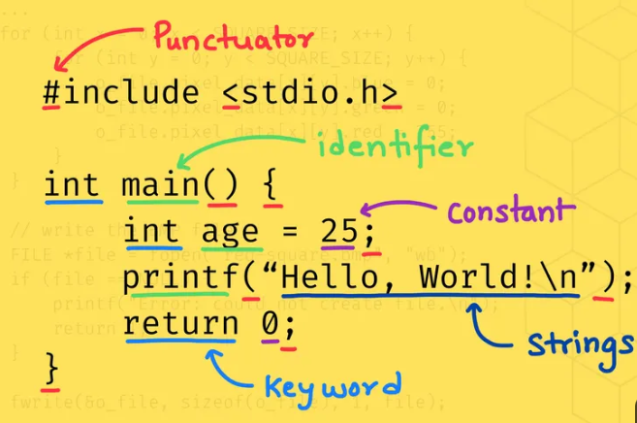
HOW TOKENS ARE SPECIFIED
Token patterns are defined using regular expressions
describing valid character sequences.
The lexical analyzer matches input against these patterns to
identify token boundaries.
When multiple patterns match, the lexer selects the longest
possible lexeme available.
If lengths tie, the pattern listed first, such as a keyword,
takes priority over identifiers.

Slide 7
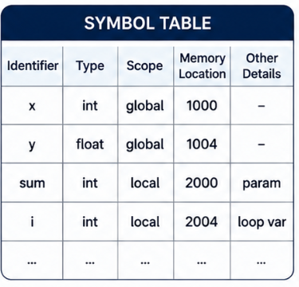
ROLE OF THE SYMBOL TABLE
Identifiers and their lexemes are stored in a symbol table for
reference during compilation.
The table records type, scope, memory location, and other
relevant details.
Later phases, like semantic analysis and code generation,
rely on this stored information.
Fast lookup structures, such as hash tables, keep symbol table
access efficient.

Slide 8
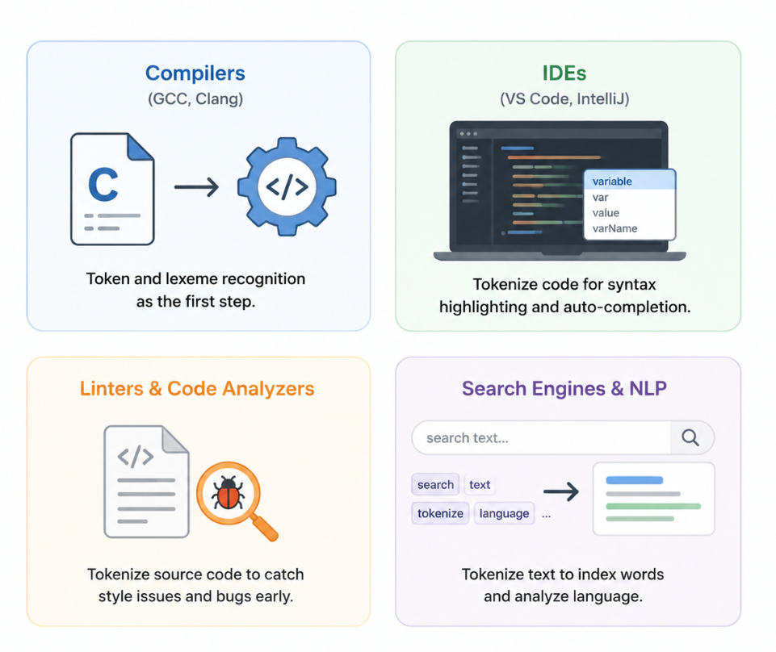
REAL-TIME APPLICATIONS
Every compiler, like GCC or Clang, uses token and lexeme
recognition as its first step.
IDEs such as VS Code and IntelliJ tokenize code for syntax
highlighting and auto-completion.
Linters and code analyzers tokenize source code to catch style
issues and bugs early.
Search engines and NLP pipelines tokenize text to index
words and analyze language.

Slide 9
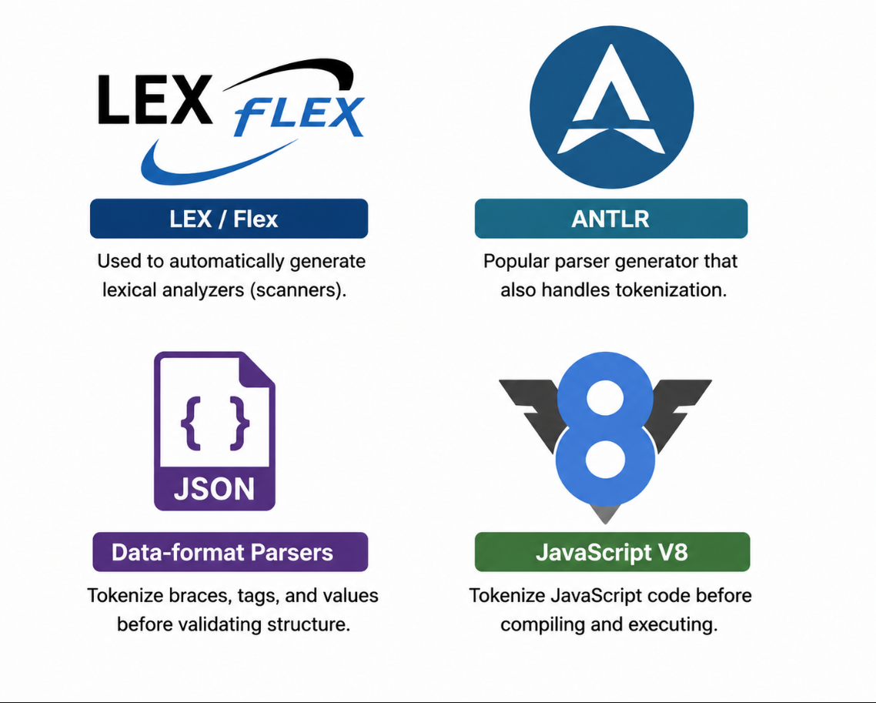
TOOLS & TECHNOLOGIES
LEX and its modern version Flex are widely used to
automatically generate lexical analyzers.
ANTLR is a popular parser generator that also handles
tokenization for many languages.
Data-format parsers tokenize braces, tags, and values before
validating overall structure.
JavaScript engines like V8 tokenize scripts before compiling
and executing them.

Slide 10
TOOLS & TECHNOLOGIES
LEX and its modern version Flex are widely used to
automatically generate lexical analyzers.
ANTLR is a popular parser generator that also handles
tokenization for many languages.
Data-format parsers tokenize braces, tags, and values before
validating overall structure.
JavaScript engines like V8 tokenize scripts before compiling
and executing them.

Slide 11
THANK YOU

