Slide 1

Bold Ninjas
Members:
Akhtar Abbas
Khawar Ahmad
Muneeb Ur Rehman
Najeeb Ahmad

Slide 2
Employee Engagement and Wellbeing Dashboards
Employee Engagement Dashboard
Consolidate Self Review survey results
Trust, Accountability, Driven, BOLDbelief, Goals performance etc.
Non-anonymous
Score 0 to 4
Individual and across practice
Trends and Insights
Employee Wellbeing Dashboard
BOLD Index
Anonymous
Score 0 to 4
Overall

Slide 3
What incorporates BOLDIndex
Work Environment
Team-work
Employee Retention
Policies
Career Growth

Slide 4
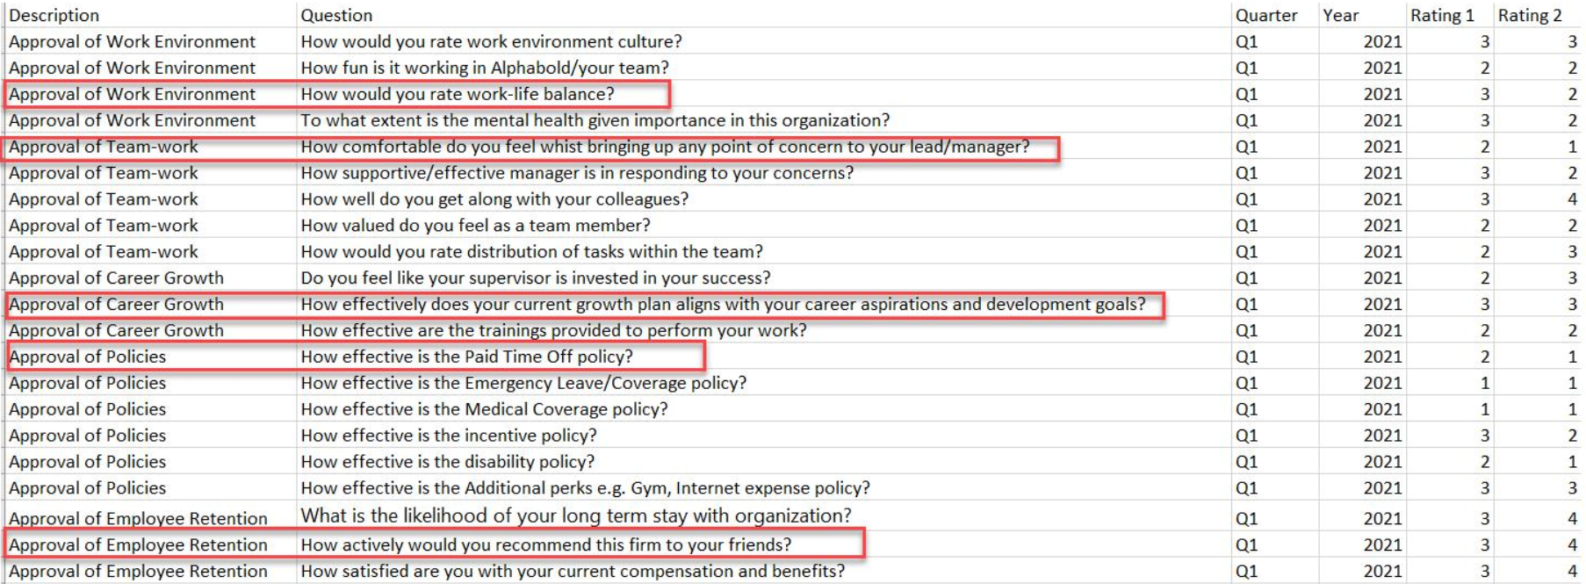
Sample Questions for BOLDIndex

Slide 5
How Employee Engagement Dashboard helps the Management
Consolidated view of all the self reviews
Individual and across practices’ comparison
Trends and Insights

Slide 6
How Employee Wellbeing Dashboard helps the Management
Anonymous feedback to the management about overall employee wellbeing
Can be used to track changes over time and during changes in policy
Can help with predicting employee retention and turnover
Employee’s feedback
work-life balance
office environment
career aspirations
career goals
compensation
PTO, benefits and more

