Slide 1
BUG TRACK
Bug Reporting and Tracking System
Team 1
08/07/2022

Slide 2
Contents
Overview
Software design
Minimum software requirements
Sample Code Snippets
Individual contribution
Experience gained
Summary

Slide 3
Overview
Bug Tracking and Reporting System developed using C++ console application for bug reporting and tracking of bugs associated with software product
Users concerned:
Admin
Engineers
Customers

Slide 4
Overview
Software Features
Customer can report/track bug.
Customer can revoke wrong bug reported.
Admin can create/manage users.
Admin can assign Engineer to an active bug.
Engineers can update progress of bug resolution.
User can view active bugs and bug history.

Slide 5
Overview
Software Modules
Authentication Module
User Management Module
Bug Management Module
1. Authentication Module
Authenticate user based on user credentials.
If authentication is successful redirect user to respective dashboard.
User account logout functionality.

Slide 6
Overview
User Module
Display user dashboard with options, based on user role.
Display bug statistics of the respective user.
Users - Admin ,Engineer and customer
i. Admin
View all active bug’s and bug history.
Assign Engineers to active bugs.
View details of all users.
View number of bugs associated with each users.
Filter users based on role.
Create/Update users.
Enable/disable users.

Slide 7
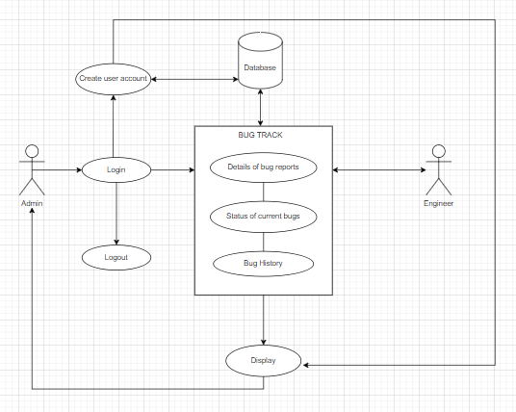
Overview
i. Admin

Slide 8
Overview
Engineer
View all active bug’s and history of bug assigned to the Engineer.
Update status and response of active bugs.

Slide 9
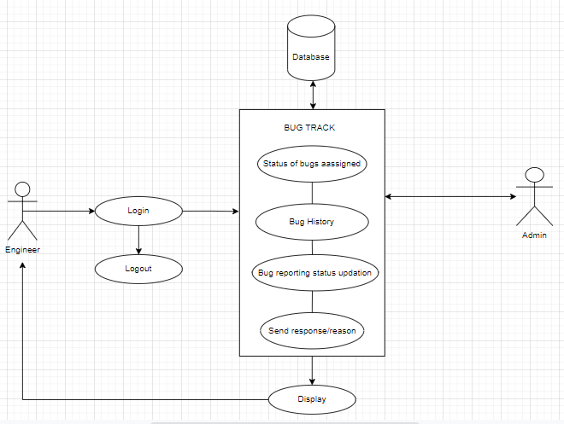
Overview
ii. Engineer

Slide 10
Overview
iii. Customer
Report bug in the software product
Revoke wrong bug reported
View active bugs and history of bug reported by user

Slide 11
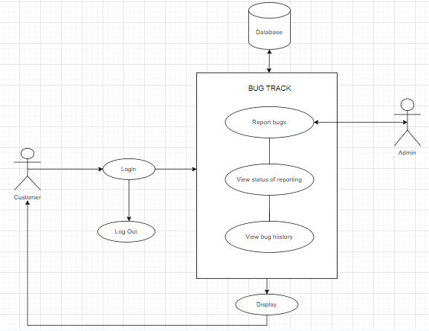
Overview
iii. Customer

Slide 12
Overview
3. Bug Management Module
Create a new bug
Track active bugs and bug history
Revoke wrong bug reported
Update bug status

Slide 13
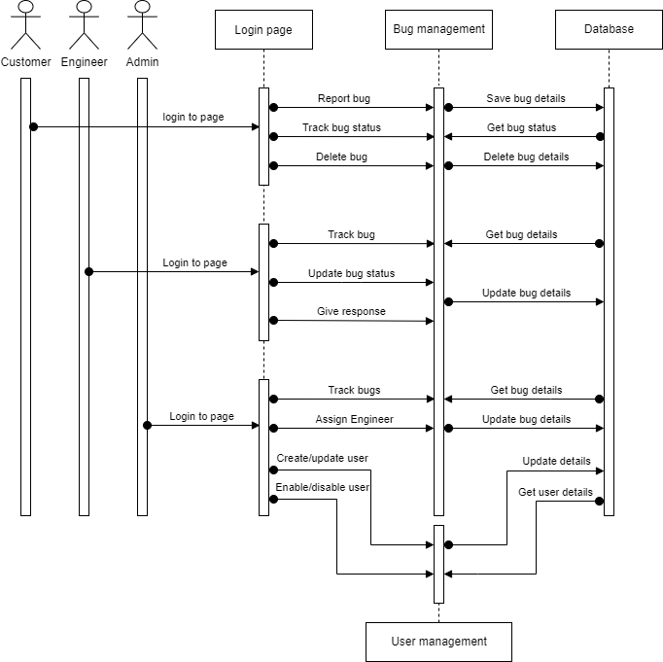
Software Design
Sequence Diagram

Slide 14
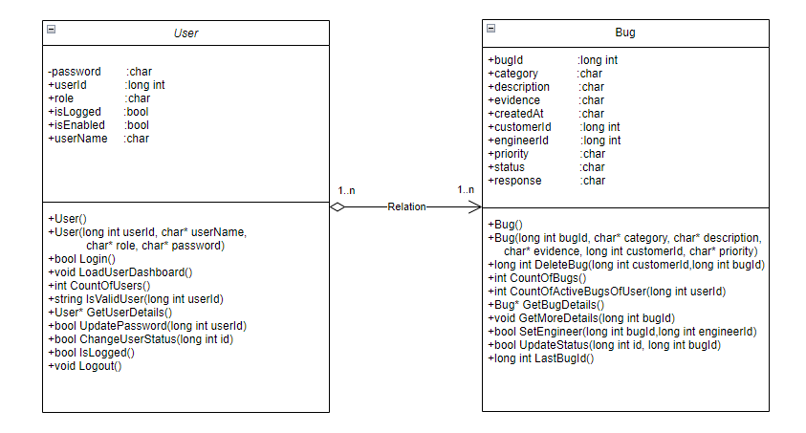
Software Design
Class Diagram

Slide 15
Software Design
Class : user
Methods | Description
User() | Default Constructor to initialize member variables
User(long int userId,char* userName,char* role,char* password) | User defined constructor to assign user Id ,user name , role and password and return User object
bool Login() | To check login is successful or not and true or false
void LoadUserDashboard() | To load user dashboard
Int CountOfUsers() | To get the total number of users
String IsValidUser(long int userId) | To check the user is valid or not
User* GetUserDetails() | To get user details
bool UpdatePassword(long int userId) | To change user password
bool ChangeUserStatus(long int id) | To change bug status
bool IsActiveUser() | To check user is active or not and return true or false
bool IsLogged() | To check user is logged in or not and return true or false
Void Logout() | To logout

Slide 16
Software Design
Class : Bug
Methods | Description
Bug() | Default Constructor to initialize member variables
Bug(long int bugId, char* category, char* description, char* evidence, long int customerId, char* priority) | User defined constructor to assign bug Id, category , description , evidence ,customer id , and priority
Int CountOfBugs() | To count the total Bug
Int CountOfActiveBugsOfUsers(long int userId) | To count the active bugs of user
Bug* GetBugDetails() | To get bug details
Bool GetMoreDetails(long int BugId) | To get more details about the bug based on BugId
string GetPriority() | To get the priority of bug
long int ReportBug() | To return bug report
long int DeleteBug() | To delete bugs
bool SetEngineer(long int bugId,long int engineerId) | To assign engineer
Bool UpadateStatus(long int id,long int bugId) | To change user bug status
Long int LastBugId() | To get last bug Id

Slide 17
Software Design
Storage Design
Persistent storage used : File system
No. of files : 2
user.dat
bug.dat
i. user.dat
Used for storing user details
ii. bug.dat
Used for storing bug details

Slide 18
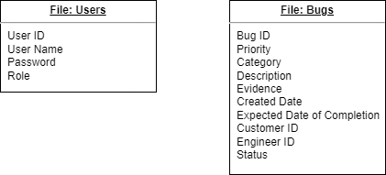
Software Design
Storage Design

Slide 19
Software Design
Tools and technologies used
Programming language : C++
Integrated development environment : Microsoft Visual studio 2017

Slide 20
Minimum Software requirements
System Specifications :
OS : Windows 10
Processor : Intel i5
Ram : 8 GB

Slide 21
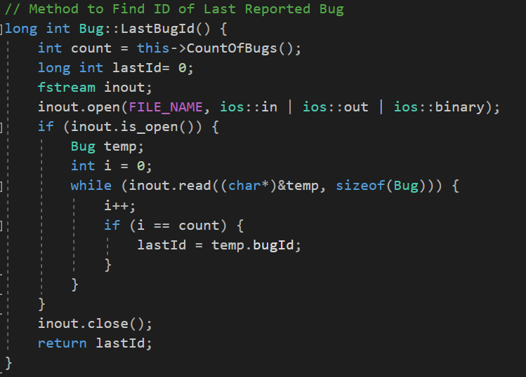
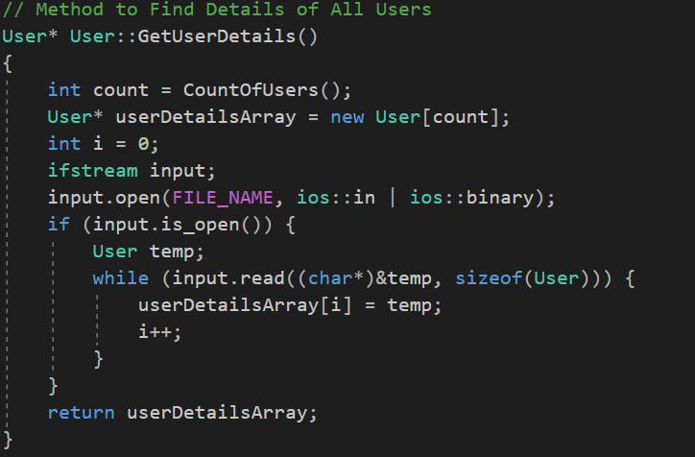
Sample Code Snippets

Slide 22
Individual contribution
Najeem VT
Developed software requirements and design architecture.
Designed user interface & prepared UI design document.
Designed file storage.
Designed classes used in the application.
Developed header files and source file method templates.
Source code integration and logical bug fixing.
Integration testing and bug fixing.
Coordinate team activities.

Slide 23
Individual contribution
Uma Devi
Actively participated in the project discussion
Designed Use Case diagrams
Prepared High Level document
Designed and developed the code for Login module
Maria Benny
Actively participated in the project discussion
Designed Sequence diagram
Designed and developed the code for User Dashboard and the navigation module
Prepared PPT

Slide 24
Individual contribution
Arunima Jayaraj
Actively participated in the project discussion
Created Class Diagram
Prepared Low Level document
Designed and developed code for Bug module
Muhammad Ajnas
Actively participated in the project discussion
Prepared SRS document
Designed and developed code for User module

Slide 25
Experience gained
Learned how to work with C++ and Visual studio
File handling
UI designing
Team coordination
Time management
Problem solving
Proper usage of programming conventions

Slide 26
Summary
This is Bug Reporting and Tracking System software product developed using C++.
File used as storage system.
End users are Admin, Engineers, Customers
If customer face any bug ,it allows customer to report it.
Admin control and manage all activities.
Under control of Admin ,the assigned Engineer solve the bug and update status.
User can view active bugs and bug history.

Slide 27
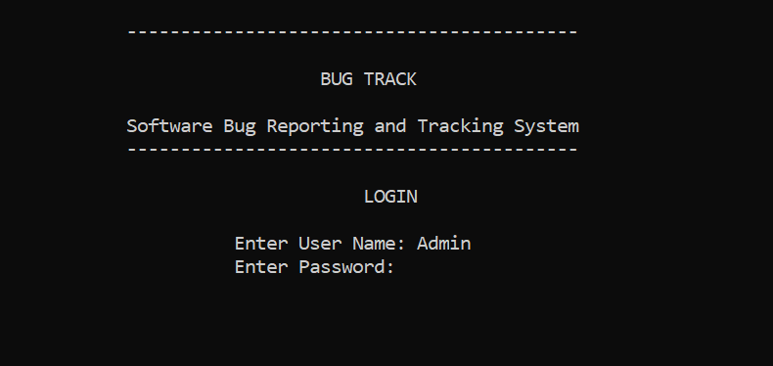
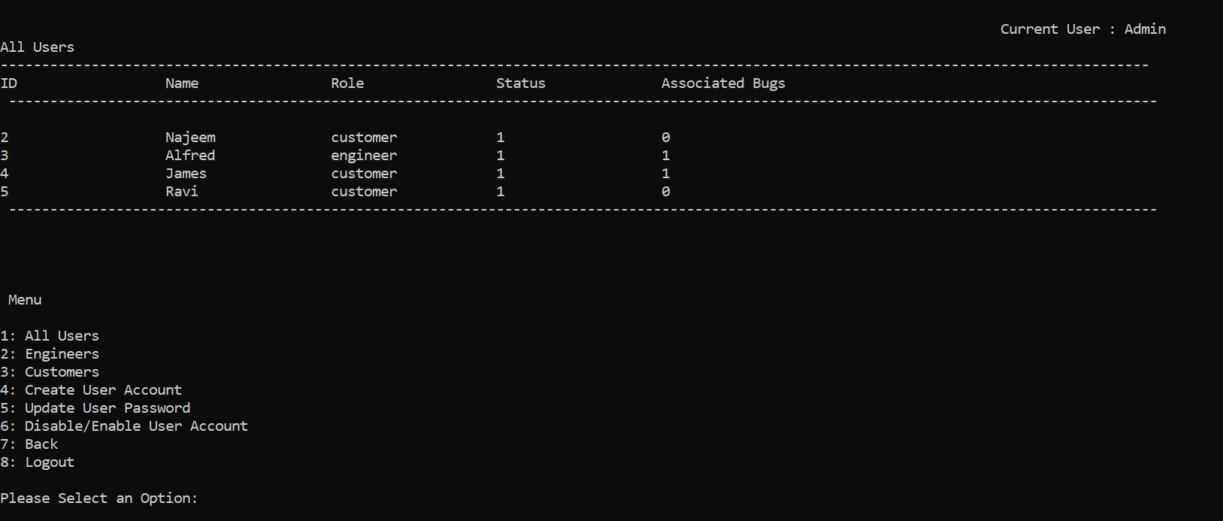
Demo

Slide 28
Thank you

