Slide 1
Apache Spark

Slide 2
What & Why
Its a open-source distributed computing system
Designed for big data processing and analytics
Provides parallelism and Fault Tolerance
High speed and efficiency
Ease of Use
Runs everywhere

Slide 3
Data Structures
RDD ( Resilient Distributed Dataset)
The foundational data structure in Spark.
Immutable and distributed collection of objects that can be processed in parallel.
DataFrame
A distributed collection of data organized into named columns, similar to a table in a relational database
Easier to work with structured data, and it is the recommended structure for most use cases.

Slide 4
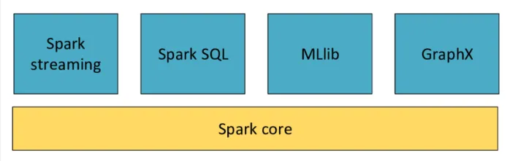
Component of Spark

Slide 5
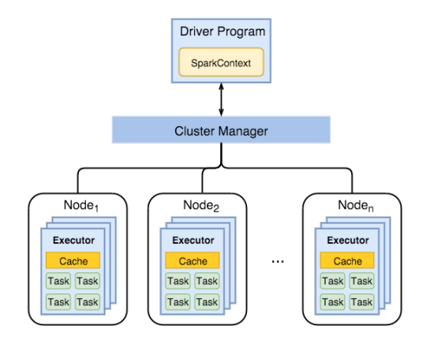
Spark Architecture

Slide 6
Spark Driver
Driver
RDD Graph
Executer
Cluster Manager
Program
DAG Scheduler
Task Scheduler
Schedule Backend

Slide 7
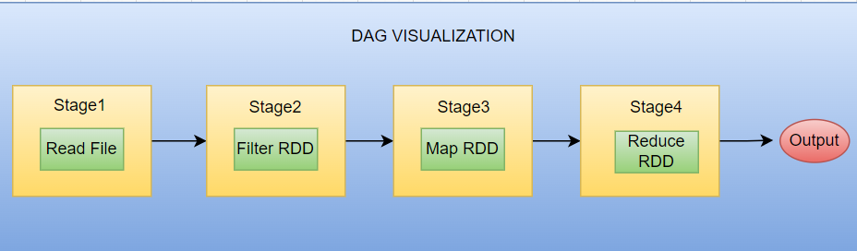

Slide 8
SparkContext – represents the connection to a Spark cluster, and can be used to create RDDs, accumulators and broadcast variables on that cluster
DAGScheduler – computes a DAG of stages for each job and submits them to TaskScheduler determines preferred locations for tasks (based on cache status or shuffle files locations) and finds minimum schedule to run the jobs
TaskScheduler – responsible for sending tasks to the cluster, running them, retrying if there are failures, and mitigating stragglers
backend interface for scheduling systems that allows plugging in different implementations(Mesos, YARN, Standalone, local)

Slide 9
Common Use Cases
Fraud Detection
Recommendation System
Predictive Analytics

Slide 10
Thanks

