Slide 1

FASHION
INSTA.
Your Personal AI Stylist.

Slide 2
THE CLOSET PARADOX
Why fashion is broken today.
Choice Paralysis
The Return Nightmare
Generic Experience
Users spend 90 mins/week deciding what to wear, yet wear only 20% of their wardrobe.
30% of online purchases are returned. Poor fit and style mismatch cost the industry billions.
E-commerce recommendations are based on 'others bought', not 'what fits YOU'.

Slide 3
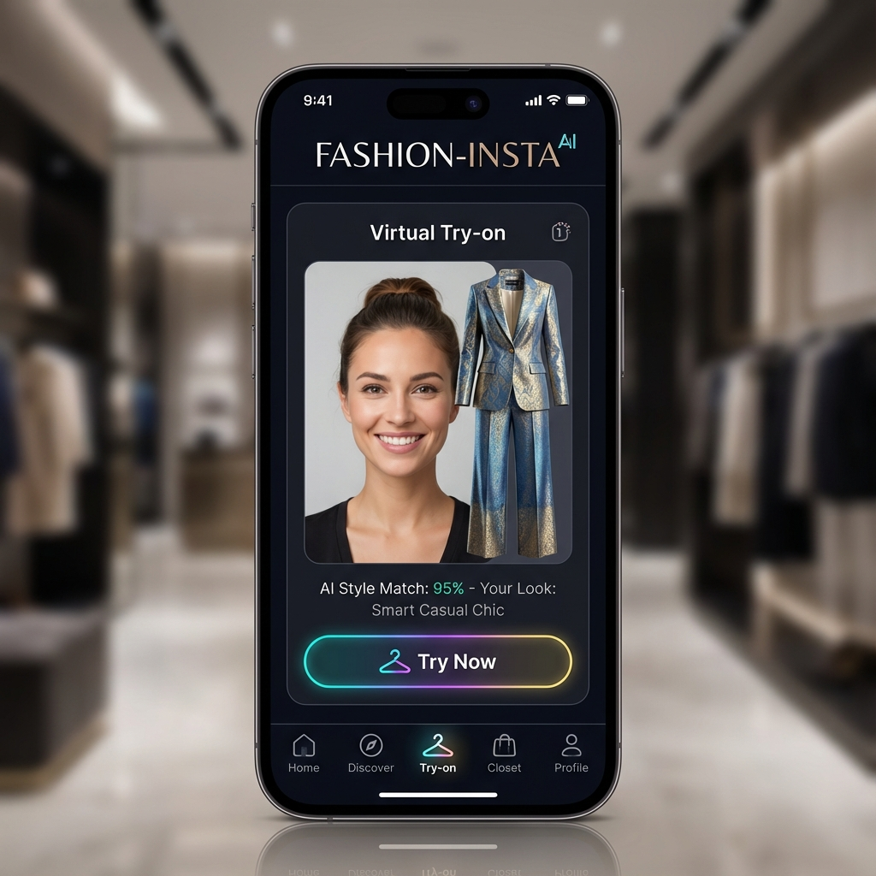
MEET YOUR AI STYLIST
Hyper-personalized fashion at your fingertips.
Virtual Try-On
Style DNA
See it on YOU before buying. Powered by Generative AI.
AI learns your taste, body shape, and vibe.
Smart Wardrobe
Eco-Score
Digitize your closet. Mix & match instantly.
Make sustainable choices with real-time impact tracking.

Slide 4
A $1.5 TRILLION OPPORTUNITY
Riding the wave of Fashion Tech.
$1.5T
Global Fashion Market
25%
CAGR AI in Fashion
Gen-Z
Digital Native Target

Slide 5
PRODUCT ROADMAP
Prioritized for maximum impact (MoSCoW).
MUST HAVE (MVP)
• AI Reco Engine
• Photo Capture
• GDPR Compliance
• Secure Auth
SHOULD HAVE (V1)
• Virtual Try-On
• Style Profiling
• Social Sharing
COULD HAVE (Scale)
• B2B Retailer API
• Marketplace
• Advanced Gamification

Slide 6
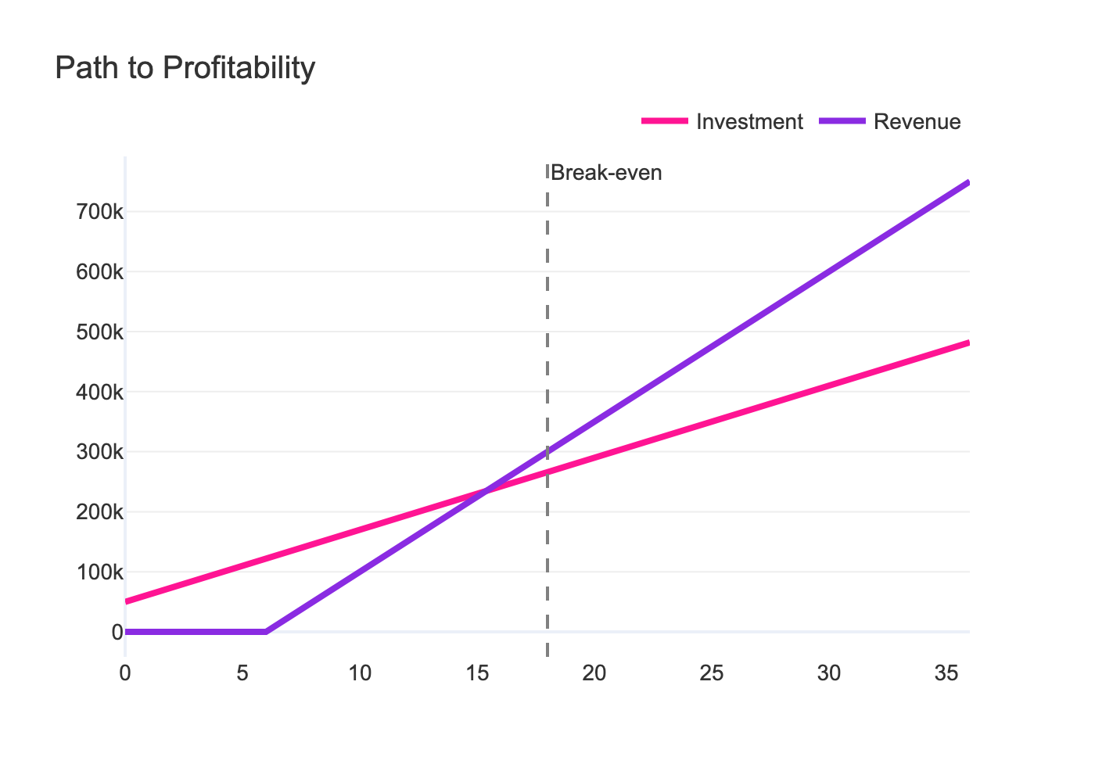
PATH TO PROFITABILITY
Sustainable growth model.

Slide 7
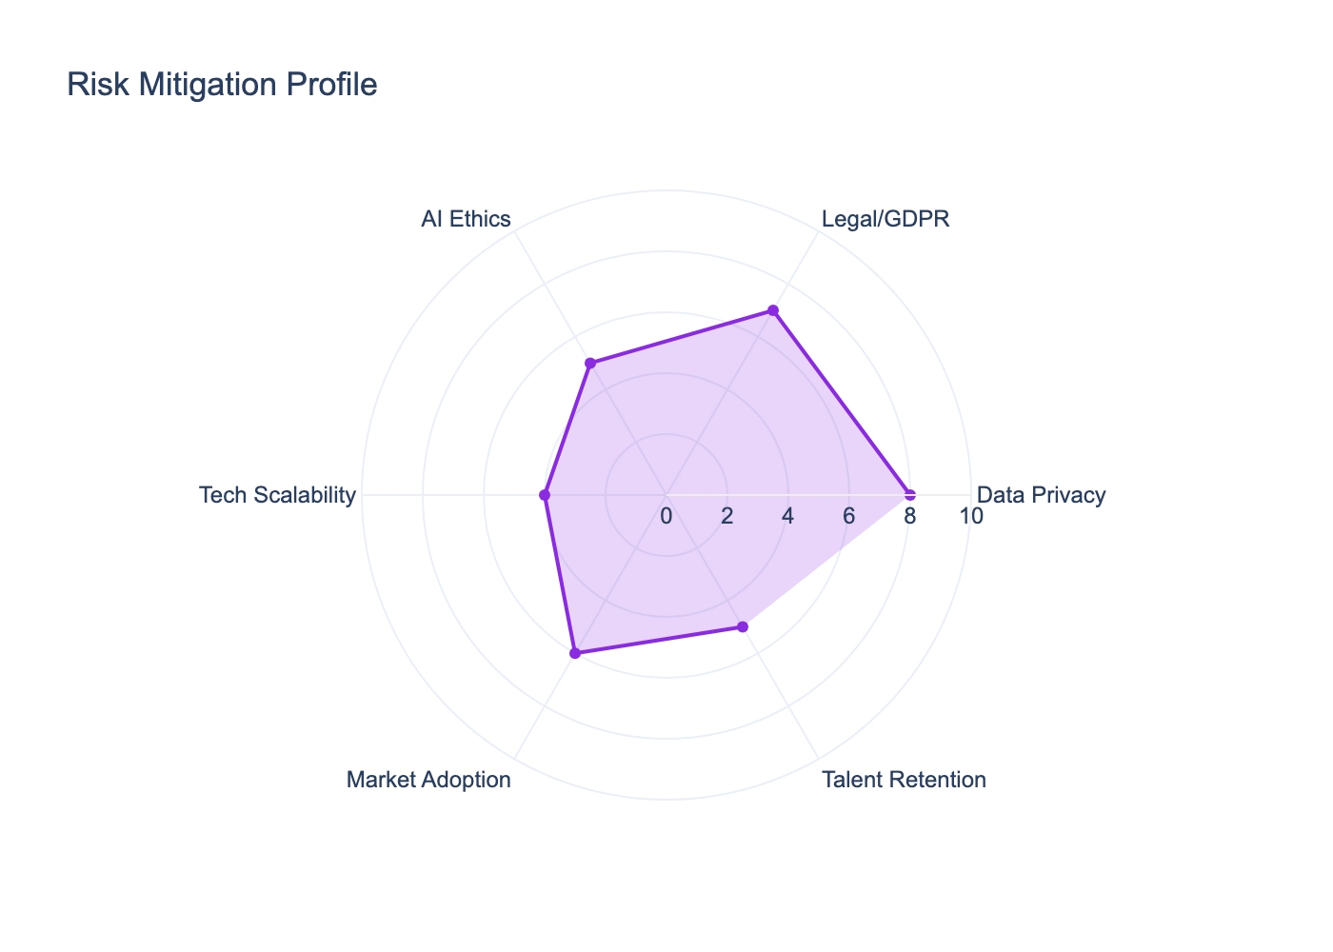
DE-RISKED EXECUTION
Proactive management of Data & Ethics.
GDPR & Privacy
Full compliance with CNIL register. AES-256 Encryption. User consent first.
Ethical AI
Bias monitoring to ensure fair representation across all body types and ethnicities.

Slide 8
AGILE GOVERNANCE
SCRUM Framework & Team Roles.
The Squad
Ceremonies
Tools
• Product Owner (Alicia)
• Scrum Master
• Lead Data Scientist
• DevOps Engineer
• Daily Stand-up (15min)
• Sprint Planning (3 weeks)
• Review & Retro
• Jira (Backlog)
• GitHub (Version Control)
• Azure DevOps (CI/CD)
• MLflow (Tracking)

Slide 9
RESOURCE ALLOCATION
CAPEX vs OPEX Breakdown.
Category | Cost Type | Estimated Amount
Development (Man-Days) | CAPEX (One-off) | €125,000 (MVP)
Cloud Infrastructure (Azure) | OPEX (Monthly) | €1,500 / month

Slide 10
COMPLIANCE & ETHICS
Trust is our currency.
CNIL Register (RGPD)
Ethical AI Framework
• Purpose: AI Personalization
• Data: Photos, Size, Purchase History
• Retention: 3 years active
• Rights: Access, Rectification, Erasure
• Fairness: Balanced datasets (Ethnicity/Body Type)
• Transparency: Explainable AI (XAI)
• Green AI: Optimized inference for low carbon footprint

Slide 11
EXECUTION TIMELINE
Key milestones to market domination.
Q1: FOUNDATION
MVP READY 🚀
VIRTUAL TRY-ON
V1 RELEASE 🏁
Sprint 1-2
Sprint 3 (Month 2)
Sprint 4 (Month 3)
Month 4

Slide 12

SCALABLE CLOUD ARCHITECTURE
Powered by Microsoft Azure.
Front-End
AI Engine
React Native
(iOS/Android)
Azure Cognitive Services
+ Custom PyTorch Models
API Gateway
Data Lake
Azure App Service
(Python/FastAPI)
Azure Blob Storage
(Images & Metadata)

Slide 13
Join the Revolution.
Seeking $2M Seed Investment

