Slide 1
Intro to programming in Python Lead: Najia Bouaddouch Facilitator: Alina Tan July 14, 2025 Materials adapted from Benjamin Rudski

Slide 2

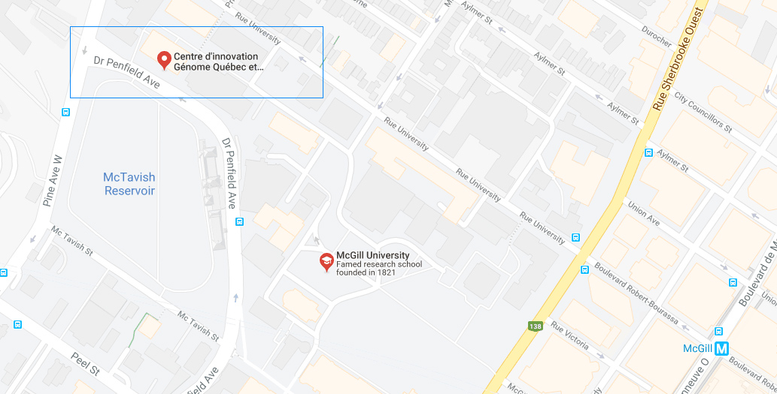
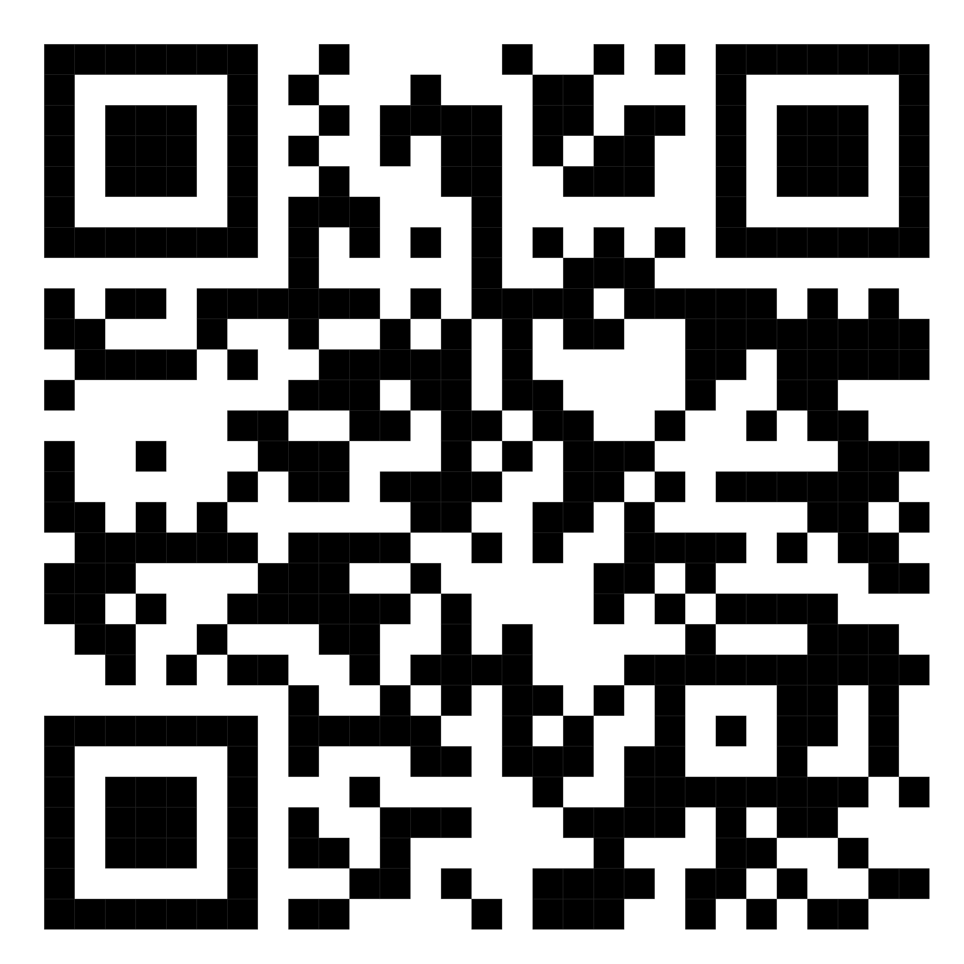
Mission statement: deliver quality workshops designed to help biomedical researchers develop the skills they need to succeed.
Location: 550 Sherbrooke West, Montreal, Quebec
Scan the QR code to sign up
for our mailing list
Contact: workshop-micm@mcgill.ca

Slide 3
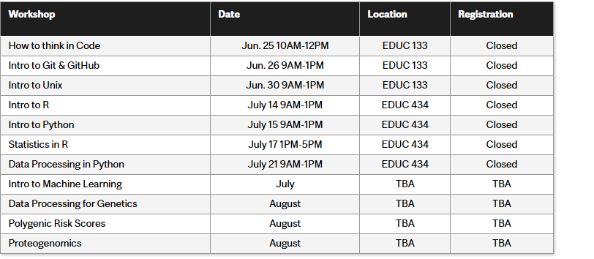
https://www.mcgill.ca/micm/training/workshops-series

Slide 4
Outline:
Welcome! (10 min)
About Python…
How to use Colab
Part 1– Python Syntax and Variables (1 hour)
Variable assignment
Operators in Python
Incrementing a variable
Intro to strings
BONUS: Get user input
Part 2 – Data Structures (30 minutes)
Lists
Dictionaries
Tuples

Slide 5
4. Part 3– Control Flow (1 hour)
Conditional statements
While loop
For loop
Iterable objects and for loops
BONUS: List Comprehension
5. Part 4 – Functions & Modules (40 minutes)
Functions
Modules
BONUS: Intro to matplotlib
6. Exercises

Slide 6
About Python…
Open Source
Anyone can download, use, modify and distribute the Python programming language.
Interpreted
Python scripts are run line-by-line
Can easily launch it from the command line and have access to an interactive shell
Object-Oriented
“Objects” – collections of data and manipulations that make it easier to represent the real world

Slide 7
This is an interactive Workshop!
Please open the Jupyter notebook using Colab (you can find the link on the GitHub repo)
https://colab.research.google.com/drive/177yXlgRgIoZRbq-UCdDBDm2N_li_J-P4?usp=sharing

Slide 8
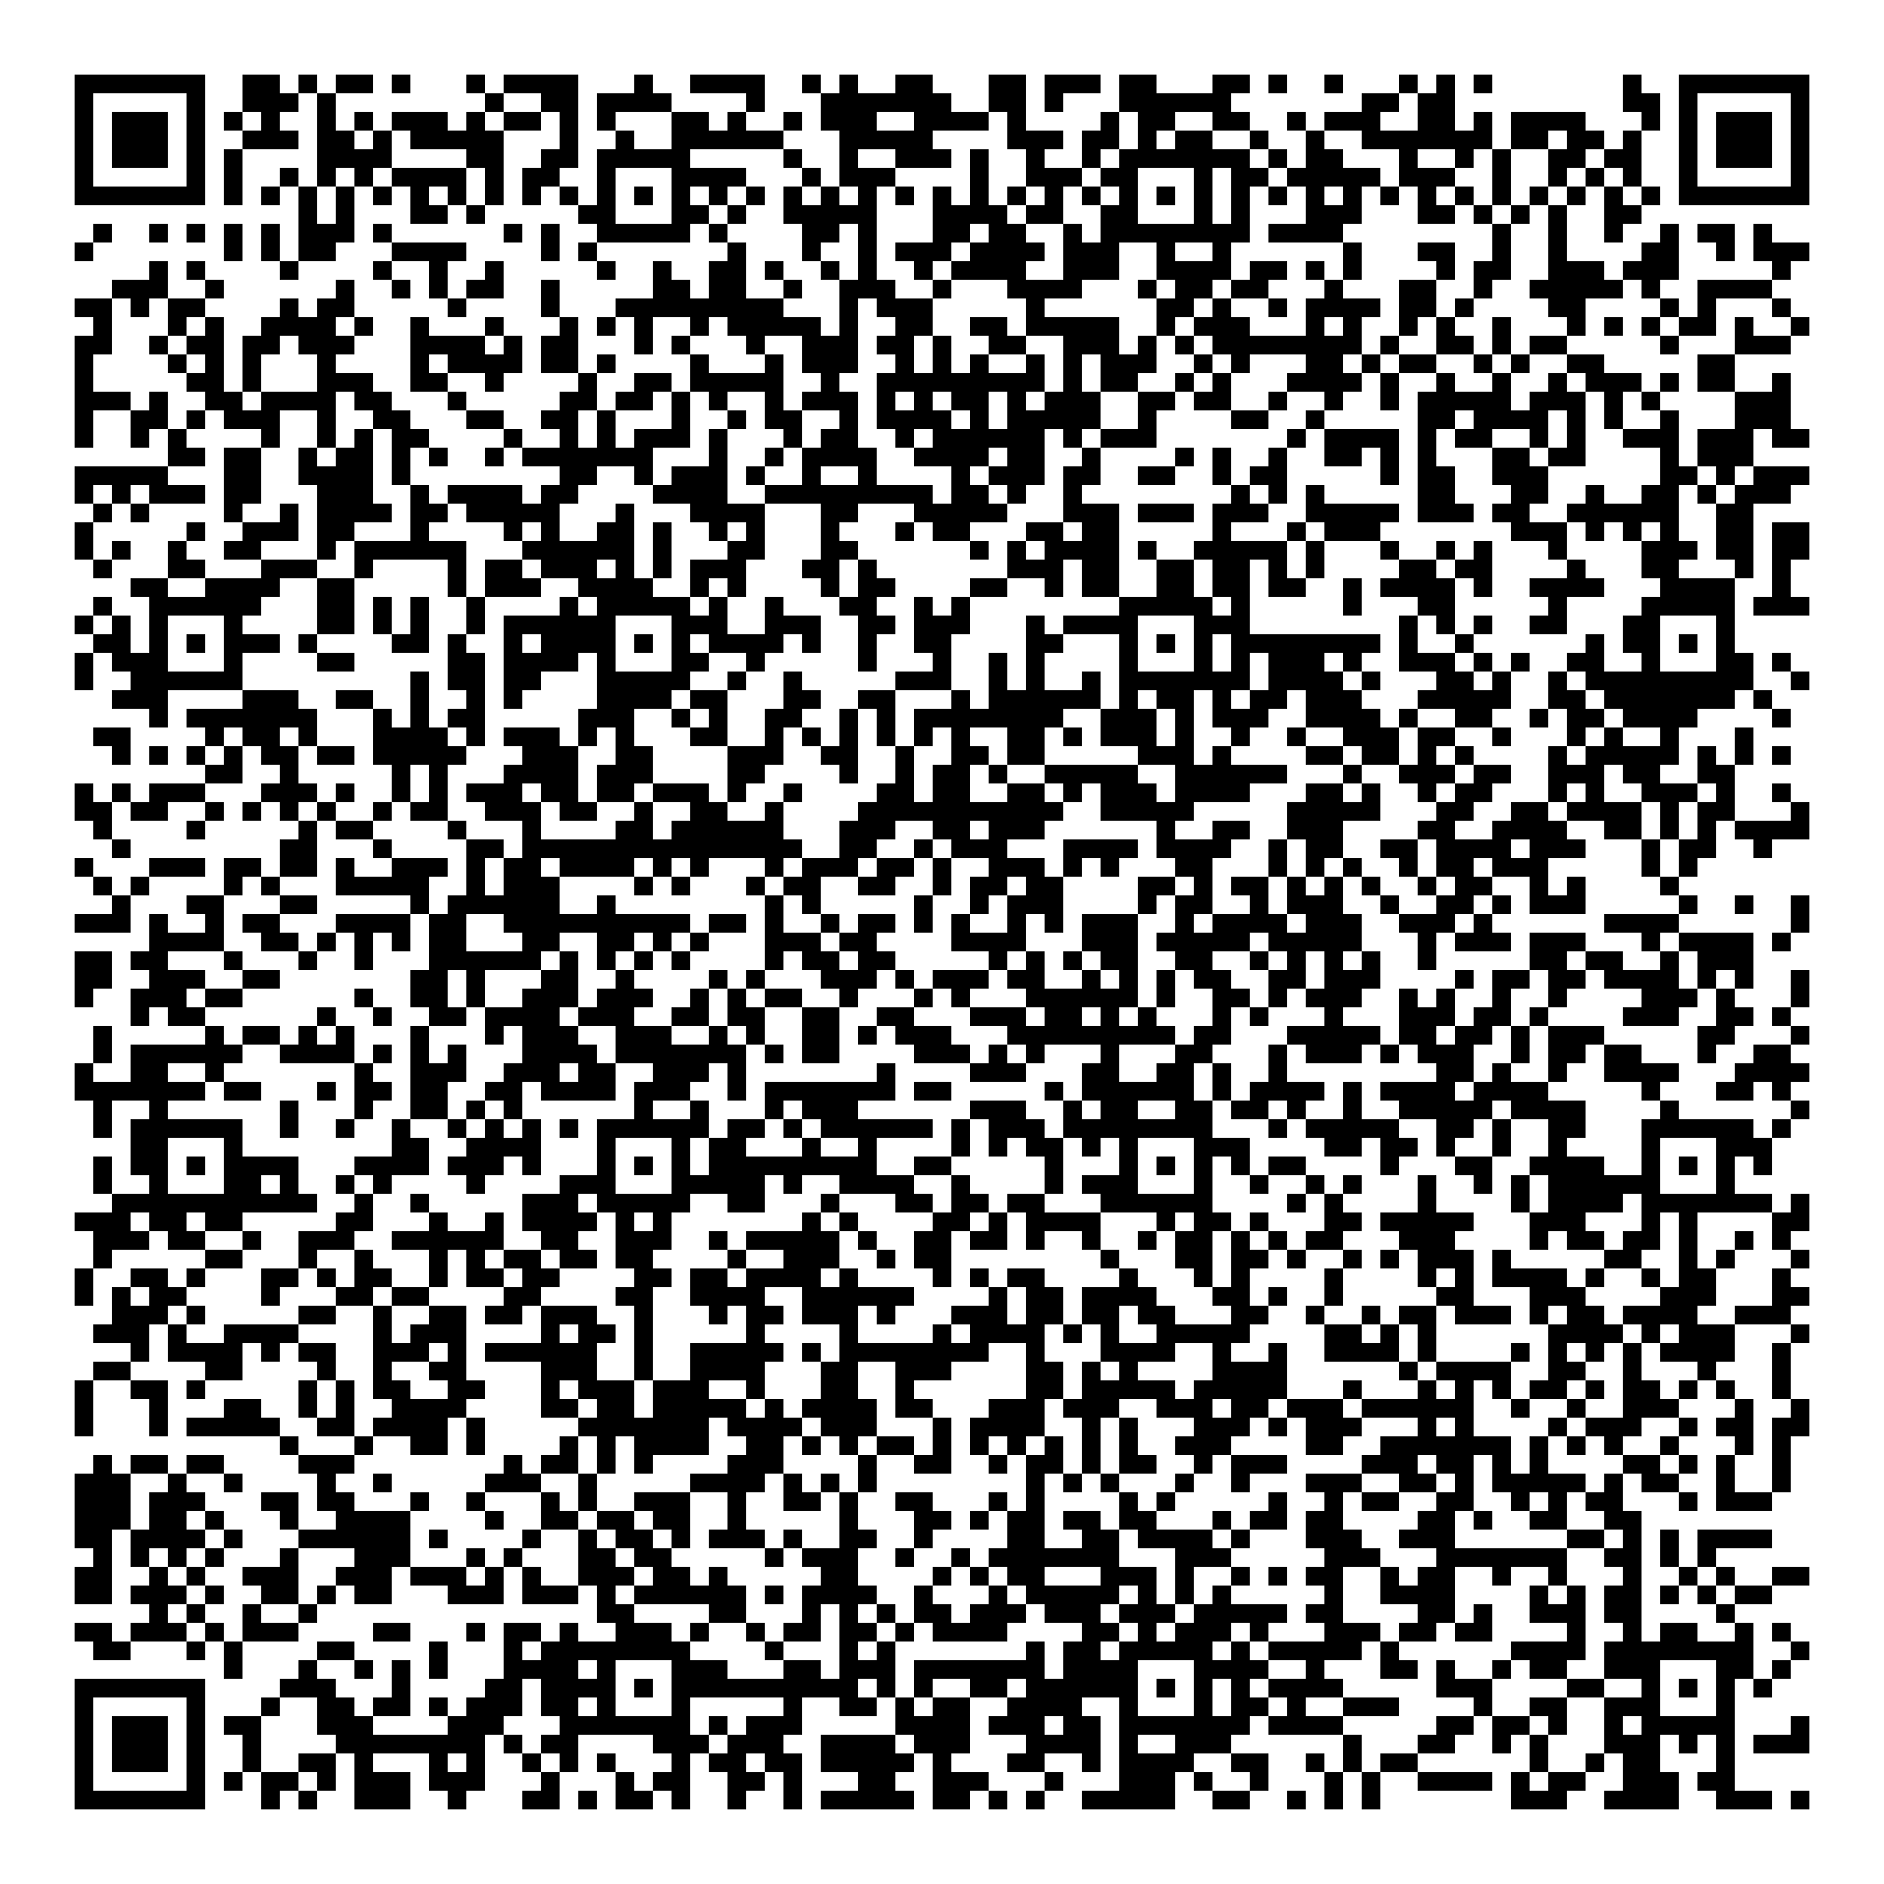
Thank you for attending!
Please scan the QR code to confirm you attended today’s workshop ☺

