Slide 1
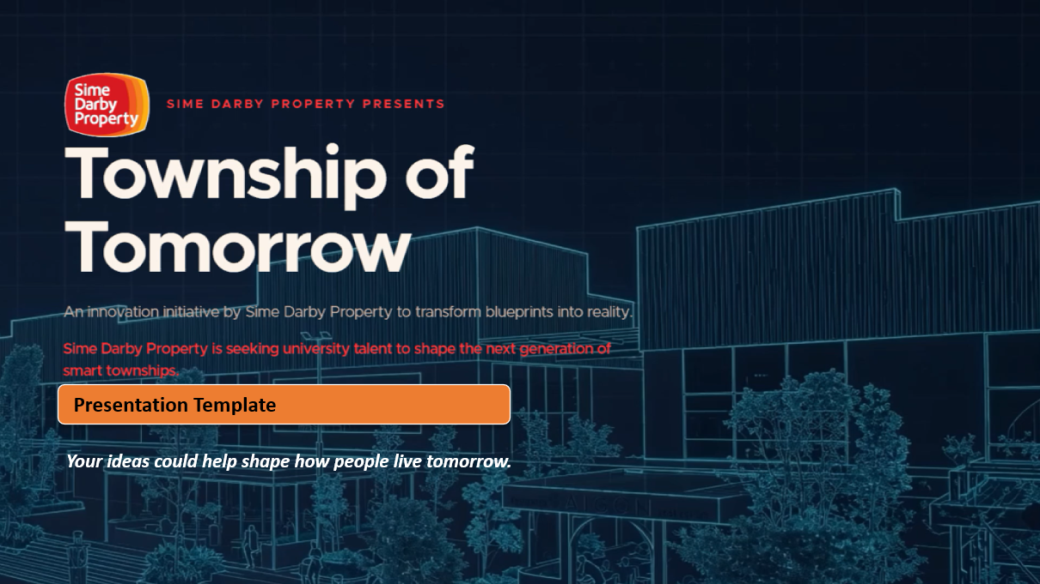

Slide 2
GreenLoop
Smart Recycling Ecosystem · recycling that pays for itself

Slide 3
Team Information
Team Name: Synkosys
  Muhammad Najib bin Ahmad Azir, Team Lead, Universiti Teknologi MARA · najibazir12@gmail.com
  Mohamad Fathin bin Mohd Zakiyuddin, Universiti Malaysia Pahang · fathinzy@gmail.com
  Muhammad Muqsith bin Mohd Hairul Wazi, Universiti Teknologi MARA · mohdmuqsith1996@gmail.com
  Leeya Sofea binti Mohd Rizal Izwan, Universiti Teknologi MARA · leeyasofea199@gmail.com
Live demo: greenloop-tan.vercel.app · Code: github.com/NajibAzir/greenloop

Slide 4
1. The Problem
Malaysia wants to recycle more, but most recyclable waste still ends up in landfill.
  ~38,000 tonnes of solid waste are generated every day; about 82% still goes to landfill.
  The national recycling rate sits around 30%, below the 40%-by-2025 target, yet ~40% of landfilled waste is recyclable.
In a township it stalls for three reasons:
  Residents have no real incentive, effort, no reward, so turnout stays low.
  Recycling is treated as a cost centre, so programmes get cut.
  Collection is blind, trucks run fixed routes to half-empty bins, wasting fuel.
Sources: UNIDO (2025); Asia News Network (2026); KPKT Circular Economy Blueprint 2025 to 2035. Figures indicative.

Slide 5
2. Target User
Three groups, one loop, modelled on real Sime Darby Property communities.
  Residents (households), want convenient recycling and an everyday reward.
  Mall tenants (F&B / retail, e.g. Elmina Lakeside Mall), want to offset monthly service charges from packaging waste.
  Developer operations (Sime Darby Property), want visibility, lower haulage cost and measurable ESG outcomes.
Grounded in real locations: City of Elmina (Elmina West / East, Denai Alam, Bukit Subang), Elmina Lakeside Mall, Bandar Bukit Raja.

Slide 6
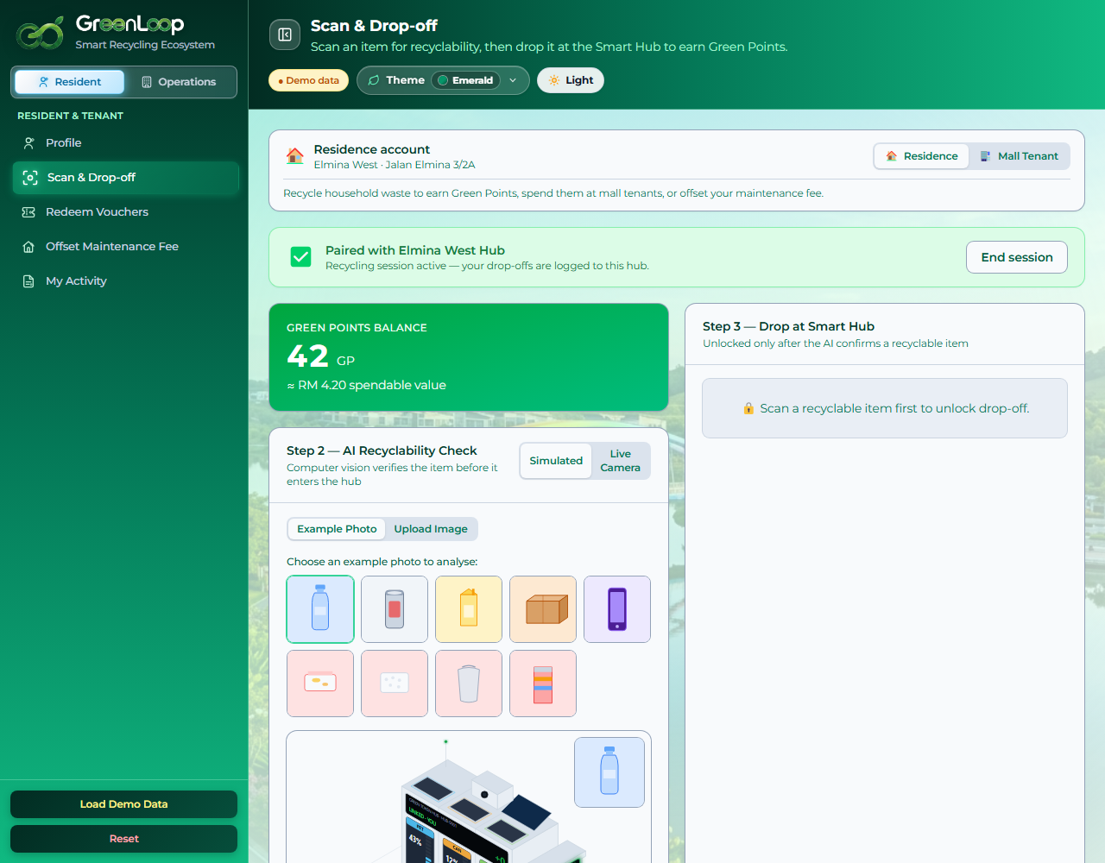
3. Your Solution
GreenLoop closes the loop: recycling becomes a self-funding economy.
  Scan & earn, AI verifies the item; residents earn Green Points (GP).
  Spend like cash, redeem GP at mall tenants or offset monthly fees.
  Funded by savings, avoided haulage + material sales + carbon value pay for it.
  Collect smart, AI dispatches trucks only to full bins.
Resident Scan & Drop-off (live prototype)

Slide 7
4. Innovation
A funded, verified, intelligent loop, not just another points app.
  Rewards are funded by avoided haulage + material sales + carbon value (not a subsidy).
  AI vision verifies each item before it is accepted (vs “trust me, it's recyclable”).
  Live AI dispatch sends trucks only to full bins, on real road routing (vs fixed routes).
  Residents and mall tenants are served by one engine (vs a single user type).

Slide 8
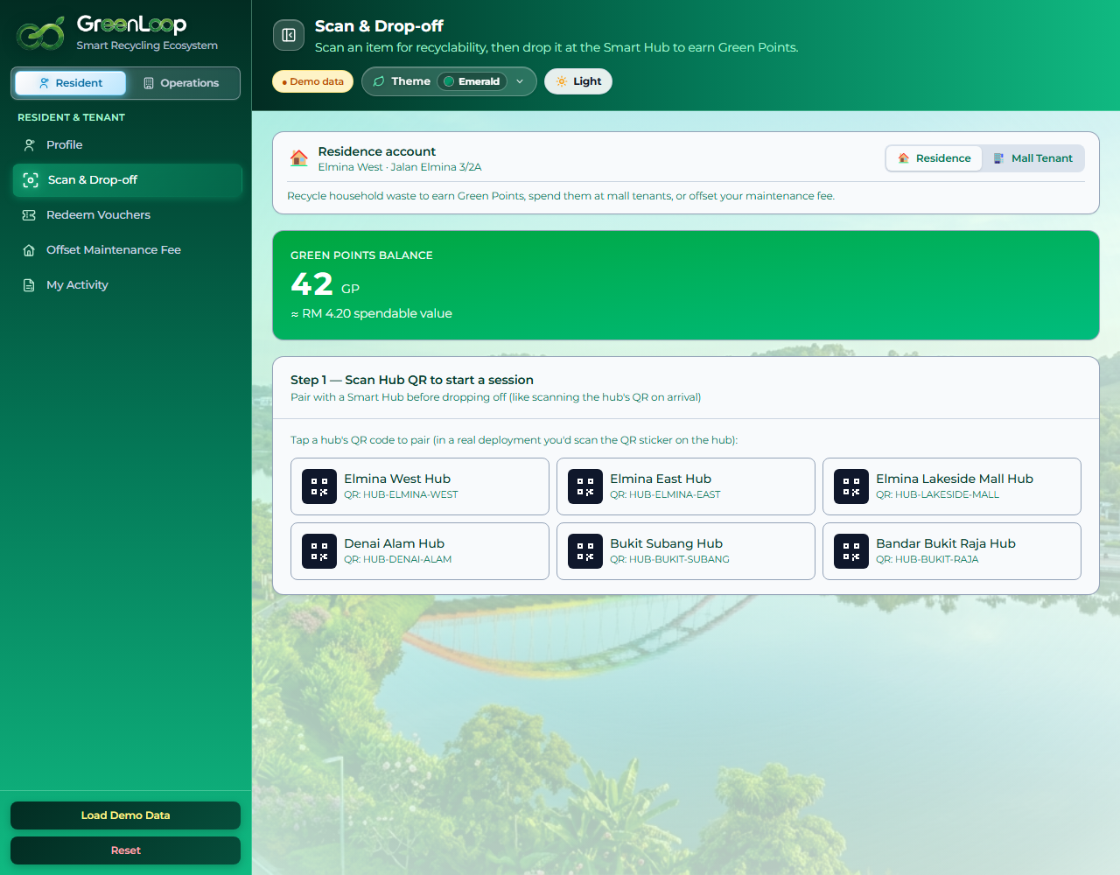
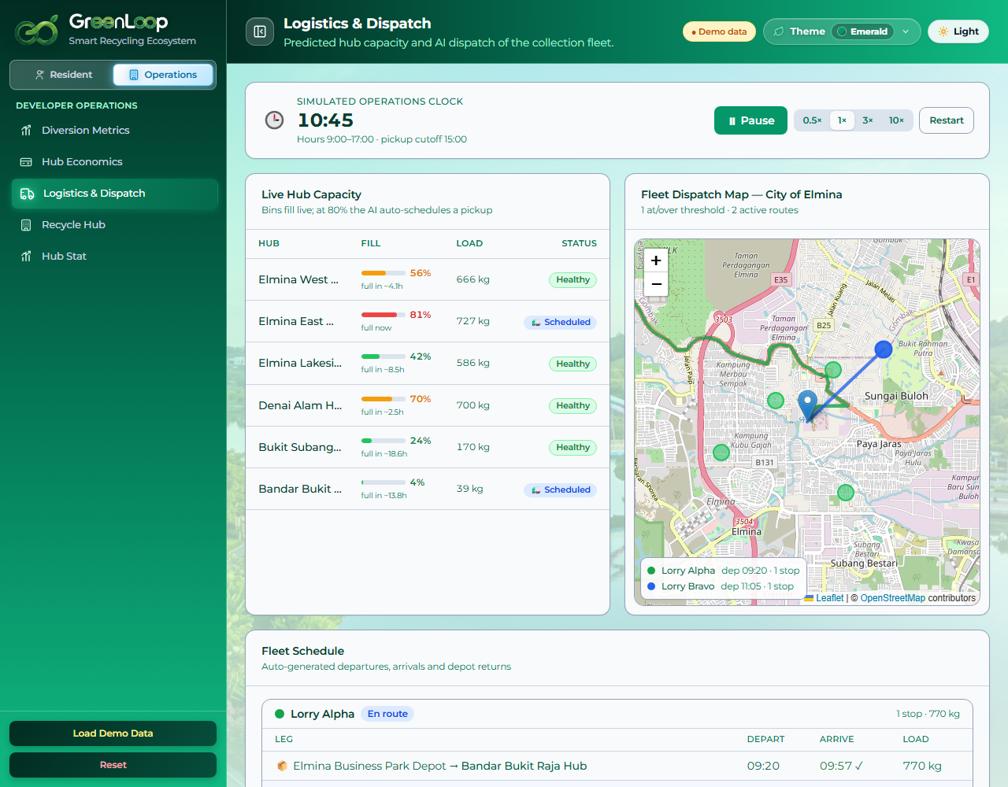
5. How it Works
Residents → Hubs → Operators → Rewards, one closed loop:
  1. Scan, resident scans an item; AI vision confirms it's recyclable.
  2. Drop at Smart Hub, pair via hub QR; item accepted, GP credited instantly.
  3. AI Dispatch, bin fills; at 80% a truck is scheduled to full bins only.
  4. Recover & Sell, material is diverted from landfill and sold to recyclers.
  5. Value funds the loop, savings + sales + carbon fund the GP and fee offsets, and the loop repeats.

Slide 9
6. Impact
Measurable outcomes, honest about what's demonstrated vs projected.
  Environmental, tonnes diverted from landfill; CO₂e avoided; supports the 40% target.
  Community, residents earn GP; GP offsets fees; higher, sustained participation.
  Operational, lower haulage cost, live hub/fleet visibility, a self-funding programme.
Demonstrated: working AI scan, GP economy, live dispatch, 6-hub map. Modelled: ~10.9 t/month diverted and an operating surplus. Needs validation: bin hardware, real haulage cost, recycler & carbon prices.

Slide 10
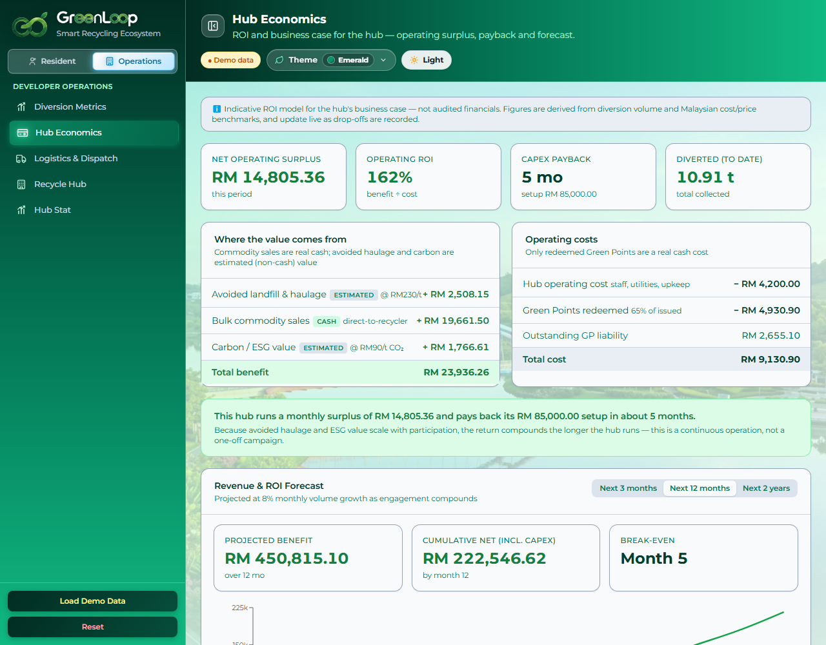
7. Feasibility
The hub pays for itself, transparent monthly economics (indicative, reconciles with the live dashboard).
  Benefit: material sales RM 19,662 (cash) + avoided haulage RM 2,508 + carbon RM 1,767 = RM 23,936.
  Cost: operating RM 4,200 + Green Points redeemed RM 4,931 = RM 9,131.
  Net cash flow ≈ RM 14,805 / month → RM 85,000 setup ÷ 14,805 ≈ 5.7-month simple payback.
  Conservative case (no carbon): net ≈ RM 13,000/mo, payback ~6.5 months. Still self-funding.
RM230/t avoided-haulage is an assumption pending validation with Sime Darby's waste contractor.

Slide 11
7. Implementation
Start with one hub at Elmina West: prove it, then scale precinct by precinct.
  Month 1, install & integrate: Smart Hub + bin hardware; link rewards and resident sign-up.
  Month 2-3, run & measure: track diversion, participation and real cost vs the model.
  Month 4, review (go / no-go): compare actuals to assumptions; confirm payback.
  Month 5+, scale: roll out to Elmina East, Denai Alam, Elmina Lakeside Mall.
Stakeholders: Sime Darby Property ops, waste contractor, mall tenants, residents, recyclers. Validate first: bin hardware, real RM/t haulage, recycler prices, POS integration, resident identity & PDPA.

Slide 12
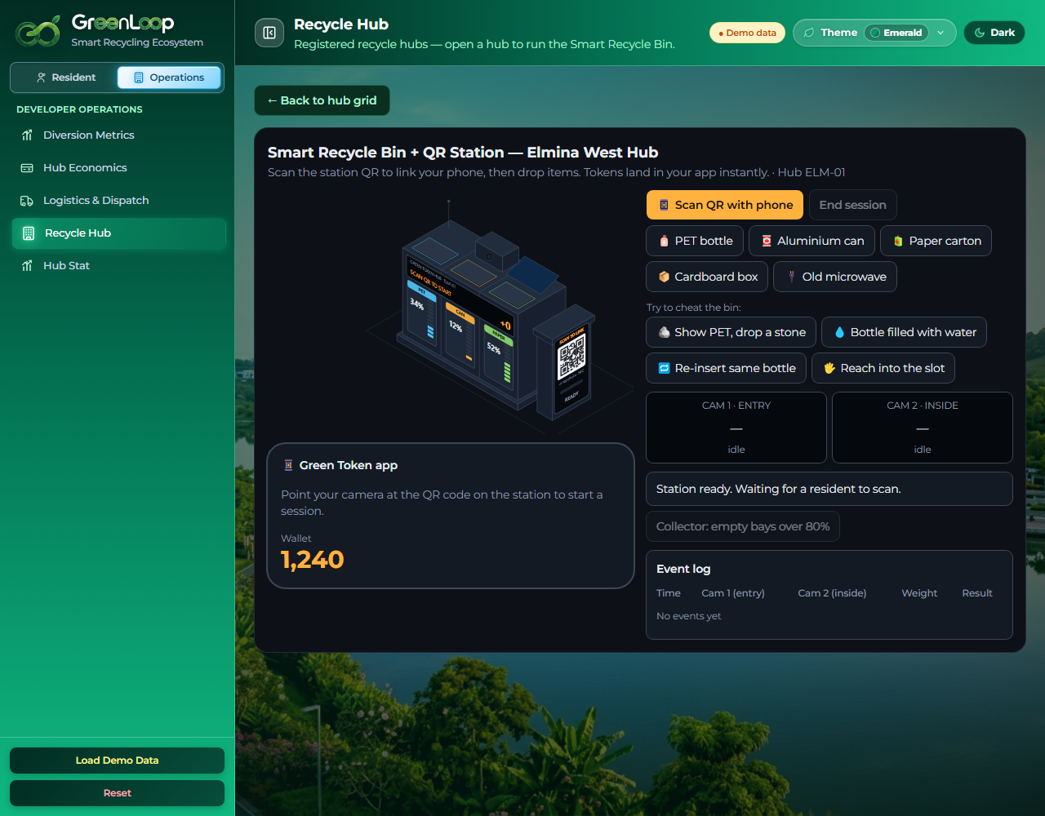
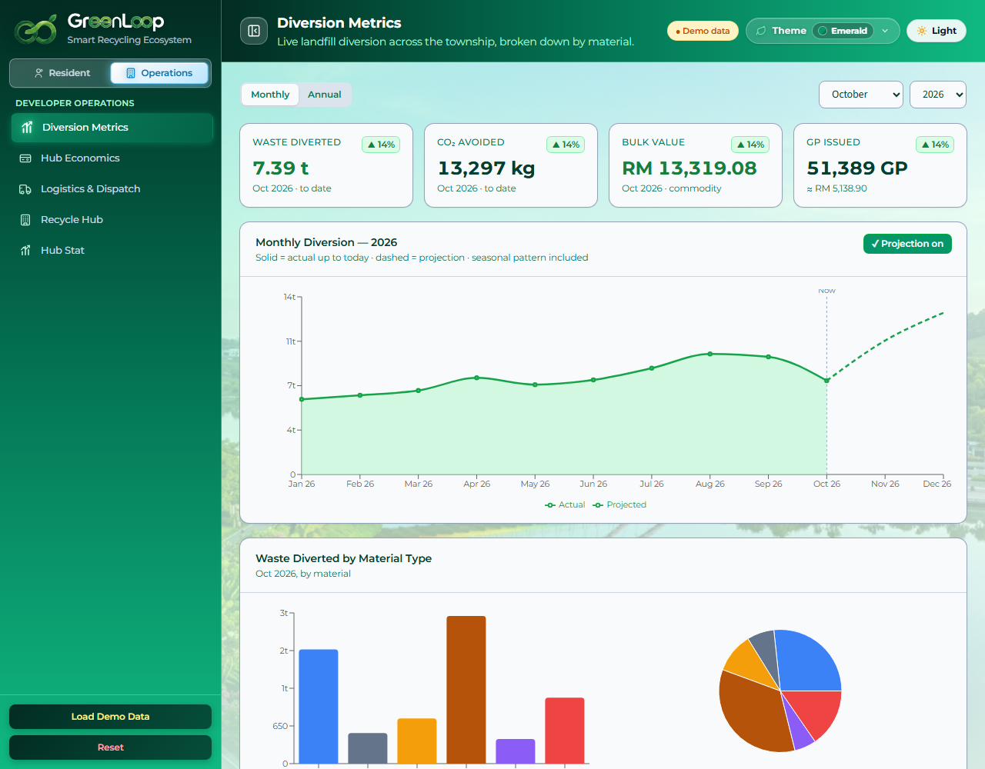
7. Visual Concept
One working ecosystem: resident app, smart bin and the operator's command centre.
Smart Recycle Bin + QR station
Diversion metrics (actual vs projected)
Hub economics (business case)

Slide 13
8. Why Your Team Should Win
GreenLoop connects AI-assisted recycling, resident rewards and smarter collection into one township ecosystem, tackling both participation and the cost of collection, not just one of them.
We built a deployed, interactive prototype and a one-hub pilot model for Elmina West, and we are transparent about what is demonstrated versus what still needs real-world validation.
Our ask: a one-hub pilot at Elmina West plus access to operational data, so we can measure actual diversion, collection savings and payback before scaling.

Slide 14
Thank You

