Slide 1
Appendix
GreenLoop · Team Synkosys · supporting detail for the pitch deck

Slide 2

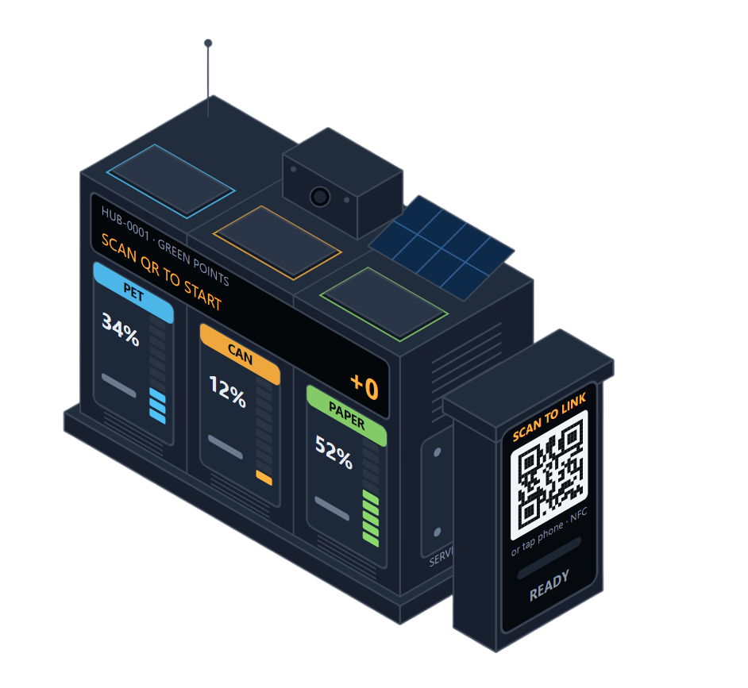
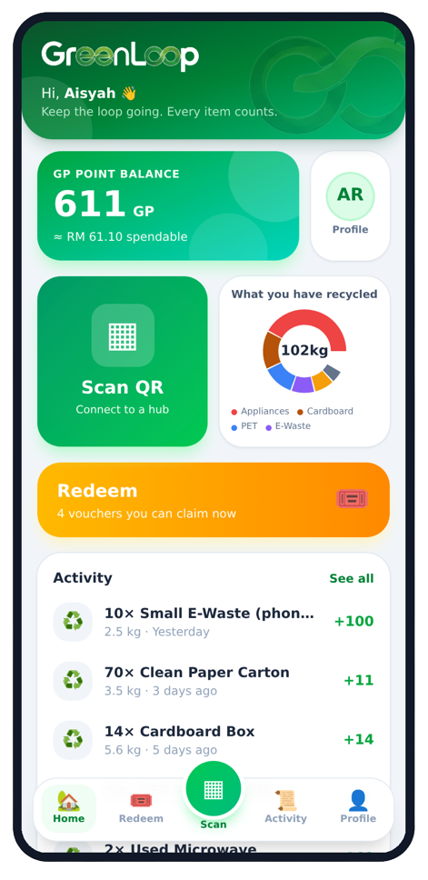
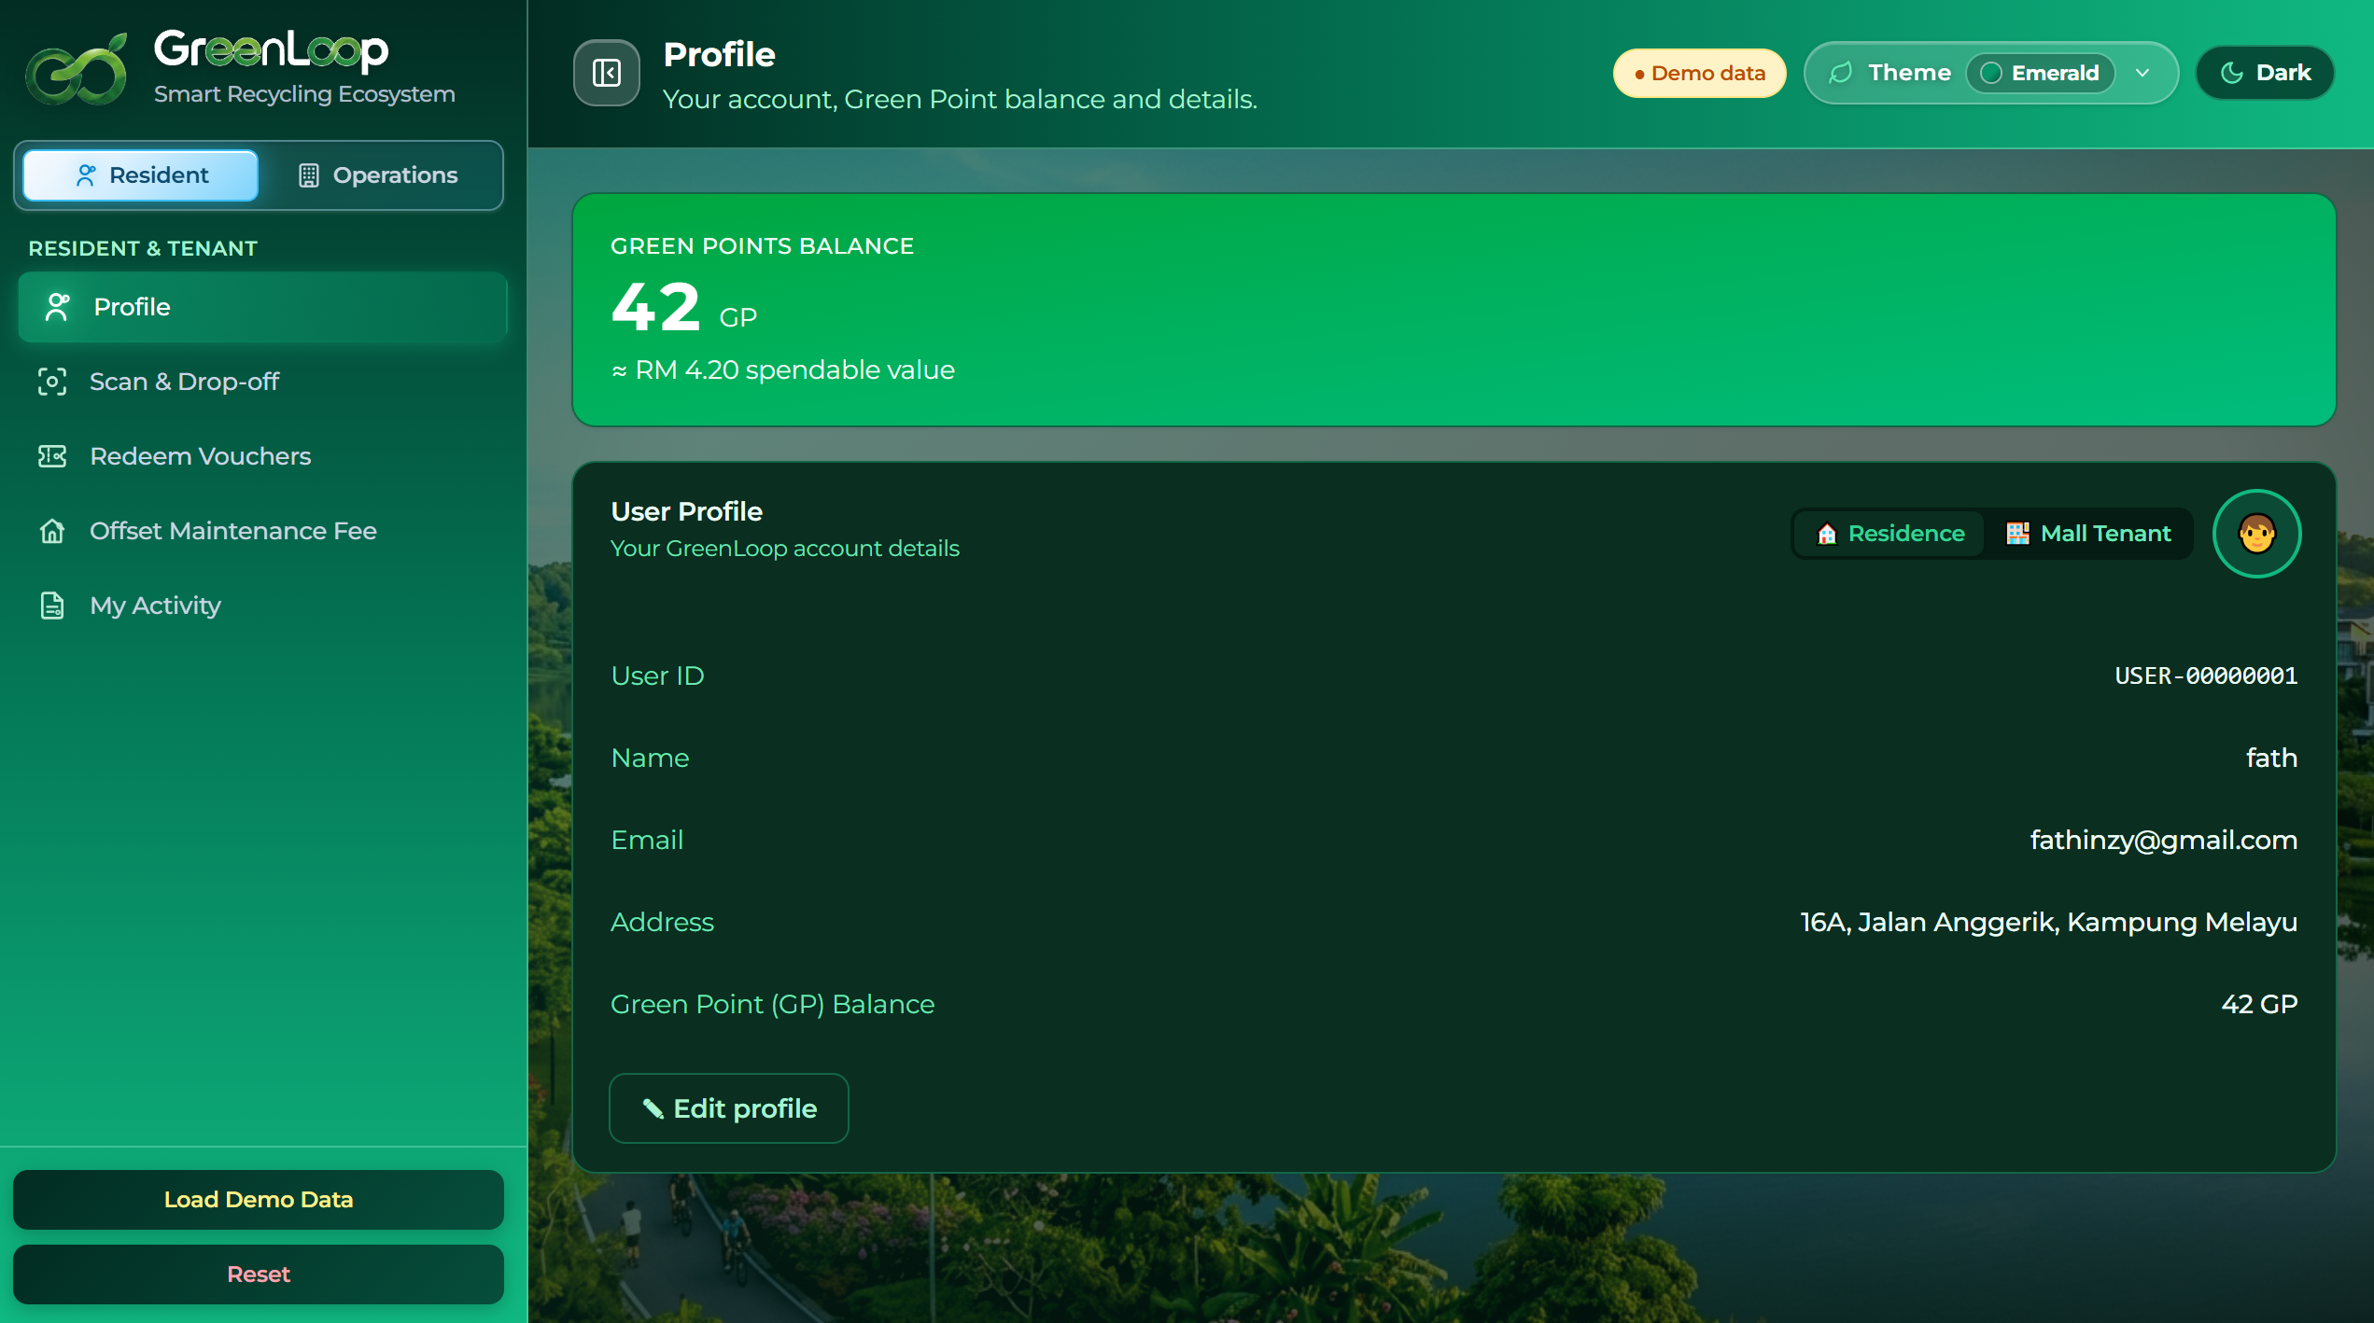
A
AI & system status · honest boundary
What is genuinely working today vs. what still needs building.
WORKING TODAY
WHAT STILL NEEDS BUILDING
✓ Working in the browser
~ Simulated in the prototype
~ Mobile Application
! Needs real-world build
• TensorFlow.js COCO-SSD on webcam / uploaded photos
• Green Points wallet, redemption & fee offset
• Dispatch sim on real roads (OSRM) + 6-hub map
• Bin fill levels & sensor weights (demo values)
• Two-camera cheat check (entry vs inside)
• Township ROI from an indicative, tunable model
• Phone Apps for User
• User to connect with the Smart Recycle Hub
• Activity monitoring + Green Points wallet, redemption & fee offset
• Recyclability/material classifier on real items
• Physical smart-bin hardware + load cells
• POS/voucher + identity + telemetry integration
On AI accuracy & anti-cheat: the demo detects common objects (bottle, can, cup, phone); it does not yet confirm material purity. Production needs a recyclability classifier validated on real items, plus the two-camera entry/inside check to stop re-scanning without depositing.
GreenLoop · Team Synkosys · Sime Darby Property University Hackathon 2026
Appendix B

Slide 3
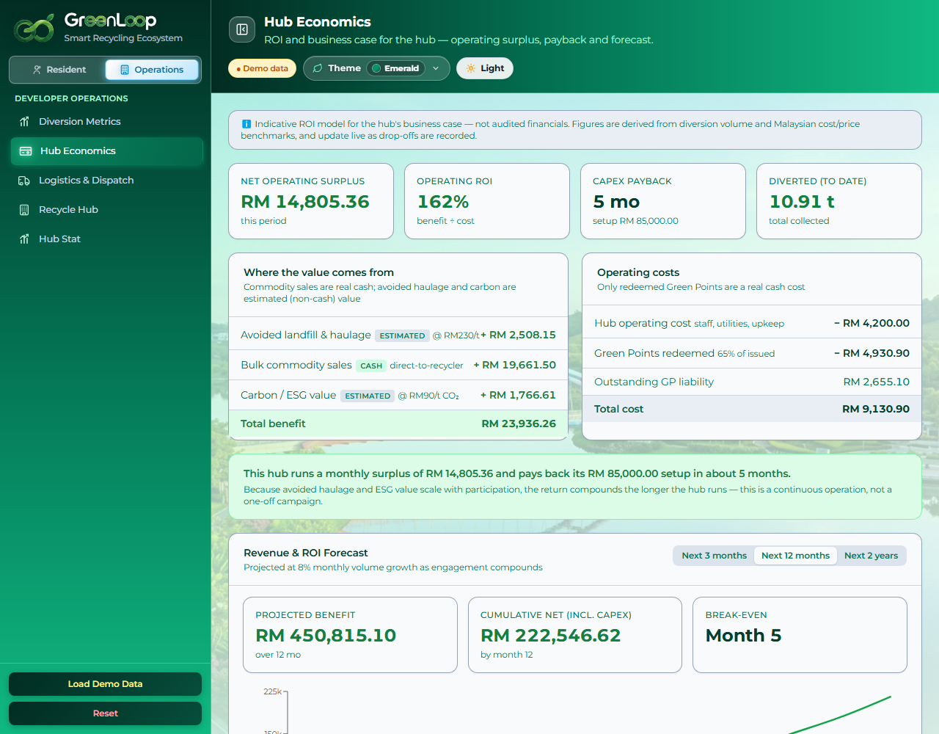
B
Business case & assumptions
Indicative Malaysian benchmarks (2024). Stated openly, not audited financials.
Avoided landfill & haulage
RM 230 / tonne diverted
Carbon / ESG value
RM 90 / tonne CO₂e
Hub operating cost (opex)
RM 4,200 / month
One-time setup (CapEx)
RM 85,000
Green Point value
RM 0.10 per GP (10 GP = RM 1)
GP redemption rate
65% of issued GP redeemed for cash
Assumed volume growth
8% per month
Bulk price: aluminium / e-waste
RM 4.2 / RM 12 per kg
Bulk price: PET / paper / cardboard
RM 1.1 / 0.55 / 0.45 per kg
GreenLoop · Team Synkosys · Sime Darby Property University Hackathon 2026
Appendix A

Slide 4
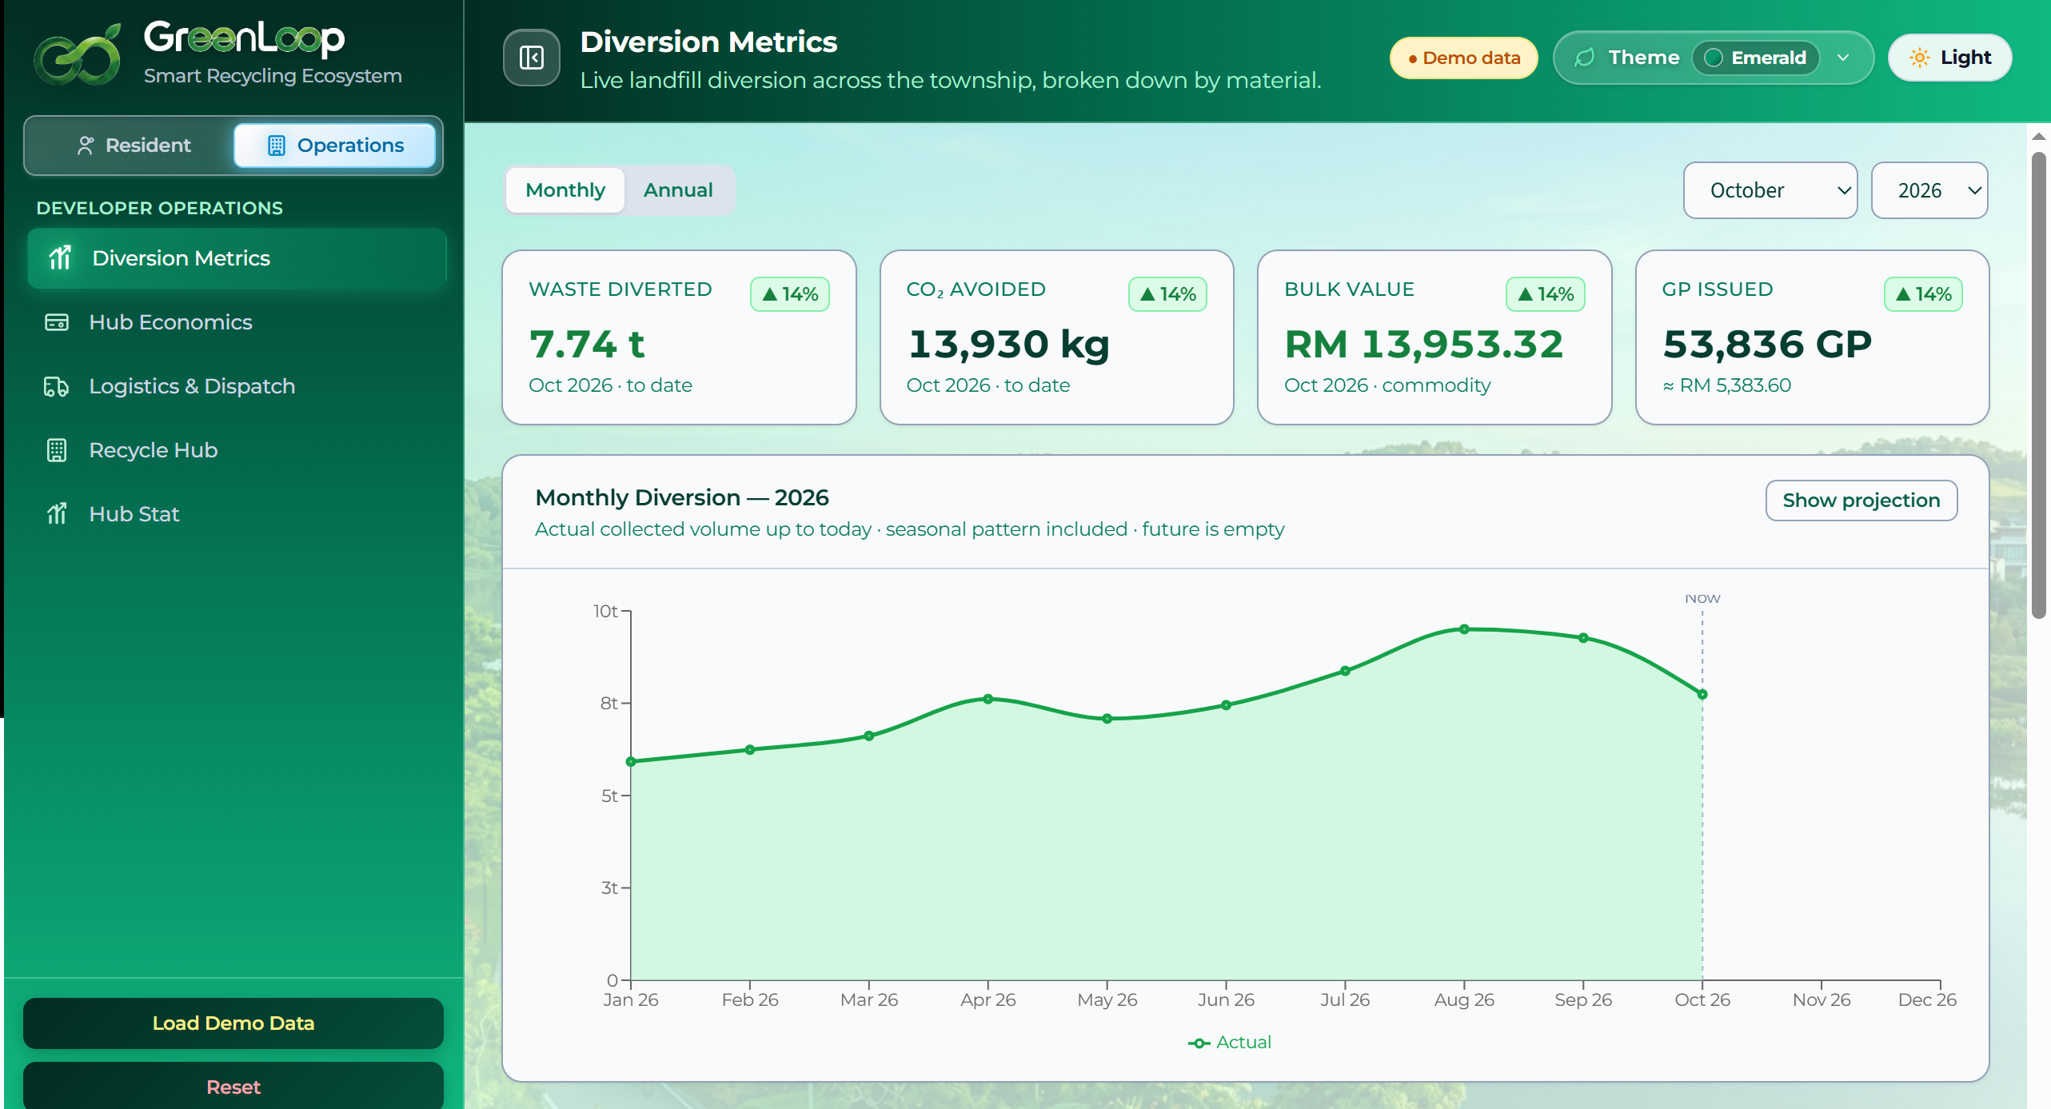
C
Diversion Metrics
Tech stack: React + Vite · Tailwind · TensorFlow.js COCO-SSD · OSRM road routing · Leaflet maps · Recharts. All client-side; no backend.
GreenLoop · Team Synkosys · Sime Darby Property University Hackathon 2026
Appendix C

Slide 5
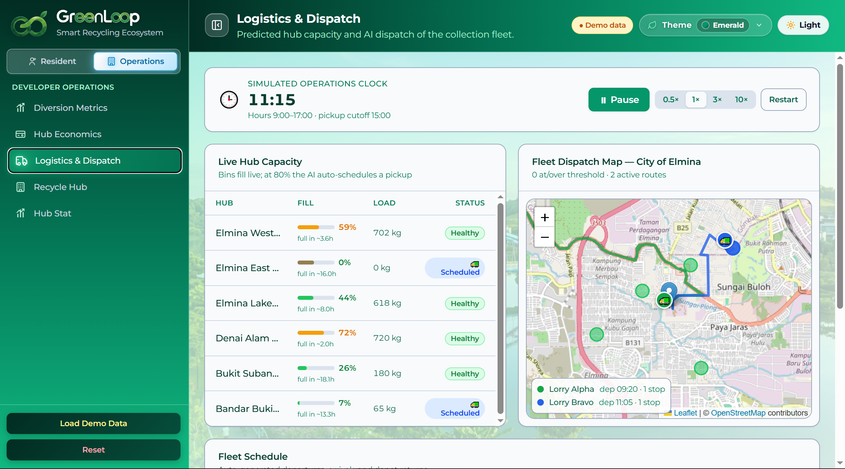
D
Logistics & Dispatch
Tech stack: React + Vite · Tailwind · TensorFlow.js COCO-SSD · OSRM road routing · Leaflet maps · Recharts. All client-side; no backend.
GreenLoop · Team Synkosys · Sime Darby Property University Hackathon 2026
Appendix C

Slide 6
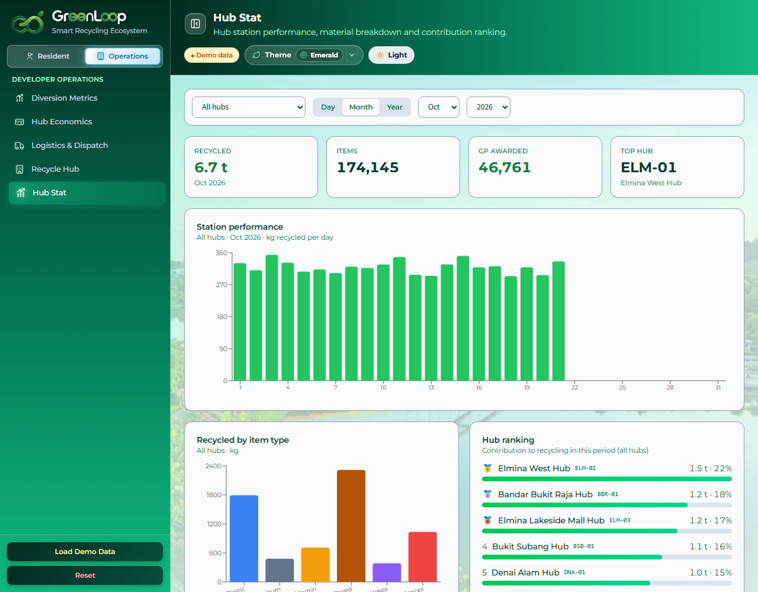
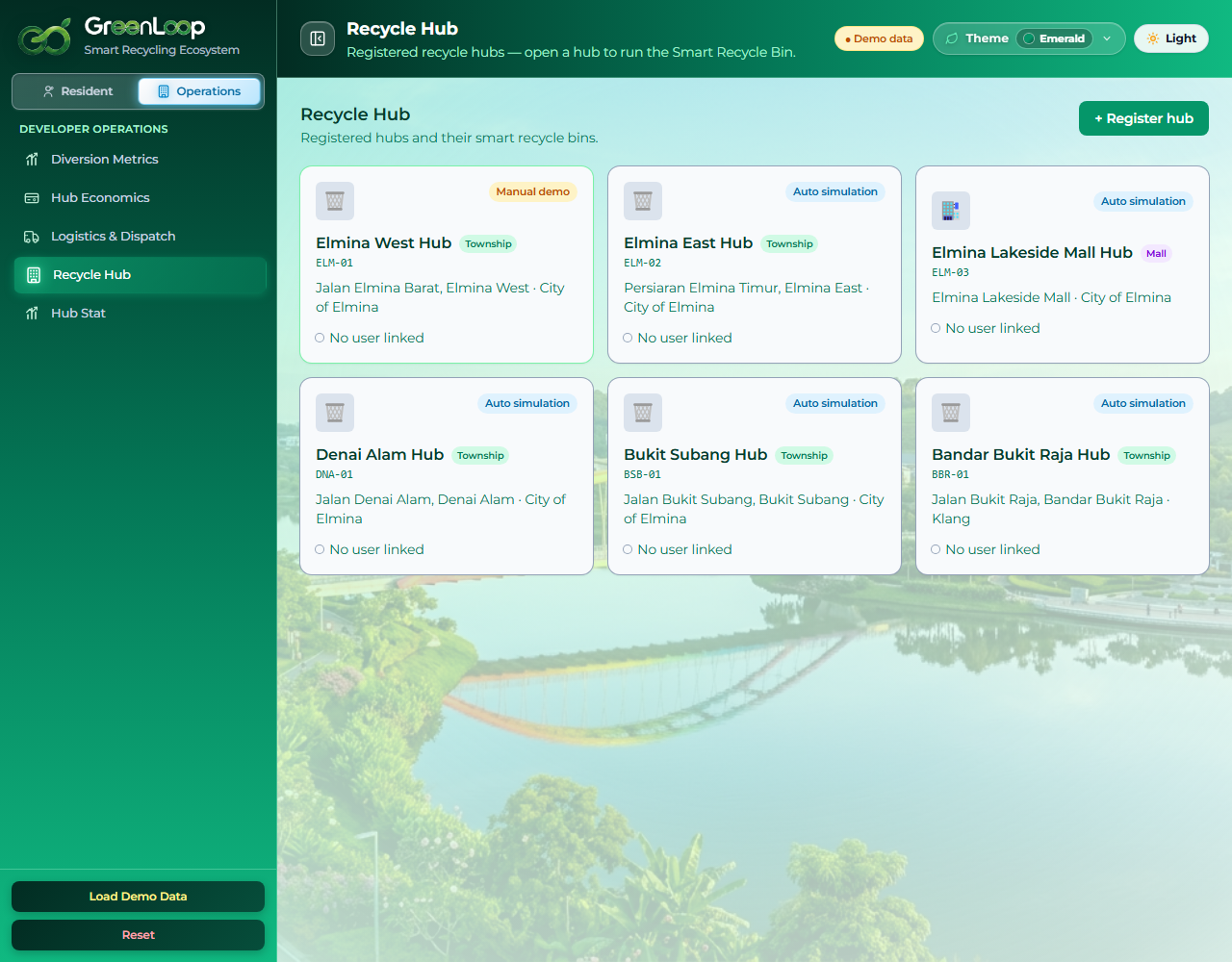
E
Operator analytics & network
Hub Stat · day / month / year, respects 09:00 to 17:00 hours
Recycle Hub network (6 hubs, City of Elmina + Bandar Bukit Raja)
Tech stack: React + Vite · Tailwind · TensorFlow.js COCO-SSD · OSRM road routing · Leaflet maps · Recharts. All client-side; no backend.
GreenLoop · Team Synkosys · Sime Darby Property University Hackathon 2026
Appendix C

Slide 7
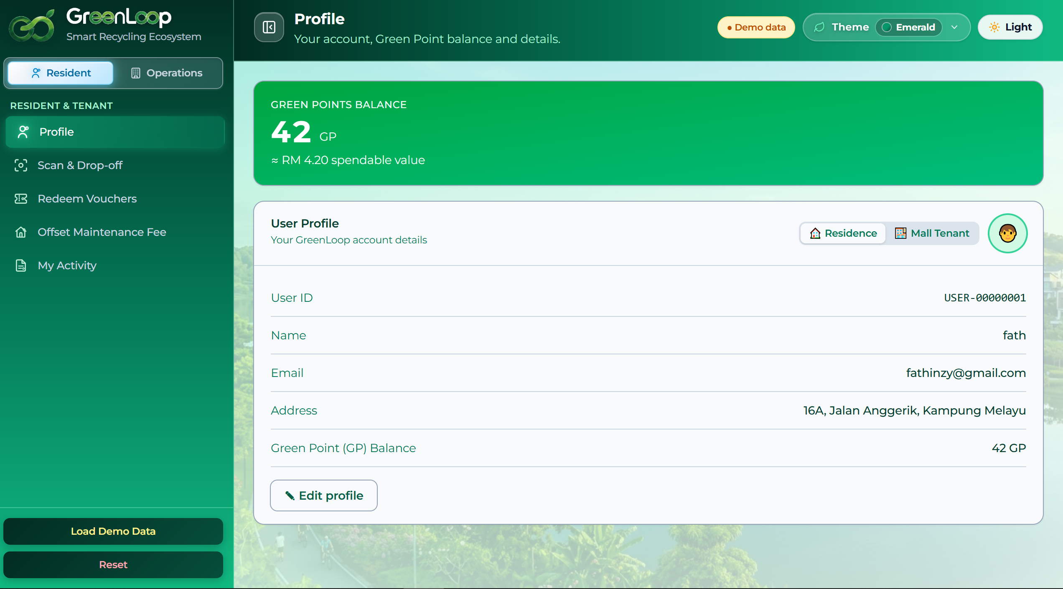
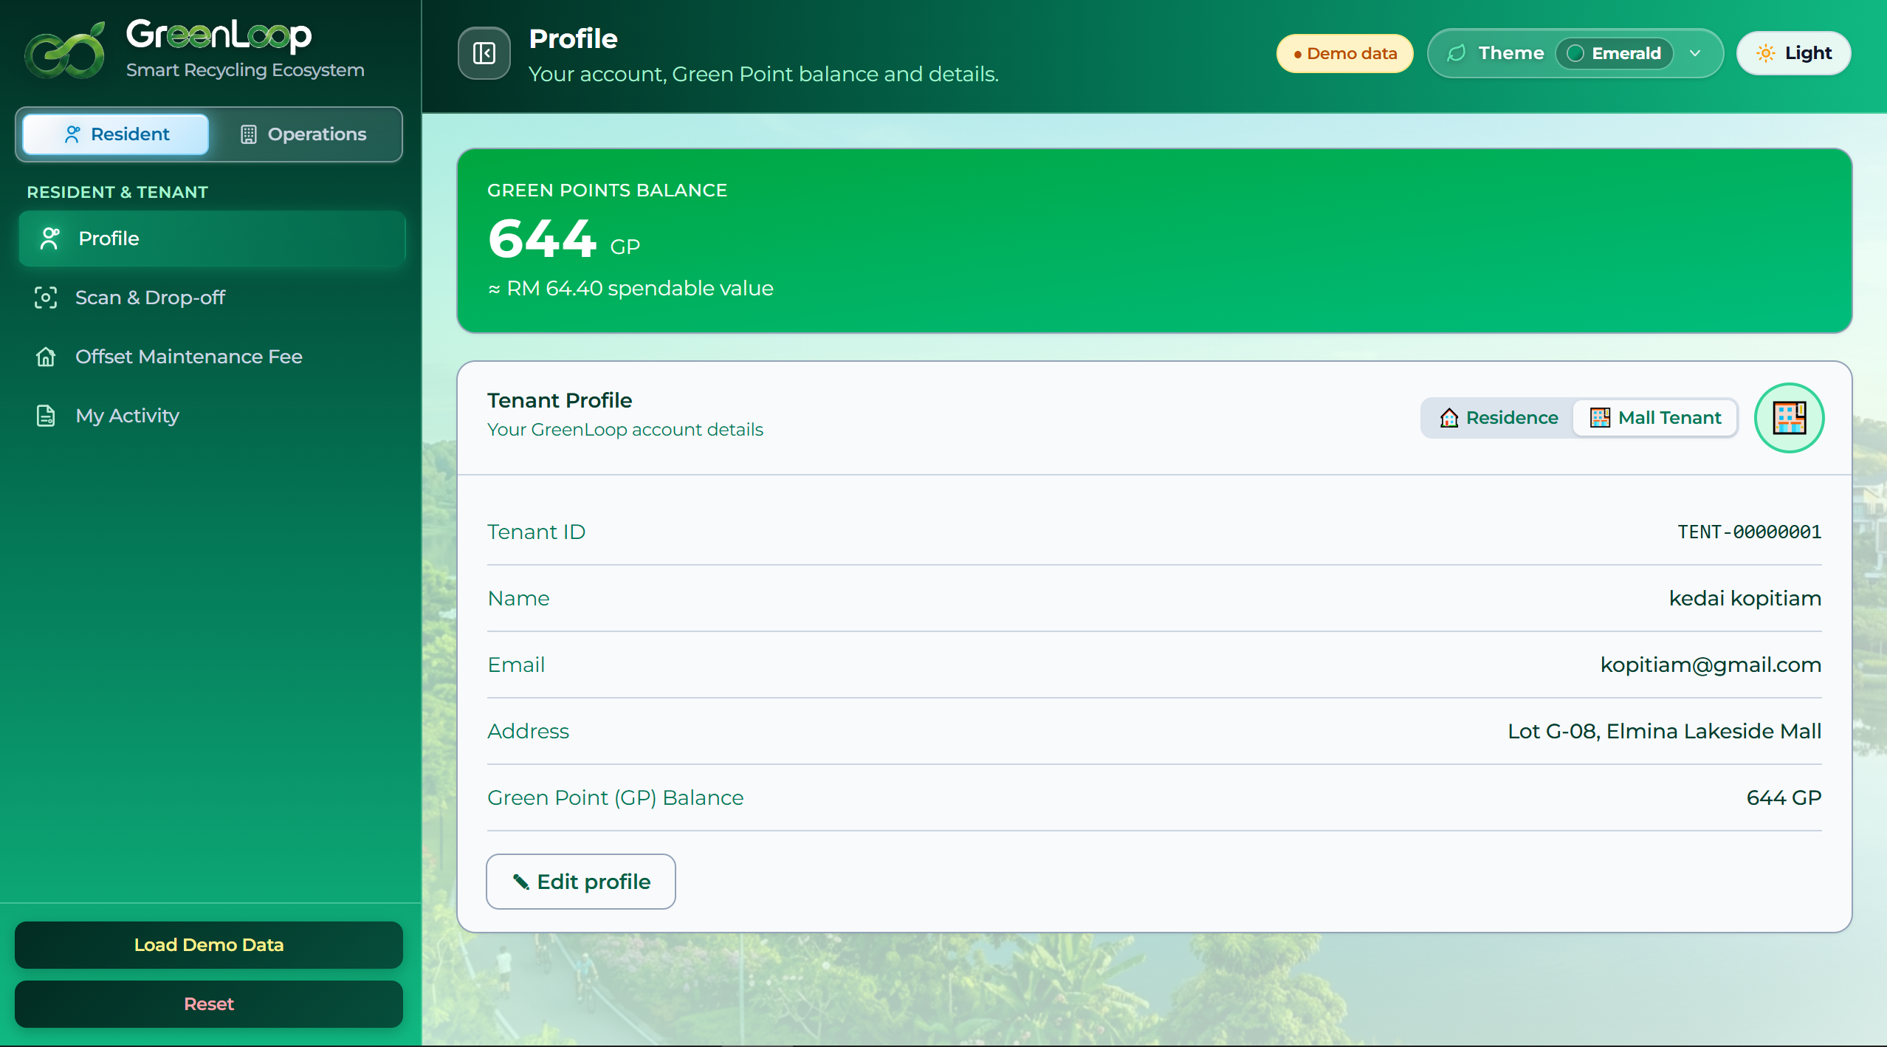
F
Profile (Resident & Tenant) View
Tech stack: React + Vite · Tailwind · TensorFlow.js COCO-SSD · OSRM road routing · Leaflet maps · Recharts. All client-side; no backend.
GreenLoop · Team Synkosys · Sime Darby Property University Hackathon 2026
Appendix C

Slide 8
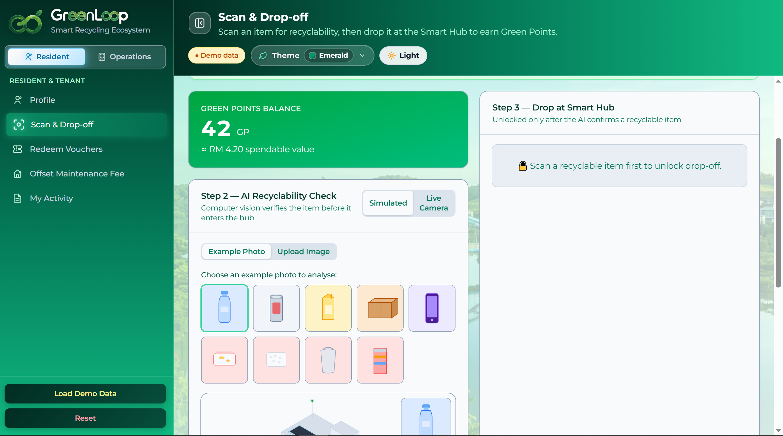
G
Recycle Item verification
Tech stack: React + Vite · Tailwind · TensorFlow.js COCO-SSD · OSRM road routing · Leaflet maps · Recharts. All client-side; no backend.
GreenLoop · Team Synkosys · Sime Darby Property University Hackathon 2026
Appendix C

Slide 9
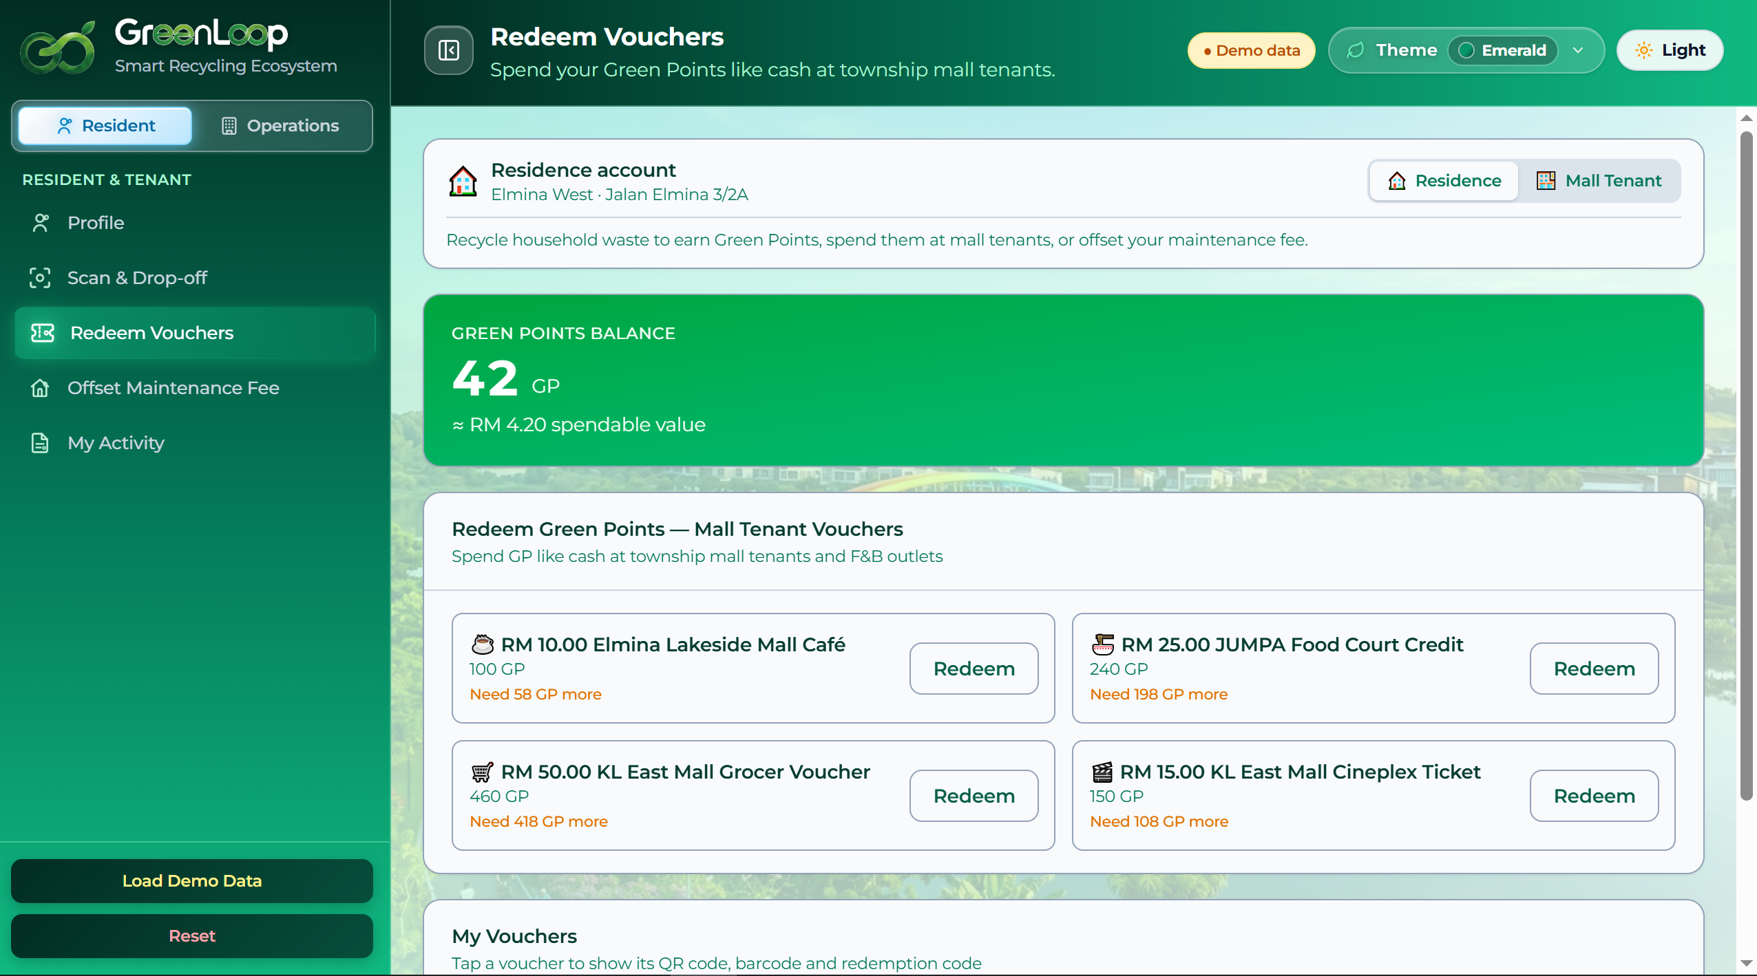
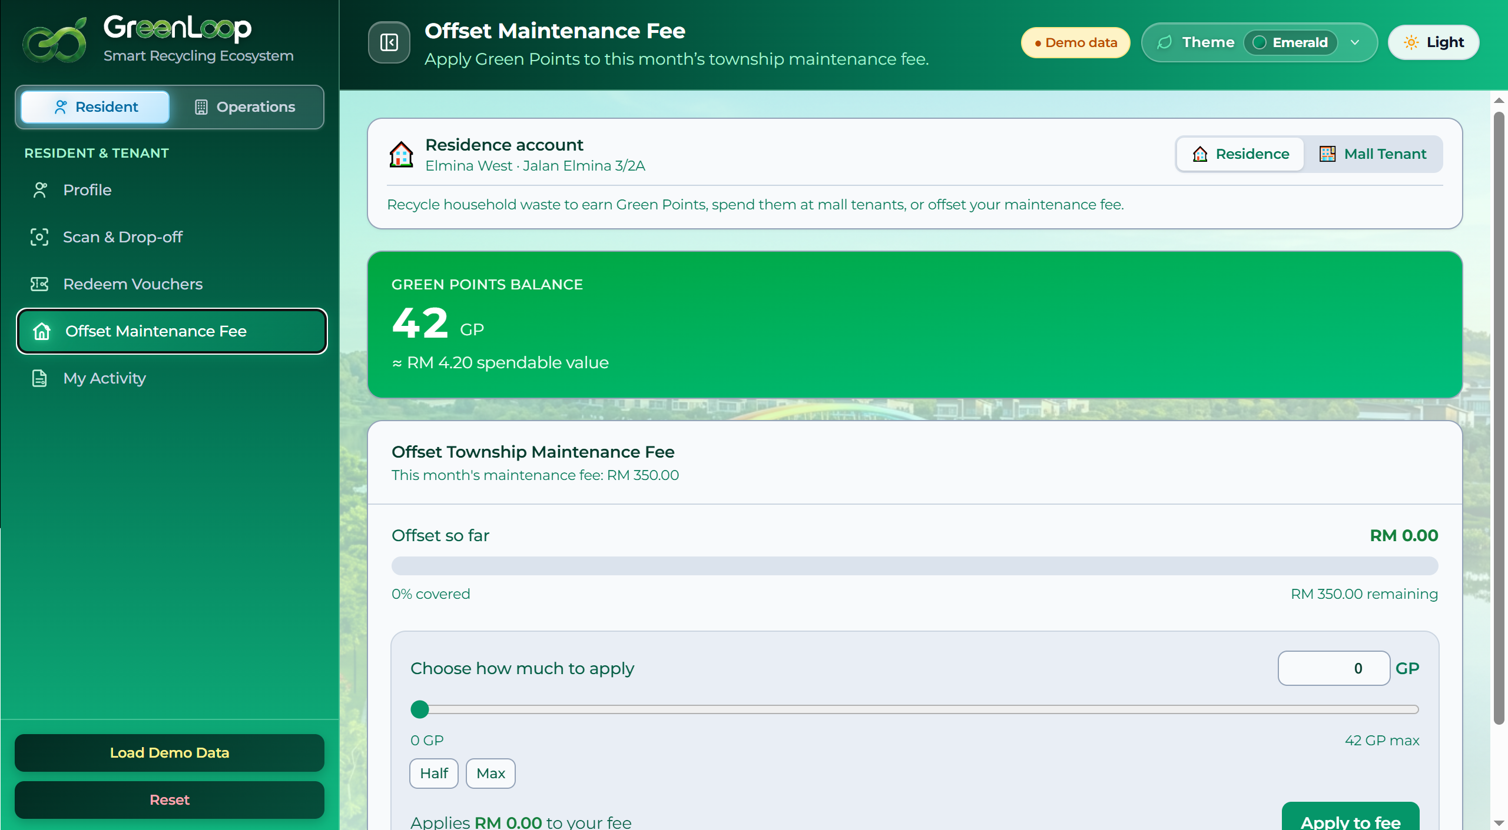
H
Voucher Redemption / Maintenance Fee offset
Tech stack: React + Vite · Tailwind · TensorFlow.js COCO-SSD · OSRM road routing · Leaflet maps · Recharts. All client-side; no backend.
GreenLoop · Team Synkosys · Sime Darby Property University Hackathon 2026
Appendix C

Slide 10
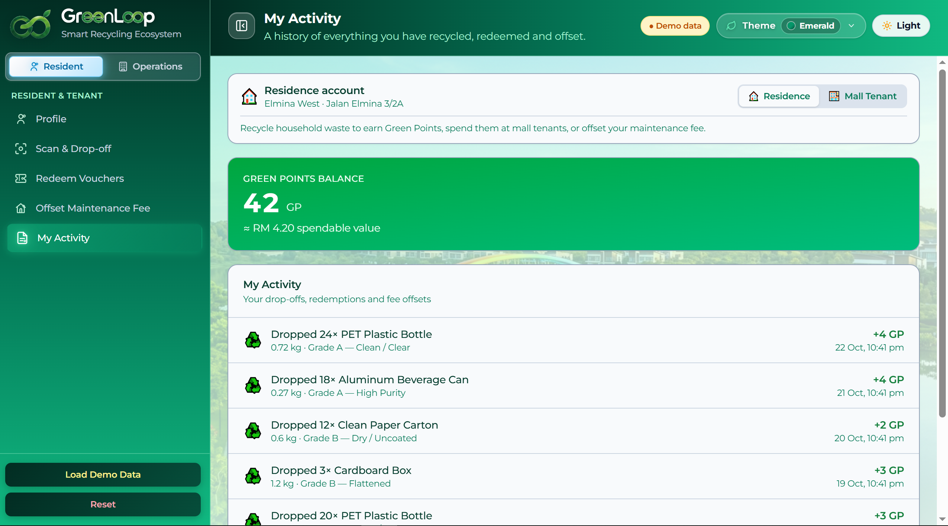
I
Activity Log
Tech stack: React + Vite · Tailwind · TensorFlow.js COCO-SSD · OSRM road routing · Leaflet maps · Recharts. All client-side; no backend.
GreenLoop · Team Synkosys · Sime Darby Property University Hackathon 2026
Appendix C

Slide 11

J
Hub Simulation (Prototype Simulator)
GreenLoop · Team Synkosys · Sime Darby Property University Hackathon 2026
Appendix C

Slide 12
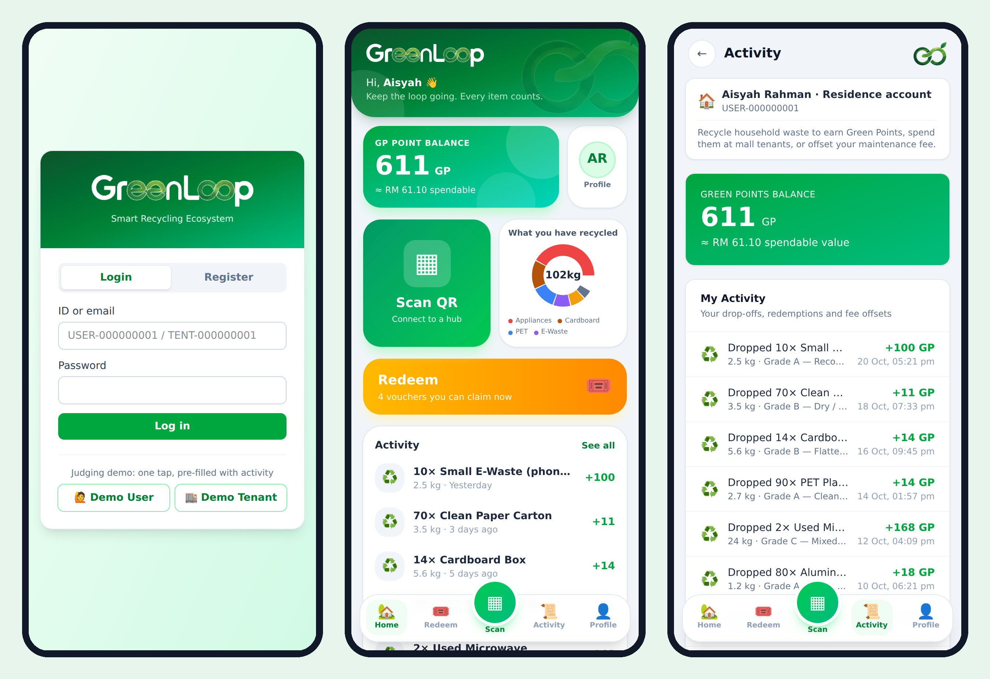
K
Mobile Apps (Proposal)
GreenLoop · Team Synkosys · Sime Darby Property University Hackathon 2026
Appendix C

Slide 13
L
How we meet the judging criteria
Impact
Environmental (diversion, CO₂), community (rewards) and operational (cost, visibility) outcomes.
Innovation
AI item verification + funded reward model + live AI dispatch in one loop.
Feasibility
Deployed working prototype; realistic one-hub pilot; clear validation checklist.
Strategic fit
Built on real Sime Darby Property townships; supports ESG and SHIFT25 goals.
Commercial value
Self-funding business case: operating surplus + CapEx payback, not a subsidy.
Team & pitch
A focused team shipping a real, honest, demoable product.
GreenLoop · Team Synkosys · Sime Darby Property University Hackathon 2026
Appendix D

