Slide 1
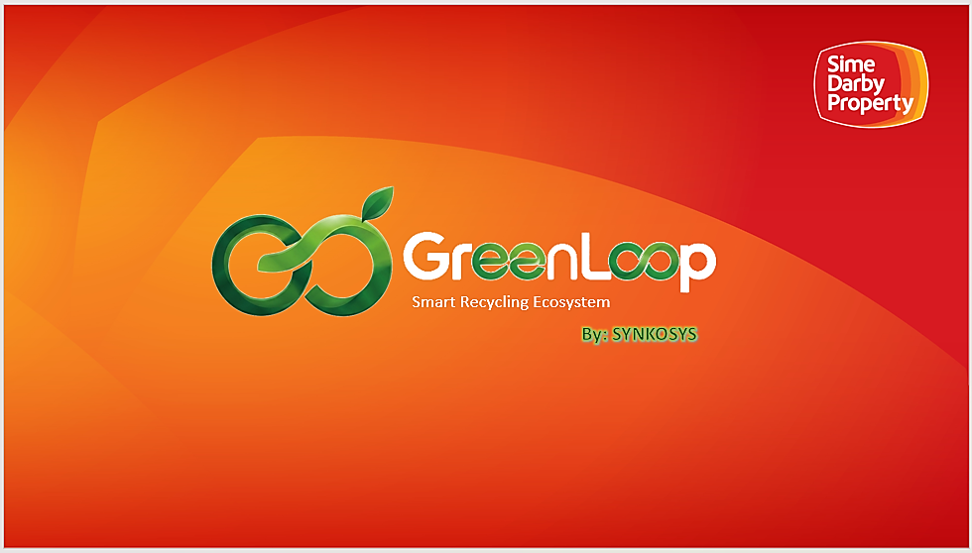


Slide 2
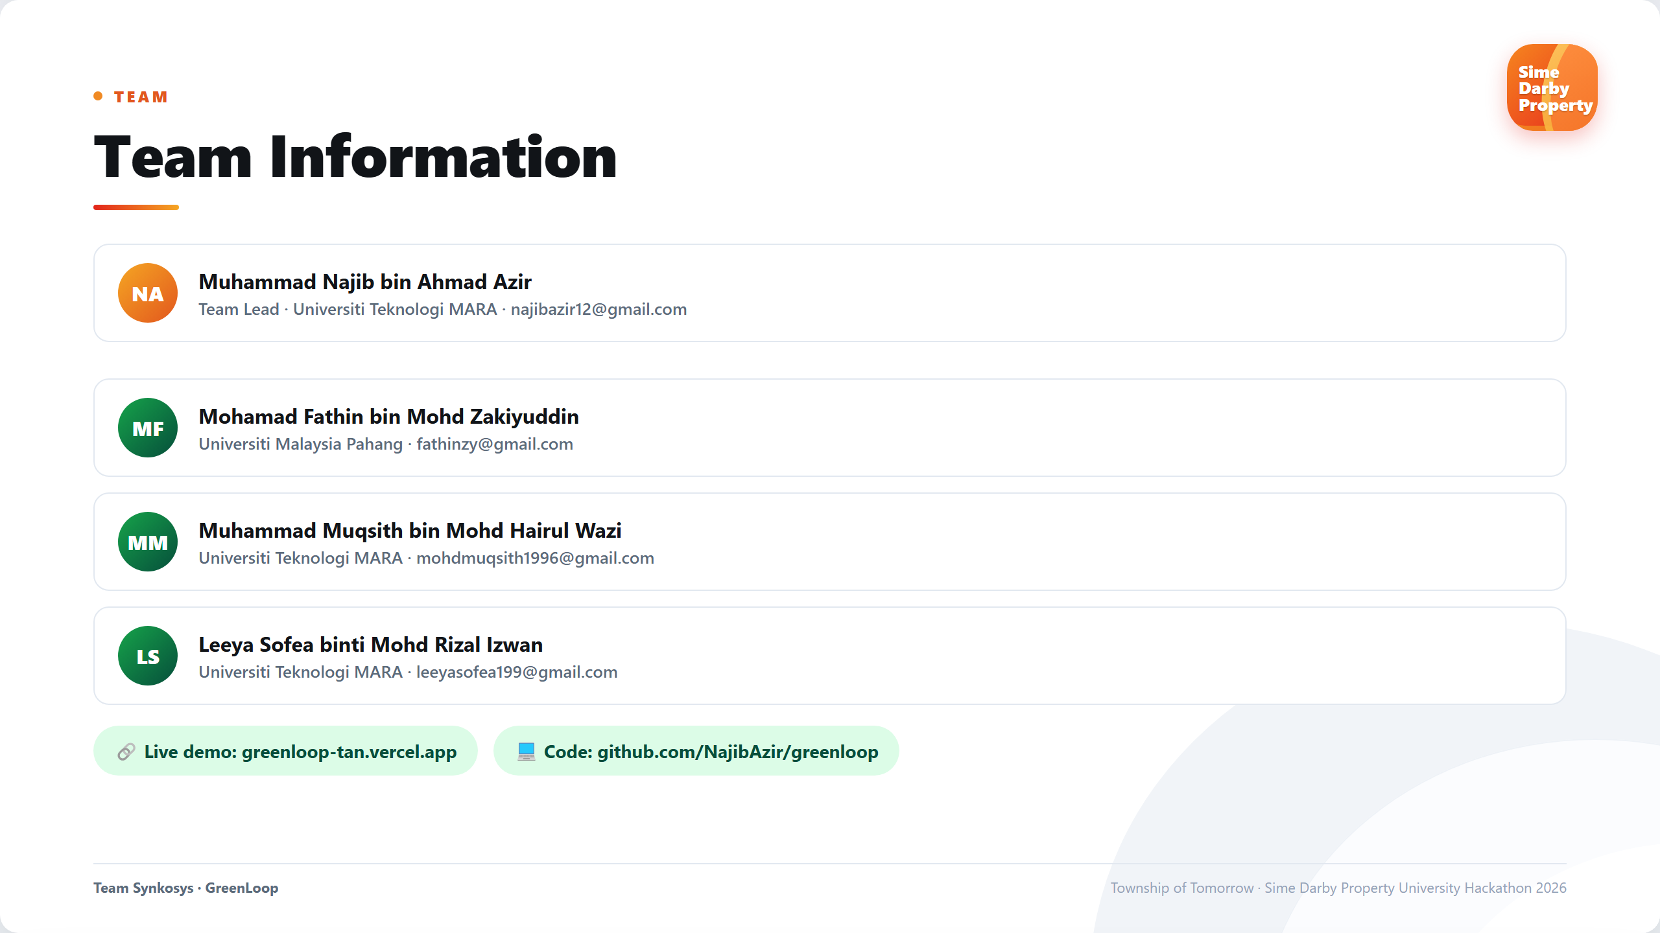

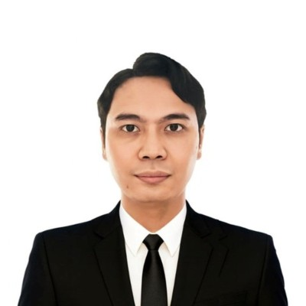
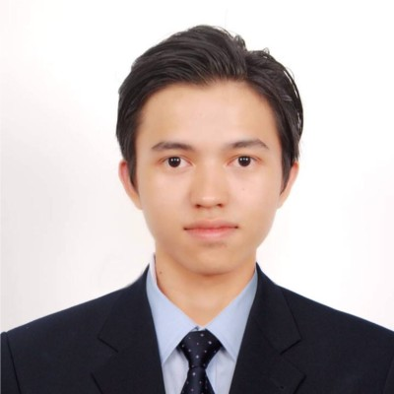
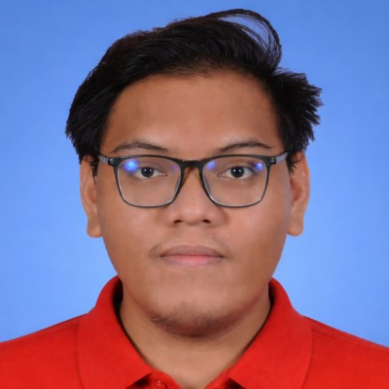
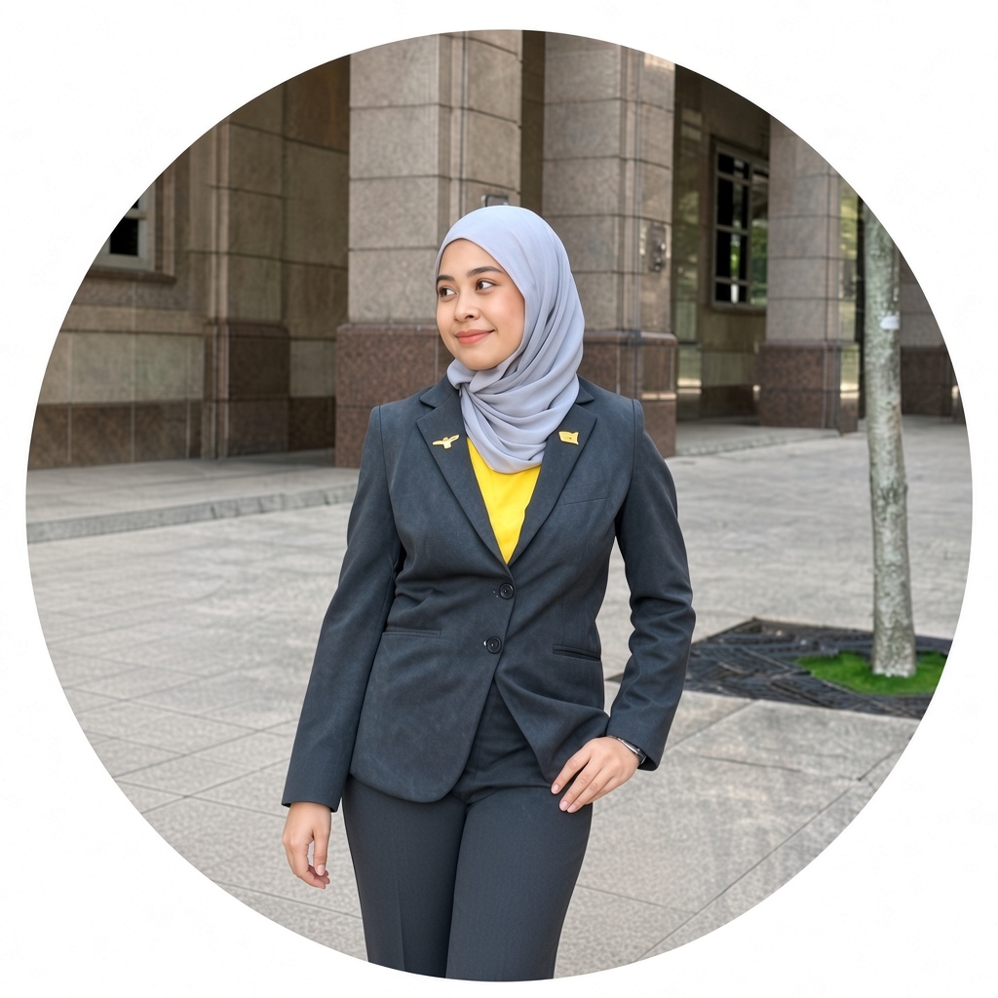
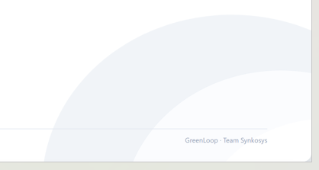
SYNKOSYS
Muhammad Najib bin Ahmad Azir
(TEAM LEADER)
Universiti Teknologi MARA
najibazir12@gmail.com
Mohamad Fathin bin Mohd Zakiyuddin
Universiti Malaysia Pahang fathinzy@gmail.com
Muhammad Muqsith bin Mohd Hairul Wazi
Universiti Teknologi MARA mohdmuqsith1996@gmail.com
Leeya Sofea binti Mohd Rizal Izwan
Universiti Teknologi MARA leeyasofea199@gmail.com

Slide 3
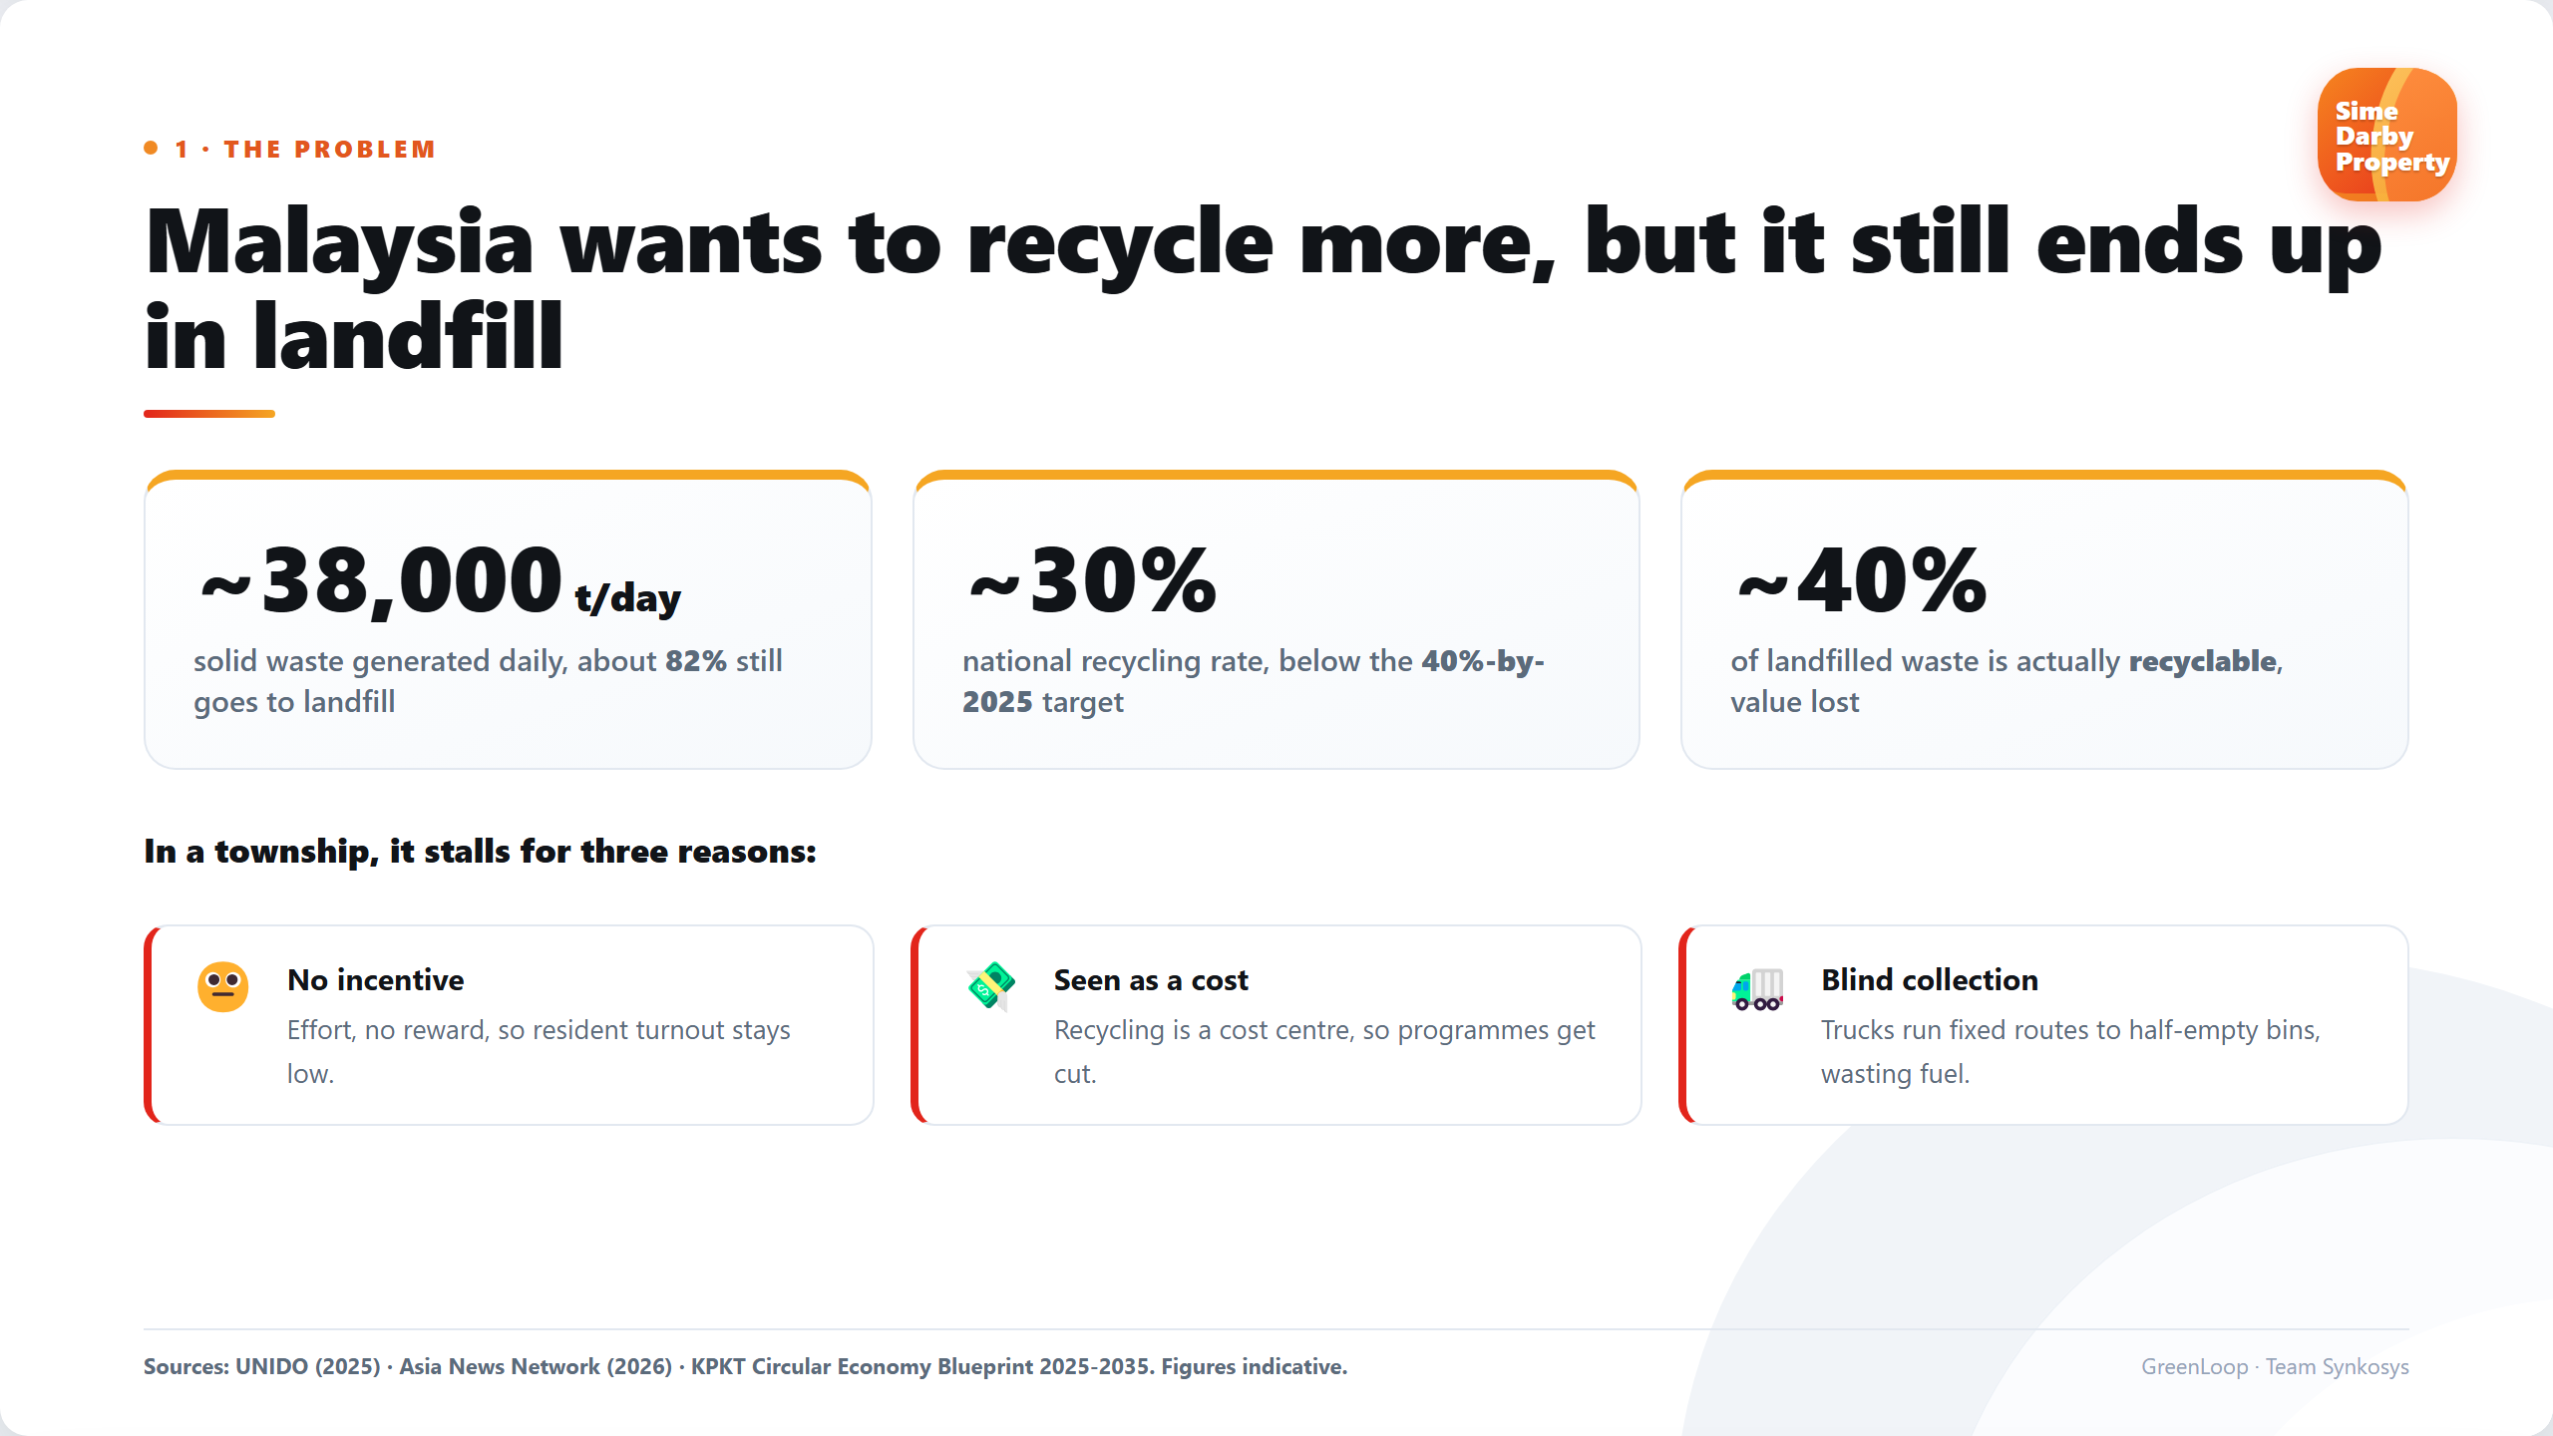

Slide 4
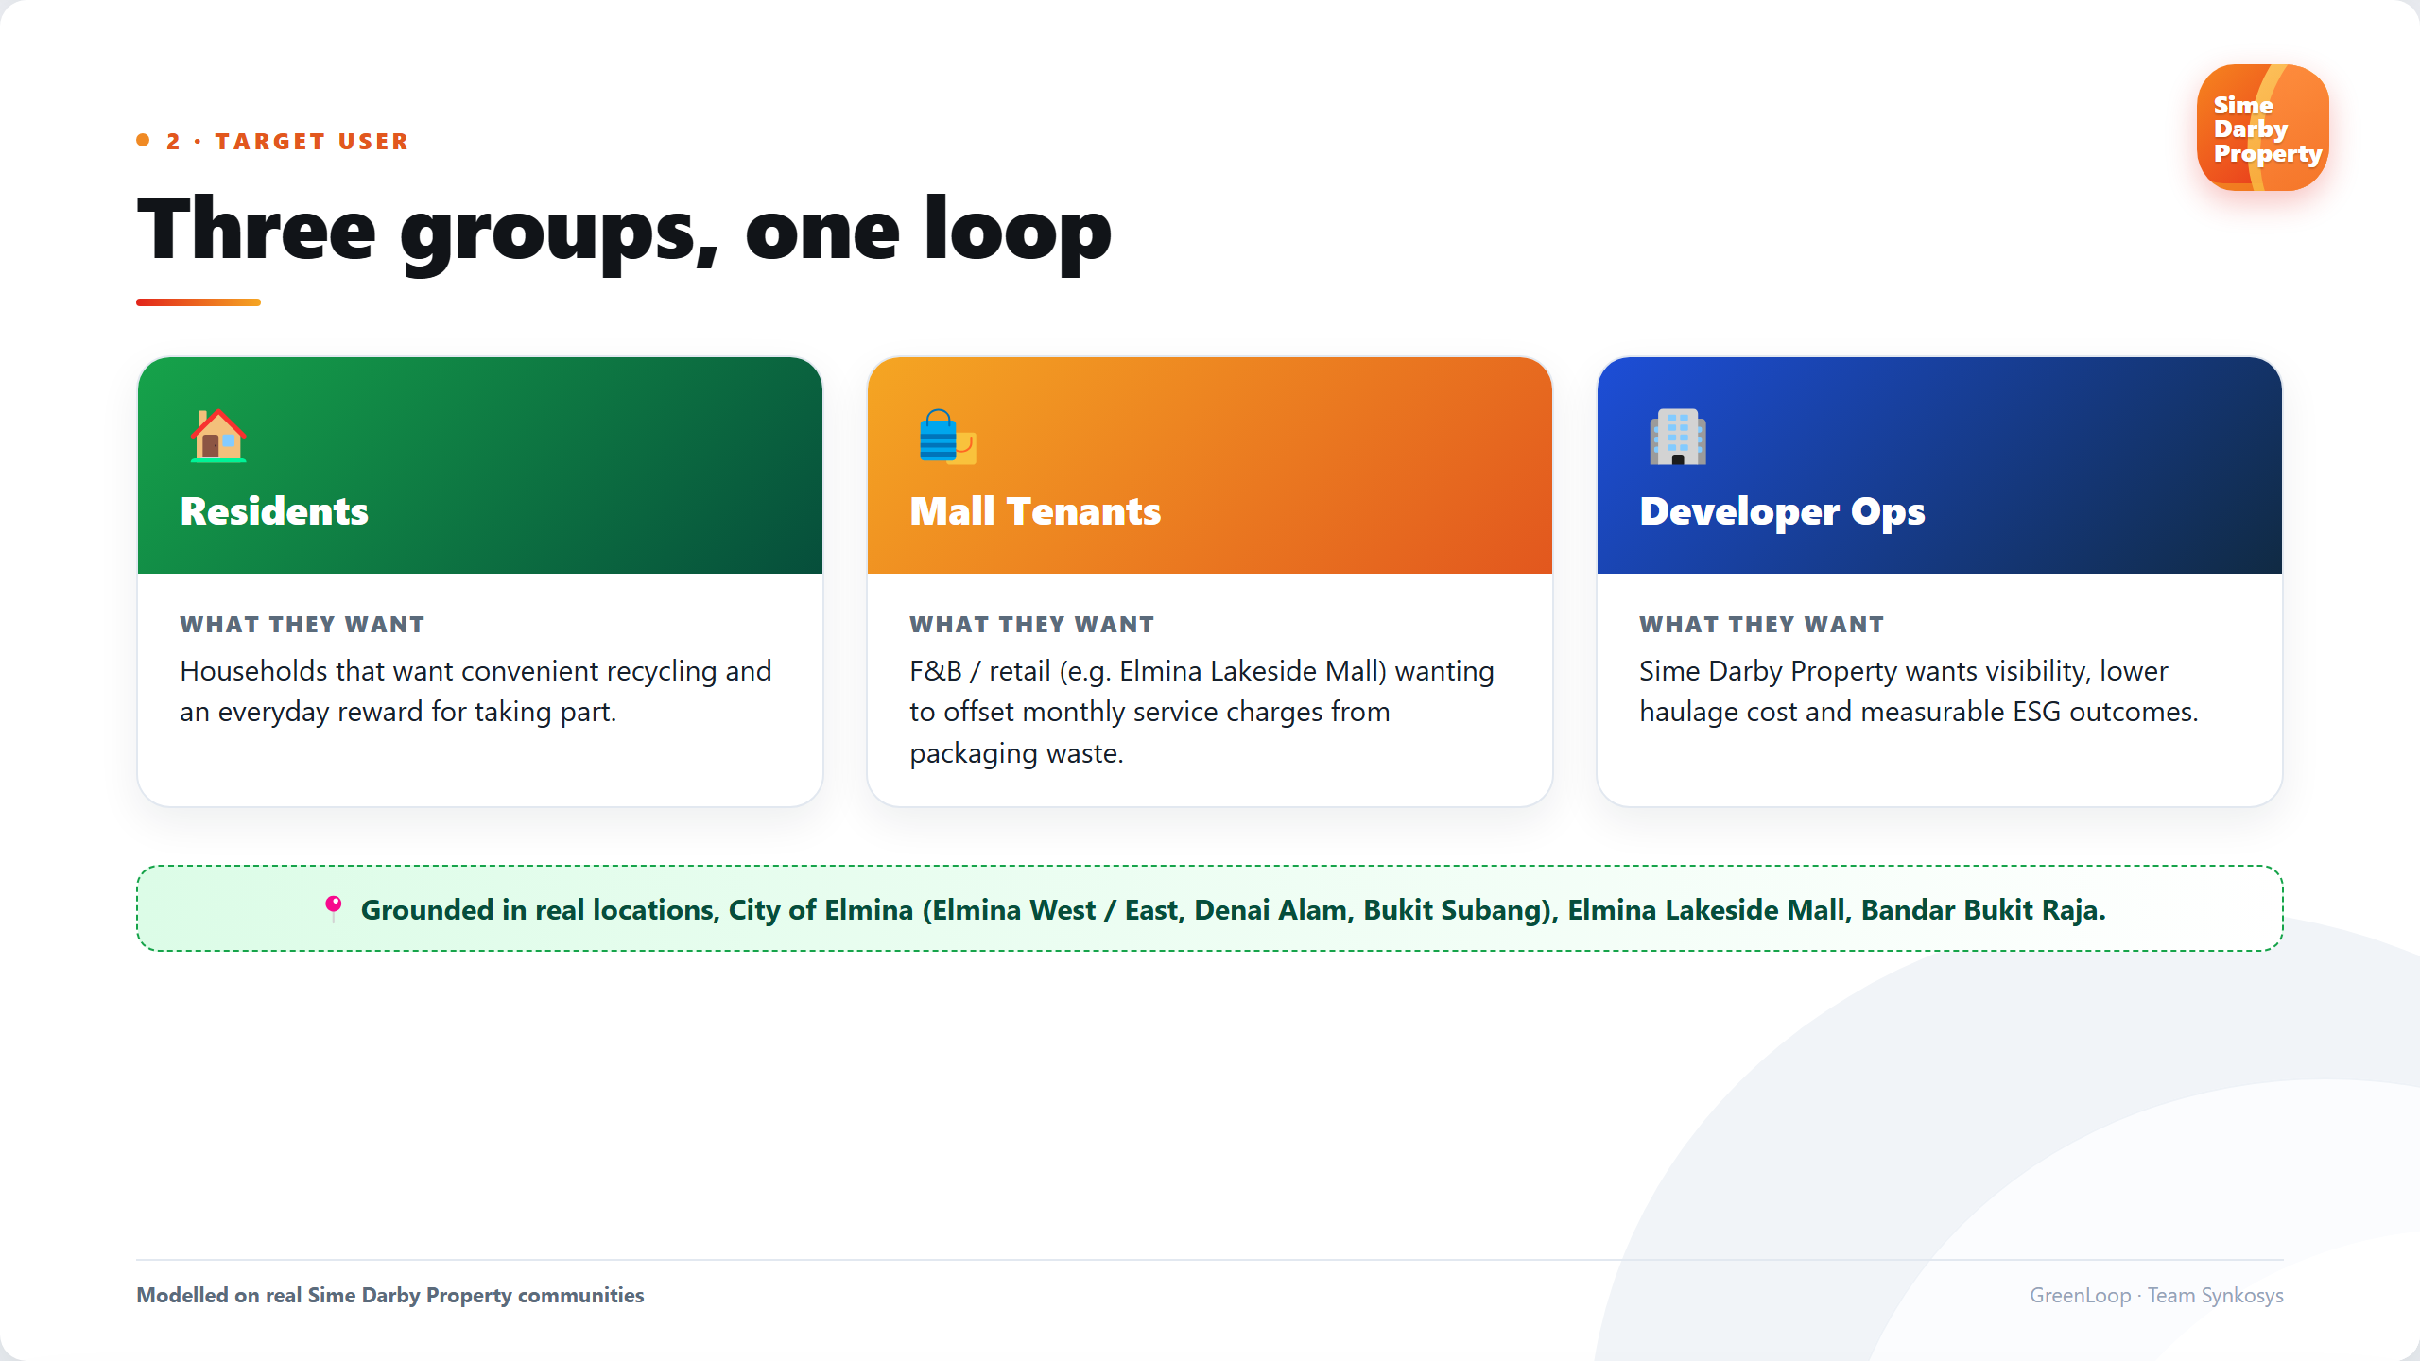

Slide 5
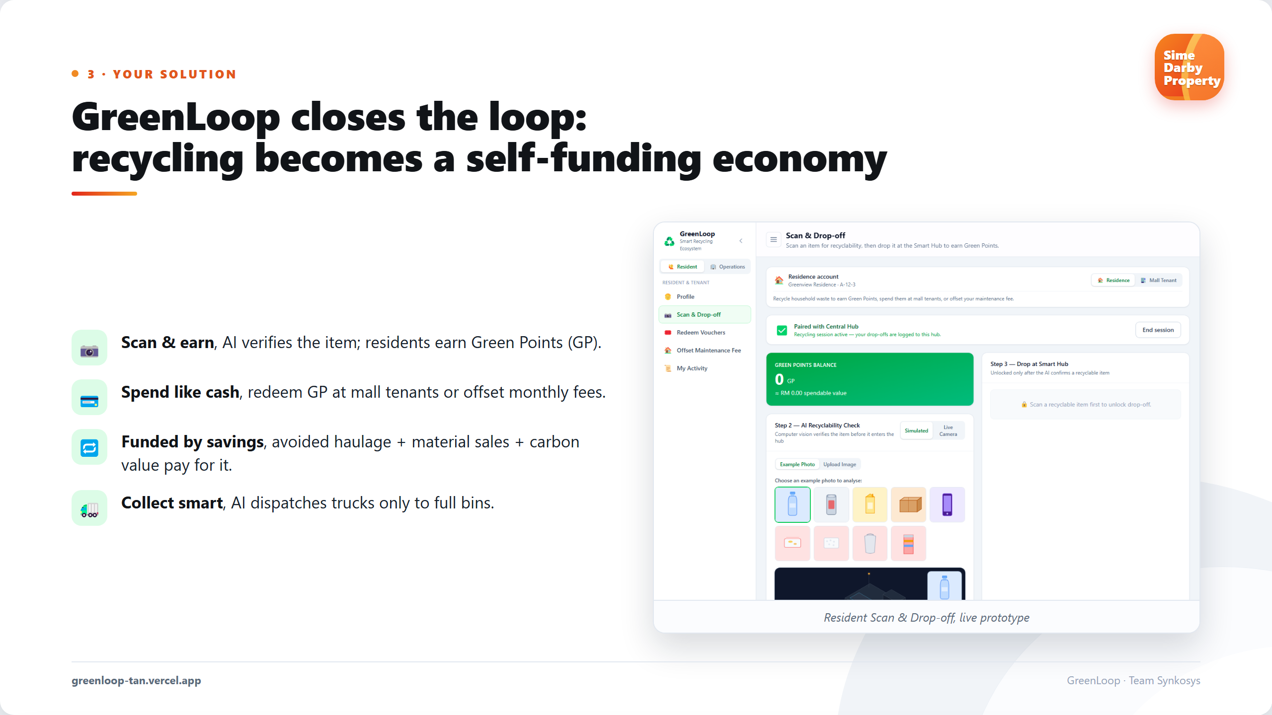

Slide 6
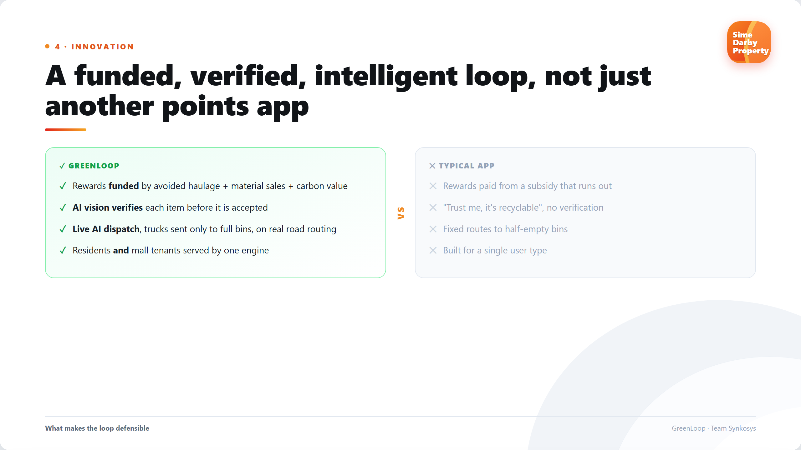

Slide 7
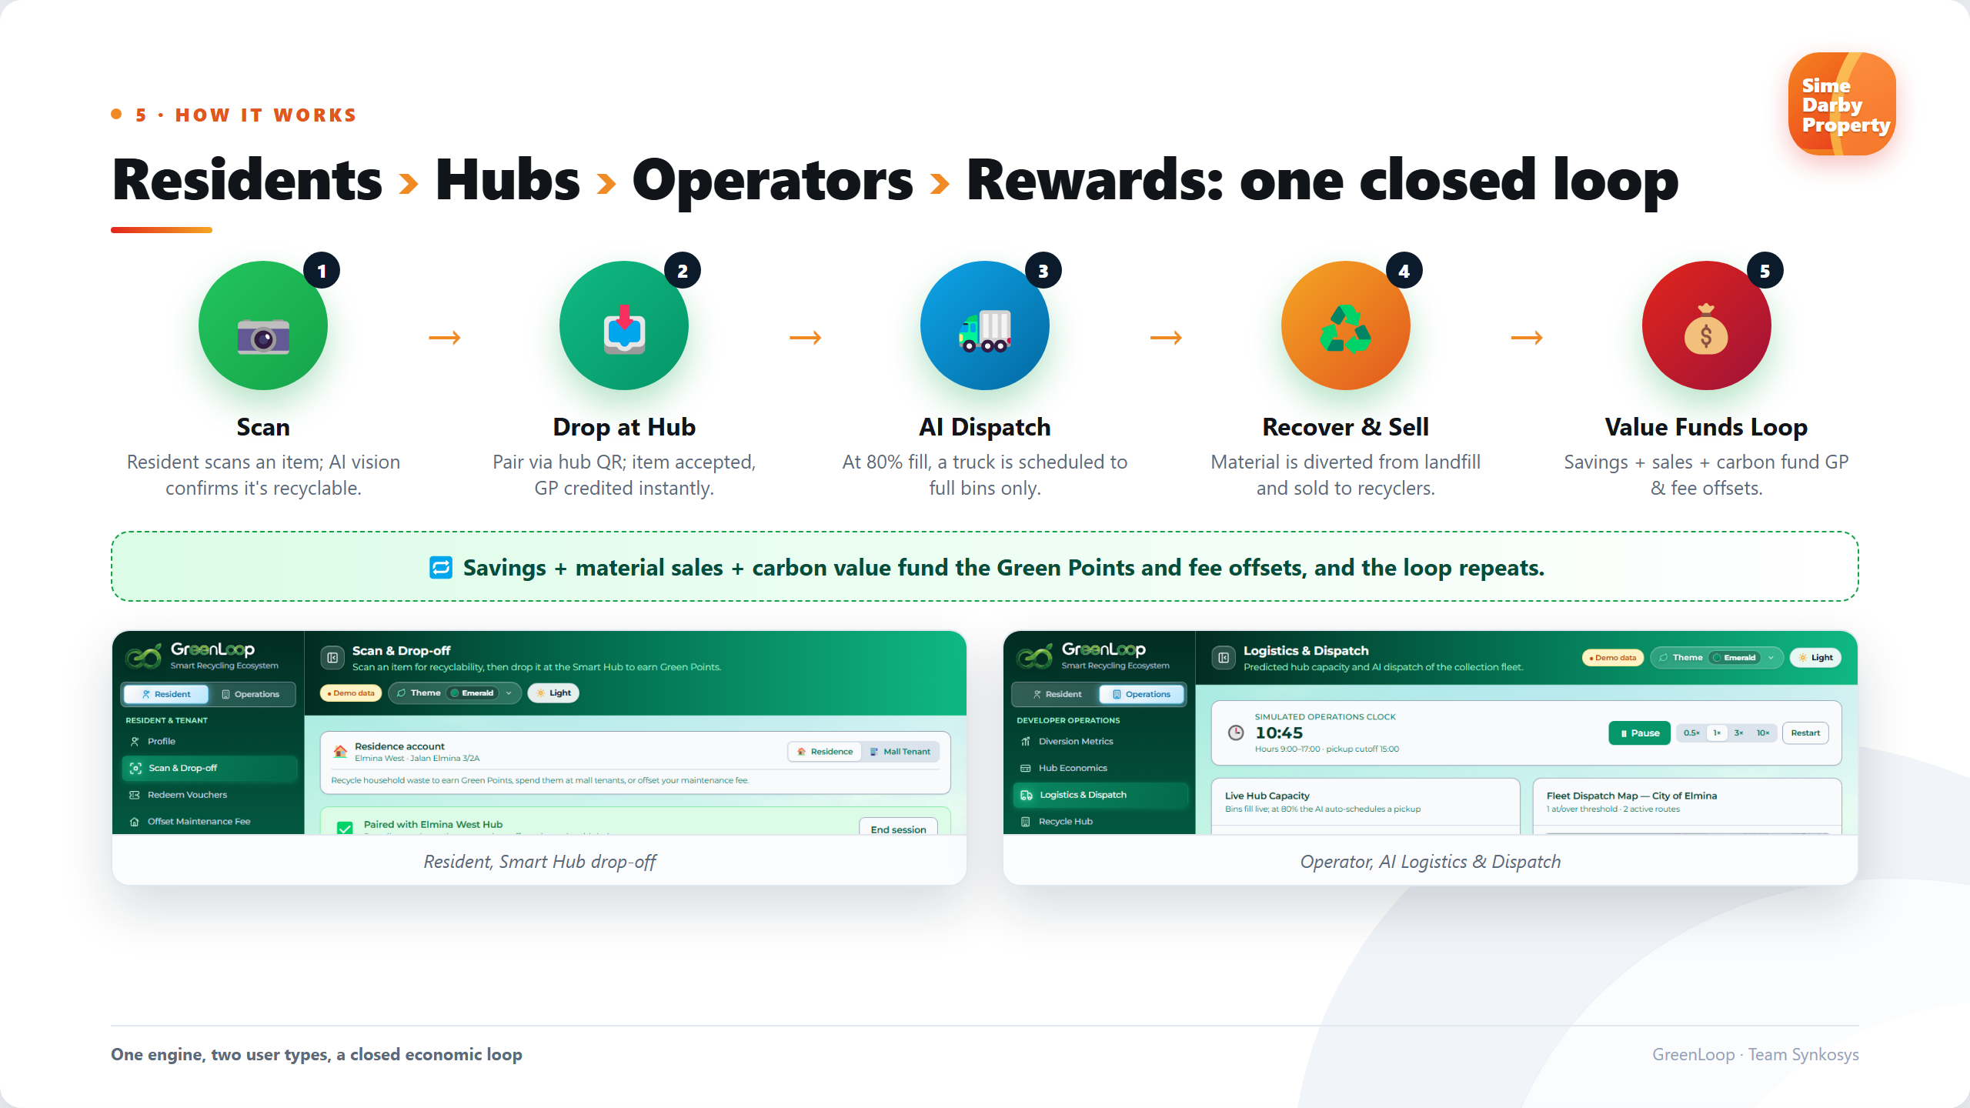
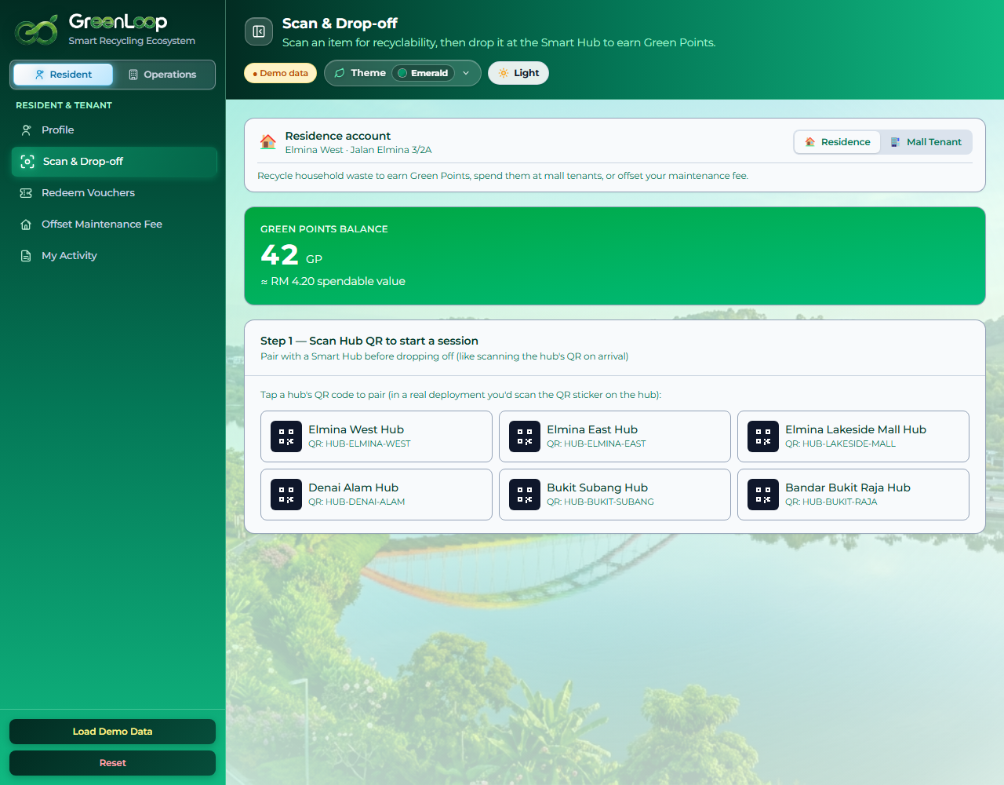
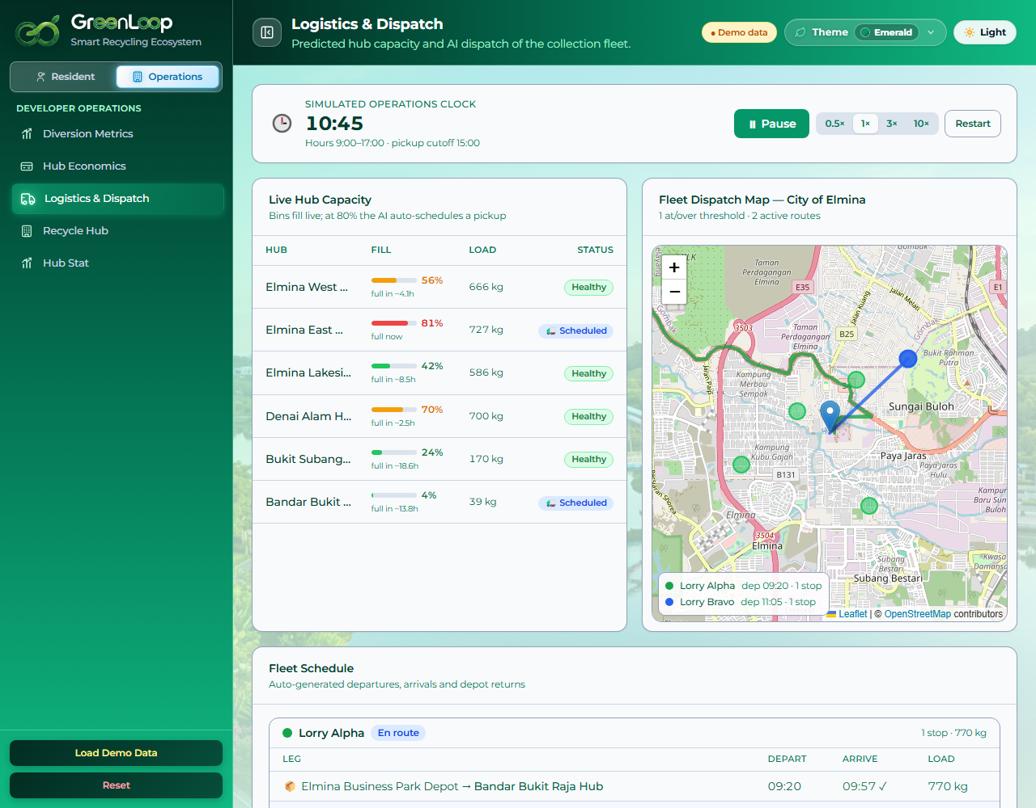
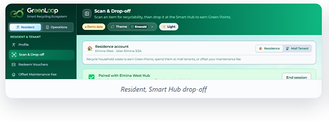
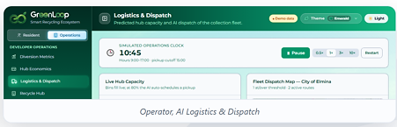

Slide 8
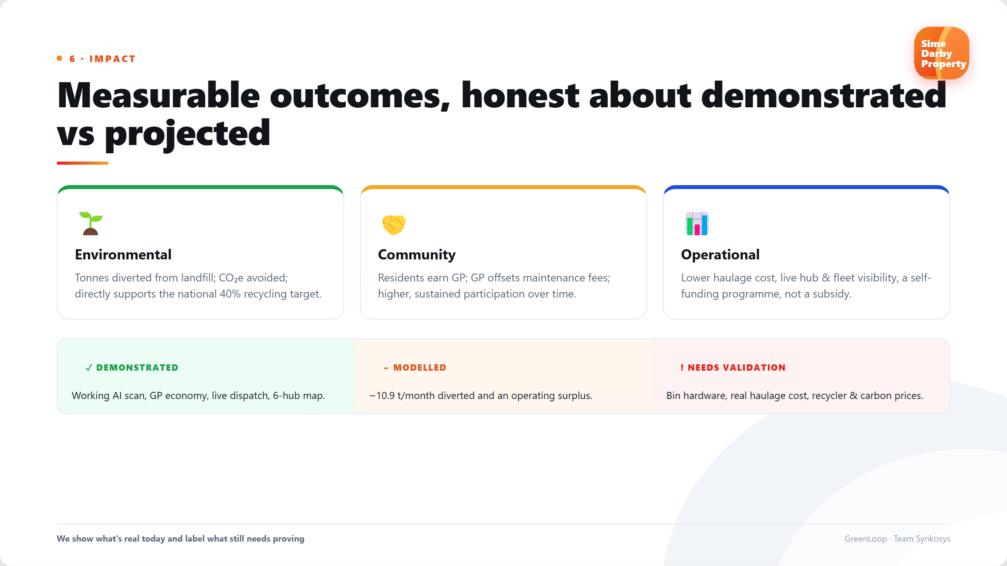

Slide 9
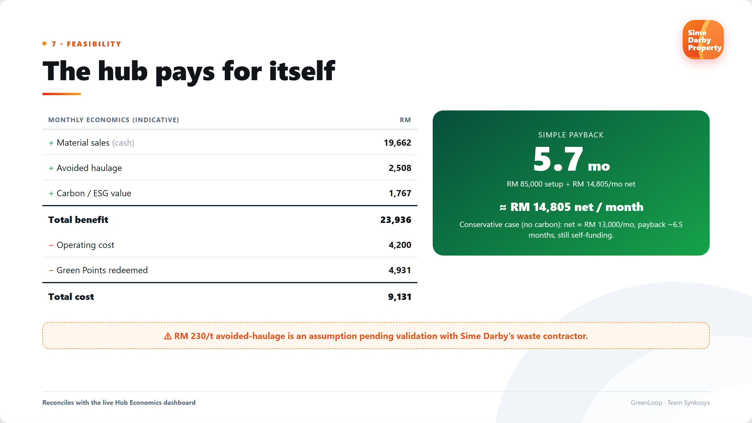

Slide 10
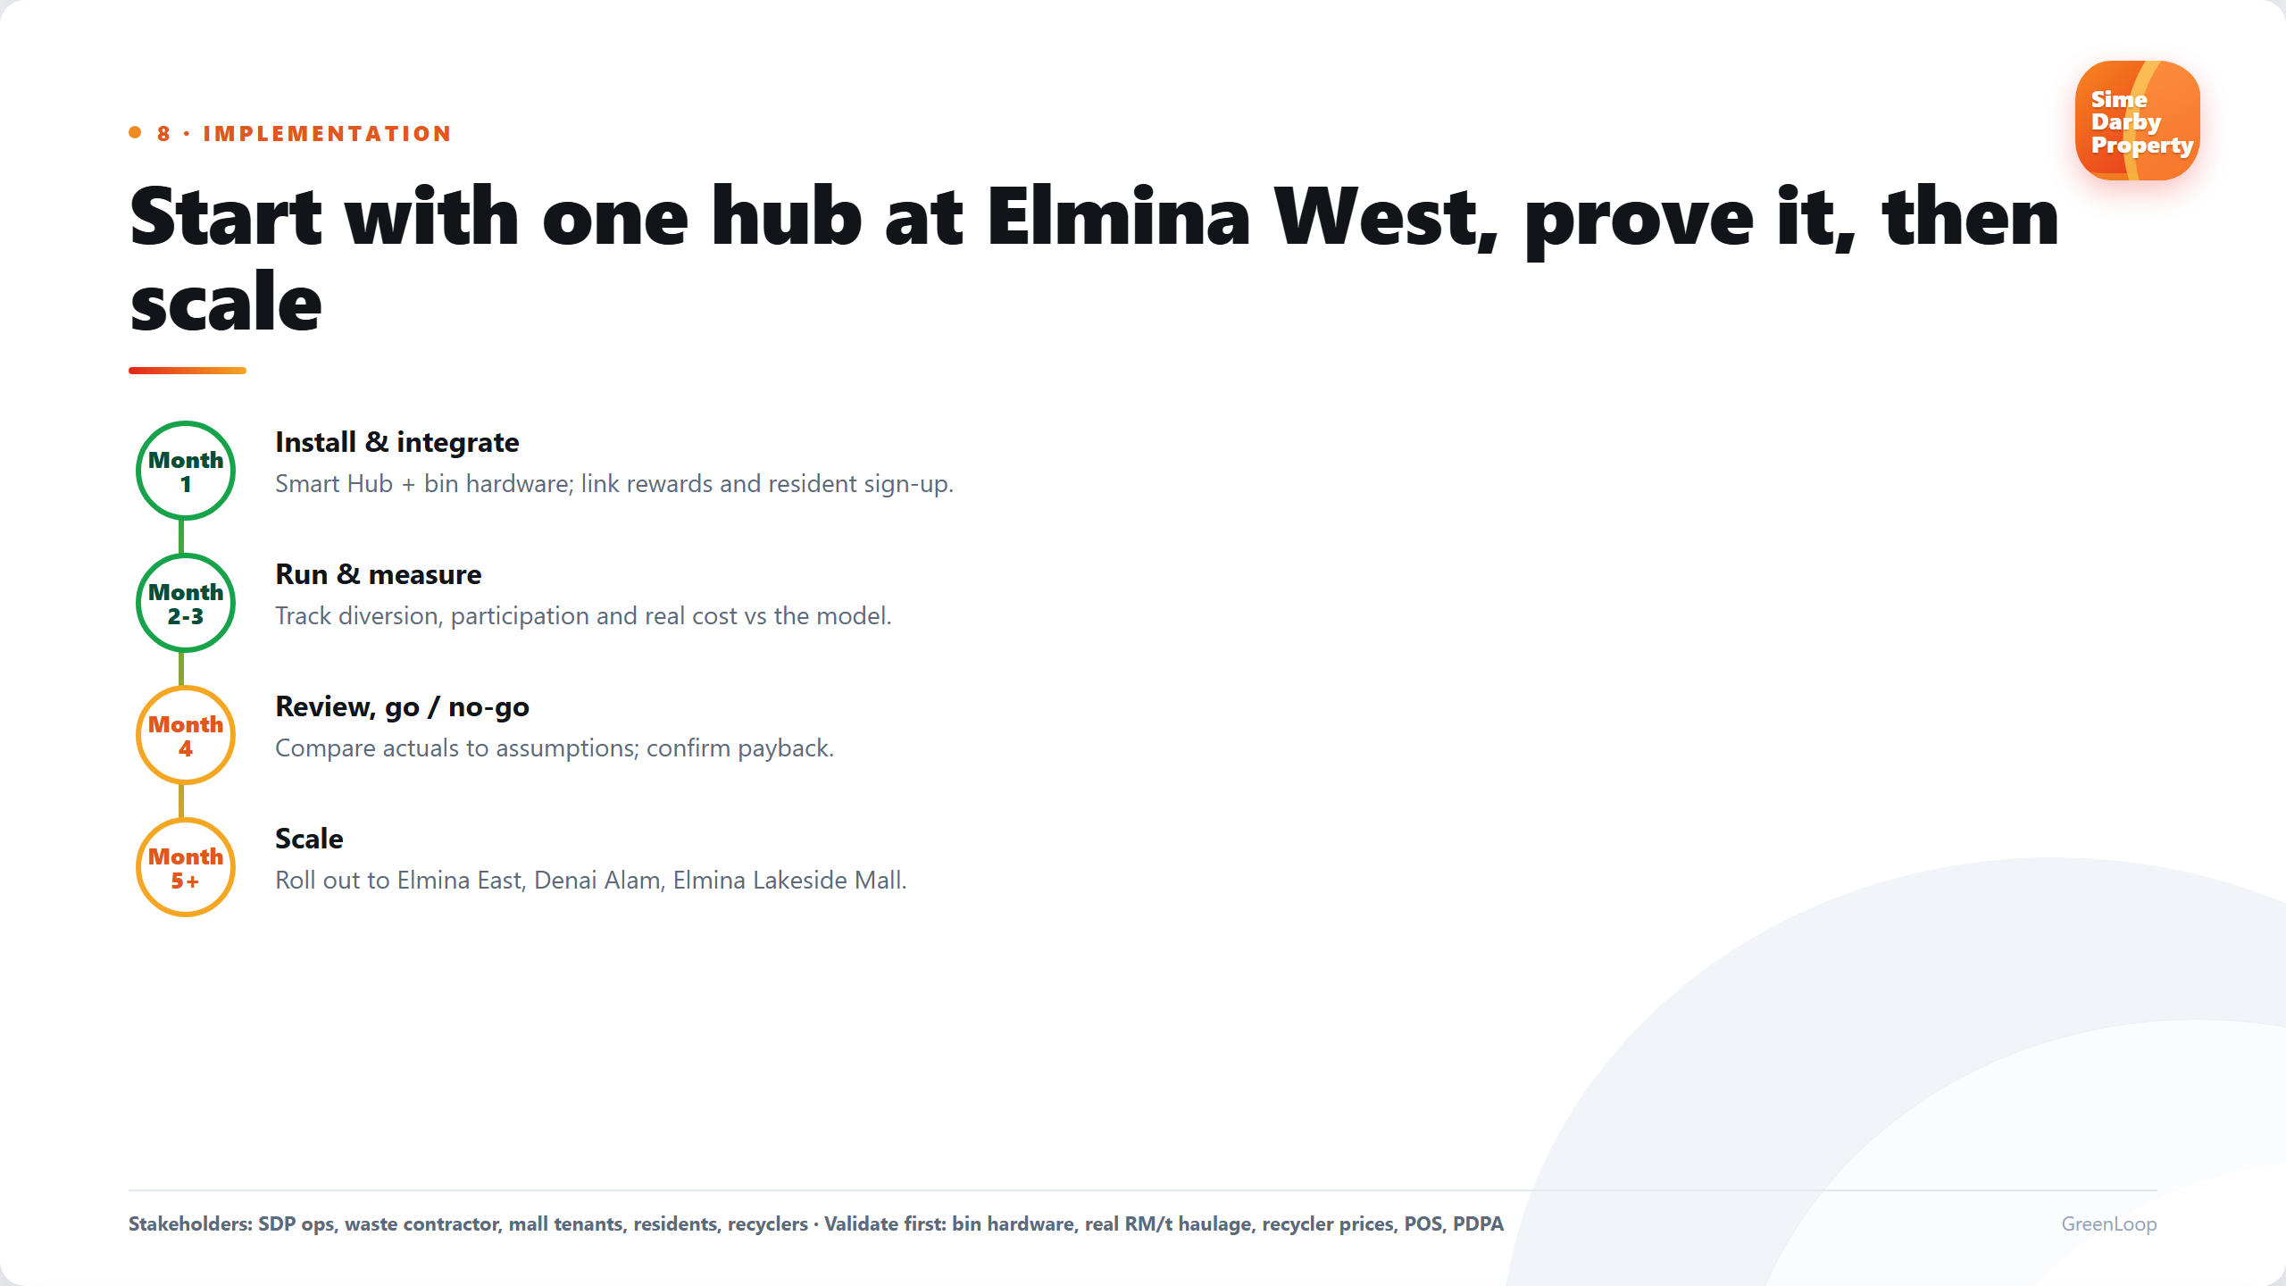
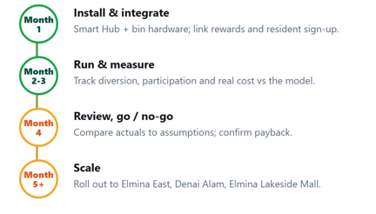

Slide 11
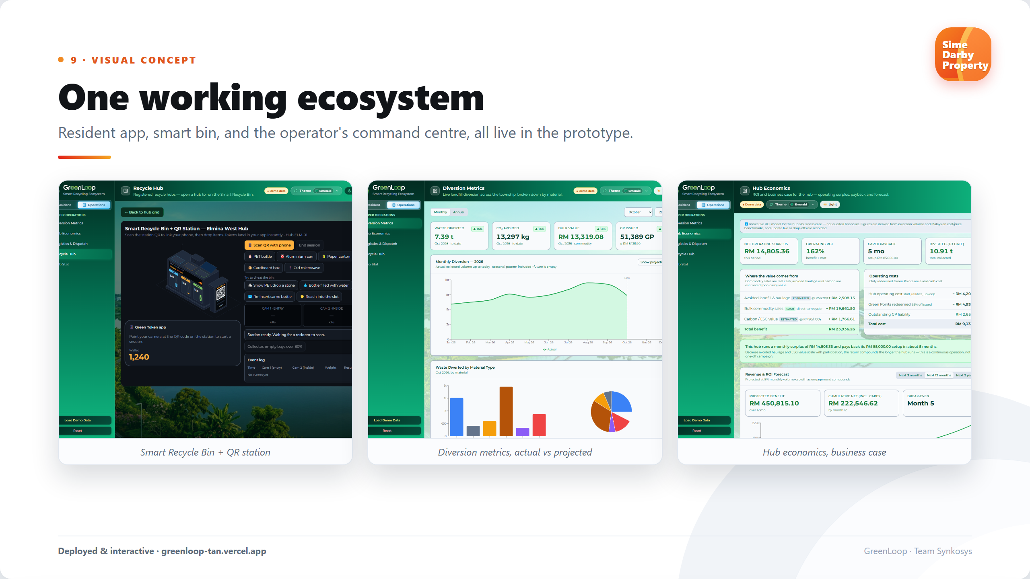
Try the live prototype 👉🏼 https://greenloop-tan.vercel.app/ 👈🏼

Slide 12
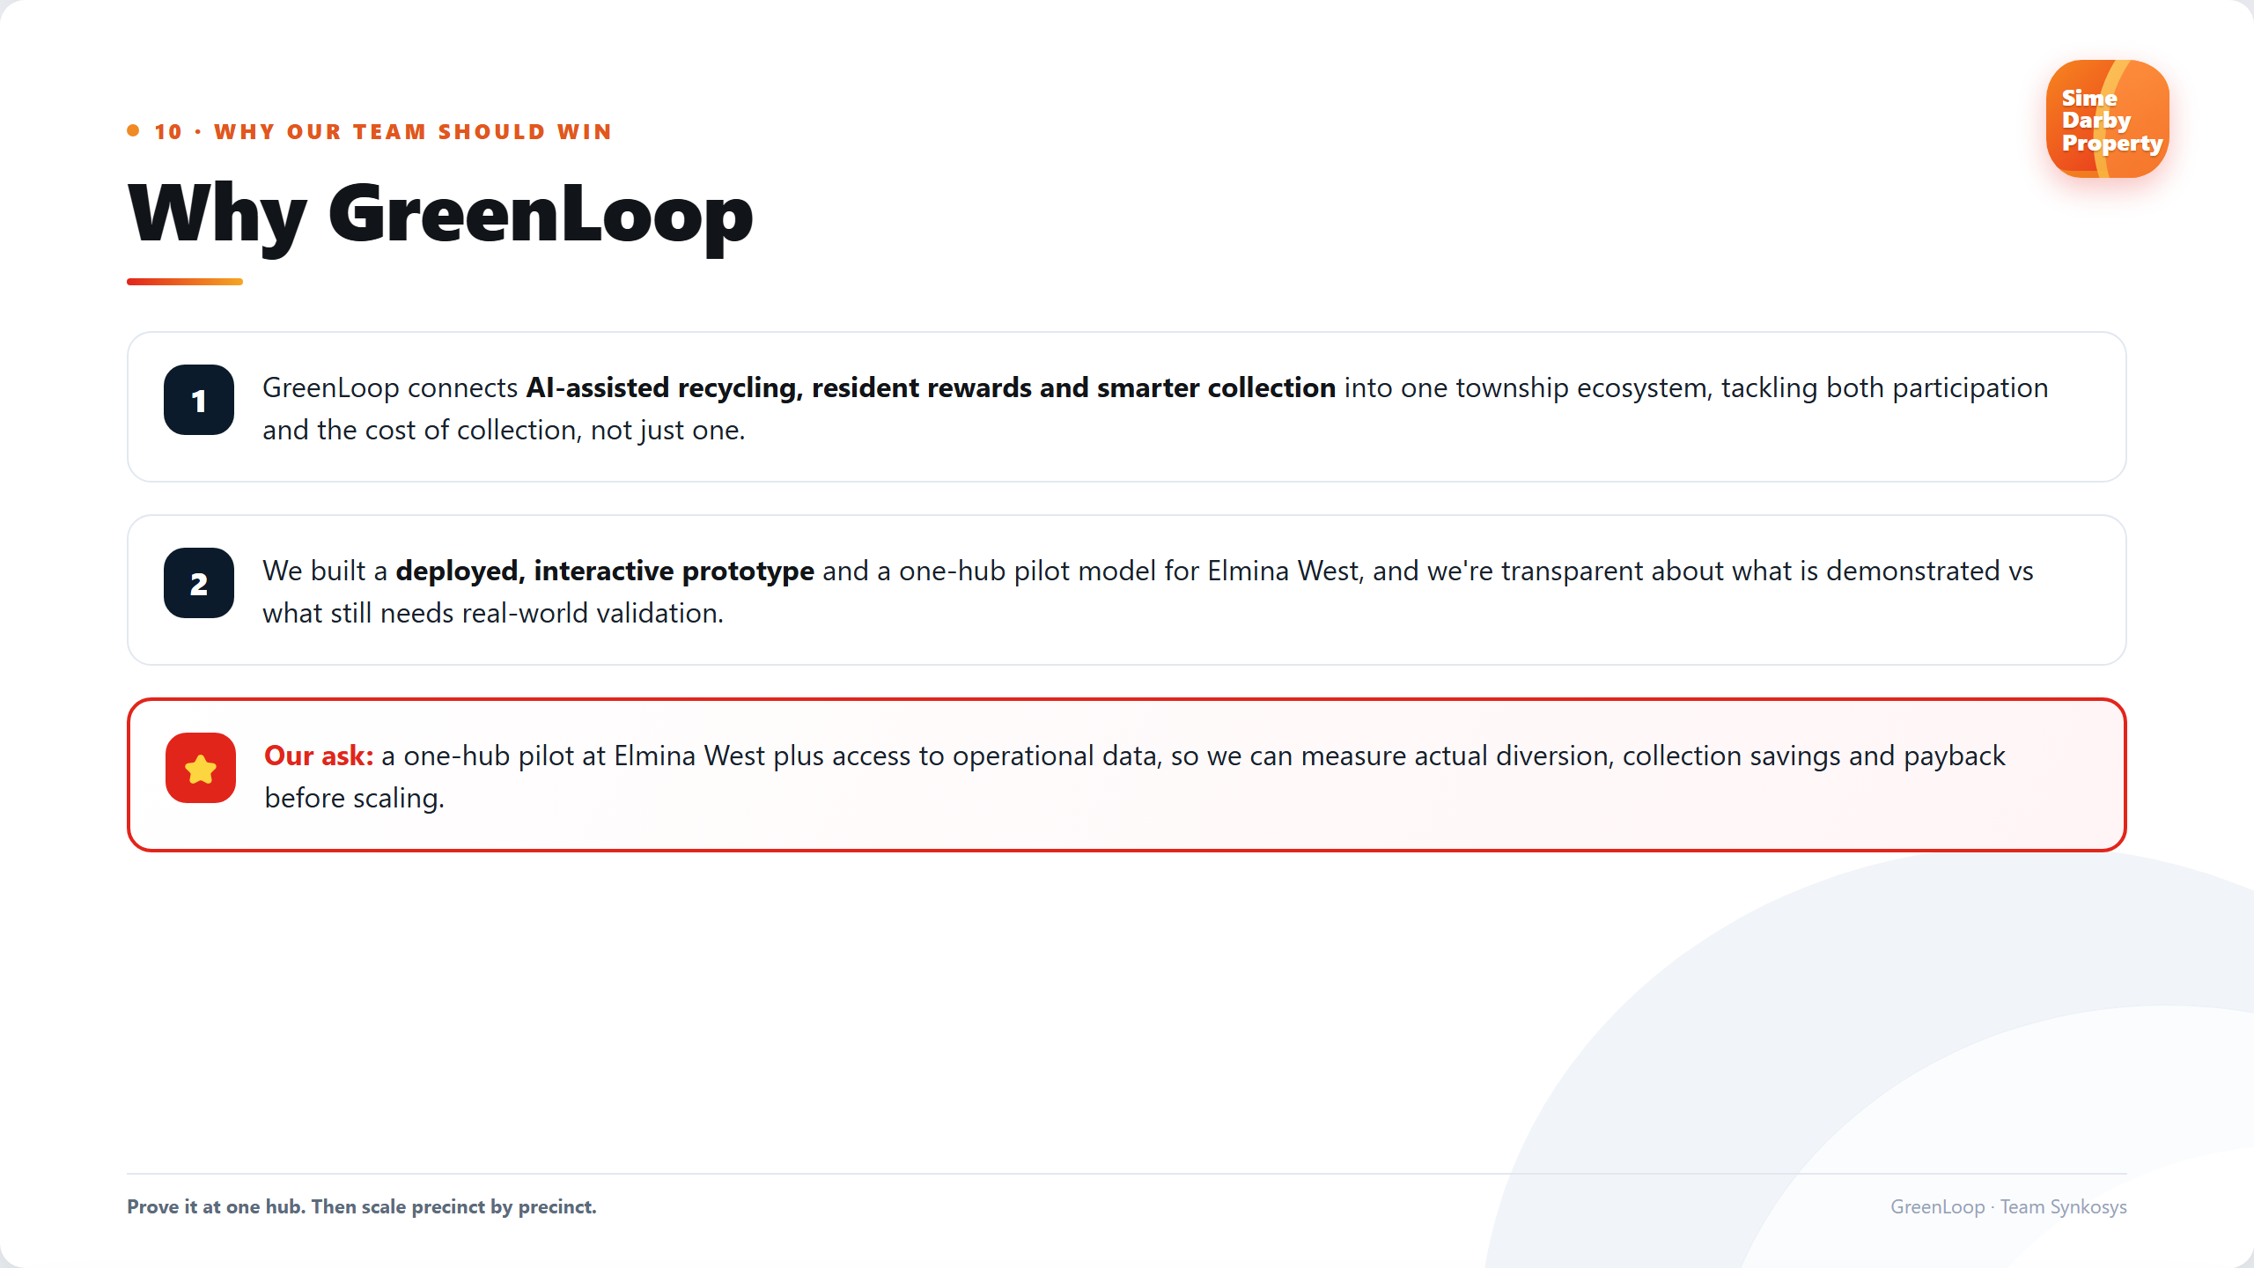

Slide 13




