Slide 1

GreenLoop
Smart Recycling Ecosystem · recycling that pays for itself.
Township waste challenge · “Level Up Recycle”
Team Synkosys
Muhammad Najib bin Ahmad Azir (Team Lead · UiTM)
najibazir12@gmail.com
Mohamad Fathin bin Mohd Zakiyuddin (UMP)
fathinzy@gmail.com
Muhammad Muqsith bin Mohd Hairul Wazi (UiTM)
mohdmuqsith1996@gmail.com
Leeya Sofea binti Mohd Rizal Izwan (UiTM)
leeyasofea199@gmail.com
Sime Darby Property University Hackathon 2026

Slide 2

1
The Problem
Malaysia wants to recycle more, but most recyclable waste still ends up in landfill.
38,000+
~30%
~40%
tonnes of waste generated every day
actual recycling rate (target is 40% by 2025)
of landfilled waste could be recycled
Why recycling stalls in a township:
🙋 No incentive
effort, no reward → low turnout
💸 Cost centre
seen as pure expense → programmes cut
🚚 Blind collection
fixed routes to half-empty bins → wasted fuel
Sources: UNIDO (2025); Asia News Network (2026); KPKT Circular Economy Blueprint 2025 to 2035. Figures indicative.
GreenLoop · Synkosys · Sime Darby Property University Hackathon 2026
2 / 10

Slide 3
2
Target User
Three groups, one loop, modelled on real Sime Darby Property communities.
🏠 Residents
Households in the township. Want convenient recycling and a tangible, everyday reward for taking part.
🏬 Mall tenants
F&B and retail outlets (e.g. Elmina Lakeside Mall). Generate bulk packaging waste; want to offset monthly service charges.
🏢 Developer operations
Sime Darby Property. Needs operational visibility, lower haulage cost, and measurable ESG / sustainability outcomes.
Grounded in real locations
City of Elmina (Elmina West / East, Denai Alam, Bukit Subang) · Elmina Lakeside Mall · Bandar Bukit Raja. The concept maps directly onto an existing Sime Darby Property township, not a made-up map.
GreenLoop · Synkosys · Sime Darby Property University Hackathon 2026
3 / 10

Slide 4
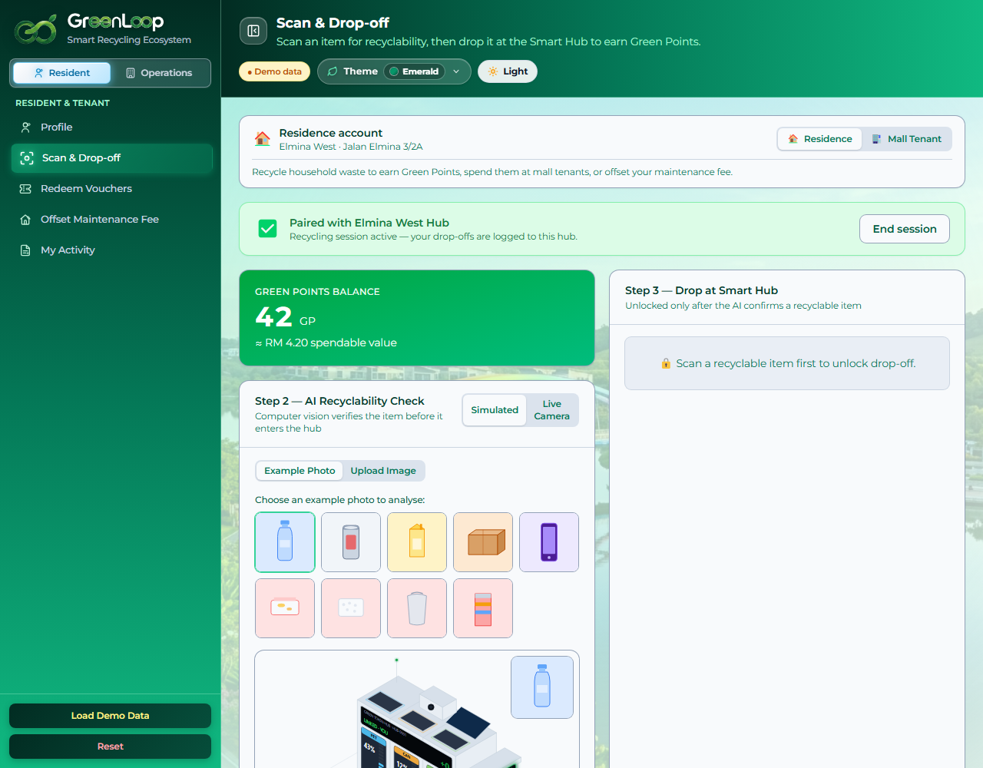
3
The Solution
Close the loop: recycling becomes a self-funding economy.
● Scan & earn. AI verifies the item; residents earn Green Points.
● Spend like cash. Redeem GP at mall tenants or offset monthly fees.
● Funded by savings. Avoided haulage + material sales + carbon pay for it.
● Collect smart. AI dispatches trucks only to full bins.
Resident Scan & Drop-off (live prototype)
GreenLoop · Synkosys · Sime Darby Property University Hackathon 2026
4 / 10

Slide 5
4
Innovation
A funded, verified, intelligent loop, not just another points app.
Typical recycling app
GreenLoop
✗ Points with no funding model
✓ Rewards funded by avoided haulage + material sales + carbon value
✗ “Trust me, it's recyclable”
✓ AI vision verifies each item before it's accepted
✗ Fixed truck routes
✓ Live AI dispatch to full bins only, on real road routing
✗ One user type
✓ Residents and mall tenants served by one engine
GreenLoop · Synkosys · Sime Darby Property University Hackathon 2026
5 / 10

Slide 6
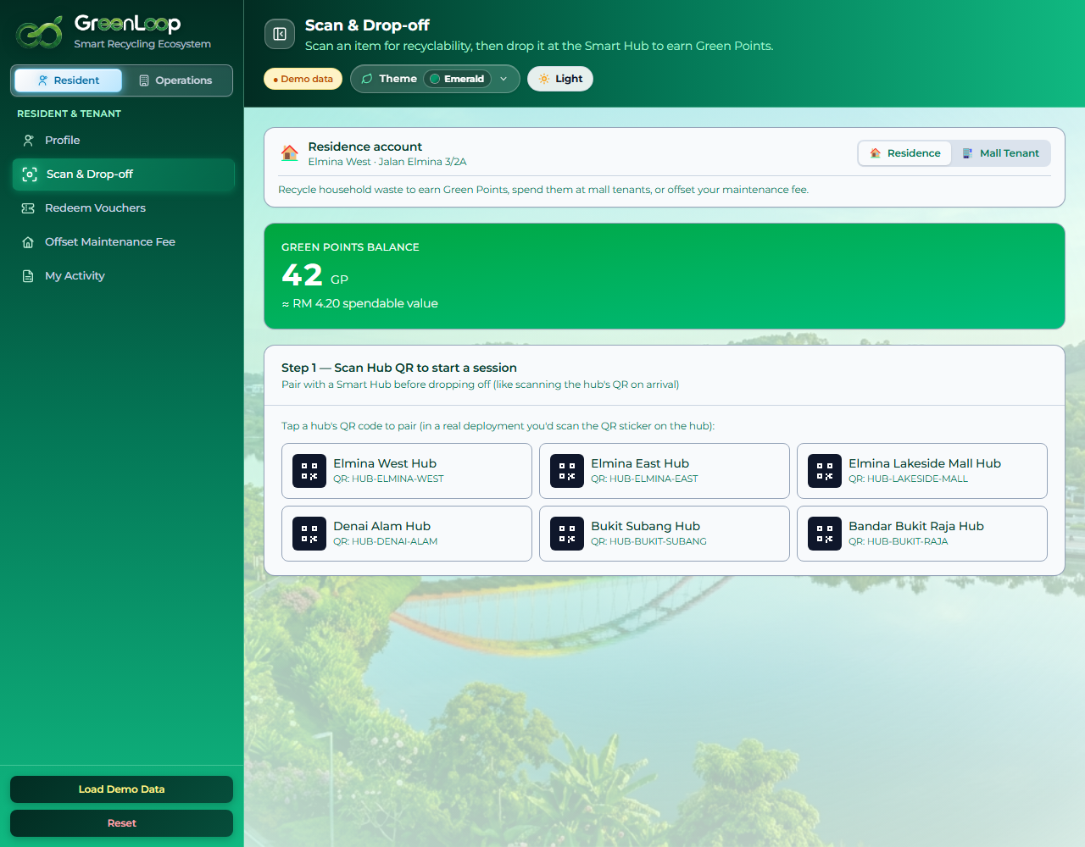
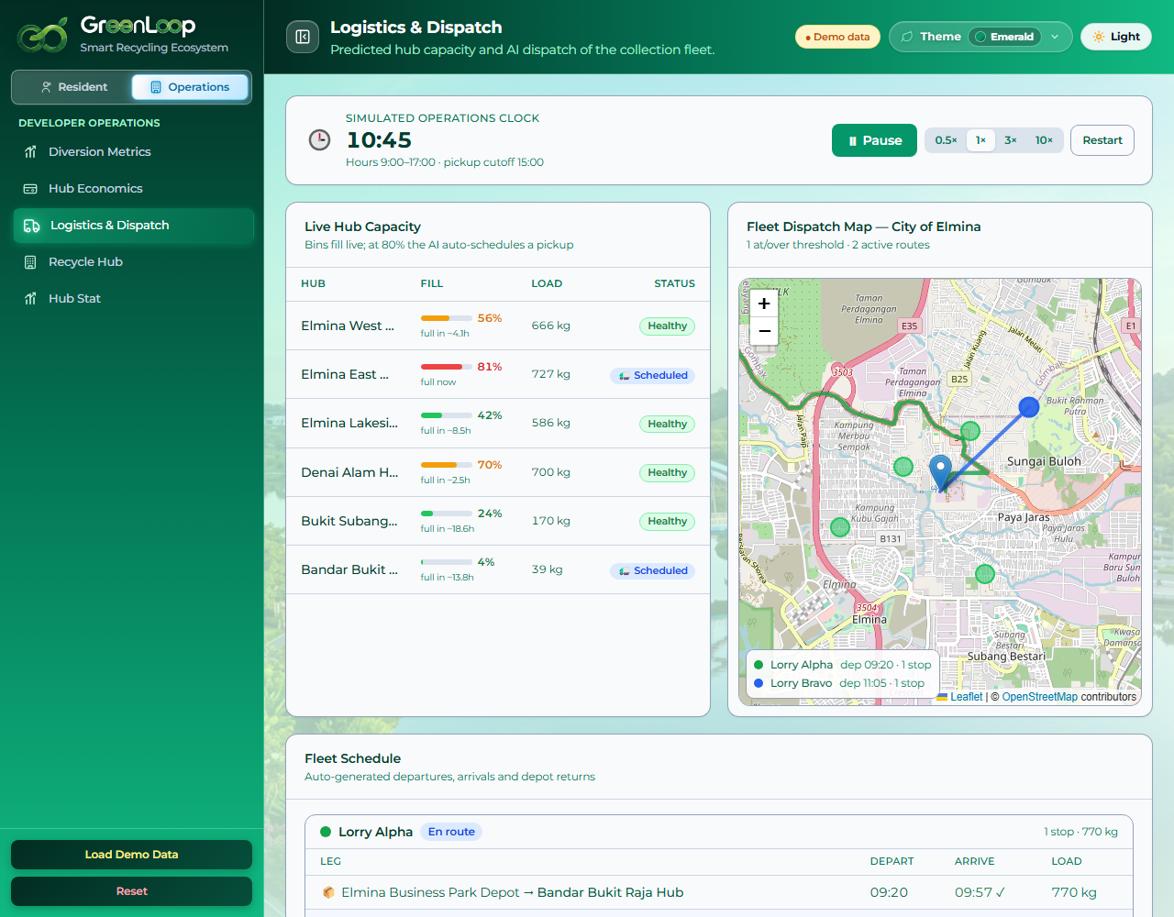
5
How It Works
Residents → Hubs → Operators → Rewards · one closed loop.
1 · Scan
Resident scans item; AI vision verifies it's recyclable
2 · Drop at Smart Hub
Pair via hub QR; item accepted, GP credited instantly
3 · AI Dispatch
Bin fills; at 80% the system schedules a truck to full bins only
4 · Recover & Sell
Material diverted from landfill and sold to recyclers
5 · Value funds the loop ↺
Avoided haulage + material sales + carbon value fund the Green Points and fee offsets. Residents redeem, and the loop repeats.
GreenLoop · Synkosys · Sime Darby Property University Hackathon 2026
6 / 10

Slide 7
6
Impact
Measurable outcomes, honest about what's demonstrated vs projected.
🌱 Environmental
🤝 Community
⚙️ Operational
● Tonnes of recyclables diverted from landfill
● CO₂e avoided (carbon / ESG value)
● Supports the national 40% recycling target
● Residents earn Green Points for everyday recycling
● GP offsets maintenance fees / mall charges
● Higher, sustained participation
● Lower haulage cost (collect full bins only)
● Live visibility of hub capacity & fleet
● A self-funding programme, not a one-off campaign
✓ DEMONSTRATED in the prototype
Working AI scan, Green Points economy, live AI dispatch and a 6-hub map.
~ MODELLED projection
Township diversion ~10.9 t/mo and an operating surplus (indicative ROI model).
! NEEDS VALIDATION with partners
Bin hardware, real haulage cost, recycler prices and carbon monetisation.
GreenLoop · Synkosys · Sime Darby Property University Hackathon 2026
7 / 10

Slide 8
7
Business Case · the numbers
Transparent monthly economics for the township network (indicative model, reconciles with the live dashboard).
Material sales (to recyclers) cash
+ RM 19,662
10.9 t
Avoided haulage assumption · RM230/t
+ RM 2,508
Carbon / ESG value est. · RM90/t CO₂e
+ RM 1,767
diverted per month (township, 6 hubs)
Total monthly benefit
RM 23,936
Operating cost staff, utilities, upkeep
− RM 4,200
Conservative case
Even with carbon value removed, net ≈ RM 13,000/mo → payback ~6.5 months. Still self-funding.
Green Points redeemed 65% of issued
− RM 4,931
Net monthly cash flow
RM 14,805
Setup RM 85,000 ÷ RM 14,805 net / month ≈ 5.7-month simple payback
RM230/t avoided-haulage is an assumption pending validation with Sime Darby's waste contractor. Figures are indicative, not audited.
GreenLoop · Synkosys · Sime Darby Property University Hackathon 2026
8 / 10

Slide 9
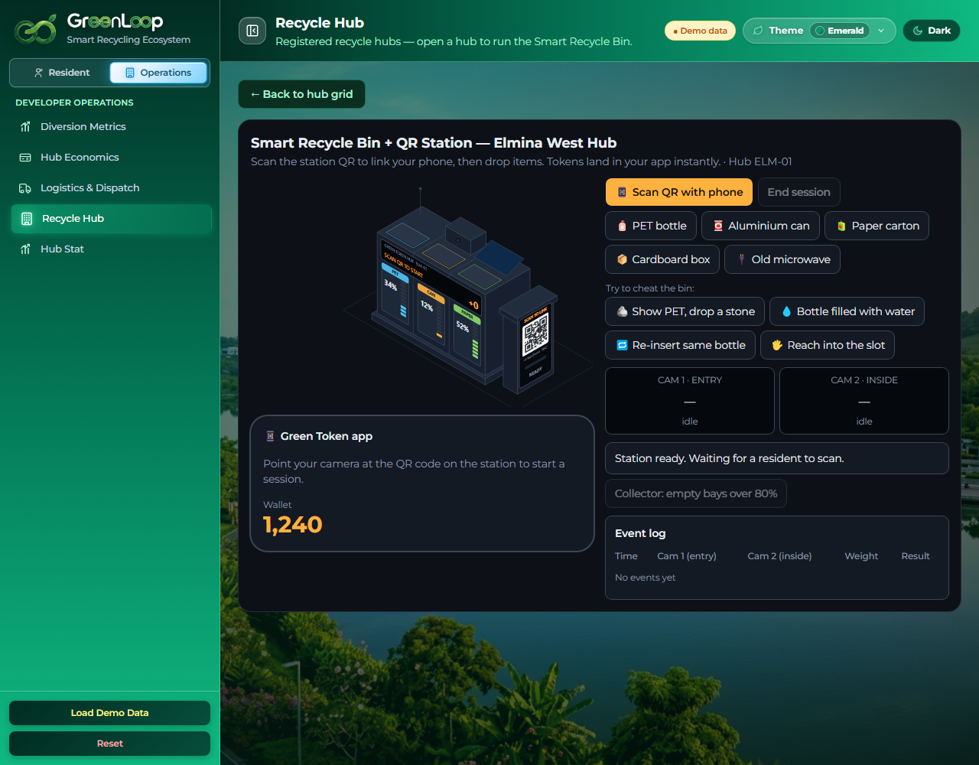
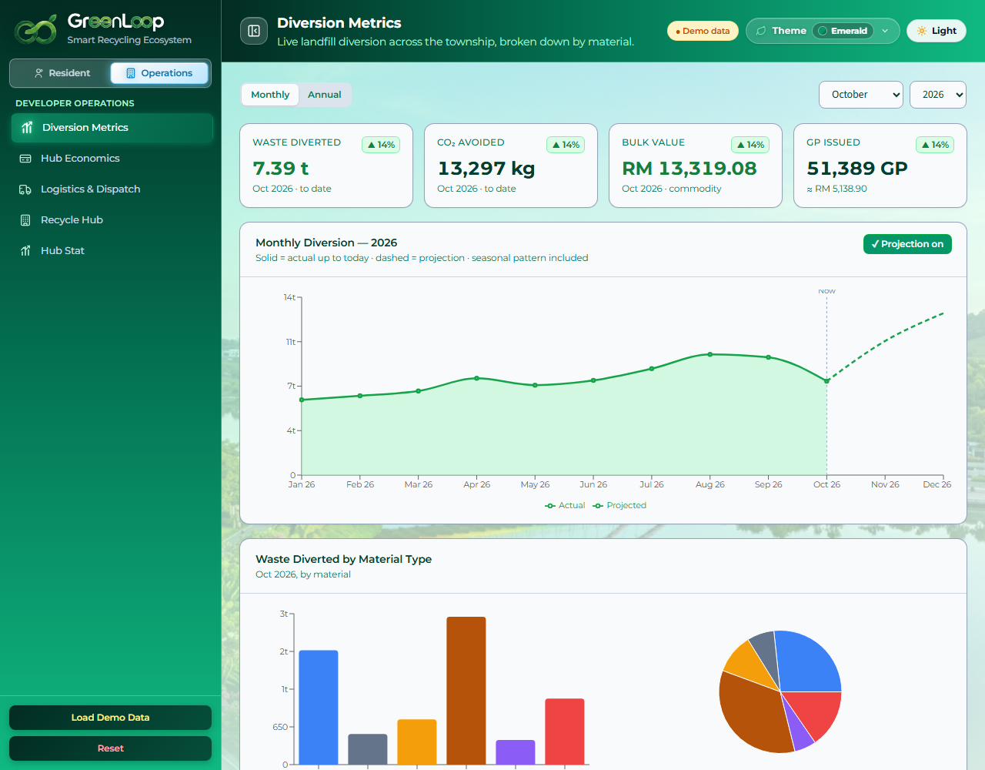
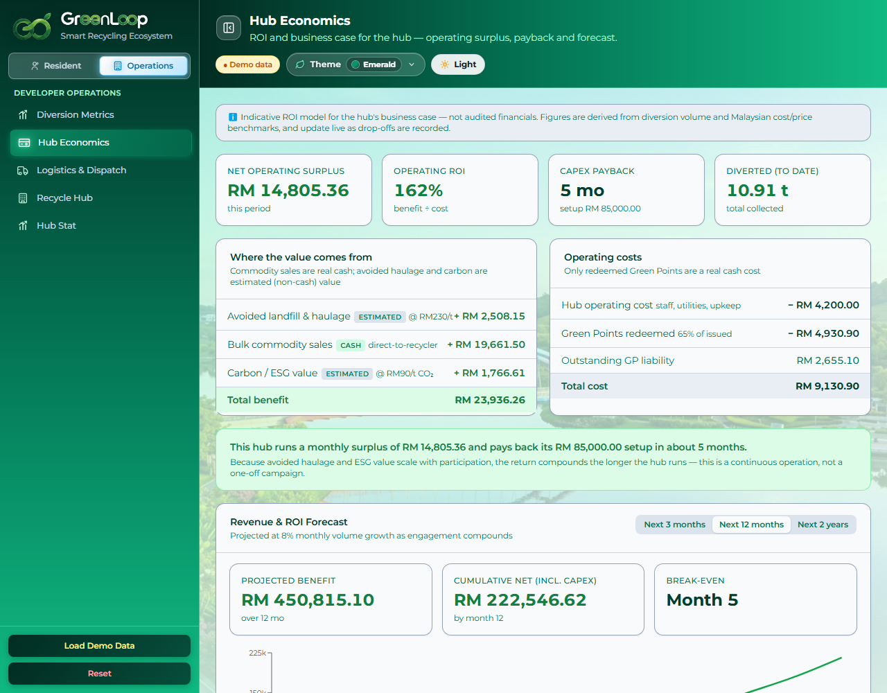
8
Visual Concept
One working ecosystem: resident app, smart bin, and the operator's command centre.
Smart Recycle Bin + QR station
Diversion metrics (actual vs projected)
Hub economics (business case)
Try the live prototype: greenloop-tan.vercel.app
GreenLoop · Synkosys · Sime Darby Property University Hackathon 2026
9 / 10

Slide 10
Why Team Synkosys Should Win
GreenLoop connects AI-assisted recycling, resident rewards and smarter collection into one township ecosystem, tackling both participation and the cost of collection, not just one of them. We've built a deployed, interactive prototype and a one-hub pilot model for Elmina West, and we're transparent about what's demonstrated versus what still needs real-world validation.
Our ask: a one-hub pilot at Elmina West + access to operational data, so we can measure actual diversion, collection savings and payback before scaling across the township.
Give us one hub and the data, and we'll prove it pays for itself.
Impact
Innovation
Feasibility
Strategic fit
Commercial value
Live demo: greenloop-tan.vercel.app · Code: github.com/NajibAzir/greenloop

Slide 11
Appendix
Supporting detail: business case, analytics, tech & judging-criteria map.

Slide 12
A
Business case & assumptions
Indicative Malaysian benchmarks (2024). Stated openly, not audited financials.
Avoided landfill & haulage
RM 230 / tonne diverted
Carbon / ESG value
RM 90 / tonne CO₂e
Hub operating cost (opex)
RM 4,200 / month
One-time setup (CapEx)
RM 85,000
Green Point value
RM 0.10 per GP (10 GP = RM 1)
GP redemption rate
65% of issued GP redeemed for cash
Assumed volume growth
8% per month
Bulk prices (sold to recyclers)
Aluminium RM4.2 · E-waste RM12 · PET RM1.1 · Paper RM0.55 · Cardboard RM0.45 /kg
GreenLoop · Synkosys · Sime Darby Property University Hackathon 2026
Appendix

Slide 13
D
Pilot plan · Elmina West (one hub)
Prove it at one hub, then scale precinct by precinct.
Month 1
Install & integrate
Smart Hub + bin hardware; link mall-tenant rewards and resident sign-up
Month 2-3
Run & measure
Residents recycle; track diversion, participation and real cost vs model
Month 4
Review (go / no-go)
Compare actuals to assumptions; confirm payback and surplus
Month 5+
Scale
Roll out to Elmina East, Denai Alam, Lakeside Mall
Who does what
Sime Darby Property hosts & operates the hub · waste contractor collects · recyclers buy material · mall tenants fund part of the rewards.
How recyclables are weighed & paid
Smart-bin load cells weigh each drop; GP credited by material × weight; material sold by the kg to contracted recyclers.
Go / no-go metrics (Month 4)
kg diverted · participation % · verified haulage saving · net monthly surplus · payback trend.
Needs validation before deployment
Bin hardware · real contractor rates (RM/t) · recycler prices · POS/voucher integration · resident identity & PDPA.
GreenLoop · Synkosys · Sime Darby Property University Hackathon 2026
Appendix

Slide 14
E
AI & system status · honest boundary
What is genuinely working today vs. what still needs building.
✓ Working in the browser
~ Simulated in the prototype
! Needs real-world build
● TensorFlow.js COCO-SSD runs live on webcam / uploaded photos
● Green Points economy, wallet, redemption & fee offset
● Dispatch sim on real roads (OSRM) + 6-hub Leaflet map
● Bin fill levels & sensor weights (demo values)
● Two-camera cheat check (entry vs inside): concept shown
● Township ROI from an indicative, tunable model
● A recyclability/material classifier trained on real items
● Physical reverse-vending / smart-bin hardware + load cells
● POS/voucher + resident-identity + telemetry integration
On AI accuracy & anti-cheat: the current demo detects common objects (bottle, can, cup, phone); it does not yet confirm material purity. Production needs a recyclability classifier validated on real items, plus the two-camera entry/inside check to stop re-scanning the same item without depositing it.
GreenLoop · Synkosys · Sime Darby Property University Hackathon 2026
Appendix

Slide 15
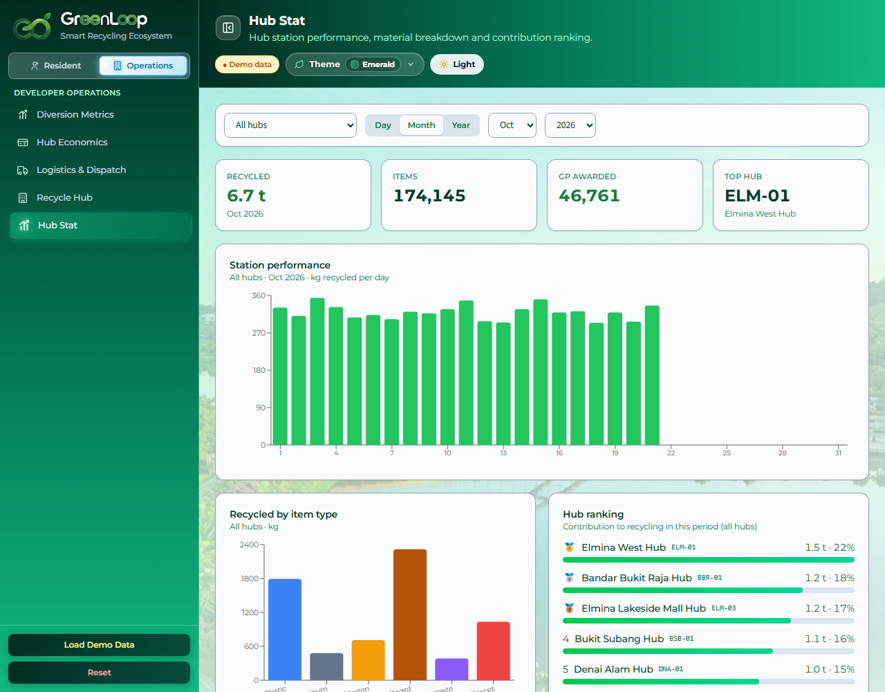
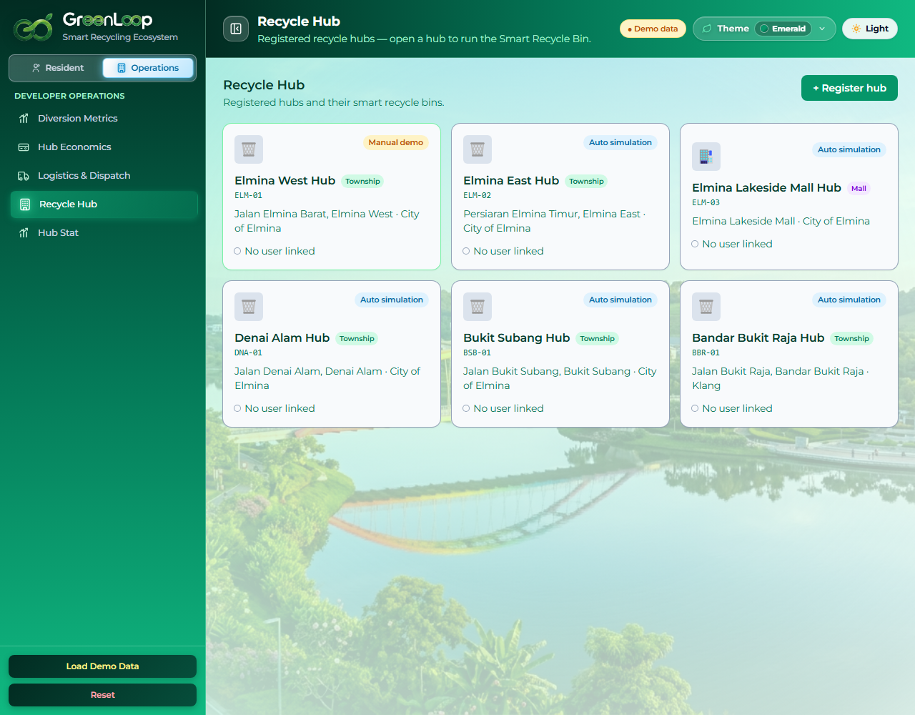
B
Operator analytics & network
Hub Stat · day / month / year, respects 09:00 to 17:00 hours
Recycle Hub network (6 hubs, City of Elmina + Bandar Bukit Raja)
Tech stack: React + Vite · Tailwind · TensorFlow.js COCO-SSD (in-browser vision) · OSRM road routing · Leaflet maps · Recharts. All client-side; no backend.
GreenLoop · Synkosys · Sime Darby Property University Hackathon 2026
Appendix

Slide 16
C
How we meet the judging criteria
Impact
Environmental (diversion, CO₂), community (rewards, participation) and operational (cost, visibility) outcomes.
Innovation
AI item verification + funded reward model + live AI dispatch in one loop.
Feasibility
Deployed working prototype; realistic one-hub pilot; clear validation checklist.
Strategic fit
Built on real Sime Darby Property townships; supports ESG and SHIFT25 goals.
Commercial value
Self-funding business case: operating surplus + CapEx payback, not a subsidy.
Team & pitch
A focused team shipping a real, honest, demoable product.
GreenLoop · Synkosys · Sime Darby Property University Hackathon 2026
Appendix

