Slide 1
MUFC – Product category
Version 1.0
Updated by Brian on 20 Dec
https://tasks.s60.com.au/browse/MUFC-31

Slide 2
HOME
PLAYING KIT
TRAINING GEAR
SUPPORTER APPAREL
ACCESSORIES
TEAM KIT
CONTACT
MENS
COMPRESSION
T- SHIRTS
BAGS
COACH
SHIRTS
MANAGER
WOMENS
POLO
FOOTBALLS
SHORTS
PHYSIO
KIDS
JACKETS
SOCKS
Men U18
HEADWEAR & SCARVES
POLO
BYL
JACKETS
GYL
TRACKSUITS
AYL
BSAP
Can entry to this menu be permission based?? – i.e if they aren’t a player they cant order
GSAP
DEV SQUAD

Slide 3
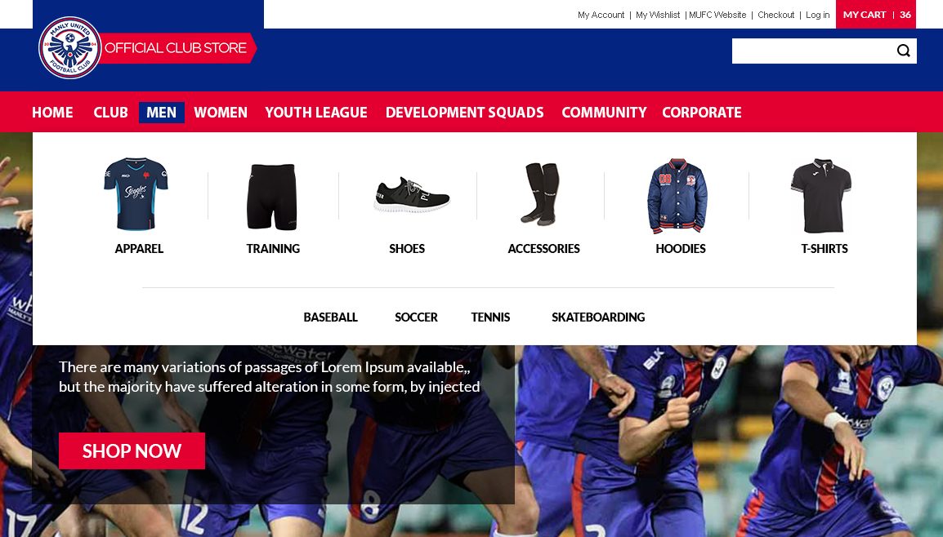

Slide 4
HOME
PLAYING KIT
TRAINING GEAR
SUPPORTER APPAREL
ACCESSORIES
TEAM KIT
CONTACT
MENS
WOMENS
KIDS

Slide 5
HOME
PLAYING KIT
TRAINING GEAR
SUPPORTER APPAREL
ACCESSORIES
TEAM KIT
CONTACT
COMPRESSION
SHIRTS
SHORTS
SOCKS
POLO
JACKETS
TRACKSUITS

Slide 6
HOME
PLAYING KIT
TRAINING GEAR
SUPPORTER APPAREL
ACCESSORIES
TEAM KIT
CONTACT
T- SHIRTS
POLO
JACKETS
HEADWEAR & SCARVES

Slide 7
HOME
PLAYING KIT
TRAINING GEAR
SUPPORTER APPAREL
ACCESSORIES
TEAM KIT
CONTACT
BAGS
FOOTBALLS

Slide 8
HOME
PLAYING KIT
TRAINING GEAR
SUPPORTER APPAREL
ACCESSORIES
TEAM KIT
CONTACT
COACH
MANAGER
PHYSIO
Men U18
BYL
GYL
AYL
BSAP
GSAP
DEV SQUAD

