Slide 1
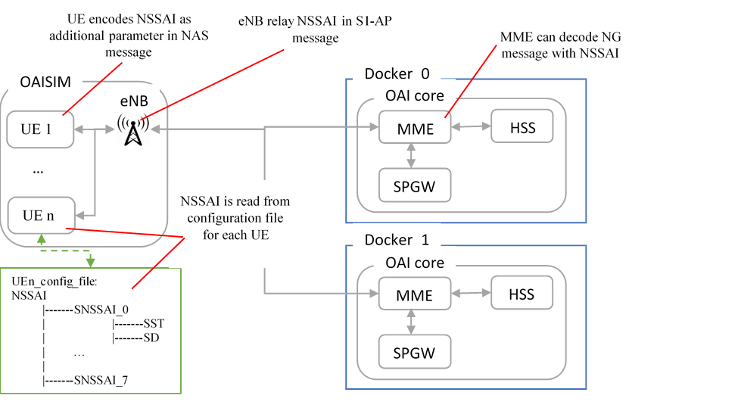
Current 5G testbed architecture

Slide 2
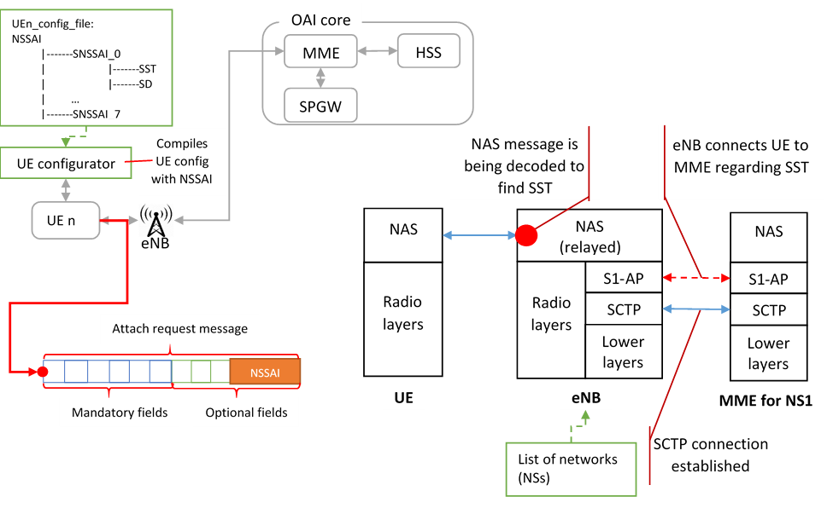
NSSAI operation in 5G testbed

