Slide 1

Hybrid CNN-Transformer Networks with Clinical Metadata for Skin Lesion Classification
Thesis Group ID: T2510619
Presented By
Supervisor
Nazif Bin Morshed | 21201484
Md. Samin Yaser | 21201033
Sayem Afridi | 21301044
Mos. Mahabuba Akter Munia | 24241110
Nazmus Shakib | 21201667
Dr. Md. Ashraful Alam
Associate Professor
Department of CSE
Department of Computer Science and Engineering, Brac University
1

Slide 2
Table of Content
# | Section
1 | Motivation, problem statement and objectives
2 | ISIC-2019 dataset, preprocessing and constraints
3 | Proposed lightweight hybrid and DEKAN architectures
4 | Training protocol, evaluation metrics and baselines
5 | Results, efficiency analysis and ablation findings
6 | Limitations, contributions and future work
2

Slide 3
Background and Motivation
Why automated dermoscopy support matters
Skin cancer outcome depends strongly on early lesion detection.
Dermoscopy reveals sub-surface lesion structure but needs specialist interpretation.
CNNs capture local texture; transformers model global shape and asymmetry.
Clinical context such as age, sex and lesion site is available but often ignored.
Local
Global
Context
CNN texture
Transformer structure
Clinical metadata
Clinically usable
AI decision support
Goal: small enough for practical deployment, strong enough across all eight classes.
3

Slide 4
Problem Statement & Research Gap
Accuracy alone is not enough for clinical usefulness
ISIC-2019 is severely imbalanced: NV has 12,875 images while DF has only 239.
Naive models can over-predict common classes and hide rare-class failure behind overall accuracy.
Most high-performing ISIC systems use heavy ensembles, limiting practical deployment.
Many image-only classifiers discard metadata that dermatologists naturally use.
Class imbalance (full collection)
NV
12,875
MEL
4,522
BCC
3,323
BKL
2,624
AK
867
SCC
628
VASC
253
DF
239
Metric choice: Balanced Multi-class Accuracy (mean recall across all classes)
4

Slide 5
Objectives
What this thesis set out to build and measure
Design a lightweight CNN-Transformer classifier under 6M parameters and 1 GMAC
Fuse age, sex and anatomical site through metadata cross-attention with learned missing tokens
3.98M
16.45M
Lightweight params
DEKAN params
0.6081
0.6438
Develop DEKAN: a higher-capacity dual-backbone model for better balanced accuracy
Compare fairly against five baselines and quantify design choices through ablations
Hybrid BMA
DEKAN BMA
5

Slide 6
Dataset: ISIC-2019
Public dermoscopic image collection with clinical metadata
25,331 labelled dermoscopic images across 8 diagnostic categories.
Sources include HAM10000, BCN20000 and MSK.
Metadata: approximate age, sex, anatomical site and lesion identifier.
Missingness is explicit: about 30% age, 20% sex and 15% site values are absent.
Class distribution
12.9k
4.5k
3.3k
2.6k
867
239
253
628
MEL
NV
BCC
AK
BKL
DF
VASC
SCC
8
25,331
54 yrs
The largest class is more than 50x larger than the smallest.
Classes
Images
Age center
6

Slide 7
Dataset Pre-processing
Cleaning, splitting and accelerating the training pipeline
Raw ISIC-2019
25,331 images
pHash near-duplicate
removal
Lesion-grouped
stratified split
Colour constancy
224 x 224
Memory-mapped
training array
Split | Images
Training | 16,872
Validation | 2,400
Test | 4,796
1,263
24,068
70/10/20
16GB
Near-duplicates removed
Unique images left
Train / val / test
GPU constraint
Key reason: removing duplicate lesions before splitting prevents train-test leakage.
7

Slide 8
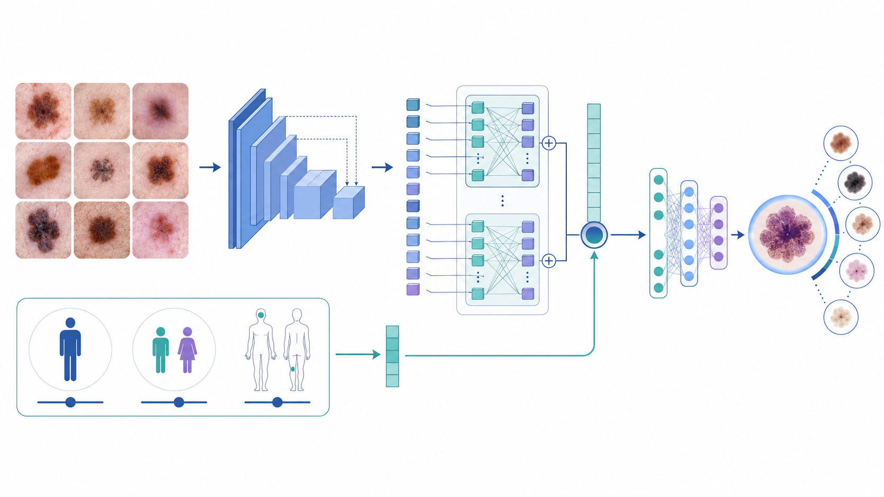
Proposed Framework Overview
One design philosophy at two capacity points
CNN stem extracts robust local texture features.
Transformer trunk models global lesion structure.
Metadata cross-attention folds in age, sex and site.
Two tiers: compact deployment model and accuracy-focused DEKAN.
CNN
ViT
Meta
Local texture
Global shape
Clinical context
8

Slide 9
Lightweight Hybrid CNN-Transformer
Compact model designed for constrained deployment
Image
3x224x224
MobileNetV2
stem
Patch proj.
49 tokens
6-block ViT
4 heads
Metadata
cross-attn
Linear
classifier
8 classes
Metadata tokens: age, sex and anatomical site. Missing values use learned “missing” embeddings instead of imputation.
3.98M
0.631
0.6081
<6M
parameters
GMACs
BMA with TTA
budget met
Truncated MobileNetV2 gives generic edge and texture features.
Token sequence is kept small to make attention cheap.
Best balanced accuracy among models under the 6M-parameter budget.
9

Slide 10
DEKAN: Dual-Backbone Flagship Model
Higher-capacity model for stronger balanced accuracy
DenseNet-121
stem
Learned
attention fusion
8-layer TinyViT
256-d, 8 heads
Metadata
cross-attn
KAN
classifier
EfficientNet-B0
stem
16.45M
6.633
0.6438
0.9271
parameters
GMACs
BMA with TTA
macro-AUC
Fuses two complementary pretrained CNN representations.
Uses the same metadata mechanism as the lightweight model.
Trades footprint for the best flagship result among the main proposed models.
10

Slide 11
Training and Evaluation Protocol
Identical recipe for all baselines and proposed models
Optimizer: AdamW, base LR 3e-4, gradient clipping at 5.
Schedule: 5-epoch warmup then cosine annealing to 1e-6.
Class-Balanced Focal Loss: beta=0.999, gamma=2.5, label smoothing=0.1.
Augmentation: flips, random resized crops, colour jitter, RandAugment and Mixup.
Efficiency: AMP, channels-last memory layout, EMA weights for validation.
Model | Eff. batch | Epochs | Backbone LR
Hybrid | 288 | 150 | 0.3x
DEKAN | 256 | 150 | 0.1x
Baselines | 128-256 | 100-150 | 0.3x
Primary metric
BMA = mean per-class recall
Secondary metrics
Macro-F1, macro-AUC, accuracy
Inference uses eight-view test-time augmentation (TTA), averaging softmax outputs.
11

Slide 12
Main Result: ISIC-2019 Test Set
Balanced multi-class accuracy with 8-view TTA
BMA comparison
0.644
Model | Params | BMA | Macro-F1 | Macro-AUC | Accuracy
Hybrid | 3.98M | 0.6081 | 0.5602 | 0.9229 | 0.7162
DEKAN | 16.45M | 0.6438 | 0.6059 | 0.9271 | 0.7467
MobileViT-S | 5.60M | 0.6020 | 0.5354 | 0.9218 | 0.6981
0.602
0.608
0.552
0.474
0.495
0.337
Hybrid has the best BMA under the 6M-parameter budget.
DEKAN leads every reported metric, with higher parameter and compute cost.
Both proposed models outperform the CNN baselines on balanced accuracy.
ResNet-18
MobileNetV2
EffNet-B0
MobileViT-S
EffFormer-L1
Hybrid
DEKAN
12

Slide 13
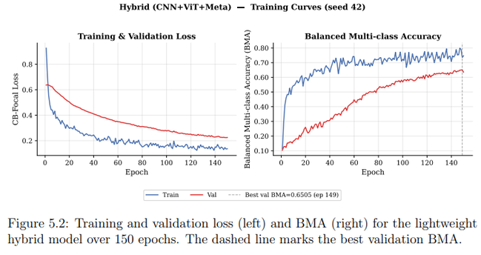
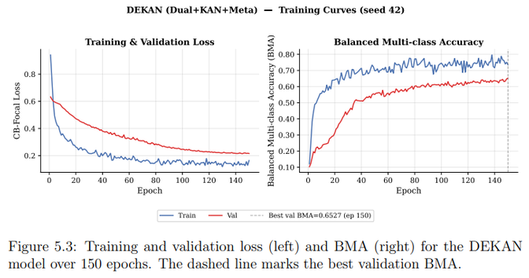
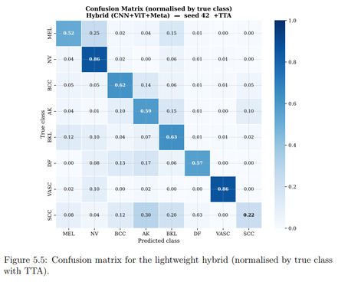
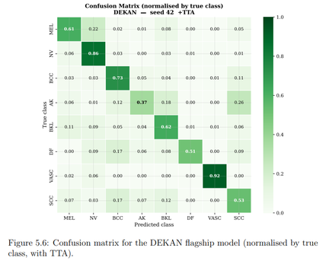

Slide 14
Per-Class Recall Analysis
Which diagnoses improve and where the models still struggle
MEL
0.61
Hybrid strengthens hard middle classes such as BCC, AK and BKL compared with EfficientNet-B0.
DEKAN recovers SCC substantially and reaches the strongest VASC and BCC recall.
Main error cluster remains among keratinocytic classes: AK / BKL / SCC.
Note: bar labels show DEKAN recall values.
NV
0.86
BCC
0.73
AK
0.37
BKL
0.62
DF
0.51
0.922
0.731
VASC
0.92
DEKAN VASC recall
DEKAN BCC recall
SCC
0.53
0.223
Hybrid
DEKAN
Hybrid SCC recall
13

Slide 15
Efficiency vs Accuracy Trade-off
Reading performance together with parameter budget
DEKAN
Hybrid is the most parameter-efficient model in the sub-6M budget: BMA per M-param = 0.153.
DEKAN achieves the highest absolute BMA but is intentionally less efficient.
This gives two deployment options: compact clinic-friendly model vs accuracy-focused model.
0.6
Hybrid
MobileViT-S
EffFormer-L1
BMA
0.5
EffNet-B0
MobileNetV2
0.4
0.153
0.039
Hybrid BMA / M-param
DEKAN BMA / M-param
ResNet-18
4
6M budget
8
12
16
Parameters (M)
14

Slide 16
TTA and Ablation Insights
What helped, what was inconclusive, and what did not improve
Model | No TTA | TTA | Change
Hybrid | 0.5815 | 0.6081 | +0.027
DEKAN | 0.6368 | 0.6438 | +0.007
MobileViT-S | 0.5925 | 0.6020 | +0.010
EffFormer-L1 | 0.5559 | 0.5519 | -0.004
Ablation summary
Lightweight: CNN stem alone to full hybrid improves BMA from 0.4853 to 0.6081 (+0.123).
Lightweight metadata effect is inconclusive on the single test run (full vs no-meta differs by 0.0004).
DEKAN: metadata helps clearly — comparing the two linear-head variants (no-meta 0.6302 vs with-meta 0.6510) gives +0.021 BMA.
KAN head is a negative result: linear head performs slightly better (0.6510 vs 0.6438).
+0.123
+0.021
0.6510
0.6438
Hybrid components gain
DEKAN metadata gain
DEKAN linear head
DEKAN KAN head
15

Slide 17
Limitations, Constraints and Ethics
What should be considered before deployment
Single-run results with seed 42; multi-seed reporting is needed for publication-grade comparison.
No external test set was used, so generalisation beyond ISIC-2019 remains unverified.
Single-backbone DEKAN ablations (DenseNet-121 alone and EfficientNet-B0 alone) were not completed, so each backbone's individual contribution is unquantified.
Qualitative interpretability was not yet included.
Uses publicly available, de-identified ISIC-2019 data only.
No new human-subject data were collected.
Age, sex and lesion site are used only as model input, not for re-identification.
The system is intended as decision support, not a substitute for a dermatologist.
16GB
BMA
Assist
single-GPU training limit
fair rare-class focus
not replace clinicians
16

Slide 18
Contributions and Conclusion
Two models, one clinically informed design direction
Introduced a lightweight CNN-Transformer with clinical-metadata cross-attention under 6M parameters and 1 GMAC.
Proposed DEKAN, a dual-backbone attention-fusion model with metadata support and a KAN classifier head.
Benchmarked both models against five established baselines under one fair training and evaluation protocol.
Reported both positive findings and negative/inconclusive results transparently.
0.6081
Best
Hybrid BMA
under 6M params
0.6438
Best
DEKAN BMA
among main models
Conclusion: Transformer design can improve balanced skin-lesion classification while keeping the model small enough for practical deployment.
17

Slide 19
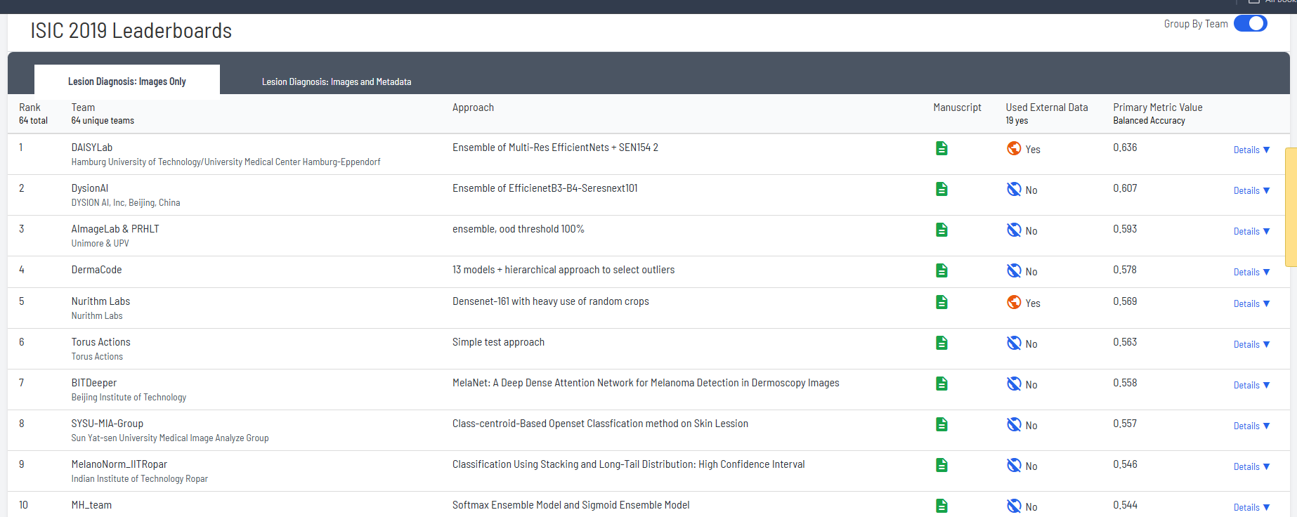
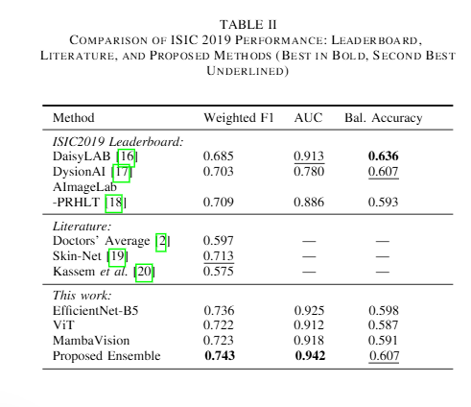
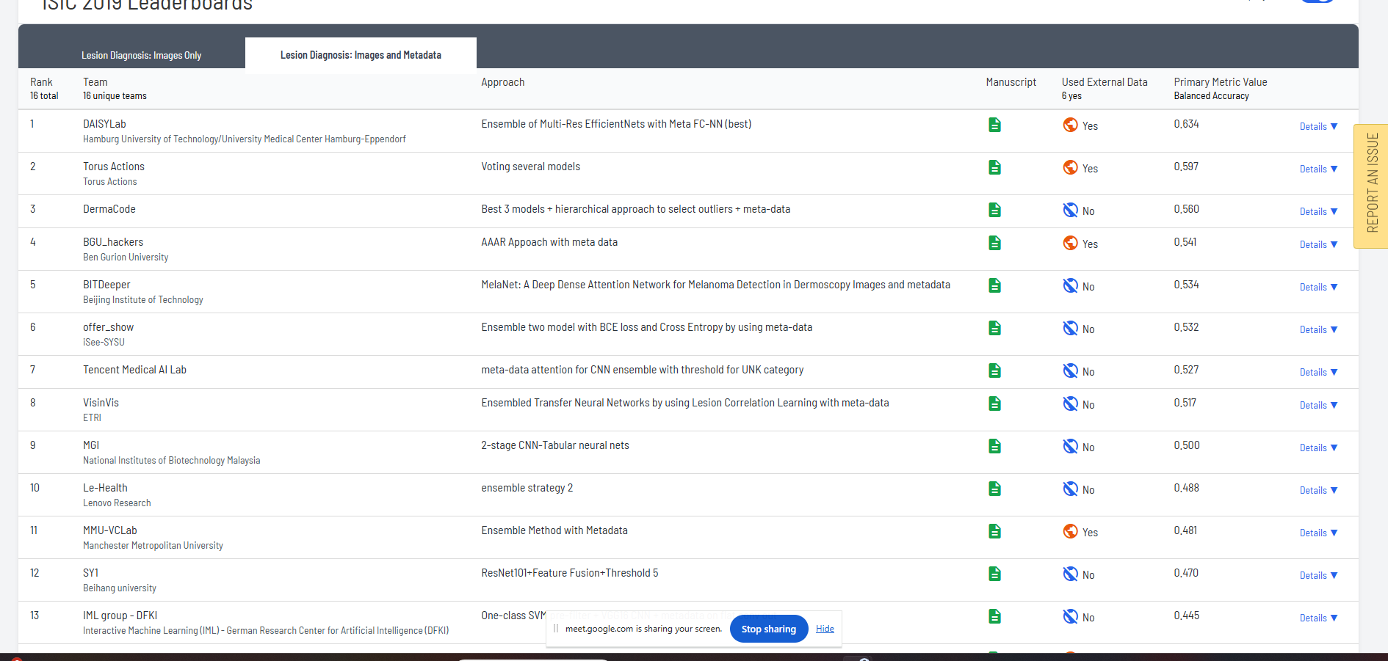
ISIC 2019 Leaderboard Comparison
How do our models compare with official ISIC-2019 challenge results?
Images Only Leaderboard
Images Only Track
Winner: 0.636
DEKAN: 0.6302
Gain: +0.0078
Images + Metadata Track
Winner: 0.634
DEKAN: 0.6438 (KAN)
0.6510 (Linear)
Gain: +0.0098
Comparison of Leading Deep Learning Architectures on Skin Lesion Classification Using the ISIC 2019 Dataset
Images + Metadata Leaderboard
0.6438
DEKAN BMA
+0.0078
Images Only
+0.0098
Metadata
ISIC 2019
Surpassed
18

Slide 20
Future Work
Next steps for strengthening the study
Repeat experiments across at least three seeds and report mean ± standard deviation.
Complete the single-backbone DEKAN ablations (DenseNet-121 alone and EfficientNet-B0 alone) to quantify each backbone's contribution.
Evaluate on an external dataset for stronger generalisation evidence.
Add Grad-CAM and attention rollout to verify clinically meaningful focus regions.
Thank You
Questions?
Hybrid CNN-Transformer Networks with Clinical Metadata for Skin Lesion Classification
19

