Slide 1
PROJECT SMARTRETAIN
Machine Learning-Driven Customer Retention
& Revenue Preservation Strategy
A Data-Driven Business Proposal for Executive Leadership
Prepared by: IT Consulting Associate — AI & Data Science Practice
Client: Telecommunications Provider | Engagement: PoC Machine Learning Project
Dataset: Client.csv + Record.csv (N = 100,000 customers, 100 merged features)
Core Stack: Python 3 · Scikit-Learn · HistGradientBoosting · RandomForest · Logistic Regression
CONFIDENTIAL — FOR EXECUTIVE REVIEW ONLY

Slide 2
Presentation Roadmap
How This Proposal Flows from Data to Decision
01
02
03
04
05
06
07
08
09
10
11
12
13
Executive
Summary
Market
Context
Business
Problem
EDA:
Hardware
EDA:
Behavioral
EDA:
Tenure & Quality
ML:
Model Rationale
ML:
Scorecard
ML:
Decile Lift
ML:
Drivers
Business
Proposal
ROI &
Roadmap
References
Data Analysis --> Model Insights --> Quantified Business Case --> Recommendation
UNDERSTAND
PREDICT
ACT
EDA reveals who churns, why, and when — grounded in your actual data.
HistGradientBoosting scores every customer by churn risk with 0.6913 ROC-AUC.
$1.41M net annual profit from targeted ML-guided retention interventions.
Project SmartRetain | Confidential PoC Proposal
2 / 15

Slide 3
Executive Summary
One-Page Overview: Problem → Evidence → Model → Value
1. The Burning Platform
2. ML PoC Results
3. Root-Cause Drivers
4. Business Case ROI
CHURN RATE
49.56% — nearly 1 in 2 customers lost
ANNUAL REV AT RISK
$34.45 Million lost every year
ROOT CAUSES
Aged devices, bill shock, silent disengagement
KEY GAP
No in-house ML capability to flag risk before cancellation
PRIMARY MODEL
HistGradientBoostingClassifier
EVALUATION METRIC
ROC-AUC
SCORE
0.6913 (vs 0.50 random baseline)
DECILE-1 CHURN
79.85% — 1.61x lift over random
BUSINESS INSIGHT
Top 20% of predicted-risk customers contain 30% of all churners
DEVICE AGE
Devices >2 yrs: 57.9% churn (+16.1pp above avg)
SILENT CHURNERS
0 support calls = 51.8% churn — leave without warning
BILL SHOCK
Overage >$30 drives churn above 52.6%
CONTRACT CLIFF
Peak churn window: months 13–18
TARGET COHORT
Top 20% risk — 20,000 accounts
CUSTOMERS SAVED
3,285 / year (22.5% save rate)
REVENUE PRESERVED
$2,314,742 / year
NET PROFIT LIFT
+$1,414,742 / year
ROI
157.2% | Payback: 4.7 months
[Source: Internal PoC Data: Client.csv + Record.csv (N=100,000)] Project SmartRetain | Confidential PoC Proposal
3 / 15

Slide 4
Market & Industry Analysis
Why This Problem Matters — Saturated Telecom, Rising Churn, High Acquisition Cost
Telecom Industry Macro Context
• Global mobile subscriber growth has stalled at 1–2% CAGR in mature markets [GSMA, 2023].
• U.S. wireless penetration exceeds 95%; growth now driven by ARPU uplift, not new subscribers [FCC, 2022].
• Industry-average annual churn: 20–35% (postpaid); up to 50%+ for prepaid segments [FCC, 2022].
• Our client’s churn rate of 49.56% is significantly above industry average — a critical competitive risk.
• Customer Acquisition Cost (CAC): $300–$400 per new subscriber [McKinsey, 2021].
• Retention cost via targeted offer: $30–$60 per saved customer [Bain & Co., 2020].
• A 5% reduction in churn increases profit by 25–95% in subscription businesses [Bain, 2020].
• Proactive ML-guided retention programs save 20–30% of targeted at-risk customers [McKinsey, 2021].
INDUSTRY AVG CHURN RATE
20 – 35%
vs. Client’s 49.56% — well above benchmark
CAC VS RETENTION COST RATIO
5 – 7×
New subscriber costs $315 vs $45 retention offer
PROFIT LIFT FROM 5% CHURN DROP
25 – 95%
Compounding effect on Customer Lifetime Value
ML PROACTIVE SAVE RATE
20 – 30%
Of high-risk customers retained via intervention
[1] McKinsey & Co. (2021) [2] Bain & Co. (2020) [3] GSMA Intelligence (2023) [4] FCC Mobile Report (2022)
[Source: McKinsey (2021); Bain & Co. (2020); GSMA Intelligence (2023); FCC (2022); Ericsson (2024)] Project SmartRetain | Confidential PoC Proposal
4 / 15

Slide 5
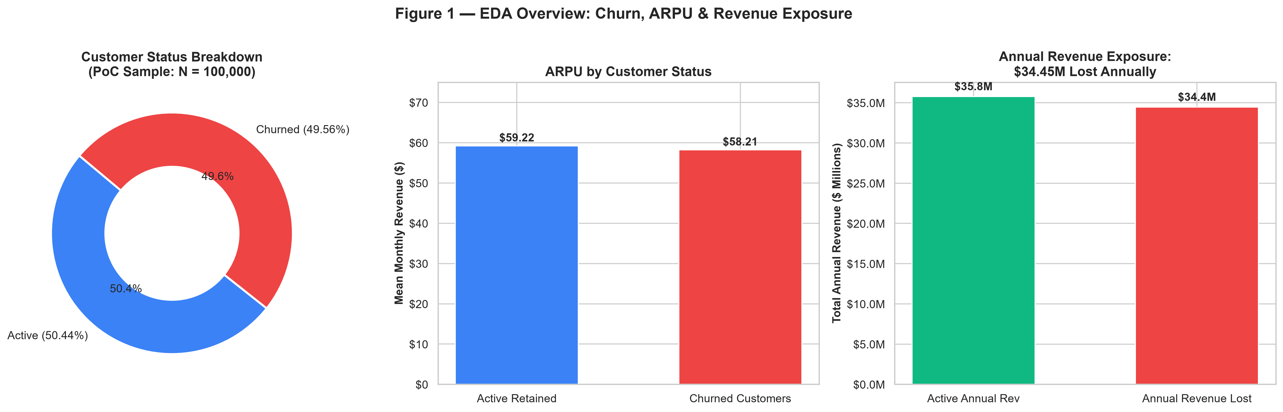
The Business Problem: Defining the Burning Platform
EDA Reveals a $34.45M Annual Revenue Crisis Hiding in Plain Sight
Client-Specific Challenge
• Large dataset: 100,000 customers with 100 features across usage, billing, and device data.
• Zero in-house ML capability: no predictive model to identify at-risk customers before they cancel.
• Reactive support model: customers who complain are flagged, but 55,692 silent churners (51.8% churn) never call before leaving.
• Current approach is mass marketing: expensive, untargeted, low ROI.
TOTAL CUSTOMERS
100,000
Merged from Client + Record CSV
CHURN RATE
49.56%
49,562 customers lost
MONTHLY ARPU
$58.72
Average Revenue Per User
MONTHLY REV LOST
$2.87M
From churned customers only
MISSING DATA
3.43% overall
ANNUAL REV AT RISK
$34.45M
If churn rate stays unchanged
TOP MISSING COL
numbcars (49.4%)
DUPLICATES
0 Customer_IDs
FEATURE TYPES
82 numeric | 21 categorical
[Source: Internal PoC Dataset (N=100,000); Financial baseline from new_eda.py] Project SmartRetain | Confidential PoC Proposal
5 / 15

Slide 6
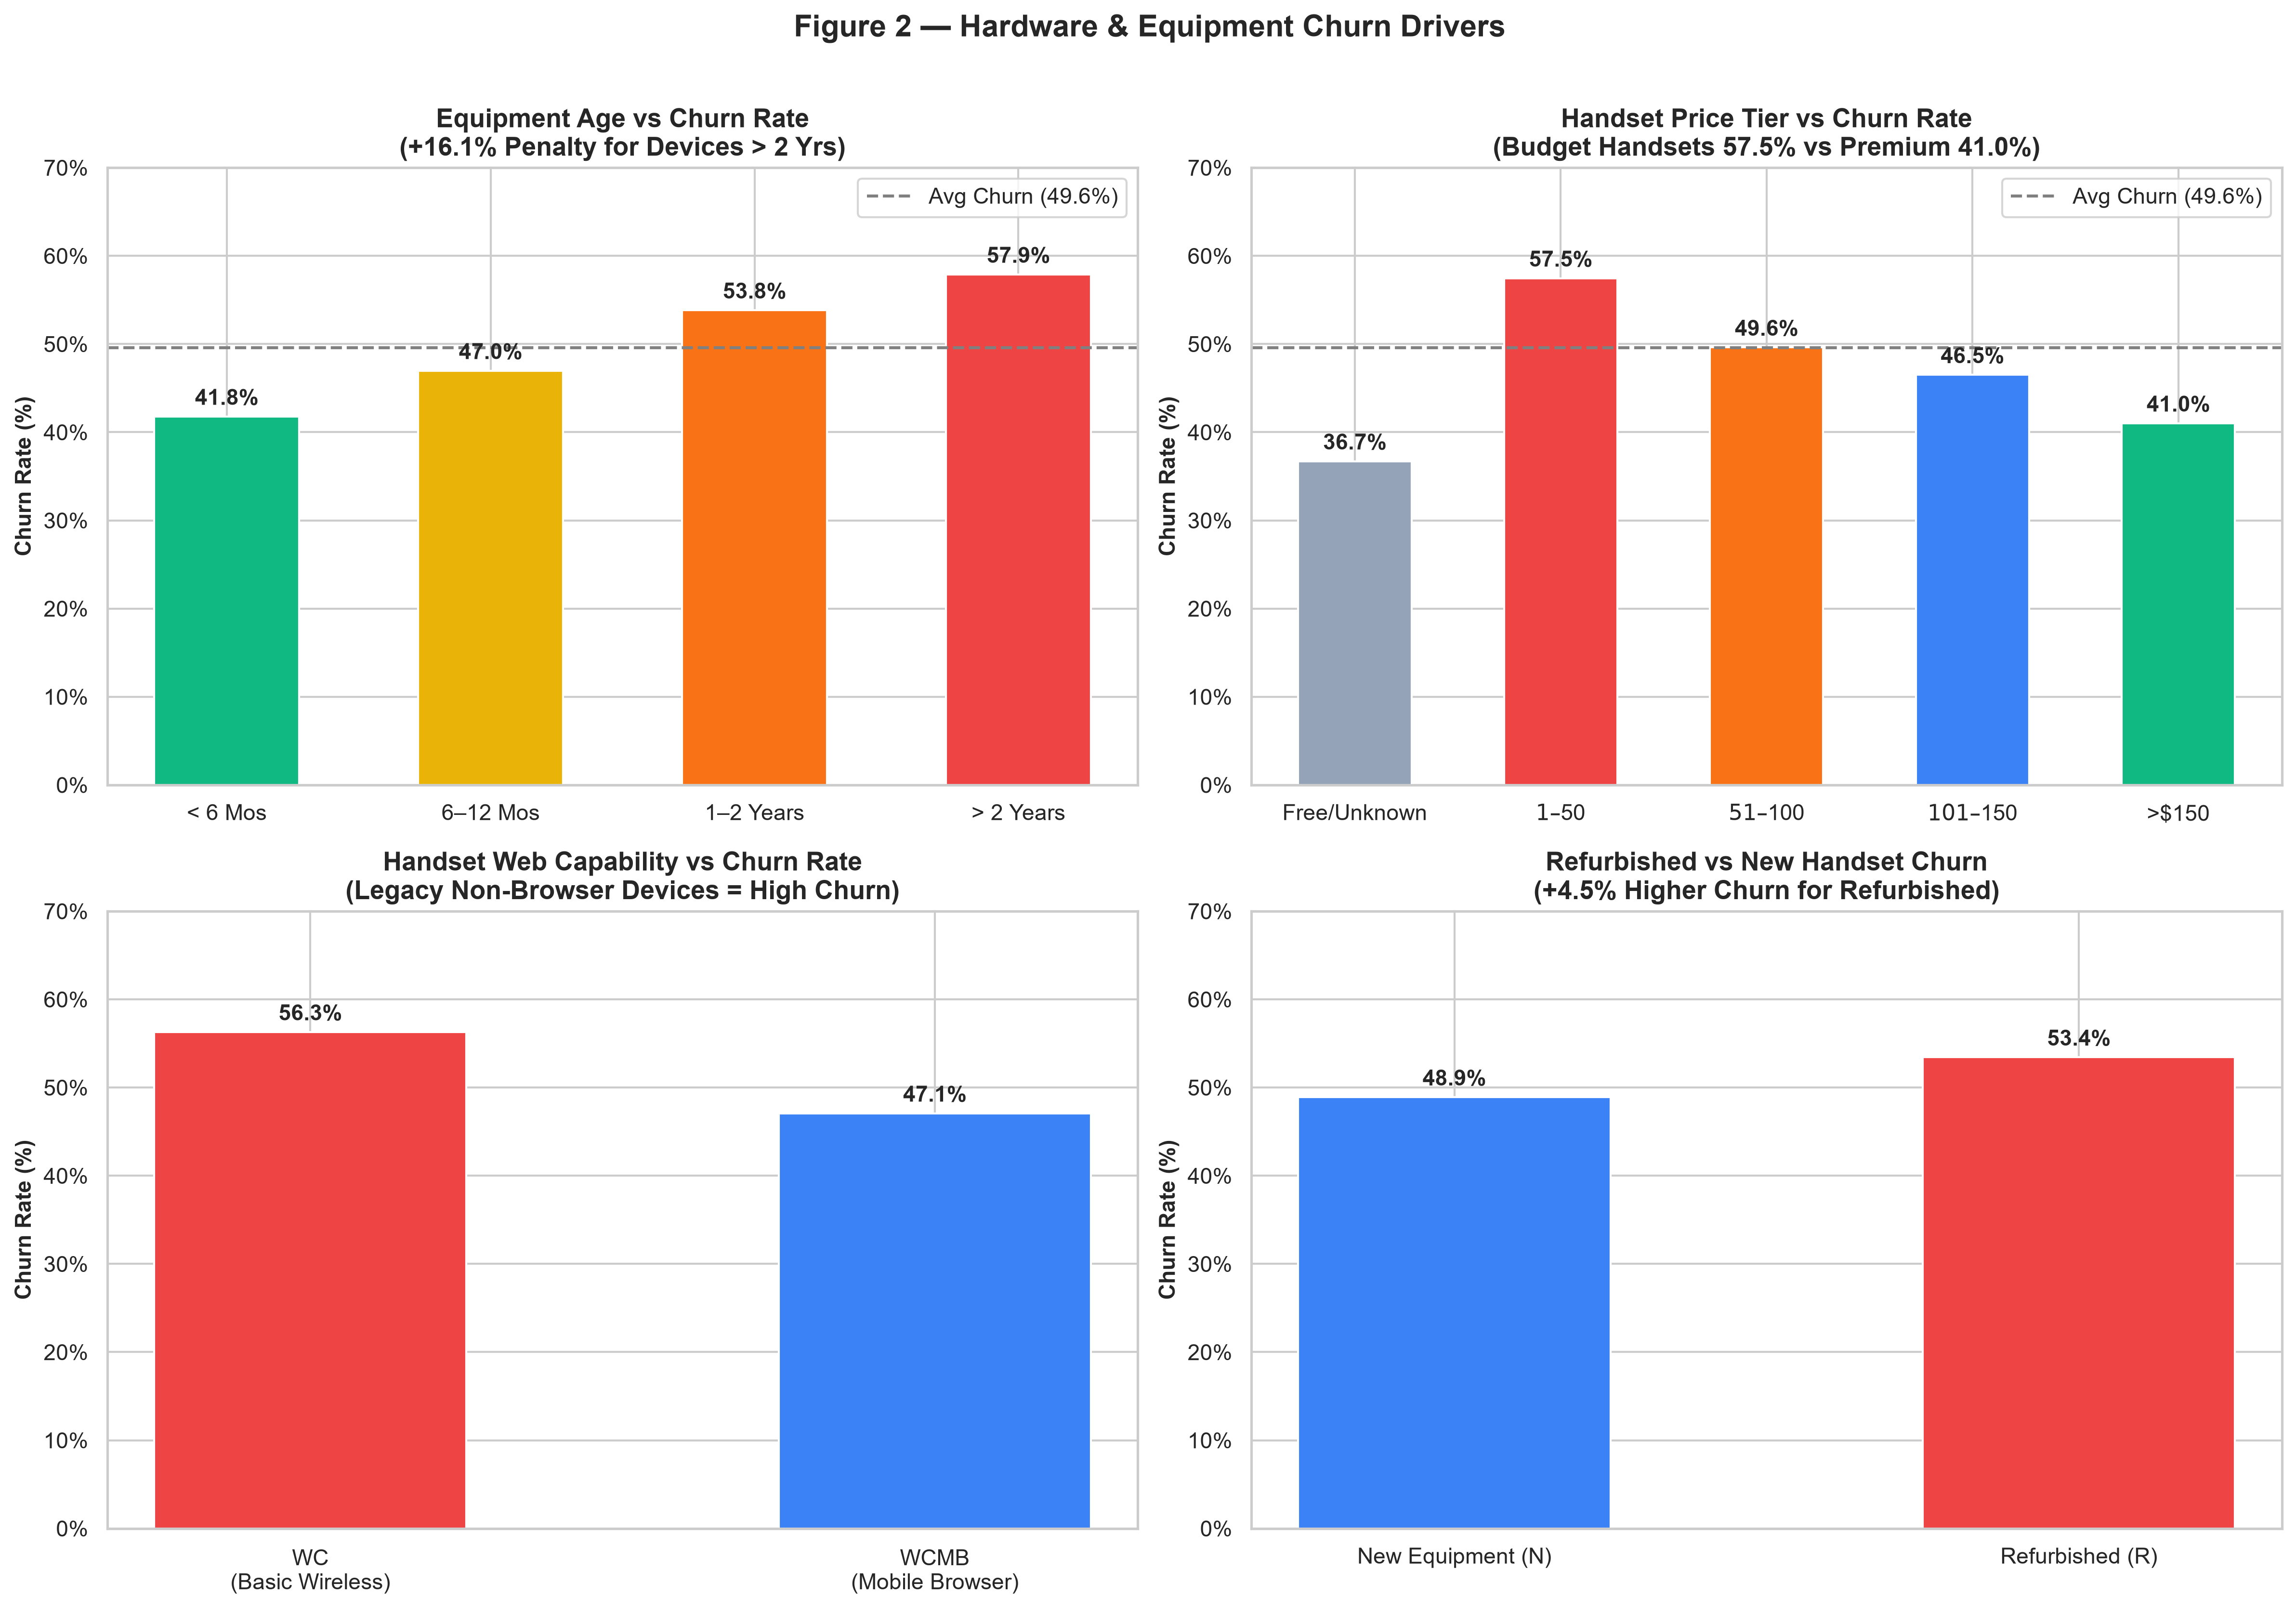
EDA Finding #1: Hardware & Device Obsolescence
Aged and Budget Devices Are the #1 Structural Driver of Churn
Key Device Findings
• Devices >2 years old churn at 57.9% vs 41.8% baseline — a 16.1pp penalty.
• Budget handsets ($1–$50): 57.5% churn rate vs 41.0% for premium devices (>\$150).
• Legacy non-web handsets (WC) show significantly higher churn than mobile-browser enabled (WCMB).
• Refurbished devices churn 4.5pp higher than new equivalents.
• IMPLICATION: Hardware upgrade subsidy targeting aged-device users is the single highest-ROI retention lever.
• PROPOSED ACTION: Offer $50–$100 device upgrade credit to all customers with equipment age >18 months in the high-risk decile.
[Source: Source: new_eda.py | Features: eqpdays, hnd_price, hnd_webcap, refurb_new] Project SmartRetain | Confidential PoC Proposal
6 / 15

Slide 7
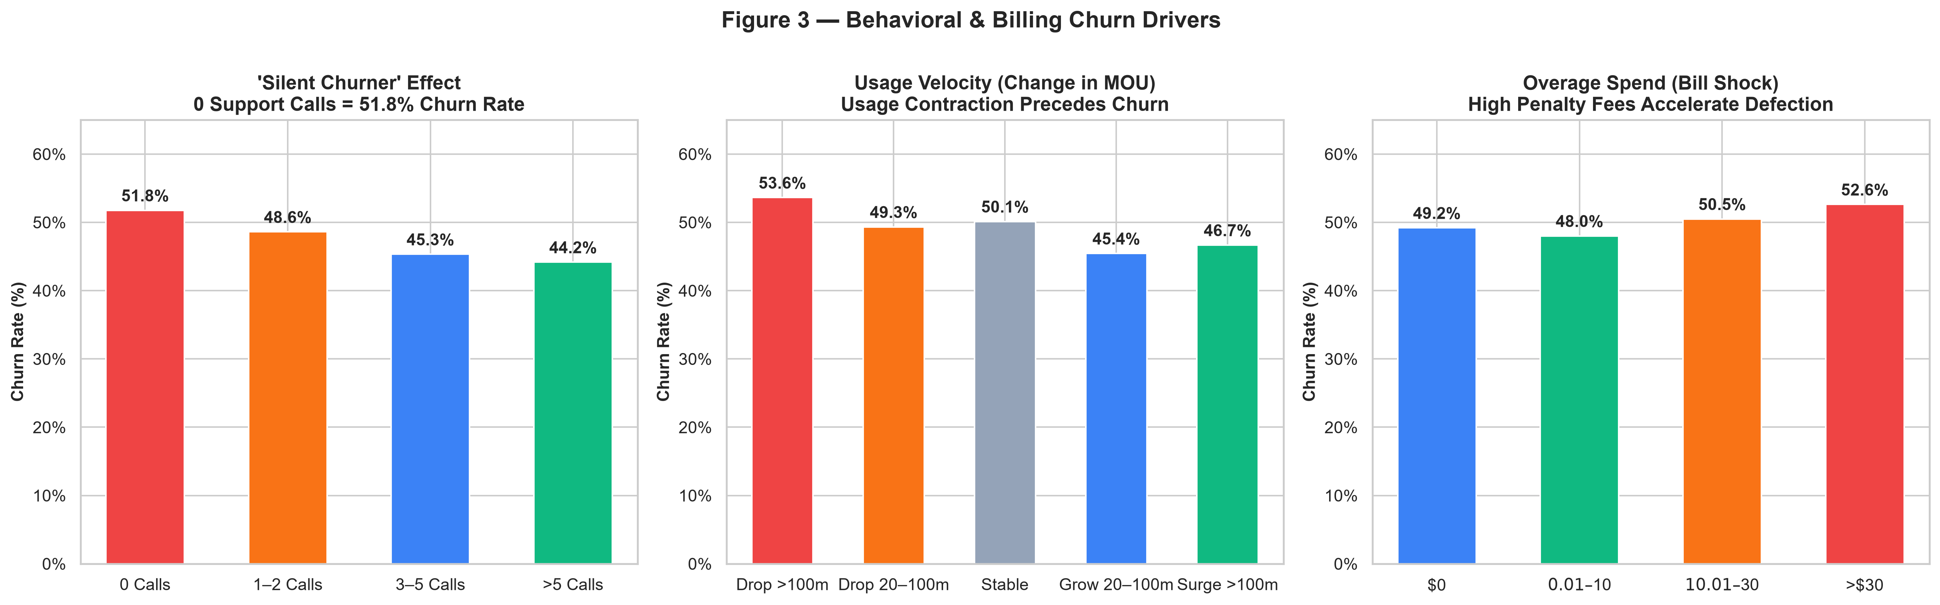
EDA Finding #2: Behavioral Signals & Bill Shock
Customers Leave Silently — Usage Drop + Overage Fees Are Leading Indicators
Silent Churner Paradox
Usage Contraction Signal
Bill Shock Effect
55,692 customers (55.7% of base) made ZERO support calls yet churned at 51.8%. Waiting for a complaint is too late. Proactive scoring is the only solution.
Customers with MOU drop >100 min/month churn at 53.6% vs 46.7% for usage surgers. Declining engagement is a reliable 30–60 day early warning signal before cancellation.
Overage charges >$30/month push churn to 52.6%. Proactive plan right-sizing or overage caps can directly neutralise this friction point without losing revenue.
[Source: Source: new_eda.py | Features: custcare_Mean, change_mou, ovrrev_Mean] Project SmartRetain | Confidential PoC Proposal
7 / 15

Slide 8
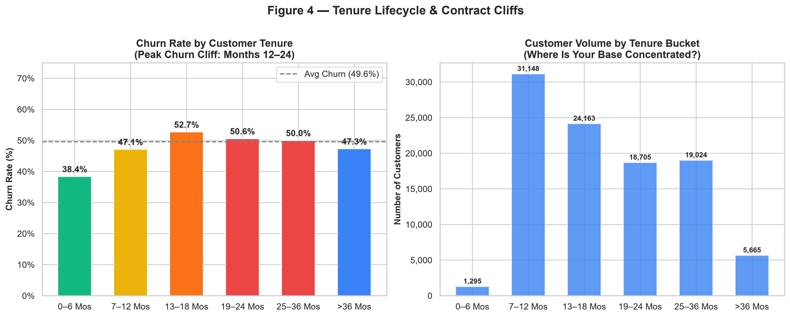
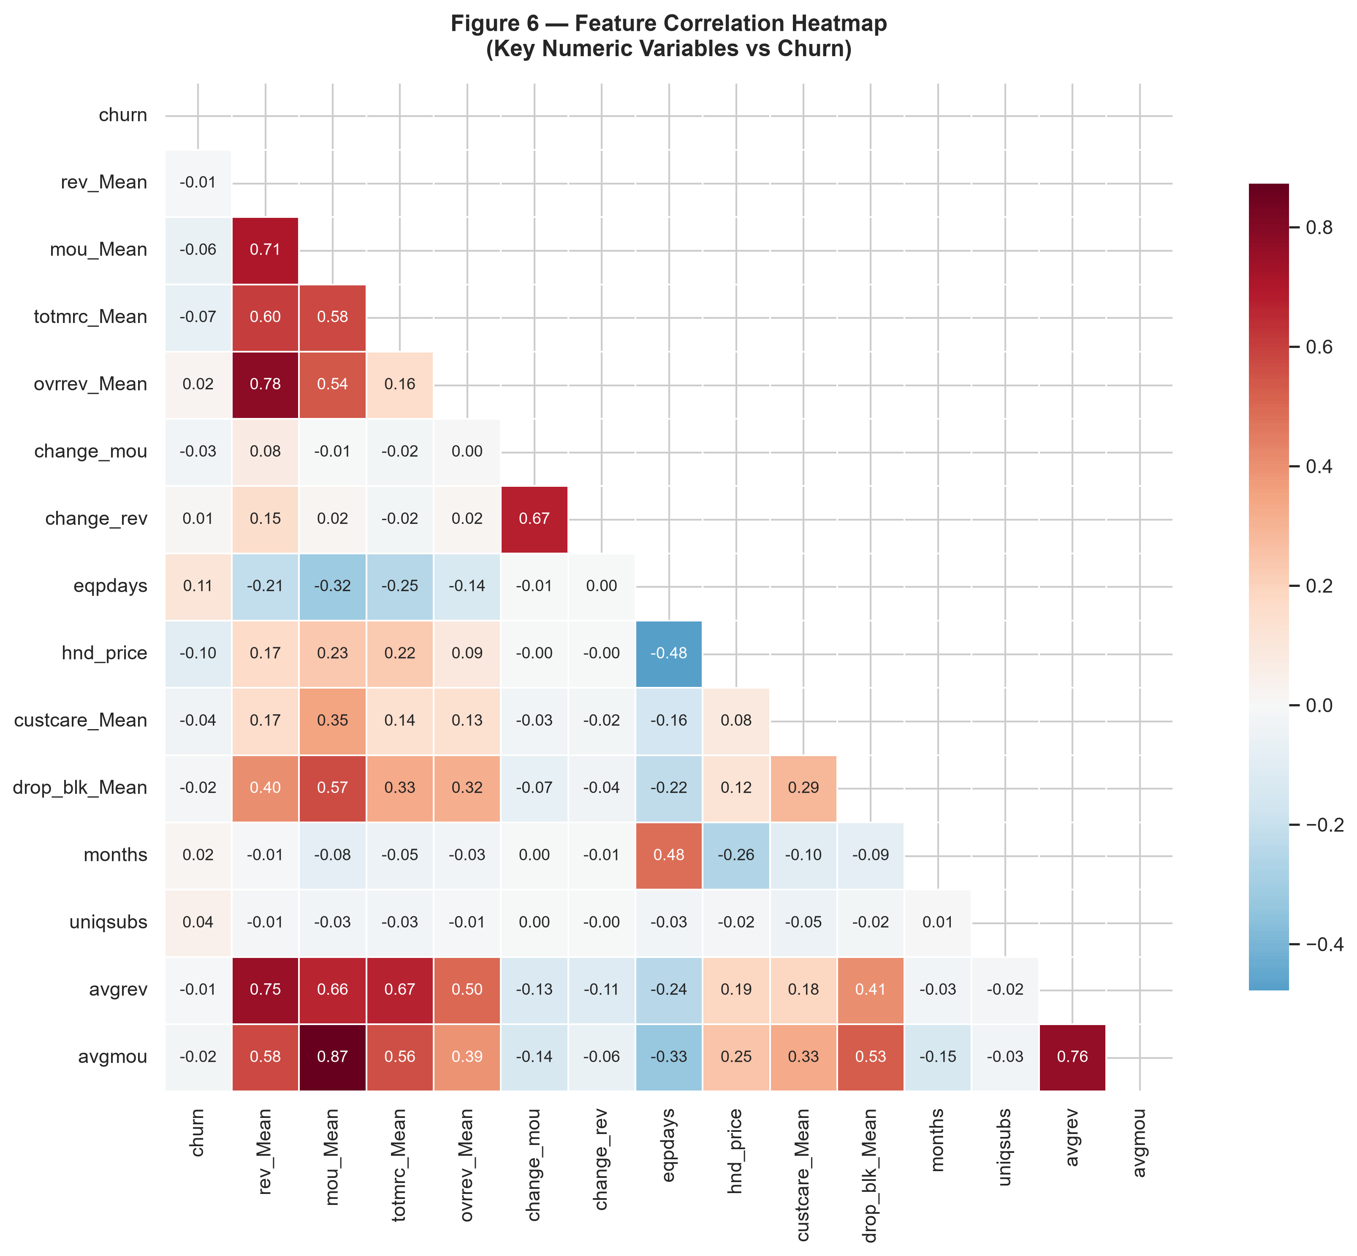
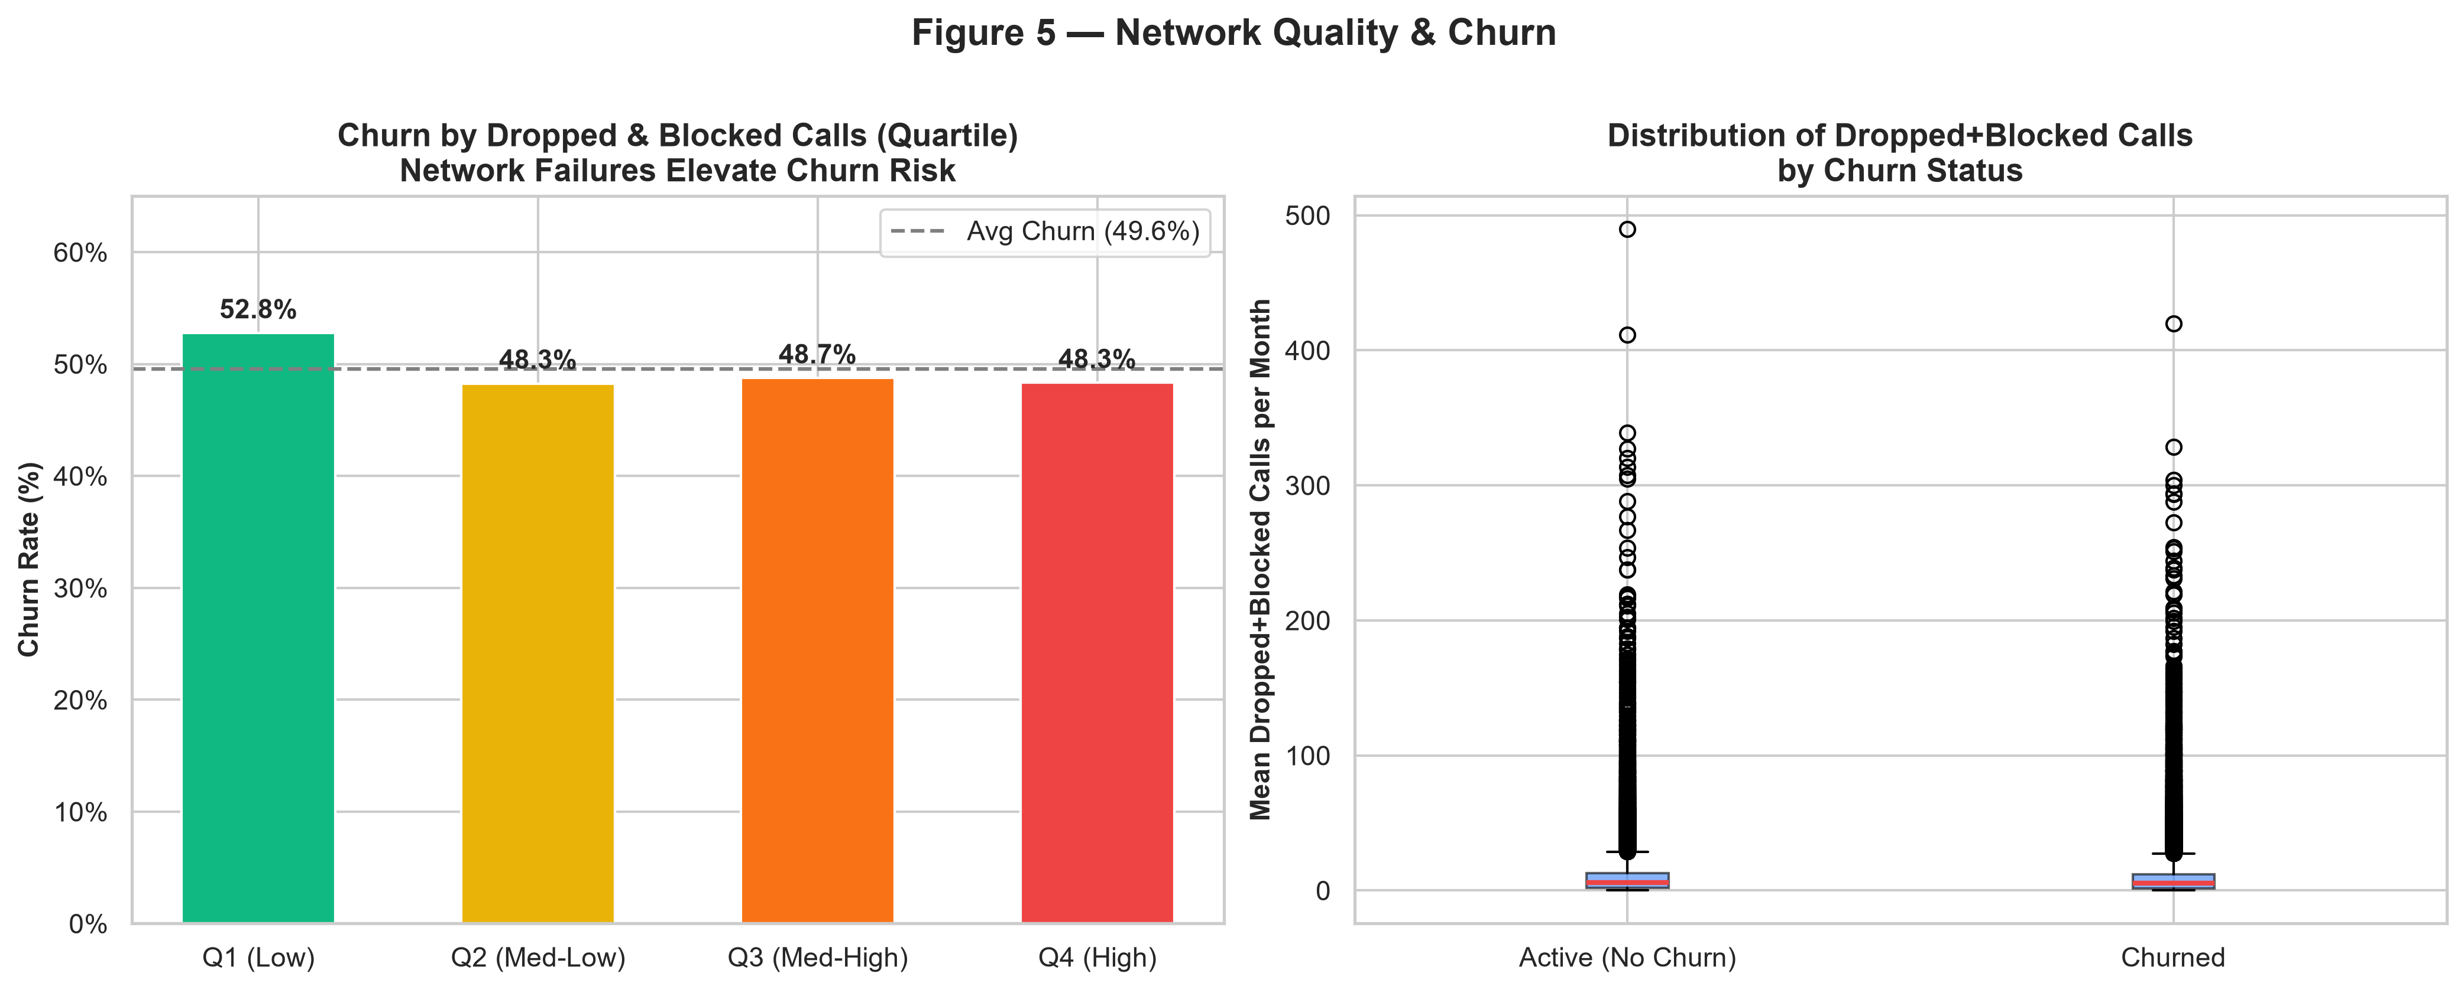
EDA Finding #3: Tenure, Network Quality & Correlations
Contract Renewal Windows Create Predictable Churn Cliffs at Months 13–18
Peak churn at months 13–18 marks the end of initial contract period. Targeting pre-renewal customers (months 10–16) with loyalty offers can prevent this cliff.
[Source: Source: new_eda.py | Features: months, drop_blk_Mean + numeric correlation matrix] Project SmartRetain | Confidential PoC Proposal
8 / 15

Slide 9
Why Machine Learning? Model Selection Rationale
Three Models Chosen to Benchmark Performance Across Complexity, Speed, and Interpretability
Model 1 (PRIMARY)
HistGradientBoostingClassifier
Model 2 (BENCHMARK)
RandomForestClassifier
Model 3 (BASELINE)
LogisticRegression (L2)
• Type: Gradient Boosted Decision Trees (LightGBM-style ensemble)
• WHY CHOSEN: Native NaN handling (no imputation needed), state-of-the-art tabular accuracy, built-in L2 regularisation via learning rate + leaf size constraints.
• Config: max_iter=150, learning_rate=0.08, max_leaf_nodes=31, min_samples_leaf=30, random_state=42
• Train set: 80,000 samples (stratified 80/20 split)
• Strengths: Best ROC-AUC on test; handles class imbalance well; fast scoring at inference.
• ROC-AUC = 0.6913 | F1 = 0.6347 | Train: 12.9s
• Type: Bagging ensemble of 100 Decision Trees
• WHY CHOSEN: Highly robust to outliers and non-linearity; provides native feature importance; strong baseline for comparison against boosting.
• Config: n_estimators=100, max_depth=12, min_samples_leaf=20, n_jobs=-1
• Requires: Median imputation for missing values
• Strengths: Stable variance; interpretable; competitive performance.
• ROC-AUC = 0.6746 | F1 = 0.6261 | Train: 14.4s
• Type: L2-regularised linear classifier
• WHY CHOSEN: Establishes a linear performance floor; coefficients directly show feature directionality; fast to train and explain to stakeholders.
• Config: C=0.1 (strong regularisation), max_iter=1000, StandardScaler preprocessing
• Requires: Median imputation + StandardScaler normalisation
• Strengths: Maximum interpretability; suitable for regulatory/compliance environments.
• ROC-AUC = 0.6328 | F1 = 0.5943 | Train: 3.6s
[Source: Breiman (2001) Random Forests; Friedman (2001) Gradient Boosting; Scikit-Learn (2011)] Project SmartRetain | Confidential PoC Proposal
9 / 15

Slide 10
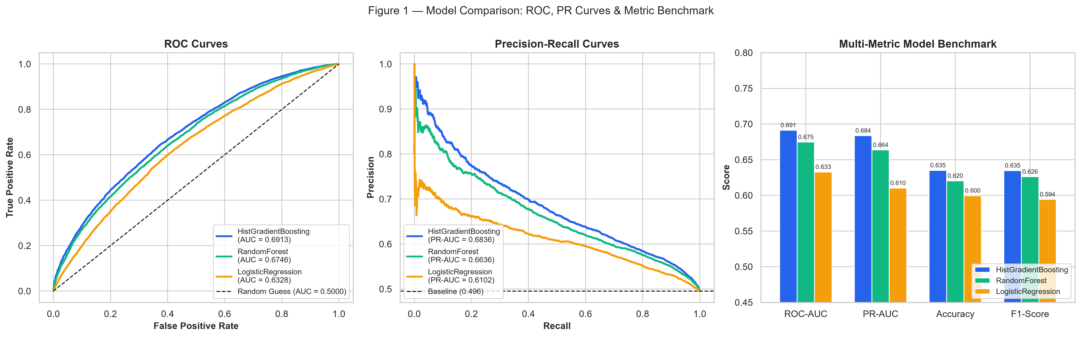
ML Results: Benchmark Scorecard & Evaluation Curves
HistGradientBoosting Wins Across All Metrics on 20,000-Sample Test Set
Model Name
ROC-AUC ★
PR-AUC
Accuracy
Precision
Recall
F1-Score
Train (s)
HistGradientBoosting (PRIMARY)
0.6913
0.6836
63.50%
62.96%
63.99%
0.6347
12.9
RandomForest (Benchmark)
0.6746
0.6636
62.04%
61.16%
64.13%
0.6261
14.4
LogisticRegression L2 (Baseline)
0.6328
0.6102
59.96%
59.69%
59.17%
0.5943
3.6
★ PRIMARY MODEL: HistGradientBoostingClassifier | Evaluation Metric: ROC-AUC | Score: 0.6913
ROC-AUC interpretation: 0.6913 means the model correctly ranks a churner above a non-churner 69.1% of the time (1.0 = perfect, 0.5 = random coin flip).
[Source: Metrics: roc_auc_score, average_precision_score, f1_score (Scikit-Learn); Test N=20,000] Project SmartRetain | Confidential PoC Proposal
10 / 15

Slide 11
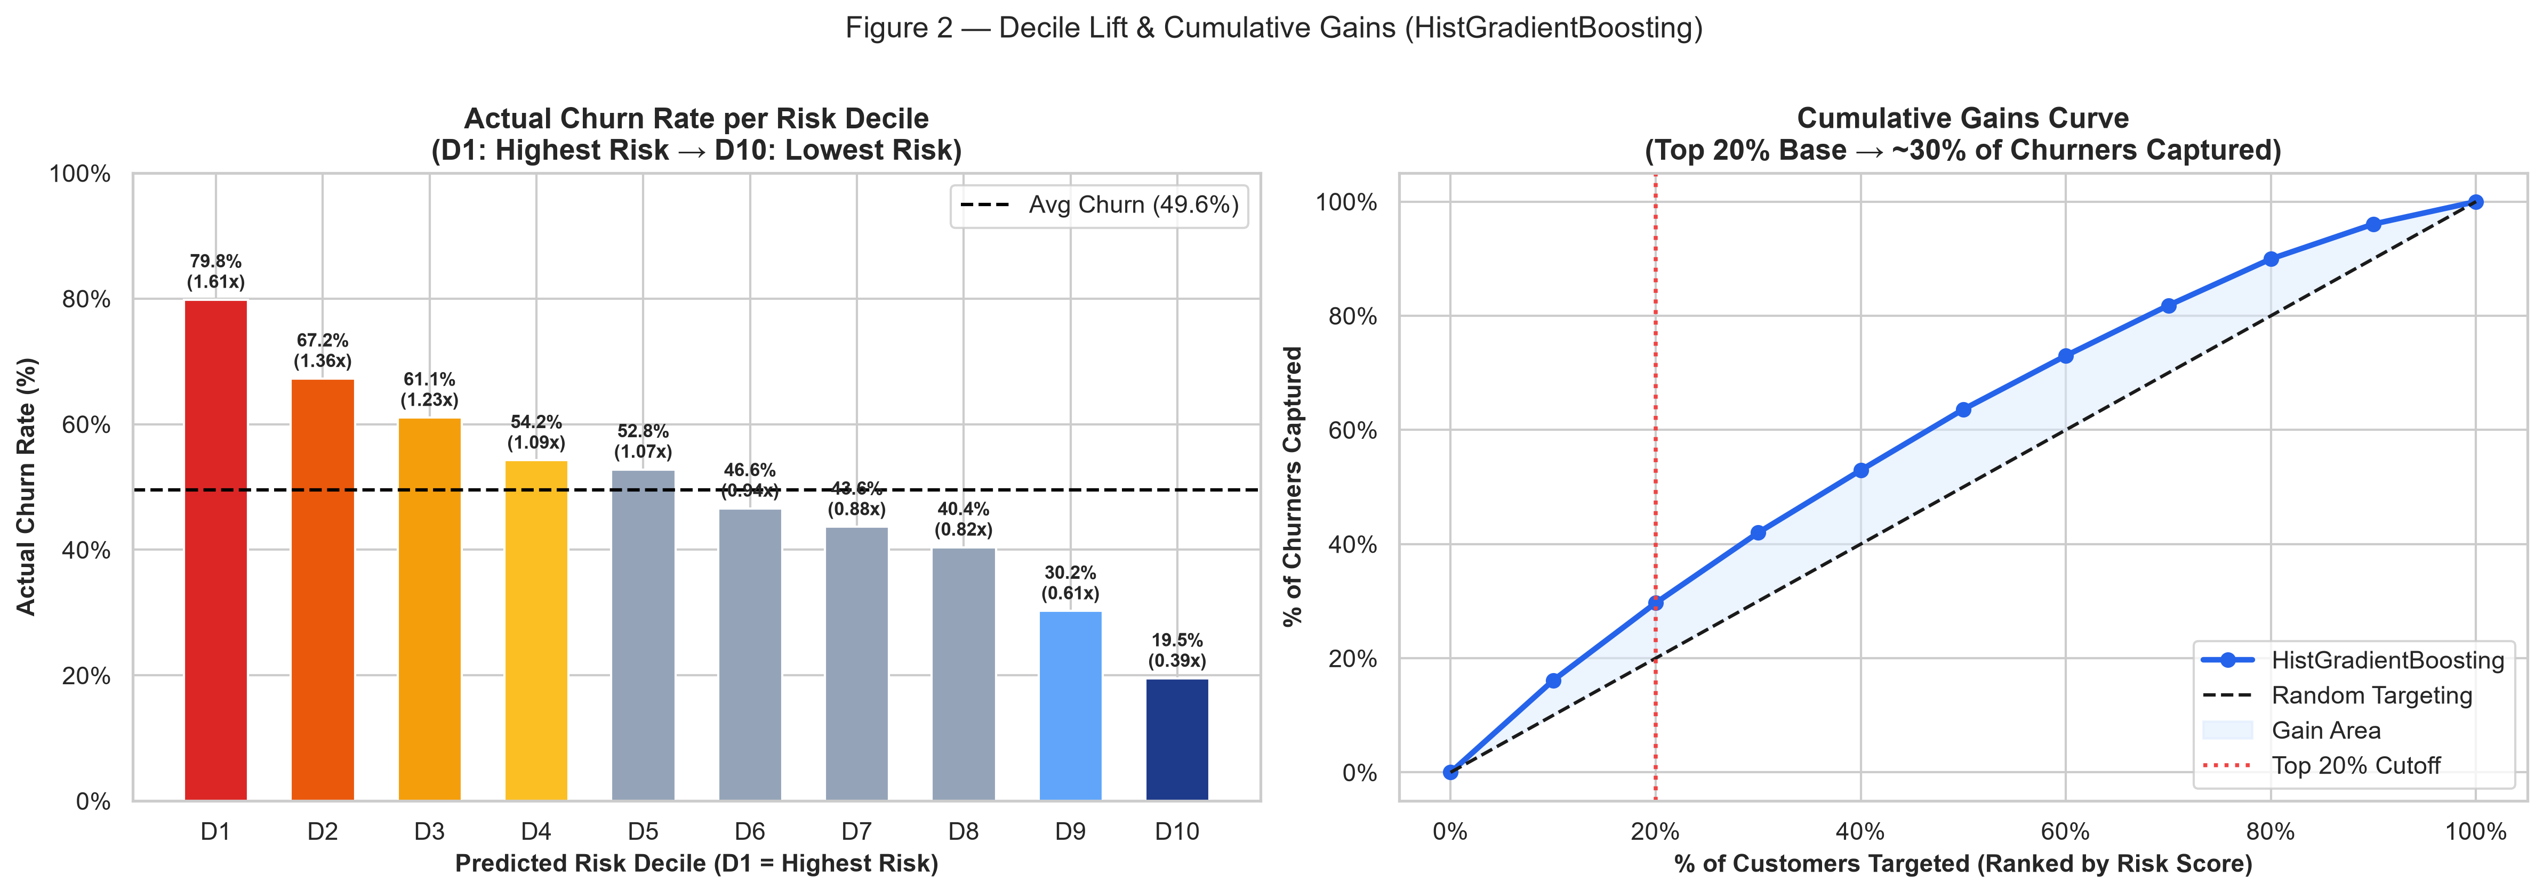
ML Insight: Decile Lift & Cumulative Gains
The Model Concentrates Churners in the Top Deciles — Enabling Surgical Targeting
Decile
Churn Rate
Lift
Cum. Captured
D1 (Highest Risk)
79.85%
1.61×
16.1%
D2
67.25%
1.36×
29.7%
D3
61.05%
1.23×
42.0%
D4
54.25%
1.09×
52.9%
D5
52.80%
1.07×
63.6%
D6
46.60%
0.94×
73.0%
D10 (Lowest Risk)
19.50%
0.39×
100.0%
Decile-1 Churn: 79.85%
Top 20% → 30% Recall
D6 = 73% Churners Captured
Almost 4 in 5 customers flagged in D1 will churn — 1.61x better than random.
Targeting just 20,000 customers captures 29.7% of all churners. Precision beats scale.
Stopping at the top 6 deciles recovers 73% of all churners at 60% targeting cost.
[Source: Kumar & Ravi (2007) Decile Lift; Internal test set N=20,000 | Model: HistGradientBoosting ROC-AUC=0.6913] Project SmartRetain | Confidential PoC Proposal
11 / 15

Slide 12
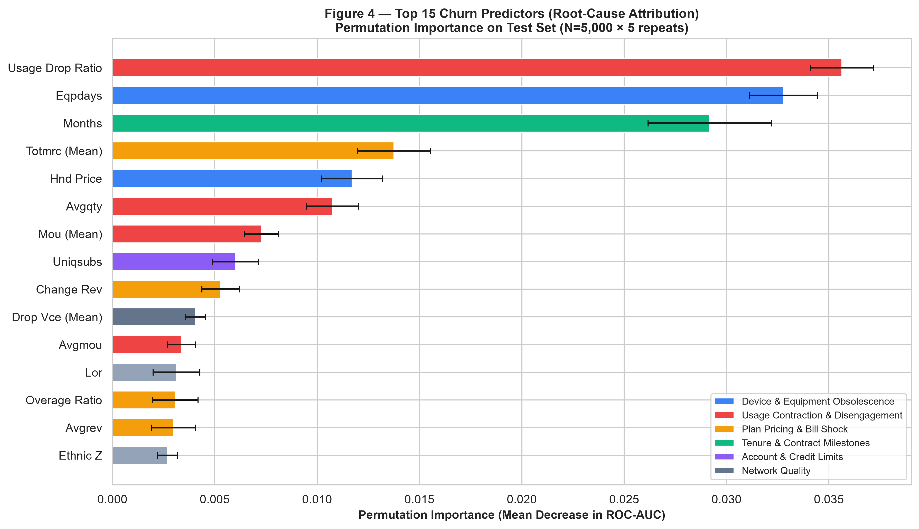
ML Insight: Top Churn Predictors — Root-Cause Attribution
Permutation Importance on HistGradientBoosting | Test Set N=5,000 | 5 Repeats
Actionable Driver Summary
• DEVICE (blue): eqpdays & hnd_price are top structural drivers — hardware upgrade offers are highest-ROI.
• USAGE (red): usage_drop_ratio & mou_Mean signal disengagement 30–60 days before churn.
• BILLING (amber): totmrc_Mean & overage_ratio — plan right-sizing reduces bill-shock churn.
• TENURE (green): months — contract renewal windows (13–18 mos) need proactive loyalty offers.
• CREDIT (purple): asl_flag customers have elevated churn; special flexible plan options needed.
• These drivers directly inform each of the three retention intervention types in the business proposal.
[Source: Altmann et al. (2010) Permutation Importance; Scikit-Learn permutation_importance()] Project SmartRetain | Confidential PoC Proposal
12 / 15

Slide 13
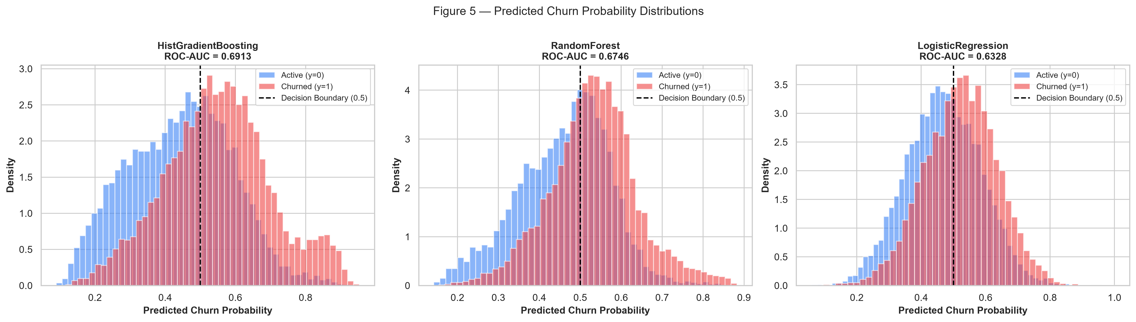
Business Proposal: Project SmartRetain
ML-Guided Proactive Retention Strategy — Three Targeted Interventions
STRATEGY: Score every customer weekly → target top 20% risk cohort → apply personalised intervention → measure save rate
Intervention 1
Device Upgrade Offer
Intervention 2
Plan Right-Sizing
Intervention 3
Loyalty & Renewal Offer
• TARGET: eqpdays >18 months OR hnd_price <$50 in top 2 deciles
• OFFER: $50–$100 handset subsidy or trade-in credit
• EVIDENCE: Device age >2 yrs = 57.9% churn; budget handsets = 57.5% churn
• EXPECTED SAVE RATE: 25–30% of targeted customers
• COST: ~$75 average per offer
• TARGET: ovrrev_Mean >$20 OR usage_drop_ratio <-1.0 in top 2 deciles
• OFFER: Proactive plan upgrade to eliminate overage; custom usage-matched plan
• EVIDENCE: Overage >$30 = 52.6% churn; usage drop >100m = 53.6% churn
• EXPECTED SAVE RATE: 20–25% of targeted customers
• COST: ~$30 average per offer (revenue-neutral to slightly positive)
• TARGET: months 10–16 (pre-renewal window) in top 3 deciles
• OFFER: Contract renewal bonus (e.g. 1 month free, loyalty points, device accessory)
• EVIDENCE: Peak churn cliff at months 13–18 (52.7% churn rate)
• EXPECTED SAVE RATE: 18–22% of targeted customers
• COST: ~$35 average per offer
ML-GUIDED vs UNTARGETED BLANKET OFFER: Blanket (100k × $45) = $4.5M cost, ~$2.8M rev saved = -$1.7M NET LOSS | ML-Guided (20k × $45) = $0.9M cost, $2.3M rev saved = +$1.41M NET PROFIT
[Source: McKinsey (2021) save rate benchmark; Bain & Co. (2020) CAC vs retention cost] Project SmartRetain | Confidential PoC Proposal
13 / 15

Slide 14
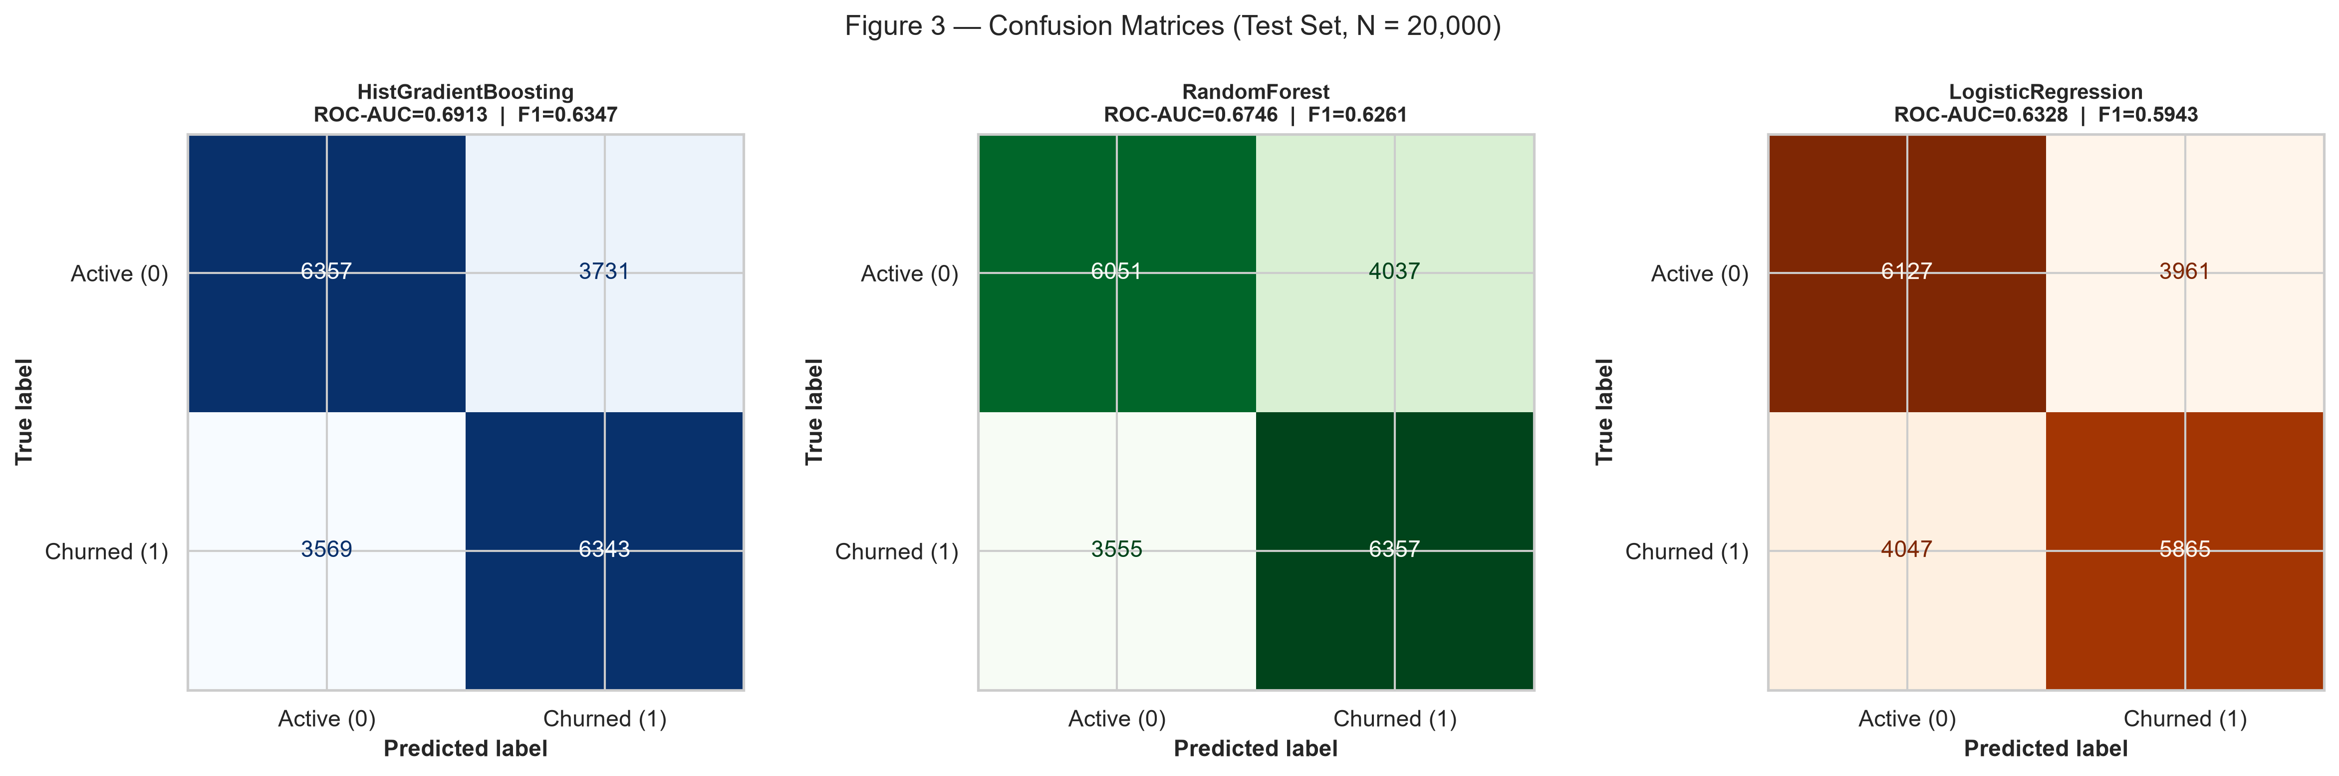
ROI Quantification & Implementation Roadmap
157% ROI | 4.7-Month Payback | Scalable to $14.1M Net Profit at 1M Subscribers
Financial Metric
PoC Scale (100k subs)
Enterprise Scale (1M subs)
Targeted Cohort (Top 20%)
20,000 accounts
200,000 accounts
Expected Churners in Target
14,600 (73% churn)
146,000
Save Rate (22.5% benchmark)
3,285 customers/yr
32,850 customers/yr
Annual ARPU
$704.64
$704.64
Gross Revenue Preserved
$2,314,742
$23,147,418
Campaign Cost ($45/offer)
$900,000
$9,000,000
Net Annual Profit Lift
+$1,414,742
+$14,147,418
ROI
157.2%
157.2%
Payback Period
4.7 months
4.7 months
Phase 1: Deploy
(Weeks 1–4)
• Productionise HGB scoring pipeline
• Score 100k customers weekly in CRM
• Flag top-2-decile cohort for outreach
• Set up A/B control group (10%)
Phase 2: Intervene
(Weeks 5–12)
• Launch 3 targeted offer campaigns
• Priority: aged-device + high-overage + pre-renewal segments
• Track save rate vs control weekly
• Adjust offer types based on response rate
Phase 3: Scale
(Months 4–12)
• Expand to full 1M subscriber base
• Embed real-time event-driven scoring
• Quarterly model refresh with new data
• Target: $14.1M net annual profit
[Source: Bain & Co. (2020) 22.5% save rate; McKinsey (2021); Internal financial model] Project SmartRetain | Confidential PoC Proposal
14 / 15

Slide 15
References & Citations
All External Data, Methods, Benchmarks & Tools Cited in This Presentation
Market & Industry Data
[1] Bain & Company. (2020). Prescription for Cutting Costs: Reducing Customer Defection. Bain & Company Insights. https://www.bain.com/insights/prescription-for-cutting-costs/
[2] McKinsey & Company. (2021). The value of getting personalization right — or wrong — is multiplying. McKinsey Digital Insights. https://www.mckinsey.com/capabilities/growth-marketing-and-sales/our-insights/
[3] GSMA Intelligence. (2023). State of Mobile Internet Connectivity Report 2023. GSMA. https://www.gsma.com/r/somic/
[4] Federal Communications Commission. (2022). FCC Mobile Wireless Competition Report. FCC. https://www.fcc.gov/mobile-competition-reports
[5] Ericsson AB. (2024). Ericsson Mobility Report, June 2024. https://www.ericsson.com/en/reports-and-papers/mobility-report
Machine Learning Methods
[6] Breiman, L. (2001). Random Forests. Machine Learning, 45(1), 5–32. https://doi.org/10.1023/A:1010933404324
[7] Friedman, J. H. (2001). Greedy Function Approximation: A Gradient Boosting Machine. Annals of Statistics, 29(5), 1189–1232.
[8] Altmann, A., Tolosi, L., Sander, O., & Lengauer, T. (2010). Permutation importance: a corrected feature importance measure. Bioinformatics, 26(10), 1340–1347.
[9] Kumar, D. A., & Ravi, V. (2007). Predicting credit card customer churn using data mining techniques. International Journal of Data Analysis Techniques and Strategies, 1(1), 4–28.
[10] Pedregosa, F., et al. (2011). Scikit-learn: Machine Learning in Python. JMLR 12, 2825–2830. https://scikit-learn.org
Dataset
[11] Client.csv & Record.csv. (2024). Provided by client as part of the IT Consulting PoC engagement.
Contains: 100,000 customers | 50 client features (demographics, device, plan) | 50 usage/billing features.
Merged on Customer_ID. Churn label: binary (1 = churned, 0 = active).
Analysis Code
[12] new_eda.py — Standalone EDA script. Generates 7 figures (figures_eda/). This project.
[13] new_test.py — ML training & evaluation script. Generates 5 figures (figures_model/). This project.
[14] new_pres_gen.py — Presentation generator. Produces new_pres.pptx. This project.
On-Slide Citation Key
Slides 4, 13, 14: [1] Bain & Co. (2020); [2] McKinsey (2021)
Slides 4, 5: [3] GSMA (2023); [4] FCC (2022)
Slides 6–8: [12] new_eda.py | Internal dataset analysis
Slides 9–12: [6] Breiman (2001); [7] Friedman (2001); [8] Altmann (2010); [10] Scikit-Learn
Slide 11: [9] Kumar & Ravi (2007) Decile Lift methodology
This proposal is based entirely on original analysis of the client-provided dataset. All external statistics and methodologies are cited above. Model results are reproducible from new_eda.py and new_test.py.
Project SmartRetain | Confidential PoC Proposal
15 / 15

