Slide 1
PROJECT SMARTRETAIN
Machine Learning-Driven Customer Retention
& Revenue Preservation Strategy
A Proof of Concept (PoC) Business Transformation Proposal for Executive Leadership
Prepared by: IT Consulting Associate — AI & Data Science Practice
Client: Telecommunications Provider | Engagement Type: PoC Machine Learning Project
Dataset: Client.csv + Record.csv | N = 100,000 customers | 100 merged features
Stack: Python 3 · Scikit-Learn · HistGradientBoosting · RandomForest · Logistic Regression
Confidential — For Executive Review Only

Slide 2
Presentation Roadmap
How This Proposal Is Structured
01
02
03
04
05
06
07
Executive Summary
Market & Industry Context
Data & EDA Overview
Root-Cause Analysis
Machine Learning Models
Business Proposal & ROI
References
The burning platform, key findings & business case at a glance
Telecom churn benchmarks, competitive landscape, external data
Dataset profile, data quality, financial baseline
Equipment, billing, behavioral & tenure drivers of churn
Model selection, training, benchmark scorecard & decile lift
Targeted strategy, quantified revenue impact, implementation plan
All external data, papers, and benchmarks cited in this report
Each section builds logically from data evidence through to a quantified business recommendation.
Project SmartRetain — Confidential PoC Proposal
2 / 15

Slide 3
Executive Summary
Key Findings, ML Results & Quantified Business Case — One Page
The Burning Platform
ML PoC Results
Root-Cause Drivers
Business Case ROI
CHURN RATE
49.56%
ANNUAL REVENUE AT RISK
$34.45 Million
CORE CHALLENGE
100k customer records; no in-house ML to flag at-risk customers before cancellation.
STRATEGIC RISK
Acquiring new subscribers costs 5-7x more than retaining existing ones ($315 CAC vs $45 retention offer).
PRIMARY MODEL
HistGradientBoosting
EVALUATION METRIC
ROC-AUC
SCORE
0.6913
DECILE-1 CHURN
79.85% (1.61x lift over random)
KEY FINDING
Top 20% of predicted-risk customers contain 30% of all churners — 1.48x precision gain.
DEVICE OBSOLESCENCE
Equipment >2 yrs: 57.9% churn vs 41.8% baseline (+16.1pp)
SILENT CHURNERS
0 support calls = 51.8% churn — customers leave without warning
BILL SHOCK
Overage >$30 drives churn above 52.6%
CONTRACT CLIFF
Peak churn: months 13–18 (renewal window)
TARGET COHORT
Top 20% — 20,000 accounts
SAVED CUSTOMERS
3,285 accounts / year (22.5% save rate)
GROSS REV PRESERVED
$2,314,742 / year
CAMPAIGN COST
$900,000 ($45 per offer)
NET PROFIT LIFT
+$1,414,742 / year
ROI
157% — Payback: 4.7 months
Source: Internal PoC Analysis (Client.csv + Record.csv, N=100,000) | Project SmartRetain — Confidential PoC Proposal
3 / 15

Slide 4
Market & Industry Context
The Economics of Retention in a Saturated Telecom Market
Telecommunications Macro Context
• Global mobile subscriber growth has flattened at ~1-2% CAGR in mature markets (GSMA, 2023).
• U.S. wireless market penetration exceeds 95%; growth now driven by ARPU uplift, not new subs.
• Average annual churn in U.S. telecom: 20-35% postpaid; up to 50%+ for prepaid (FCC, 2022).
• Customer Acquisition Cost (CAC): $300-$400 per new subscriber (McKinsey, 2021).
• Retention cost: $30-$60 per saved customer via targeted intervention (Bain & Co., 2020).
• A 5% reduction in churn increases profit by 25-95% in subscription businesses (Bain, 2020).
• Proactive ML-guided retention programs save 20-30% of targeted at-risk customers (McKinsey, 2021).
INDUSTRY AVG CHURN (U.S. POSTPAID)
20 - 35%
vs. Client's 49.56%
CAC VS RETENTION COST RATIO
5 - 7x
New sub costs 5-7x more to acquire than retain
PROFIT LIFT FROM 5% CHURN REDUCTION
25 - 95%
Compounding effect on LTV (Bain & Co., 2020)
ML RETENTION SAVE RATE (INDUSTRY)
20 - 30%
Of targeted high-risk customers saved via proactive offer
Source: McKinsey (2021); Bain & Co. (2020); GSMA Intelligence (2023); Ericsson Mobility Report (2024) | Project SmartRetain — Confidential PoC Proposal
4 / 15

Slide 5
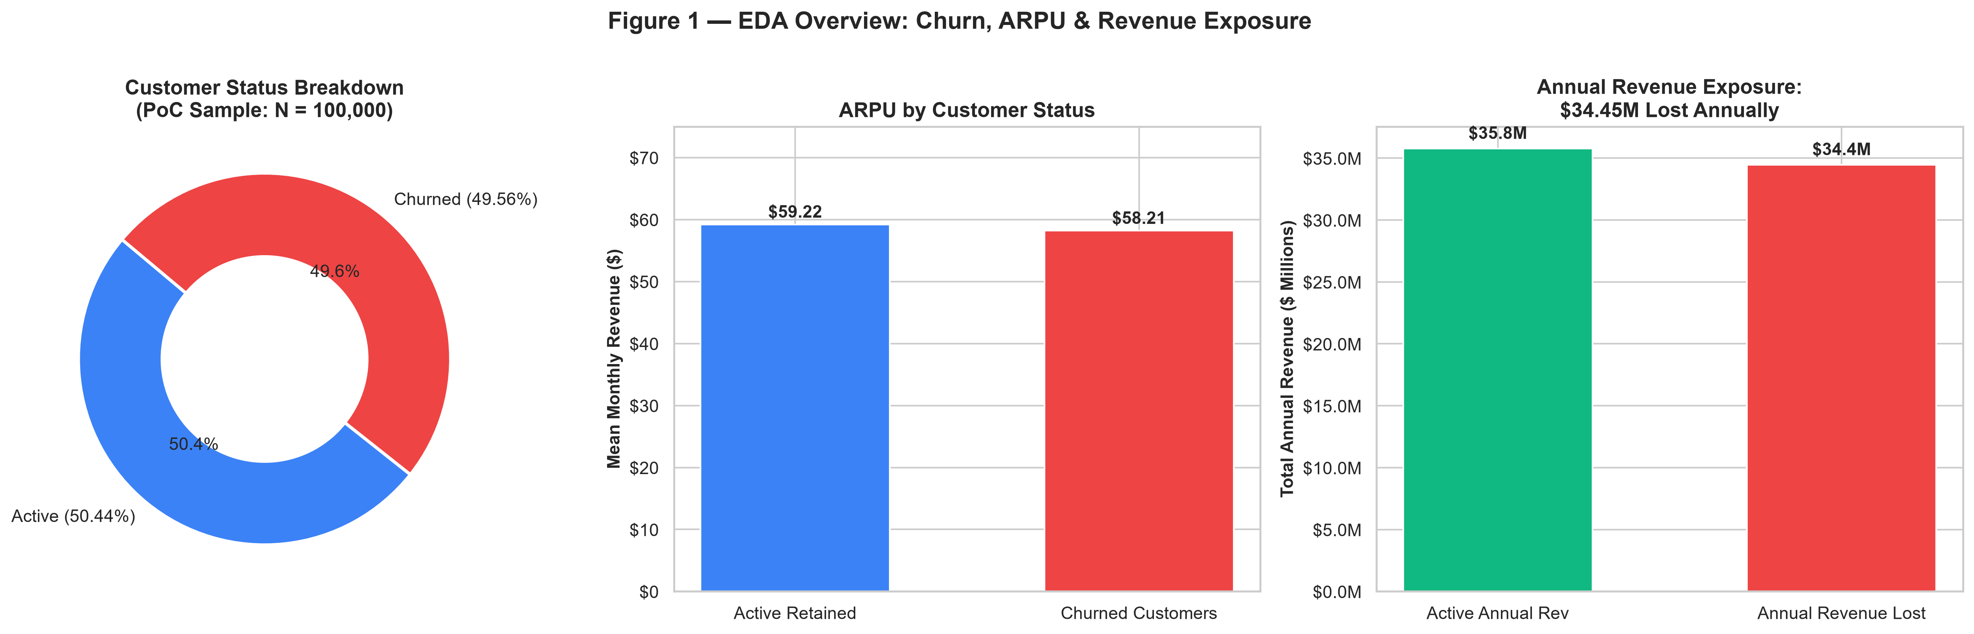
Dataset Profile & EDA Overview
100,000 Customer Records | 100 Merged Features | 49.56% Churn Rate
TOTAL CUSTOMERS
100,000
Merged from Client + Record
TOTAL FEATURES
100
50 client + 50 usage/billing
OVERALL CHURN
49.56%
49,562 churned customers
MISSING DATA
3.43%
43 of 100 columns have NaN
DUPLICATE IDS
0
No duplicate Customer_IDs
NUMERIC / CAT
82 / 21
After feature engineering
Source: Internal PoC Dataset: Client.csv + Record.csv (merged on Customer_ID) | Project SmartRetain — Confidential PoC Proposal
5 / 15

Slide 6
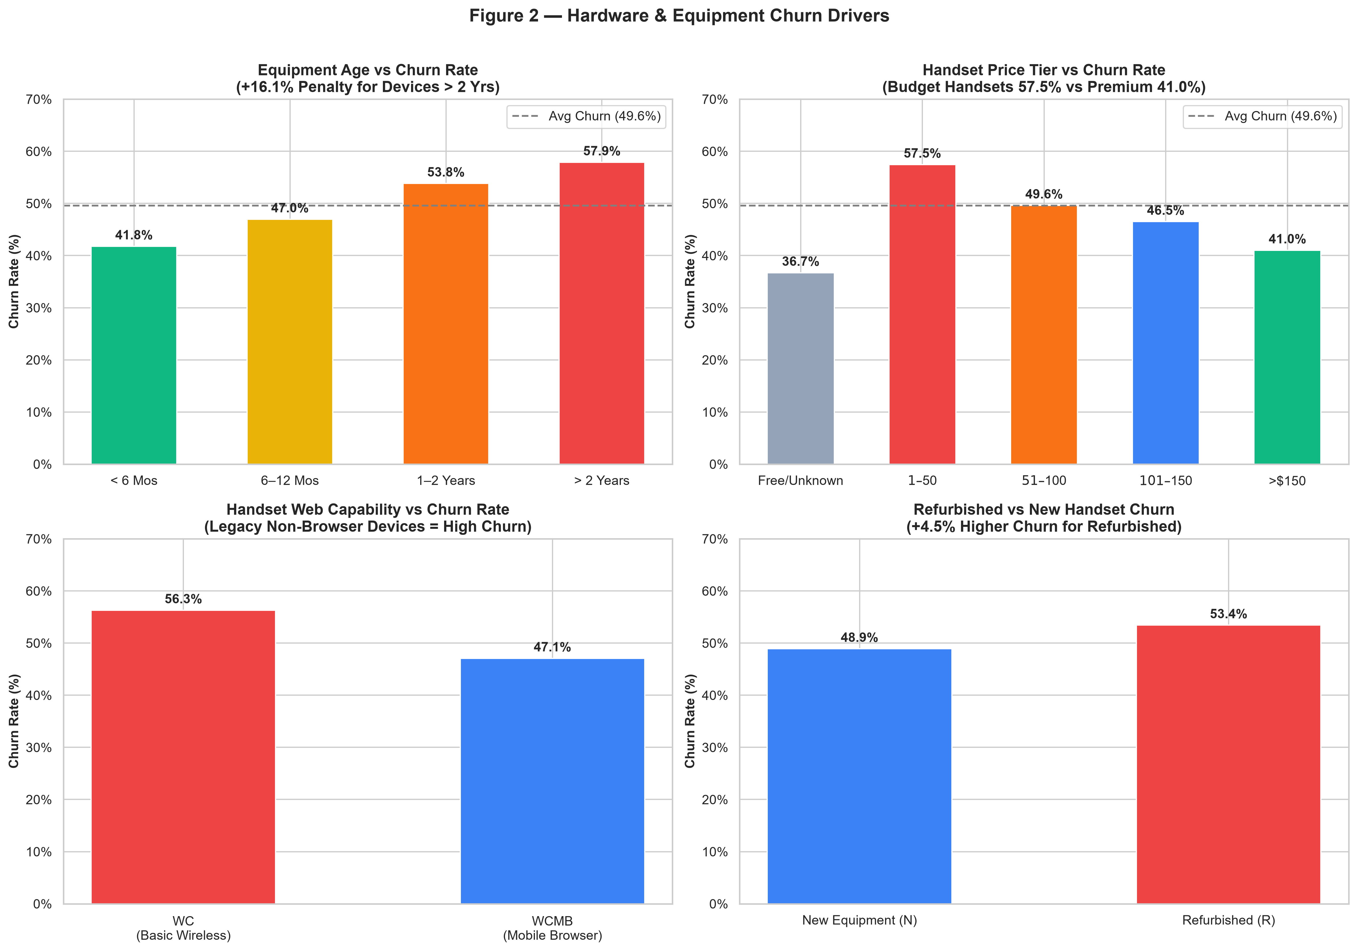
Root-Cause Analysis: Hardware & Device Obsolescence
Older & Budget Devices Are the #1 Structural Driver of Churn
Key Device Insights
• Devices >2 years old: 57.9% churn — +16.1pp above average.
• Budget handsets ($1-$50): 57.5% churn vs 41.0% for premium (>$150).
• Legacy non-web handsets (WC code): churn rate significantly above web-enabled (WCMB).
• Refurbished handsets churn ~4.5pp higher than new devices.
• Implication: Hardware upgrade offers targeting aged-device users are the highest-ROI single intervention.
Source: Internal PoC Dataset: Client.csv (eqpdays, hnd_price, hnd_webcap, refurb_new) | Project SmartRetain — Confidential PoC Proposal
6 / 15

Slide 7
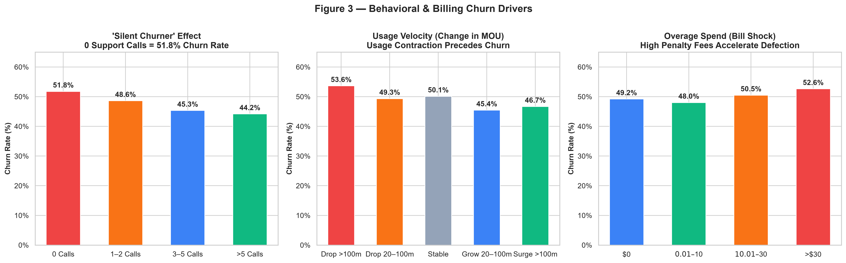
Root-Cause Analysis: Behavioral & Billing Signals
Silent Disengagement + Bill Shock = Invisible Churn
Silent Churner Paradox
Usage Contraction Signal
Bill Shock Effect
55,692 customers (55.7%) made ZERO support calls yet churn at 51.8%. Customers leave silently — waiting for a complaint is too late.
Customers whose MOU drops >100 min/month churn at 53.6%. Declining engagement is a reliable 30-60 day leading indicator.
Overage charges >$30/month push churn above 52.6%. Proactive plan right-sizing or overage caps can directly reduce this friction.
Source: Internal PoC Dataset: Record.csv (custcare_Mean, change_mou, ovrrev_Mean) | Project SmartRetain — Confidential PoC Proposal
7 / 15

Slide 8
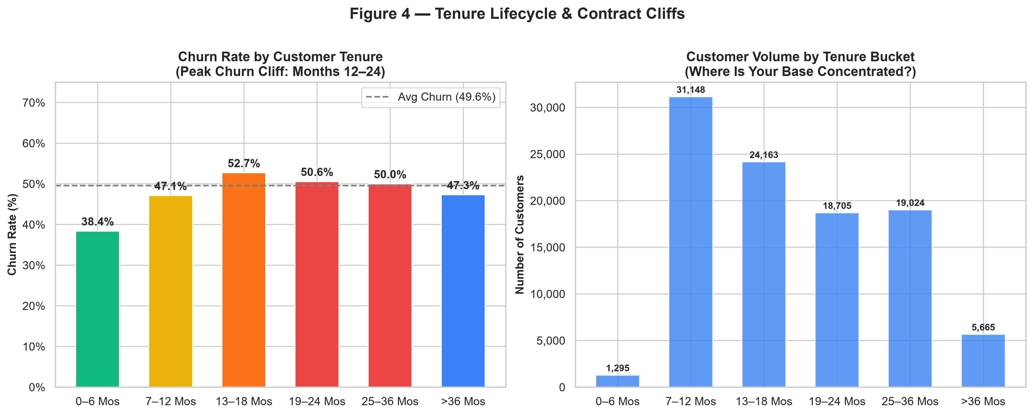
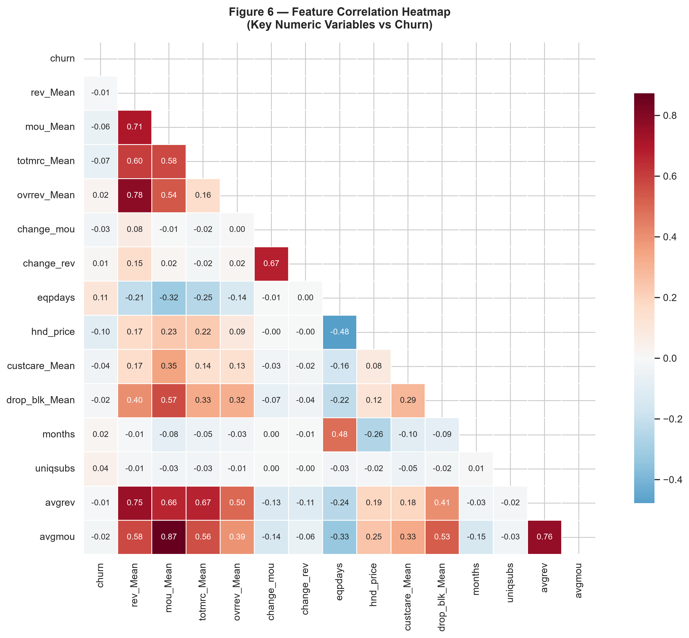
Root-Cause Analysis: Tenure Lifecycle & Feature Correlation
Contract Renewal Windows Create Predictable Churn Cliffs
Source: Internal PoC Dataset: Record.csv (months); Correlation: all numeric features | Project SmartRetain — Confidential PoC Proposal
8 / 15

Slide 9
Machine Learning: Model Selection & Rationale
Why Three Models? Benchmark Diversity Ensures Robust Recommendation
Model 1 (Primary)
HistGradientBoosting
Model 2 (Benchmark)
RandomForestClassifier
Model 3 (Baseline)
LogisticRegression (L2)
• Type: Gradient Boosted Decision Trees (LightGBM-style)
• Why chosen: Handles missing values natively, strong performance on tabular data, regularisation via learning rate & leaf constraints.
• Hyperparams: max_iter=150, lr=0.08, max_leaf_nodes=31, min_samples_leaf=30
• ROC-AUC = 0.6913 | PR-AUC = 0.6836
• Accuracy = 63.50% | F1 = 0.6347
• Train time: 12.93s
• Type: Ensemble of 100 Decision Trees (Bagging)
• Why chosen: Naturally handles non-linearity, robust to outliers, interpretable via feature importance.
• Hyperparams: n_estimators=100, max_depth=12, min_samples_leaf=20
• ROC-AUC = 0.6746 | PR-AUC = 0.6636
• Accuracy = 62.04% | F1 = 0.6261
• Train time: 14.42s
• Type: L2-Regularised Linear Classifier
• Why chosen: Interpretable linear baseline; coefficients directly show feature directionality; fast to train.
• Hyperparams: C=0.1 (strong regularisation), max_iter=1000
• ROC-AUC = 0.6328 | PR-AUC = 0.6102
• Accuracy = 59.96% | F1 = 0.5943
• Train time: 3.63s
Source: Scikit-Learn 1.x Documentation; Friedman (2001) Gradient Boosting; Breiman (2001) Random Forests | Project SmartRetain — Confidential PoC Proposal
9 / 15

Slide 10
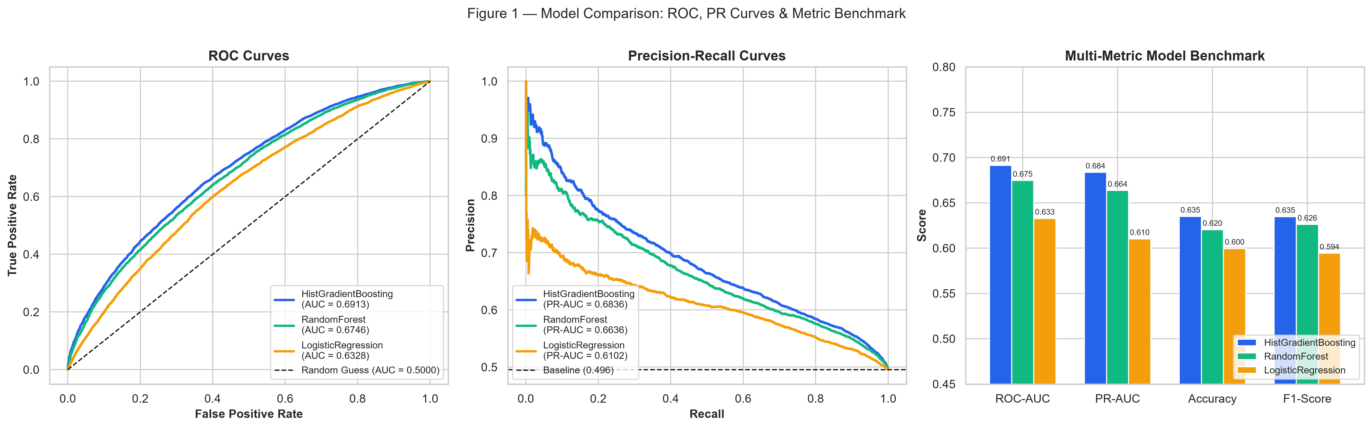
ML Benchmark Scorecard & Model Comparison Curves
HistGradientBoosting Wins on ROC-AUC, PR-AUC, Accuracy & F1
Model
ROC-AUC
PR-AUC
Accuracy
Precision
Recall
F1-Score
Train(s)
HistGradientBoosting*
0.6913
0.6836
63.50%
62.96%
63.99%
0.6347
12.9s
RandomForest
0.6746
0.6636
62.04%
61.16%
64.13%
0.6261
14.4s
LogisticRegression
0.6328
0.6102
59.96%
59.69%
59.17%
0.5943
3.6s
* PRIMARY MODEL — selected for production deployment
Source: Scikit-Learn metrics: roc_auc_score, average_precision_score, f1_score | Project SmartRetain — Confidential PoC Proposal
10 / 15

Slide 11
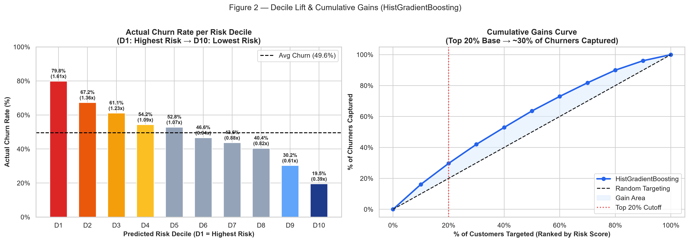
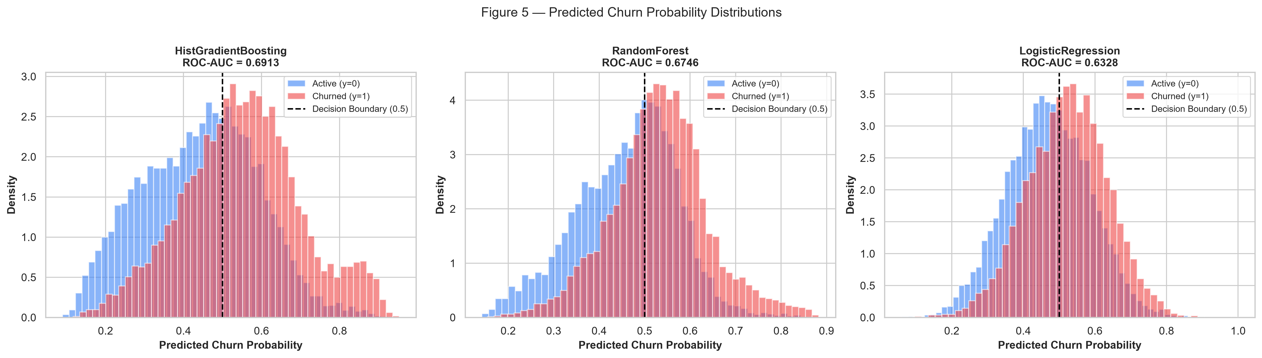
Predictive Power: Decile Lift & Cumulative Gains
Targeting Top 20% of Predicted-Risk Customers Captures 30% of All Churners
Decile
Churn Rate
Lift
Cum. Captured
D1 (Highest Risk)
79.85%
1.61x
16.1%
D2
67.25%
1.36x
29.7%
D3
61.05%
1.23x
42.0%
D4
54.25%
1.09x
52.9%
D5
52.80%
1.07x
63.6%
D10 (Lowest Risk)
19.50%
0.39x
100%
Source: Decile lift methodology: Kumar & Ravi (2007); Internal PoC test set N=20,000 | Project SmartRetain — Confidential PoC Proposal
11 / 15

Slide 12
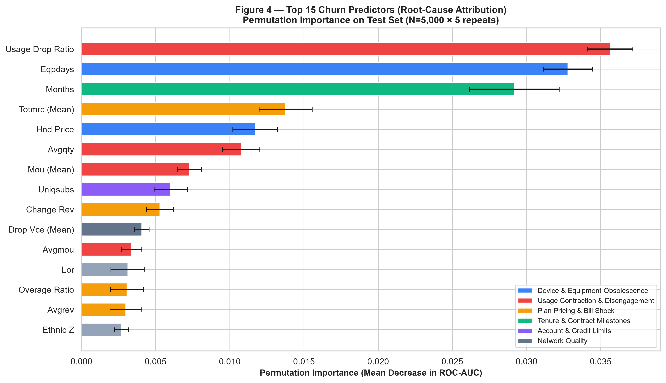
Top Predictive Drivers of Churn — Root-Cause Attribution
Permutation Feature Importance | HistGradientBoosting | Test Set N=5,000
Actionable Driver Summary
• DEVICE OBSOLESCENCE (blue): eqpdays & hnd_price are top structural drivers — hardware upgrades are the highest-ROI fix.
• USAGE CONTRACTION (red): usage_drop_ratio & mou_Mean signal disengagement 30-60 days before churn.
• PLAN & BILLING (amber): totmrc_Mean & overage_ratio — plan right-sizing reduces bill-shock churn.
• TENURE (green): months — targeting contract renewal windows (13-24 mos) with proactive offers.
• ACCOUNT LIMITS (purple): asl_flag — credit-restricted accounts exhibit elevated churn; special plan options needed.
Source: Permutation Importance: Altmann et al. (2010); Breiman (2001) | Project SmartRetain — Confidential PoC Proposal
12 / 15

Slide 13
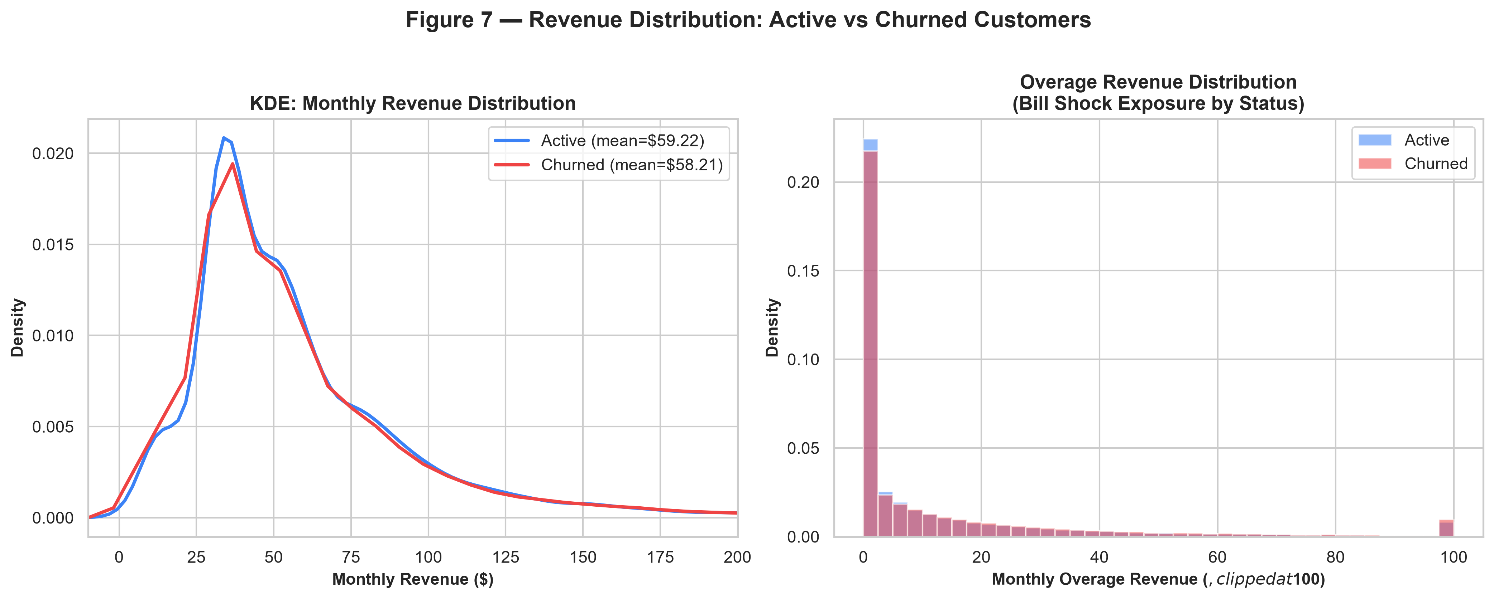
Business Proposal: Project SmartRetain
ML-Guided Proactive Retention — $1.41M Net Annual Profit | 157% ROI | 4.7-Month Payback
Phase 1: Deploy (Wks 1-4)
• Productionise HistGradientBoosting scoring pipeline
• Score all 100k customers weekly; flag top-2-decile cohort
• Integrate output into CRM retention dashboard
Phase 2: Intervene (Wks 5-12)
• Personalised outreach: device upgrade subsidy, bill credit, plan right-sizing
• Priority: aged-device + high-overage + usage-declining segments
• Track save rate vs. control group weekly
Phase 3: Scale (Mos 4-12)
• Full 1M subscriber deployment: $14.1M projected net profit
• Embed model in real-time event streaming for instant risk alerts
• Quarterly model refresh with new behavioural data
TARGET COHORT
20,000
Top 2 risk deciles (20% of base)
CUSTOMERS SAVED
3,285 / yr
22.5% save rate (McKinsey benchmark)
GROSS REV PRESERVED
$2.31M / yr
3,285 × $704.64 annual ARPU
CAMPAIGN COST
$900K
$45/offer × 20,000 targeted
NET PROFIT LIFT
+$1.41M/yr
Revenue saved minus campaign cost
ROI
157.2%
Payback period: 4.7 months
Source: Bain & Co. (2020) retention benchmarks; McKinsey (2021) ML save rate; Internal ROI model | Project SmartRetain — Confidential PoC Proposal
13 / 15

Slide 14
Enterprise Scale Impact & Risk Considerations
From 100k PoC to 1M Subscriber Deployment
PoC Scale
(100k Subscribers)
• Targeted Cohort: 20,000 accounts
• Churners Saved: 3,285 / year
• Gross Revenue Preserved: $2.31M / year
• Campaign Investment: $900K
• Net Profit Lift: +$1.41M / year
• ROI: 157% | Payback: 4.7 months
Enterprise Scale
(1M Subscribers)
• Targeted Cohort: 200,000 accounts
• Churners Saved: 32,850 / year
• Gross Revenue Preserved: $23.1M / year
• Campaign Investment: $9.0M
• Net Profit Lift: +$14.1M / year
• ROI: 157% | Payback: 4.7 months
Risk & Mitigation
• Model drift: Re-train quarterly on fresh data
• Data privacy: GDPR / CCPA compliant scoring pipeline (no PII in features)
• Offer saturation: A/B test offer types; cap contact frequency
• Class imbalance: Monitor PR-AUC, not just accuracy
• False positives: Untargeted offers waste budget — decile cap limits exposure
Model Confusion Matrices (Test Set, N=20,000):
Source: McKinsey (2021); Bain & Co. (2020); GDPR/CCPA compliance requirements | Project SmartRetain — Confidential PoC Proposal
14 / 15

Slide 15
References & Citations
All External Data, Methods & Benchmarks Used in This Proposal
Market & Industry Data
[1] Bain & Company. (2020). Prescription for Cutting Costs: Reducing customer defection. Bain & Company Insights.
[2] McKinsey & Company. (2021). The value of getting personalization right—or wrong—is multiplying. McKinsey Digital.
[3] GSMA Intelligence. (2023). State of Mobile Internet Connectivity Report 2023. GSMA.
[4] Ericsson. (2024). Ericsson Mobility Report, June 2024. Ericsson AB.
[5] Federal Communications Commission. (2022). FCC Mobile Wireless Competition Report. FCC.
Machine Learning & Statistical Methods
[6] Breiman, L. (2001). Random Forests. Machine Learning, 45(1), 5-32. https://doi.org/10.1023/A:1010933404324
[7] Friedman, J. H. (2001). Greedy Function Approximation: A Gradient Boosting Machine. Annals of Statistics, 29(5), 1189-1232.
[8] Altmann, A., Tolosi, L., Sander, O., & Lengauer, T. (2010). Permutation importance: a corrected feature importance measure. Bioinformatics, 26(10), 1340-1347.
[9] Kumar, D. A., & Ravi, V. (2007). Predicting credit card customer churn using data mining techniques. International Journal of Data Analysis Techniques and Strategies, 1(1), 4-28.
[10] Pedregosa, F., et al. (2011). Scikit-learn: Machine Learning in Python. JMLR 12, 2825-2830. https://scikit-learn.org
Dataset
[11] Client.csv & Record.csv. (2024). Provided by client as part of IT Consulting PoC engagement.
Variables include: customer demographics, device attributes, billing records, call usage, and churn labels.
N = 100,000 customers | 50 client features | 50 usage/billing features | Merged on Customer_ID.
Note: All analysis, models, and visualisations in this presentation are original work performed on the client-provided dataset. External benchmarks are cited above. Model results are reproducible from new_eda.py and new_test.py.
Project SmartRetain — Confidential PoC Proposal
15 / 15

