Slide 1

Churn Why we lose costumers
By: Najm Adin Hussain
Dec 2024

Slide 2
Introduction
Objective : -
“The objective of this report is to analyze customer CHURN performance over the past years to identify trends, assess Service performance, and recommend strategic improvements.”
Scope : -
We will cover Churn by different areas “ Service, Relations, Financial, Timing, and others”

Slide 3
Methodology
Data Sources : -
The data used in this report were obtained from internal records “churn analysis dataset.CSV”
Tools and Techniques : -
Analysis was conducted using Power Query for data cleaning and Power Bi for data visualization.
Process : -
The process is described in “Process.docx”

Slide 4

Findings and Analysis

Slide 5
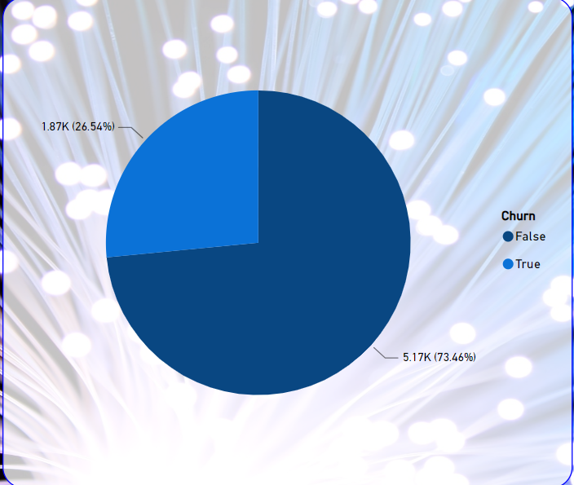
Key Insights
Churn rate is near 27%
High compared to competitors

Slide 6
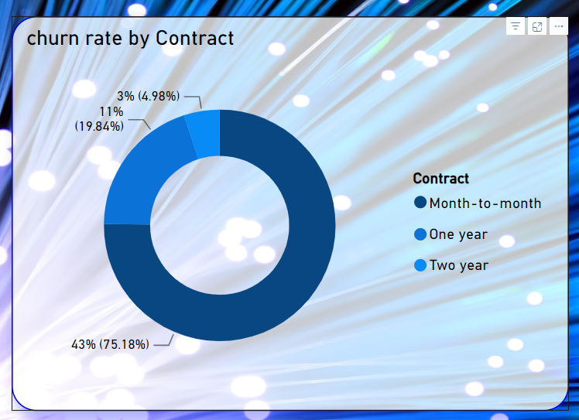
Key Insights
Month to Month has the highest churn rate that’s by 73% from total churn and 43% from All customers

Slide 7
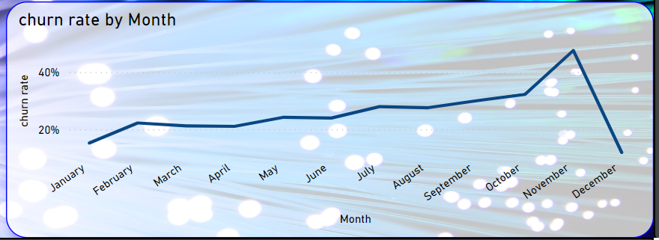
Key Insights
Churn rate for the customer how start in November is max churn rate by 48%

Slide 8
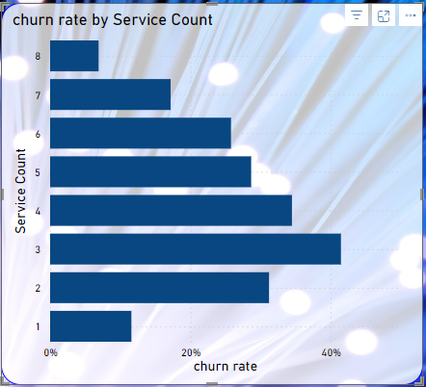
Key Insights
If the customer have more services the churn rate down

Slide 9
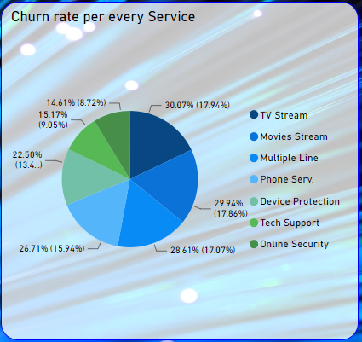
Key Insights
The online Security and Tech support have the lowest churn rate among the other service
The TV streaming and Movies Streaming have the highest churn rate among the other service

Slide 10
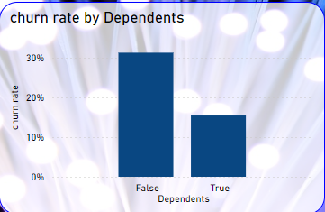
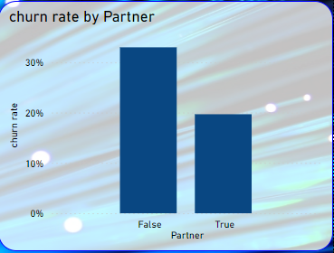
Key Insights
The customers that don’t have partner nor dependencies have more churn rate

Slide 11
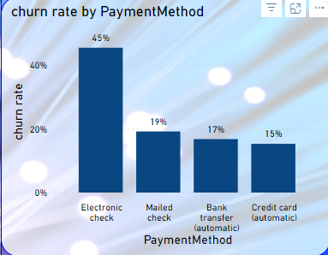
Key Insights
Customers who use Electronic Check are more likely to churn with churn rate 45%

Slide 12
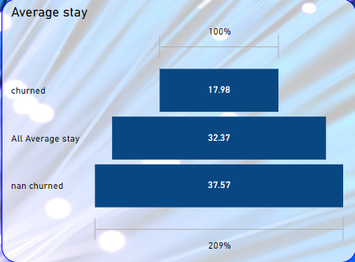
Key Insights
The less the customer stay the more likely to churn

Slide 13

Recommendations
The churn rate seems to be very high so we may need the following:-
Reduce the price of Month to Month packages
Many customers churn during November “Black Friday season” so we need to offer better deals
Offer discounts on some services:-
such as online protection
Technical support "maybe include them for free for some time“ As they were found to be the services with the lowest churn rate
Customers are less likely to cancel automatic subscriptions. Therefore, offering a discount at the start can encourage them to switch to later payment methods.
Urge customers to try the service for a longer period in case they want to cancel the contract

Slide 14

Thanks

