Slide 1


Profiling Software implementation of workload
Presenters:
Najmeh Nazari
August 2020
EEC 286: Digital Systems Testing
1

Slide 2
Intel Advisor
A prototyping tool that allows users to analyze their code and determine the costs and benefits of adding various threading models on Intel processors.
Works on code written in C, C++, and Fortran.
Can model parallelism using OpenMP, Intel Thread Building Blocks, and Intel Cilk Plus
Provide guidance to help codes get better vectorization, which is becoming increasingly important with wide vector units in modern processors.
A graphical user interface (GUI)
Accessed with the advixe-gui
Begin by creating a new project, entering the executable path and arguments, and setting other options. Once the Advisor project is created, run through the threading and/or vectorization workflows
A command line (CL) interface
Accessed with the advixe-cl commands.
Command line can be available on DevCloud.

Slide 3
Intel Advisor
Composed of two tools:
Threading Advisor is a fast-track threading design and prototyping tool
Analyze, design, tune, and check threading design options without disrupting your normal development.
Vectorization Advisor is a vectorization optimization tool
Identify
High-impact, under-optimized loops
What is blocking vectorization
Where it is safe to force vectorization
Provides code-specific how-can-I-fix-this-issue? recommendations.

Slide 4
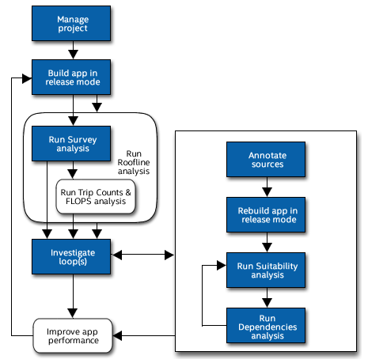
Threading Workflow (I)
1. Survey Report
Shows the loops and functions where your application spends the most time
Use this information to discover candidates for parallelization with threads.
2. Trip Counts analysis
Shows the minimum, maximum, and median number of times a loop body will execute
Shows the number of times a loop is invoked.
Use this information to make better decisions about your threading strategy for particular loops.
3. Roofline chart
Helps visualize actual performance against hardware-imposed performance ceilings
Determine the main limiting factor (memory bandwidth or compute capacity)
Providing an ideal roadmap of potential optimization steps

Slide 5
Threading Workflow (II)
Annotations
Insert to mark places in your application that are good candidates for later replacement with parallel framework code that enables threading parallel execution.
Are subroutine calls or macros (depending on the programming language) that can be processed by your current compiler but do not change the computations of your application.
Suitability Report
Predicts the maximum speed-up of your application based on the inserted annotations and a variety of what-if modeling parameters with which you can experiment.
Use this information to choose the best candidates for parallelization with threads
Dependencies Report
Predicts parallel data sharing problems based on the inserted annotations.
Use this information to fix the data sharing problems if the predicted maximum speed-up benefit justifies the effort.

Slide 6
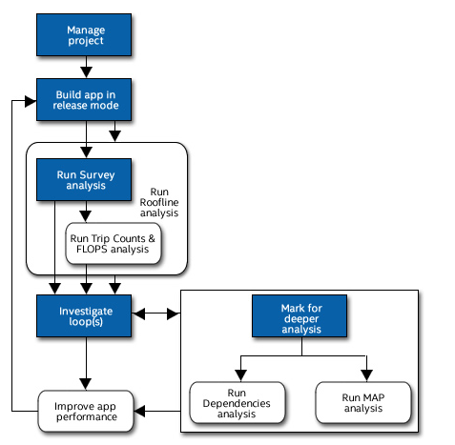
Vectorization Workflow
Survey Report
Offers integrated compiler report data and performance data all in one place.
Use it to help identify: Where vectorization, or parallelization with threads, will pay off the most
Trip Counts and FLOP analysis
Dynamically identifies the number of times loops are invoked and execute (sometimes called call count/loop count and iteration count respectively);
measures the number of floating-point and integer operations, and memory traffic.
Use to make better decisions about your vectorization strategy for particular loops, as well as optimize already-parallel loops.
Roofline chart
Helps visualize actual performance against hardware-imposed performance ceilings
Determine the main limiting factor (memory bandwidth or compute capacity)
Providing an ideal roadmap of potential optimization steps

Slide 7
Vectorization Workflow
Dependencies Report
For safety purposes, the compiler is often conservative when assuming data dependencies.
Use a Dependencies-focused Refinement Report to check for real data dependencies in loops the compiler did not vectorize because of assumed dependencies. If real dependencies are detected, the analysis can provide additional details to help resolve the dependencies.
Your objective: Identify and better characterize real data dependencies that could make forced vectorization unsafe.
Memory Access Patterns (MAP) Report
Use a MAP-focused Refinement Report to check for various memory issues, such as non-contiguous memory accesses and unit stride vs. non-unit stride accesses.
Your objective: Eliminate issues that could lead to significant vector code execution slowdown or block automatic vectorization by the compiler.

Slide 8
Intel Advisor
Survey
Trip Counts
FLOPS
Roofline Analyses

Slide 9

Survey Analysis
Where vectorization, or parallelization with threads, will pay off the most?
If vectorized loops are providing benefit, and if not, why not?
Un-vectorized loops and why they are not vectorized.
Performance problems in general.

Slide 10
Trip Counts Analysis
Dynamically identifies the number of times loops and functions are invoked and executed (also called call count/loop count and iteration count respectively).
Use Trip Counts data to:
Detect loops with too-small trip counts and trip counts that are not a multiple of vector length.
Analyze parallelism granularity more deeply.

Slide 11
FLOPS Analysis
Dynamically measures
Floating-point operations
Integer operations
Memory traffic.
Using the FLOP analysis
Generate application memory usage and performance values
Help you make better decisions about your vectorization strategy.

Slide 12

Roofline Analysis
Helps you visualize actual performance against hardware-imposed performance ceilings
Determine the main limiting factor (memory bandwidth or compute capacity)
Providing an ideal roadmap of potential optimization steps.
Use the Roofline chart to answer the following questions:
What is the maximum achievable performance with your current hardware resources?
Does your application work optimally on current hardware resources?
If not, what are the best candidates for optimization?
Is memory bandwidth or compute capacity limiting performance for each optimization candidate?

Slide 13
Refinement Reports
Intel Advisor offers two refinement analyses:
Dependencies analysis (optional)
For safety purposes, the compiler is often conservative when assuming data dependencies.
Run a Dependencies analysis to check for real data dependencies in loops the compiler did not vectorize because of assumed dependencies.
If real dependencies are detected, the analysis can provide additional details to help resolve the dependencies.
Your objective: Identify and better characterize real data dependencies that could make forced vectorization unsafe.
Memory Access Patterns (MAP) analysis (optional)
Run a MAP analysis to check for various memory issues, such as non-contiguous memory accesses and unit stride vs. non-unit stride accesses.
Your objective: Eliminate issues that could lead to significant vector code execution slowdown or block automatic vectorization by the compiler.

Slide 14
Offload Advisor
Intel Advisor (Beta)
Includes Offload Advisor, a tool that allows you to collect performance predictor data in addition to the profiling capabilities of Intel Advisor.
Design Code for Efficient Vectorization, Threading, and Offloading to Accelerators
For software architects and developers (give the right information and recommendations to make the best design and optimization decisions)
Determine which parts of your code will benefit from offloading to an accelerator.
Optimize CPU or GPU code for memory and compute with Roofline Analysis.
Enable more vector parallelism and improve its efficiency.
Model, tune, and test multiple threading designs.
Create and analyze data flow and dependency-computation using heterogeneous algorithms.

Slide 15
Offload Advisor Workflow
Run performance profiling to collect data about your application
Performed using the collect.py script.
Run performance modeling and generate your report results.
Performed using analyze.py scripts
predict your application performance on a target device (for example, on a GPU) and generate Intel® Advisor Beta output results
advixe-python <APM>/analyze.py <project-dir> [--options]
Offload Advisor environment variable that points to script directory

Slide 16
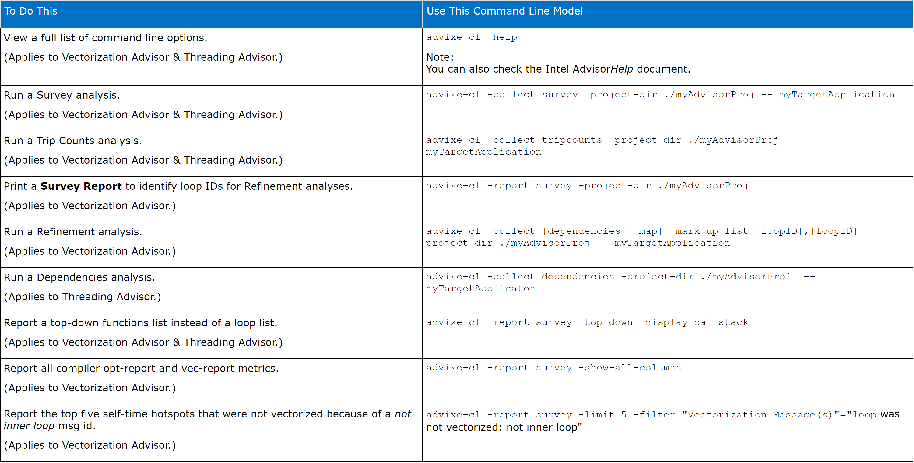
How to use Advisor?
Use command line interface : advixe-cl to run analyses and reports.

Slide 17
Intel Advisor’s Features
Vectorization Advisor: lets you identify high-impact, under-optimized loops, what is blocking vectorization, and where it is safe to force vectorization. It also provides code-specific how-can-I-fix-this-issue recommendations.
Roofline Analysis: visualizes actual performance against hardware-imposed performance ceilings (rooflines). It provides insights into where the bottlenecks are, which loops are worth optimizing for performance, what are the likely causes of bottlenecks and what should be the next optimization steps.
Threading Advisor: a fast-track threading design and prototyping tool that lets you analyze, design, tune, and check threading design options without disrupting your normal development.
Offload Advisor (Intel® Advisor Beta only): allows you to identify high-impact opportunities to offload to GPU as well as the areas that are not advantageous to offload. It provides performance speedup projection on accelerators along with offload overhead estimation and pinpoints accelerator performance bottlenecks.
Flow Graph Analyzer: a visual prototyping tool that lets you represent and analyze performance for applications that use the Intel® Threading Building Blocks (Intel® TBB) flow graph interfaces.

Slide 18
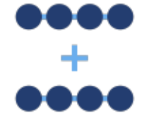
Intel Advisor’s Features (I)
Design Well-Threaded & Vectorized Code
Develop performant software using vectorization optimization and thread prototyping capabilities.
Analyze Roofline for CPU and GPU
Optimize your CPU or GPU code for compute and memory.
Locate bottlenecks and identify performance headroom for each loop or kernel to prioritize which optimizations will deliver the highest performance payoff.
Note: GPU Roofline Analysis is in technical preview.
https://software.intel.com/content/www/us/en/develop/documentation/advisor-user-guide/top/intel-advisor-beta-gpu-roofline.html

Slide 19


Intel Advisor’s Features (II)
Offload Where It Pays Off the Most
Use this command-line feature to design code for efficient offloading to accelerators—even before you have hardware. Estimate code performance and compare it with data transfer costs. No recompilation required.
Build Heterogeneous Algorithms
Model and build heterogeneous computational graphs and decide which kernels will benefit from offloading to GPU or FPGA accelerators.

Slide 20
Intel Vtune
Quickly Find and Fix Performance Bottlenecks
Performance Analysis for Applications & Systems
Intel® VTune™ Profiler takes the guesswork out of how best to improve performance in software deployed across CPUs and multiple accelerator architectures, including GPUs and FPGAs.
It does this by
Analyzing your code
Collecting key profiling data
Presenting its findings through a powerful interface that simplifies interpretation and helps you focus on the most effective software optimizations from computation and threading to memory and storage.

Slide 21
Intel Vtune
Optimize application performance, system performance, and system configuration for HPC, cloud, IoT, media, storage, and more.
CPU, GPU, and FPGA: Tune the entire application’s performance―not just the accelerated portion.
Multilingual: Profile Data Parallel C++ (DPC++), C, C++, C#, Fortran*, OpenCL™, Python*, Google Go* programming language, Java*, Assembly, or any combination.
System or application: Get coarse-grained system data for an extended period or detailed results mapped to source code.
Power: Optimize performance while avoiding power- and thermal-related throttling.

Slide 22
Intel VTune
A performance profiling tool for C, C++, and Fortran code
Identify where in the code time is being spent in both serial and threaded applications.
For threaded applications, it can also determine the amount of concurrency and identify bottlenecks created by synchronization primitives.
VTune Profiler uses dynamic instrumentation and thus does not require use of Intel compilers or the use of any special compiler flags.
A graphical user interface (GUI)
Accessed with the vtune-gui
A command line (CL) interface
Accessed with the vtune.
The analysis types include:
Hotspots
Threading
Memory Consumption.

Slide 23
Analysis Types
Hotspot
Profile your code's execution to determine which functions are consuming the most time and thus are targets for optimization.
The hotspots analysis includes timing information from all threads and from sub-processes.
The threading analysis
Analyzes how well a threaded application takes advantage of multi-core hardware and identifies functions and times during execution where available CPUs aren't fully utilized.
The memory consumption analysis
Identifies RAM usage over time and identifies memory objects allocated and released during the analysis run.

Slide 24
Microarchitectural Tuning Methodology
Select a hotspot function (one with a large percentage of the application's total clockticks).
Evaluate the efficiency of that hotspot using the Top-Down Method and the guidelines given below.
If inefficient, drill down the category representing the primary bottleneck, and use the next levels of sub-bottlenecks to identify causes.
Optimize the issue(s). VTune Profiler tuning guides contain specific tuning suggestions for many of the underlying performance issues in each category.
Repeat until all significant hotspots have been evaluated.

Slide 25
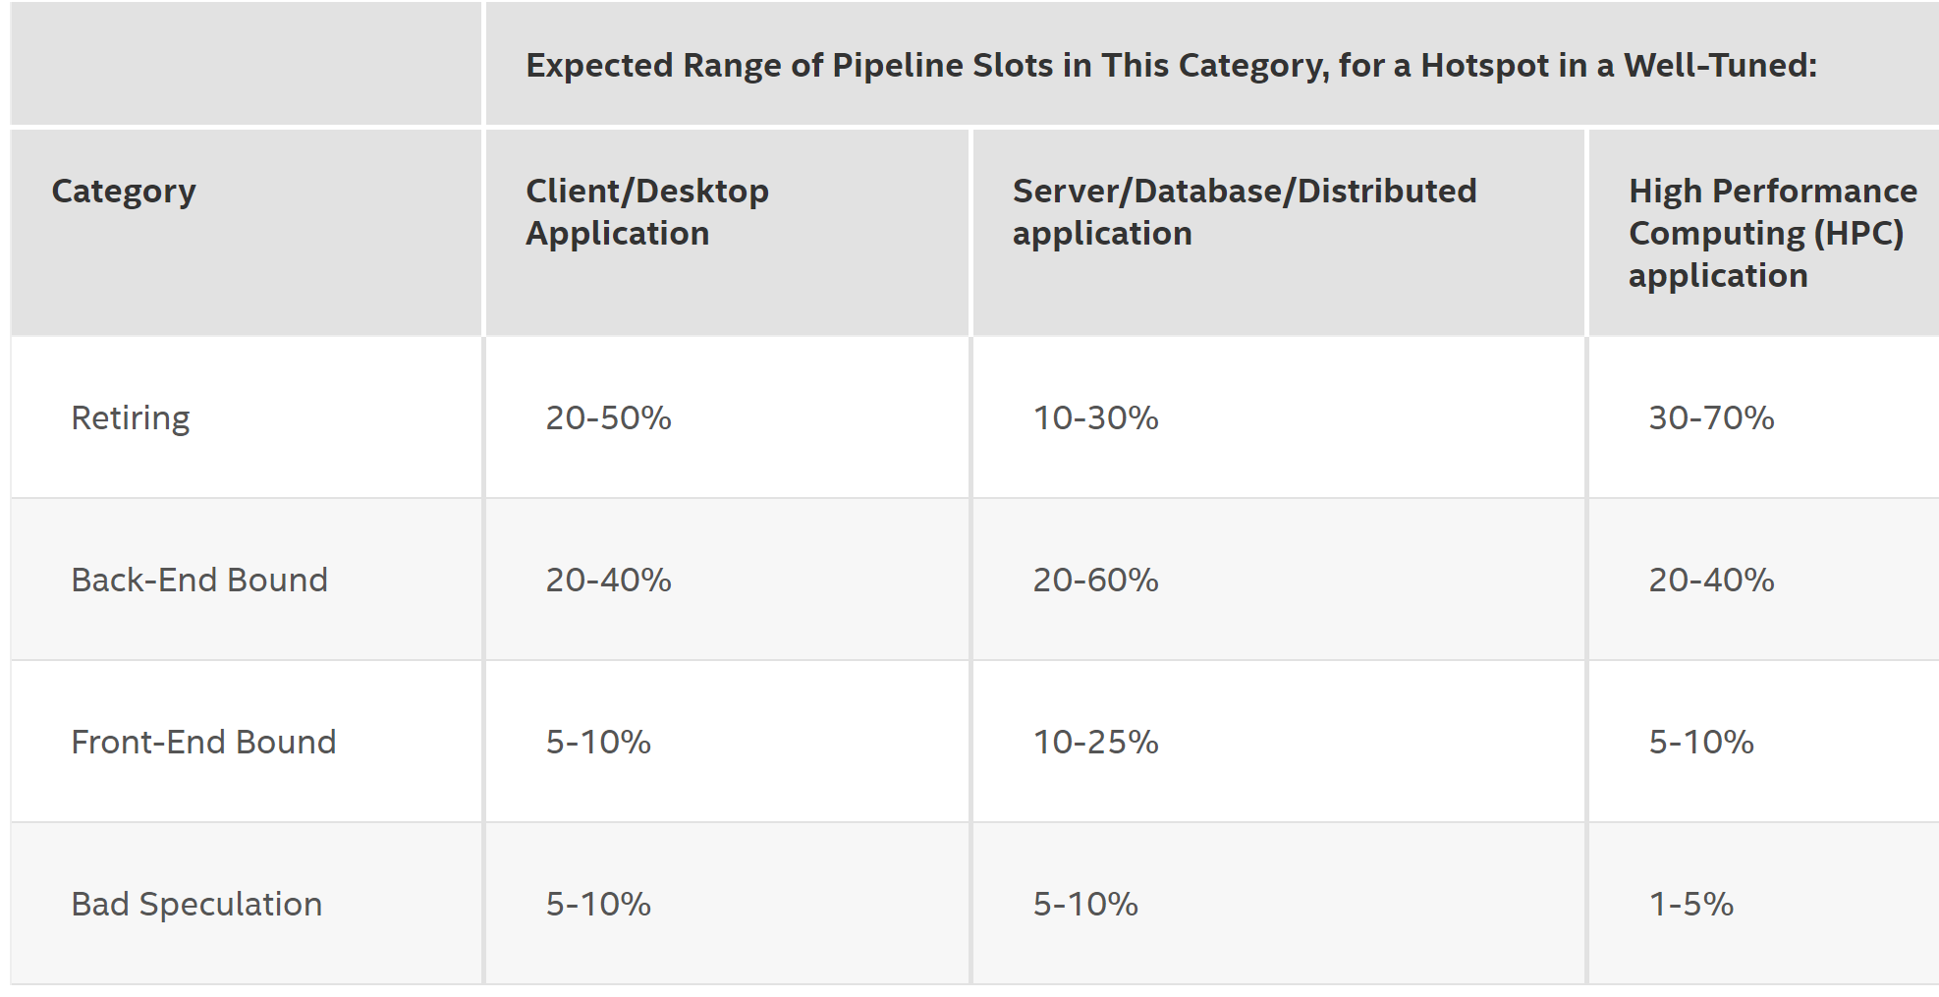
Microarchitectural Tuning Methodology

Slide 26
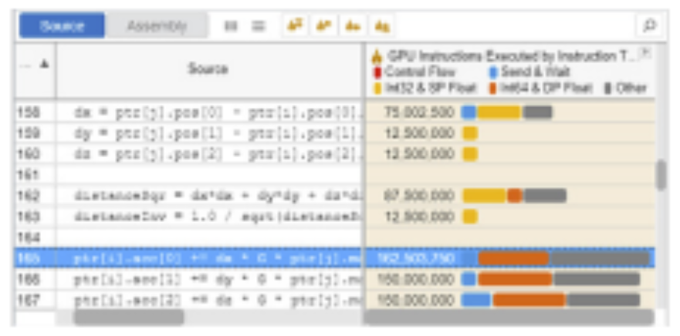
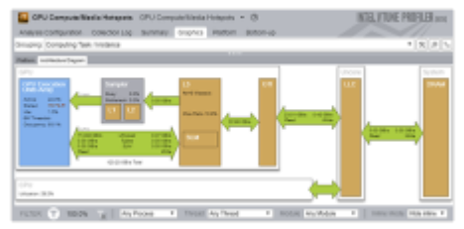
Intel Vtune Feature (I)
Analyze Intel® oneAPI DPC++
View profiling results on your DPC++ source. See the exact lines of code that are consuming the most time.
Tune for CPUs, GPUs, and FPGAs
Software developed on top of a framework or library that’s optimized for CPUs, GPUs, and FPGAs can benefit from those accelerations without further tuning. But parts of your application may benefit from tuning for the accelerators it will use.
Get the data you need to optimize your software on any supported hardware accelerator with Intel VTune Profiler.

Slide 27
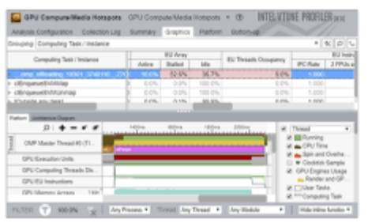
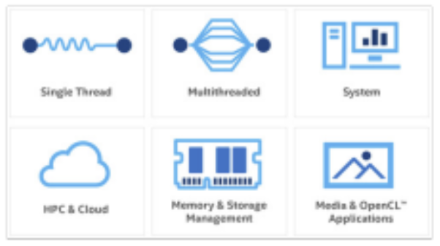
Intel Vtune Feature (II)
Optimize Offload
Tune offload performance on supported GPUs.
Profile Threading, Memory, Persistent Memory, Storage, and MoreSoftware
Access this tool’s wealth of analysis types to identify a wide variety of performance issues.

Slide 28
Similarities and Differences Between the Intel Advisor and Intel Vtune Amplifier
Both provide tools to determine where time is spent in a running application.
Both tools use the same low-overhead statistical sampling technology
Intel Advisor Survey shows time spent in loops in addition to total time while VTune™ Amplifier Hotspots does not
Intel Advisor only provides a top-down call tree, whereas Amplifier provides a top-down and bottom-up tree to help tune hot paths as well as individual functions
Intel Advisor Survey is integrated into the Intel Advisor Threading and Vectorization Workflow
Intel Advisor Survey is the more powerful tool for SIMD analysis
Intel Advisor provides integration with the Intel Compiler and SIMD static analysis
Intel Advisor Survey has recommendations to improve vectorization

Slide 29
When do you use Intel Vtune VS Advisor?
Intel Vtune
What’s your cache hit ratio?
Which loop/function is consuming most time overall?(bottom-up)
Are you stalling often? IPC?
Are you keeping all the threads busy?
Are you hitting remote NUMA?
When do you maximize your BW?
Intel Advisor
Which wevtor ISA are you using?
Flow of execution (callstacks)
What is your vectorization efficiency?
Can you safely force vectorization?
Inlining? Data type conversion?
Roofline

Slide 30
Thank you

