Slide 1


Implementation of AES in FPGA Hardware
Presenters:
Najmeh Nazari
August 2020
1

Slide 2
Outline
Goal
Overview on Advanced Encryption Standard (AES)
Review of RTL Design Methodology
Hardware Implementation of AES
2

Slide 3
Goal
Develop the RTL code of AES.
Based on the RTL design
Design the Datapath
Design the controller unit for their hardware
Perform the implementation of the design

Slide 4
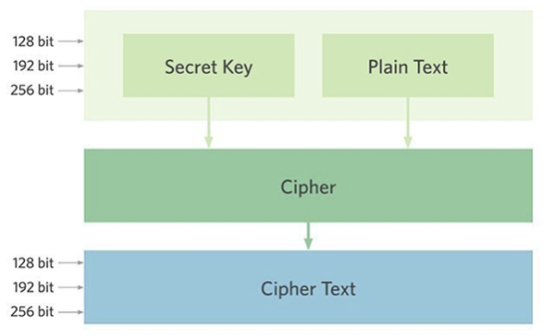
Overview on AES (I)
AES is a popular cipher: a method or process used to change raw information. (Encryption)
uses a known, external piece of information (key), to uniquely change the data.
Reversible: it can be applied again to put the information back into its original form (Decryption)
AES includes three block ciphers :
AES-128: Confidential
AES-192: Secret
AES-256: Top Secret
Block Size :128 bit = 16 byte
Each cipher encrypts and decrypts data in blocks of 128 bits
Fastest
The most secure

Slide 5
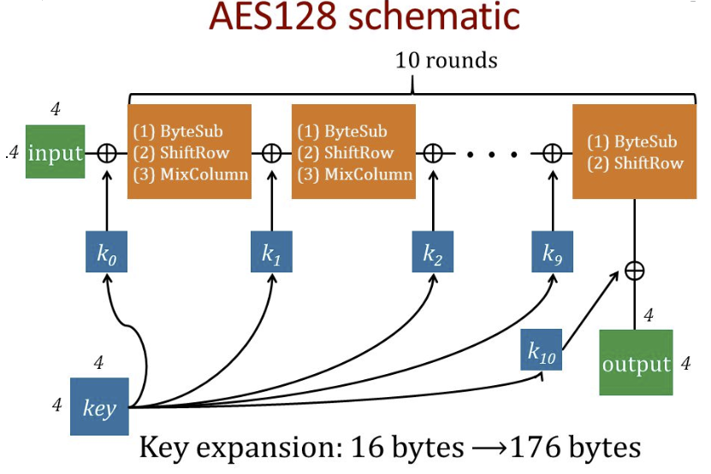
Overview on AES (II)
XOR
Byte Sub
ShiftRows
MixColumns
Add round key
Substitution
Permutation

Slide 6
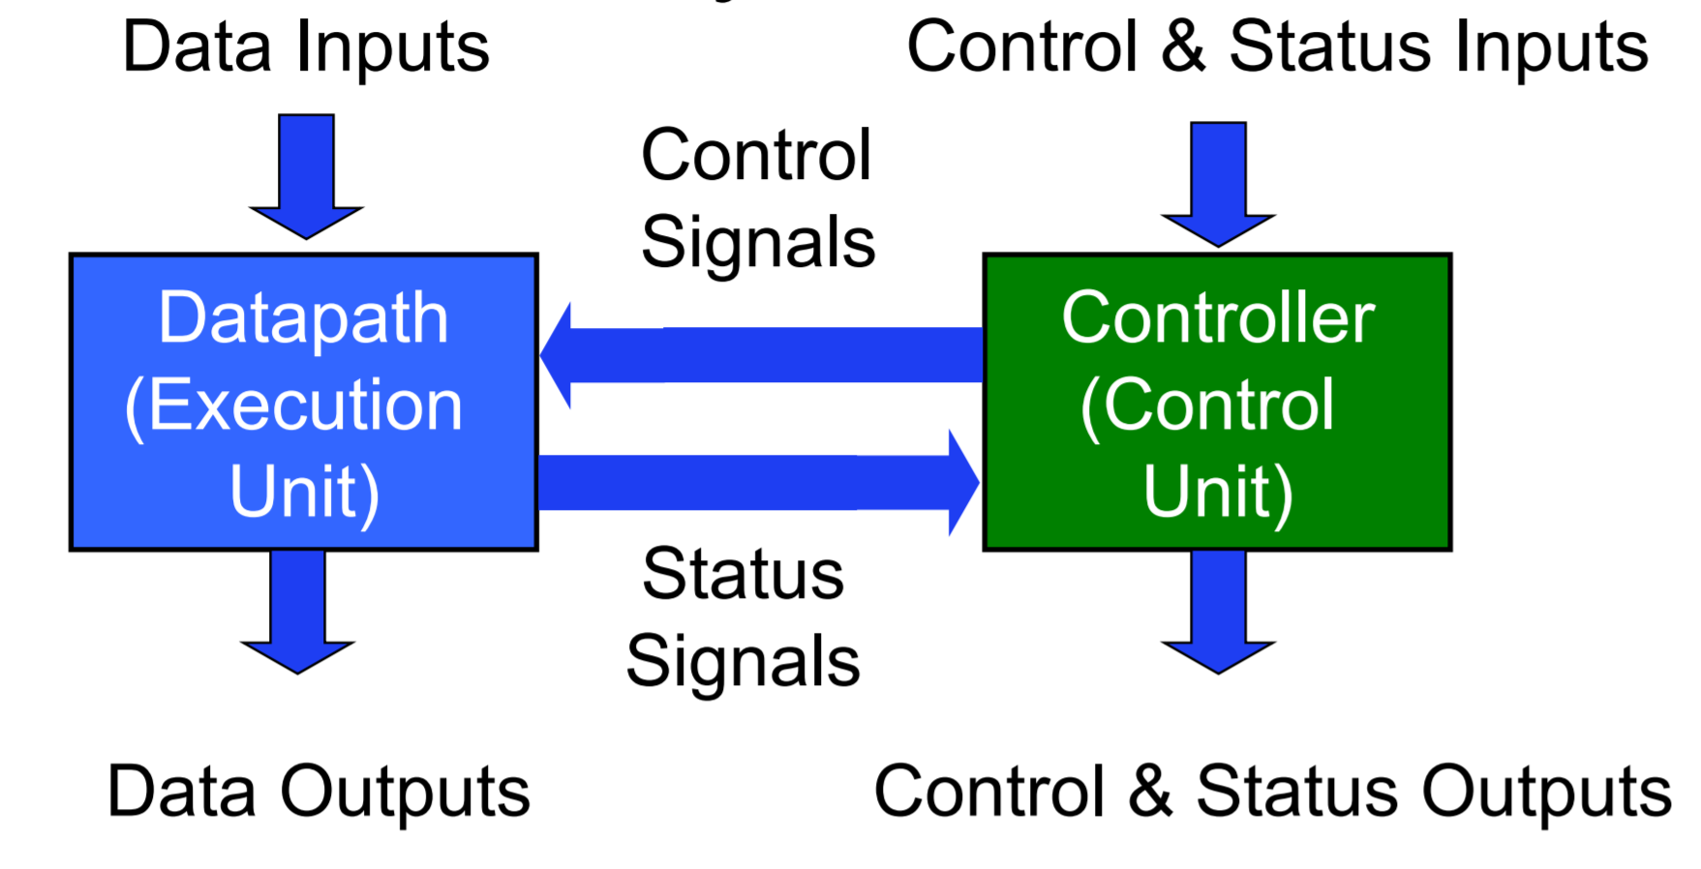
RTL Design Methodology
Structure of a Typical Digital System

Slide 7
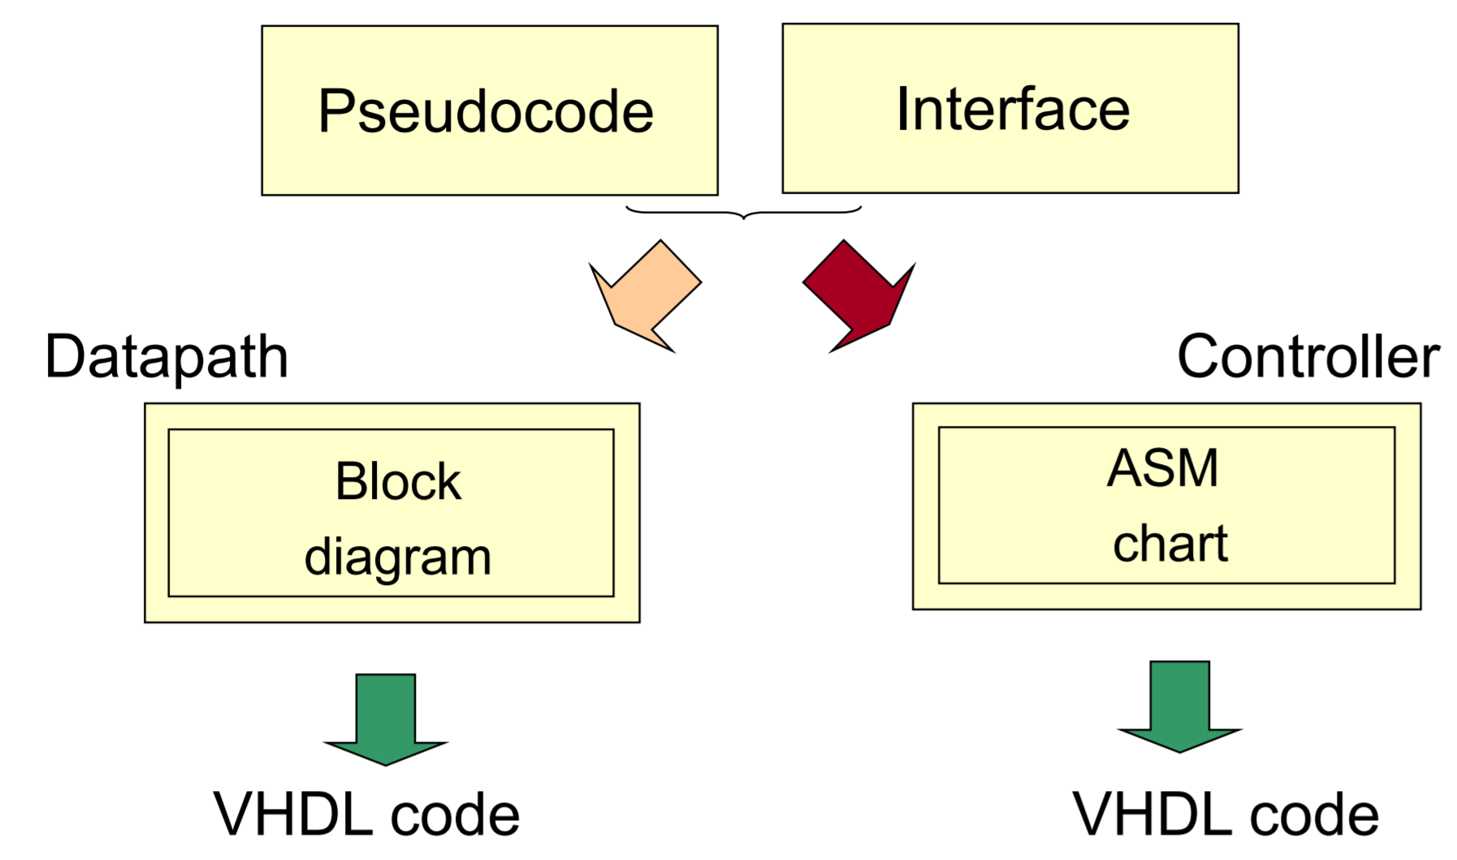
Hardware Design with RTL VHDL

Slide 8
Steps of the Design Process
1. Text description
2. Interface
3. Pseudocode
4. Block diagram of the Datapath
5. Interface divided into the Datapath and Controller
6. ASM chart of the Controller
7. RTL VHDL code of the Datapath, Controller, and Top-Level Unit
8. Testbench for the Datapath, Controller, and Top-Level Unit
9. Functional simulation and debugging
10. Synthesis and post-synthesis simulation
11. Implementation and timing simulation
12. Experimental testing using FPGA board

Slide 9
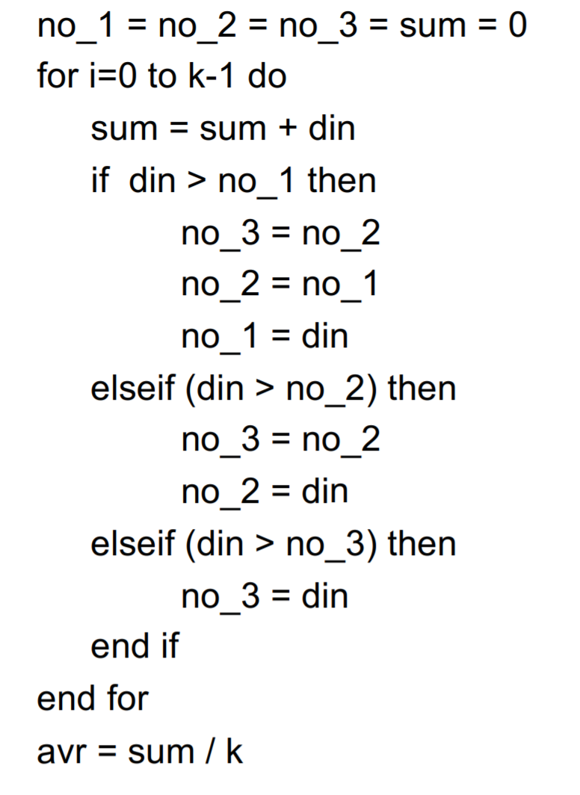
Exercise : Pseudocode
Calculates the average of K numbers and keep the 3 largest values in no_1, no_2, and no_3

Slide 10
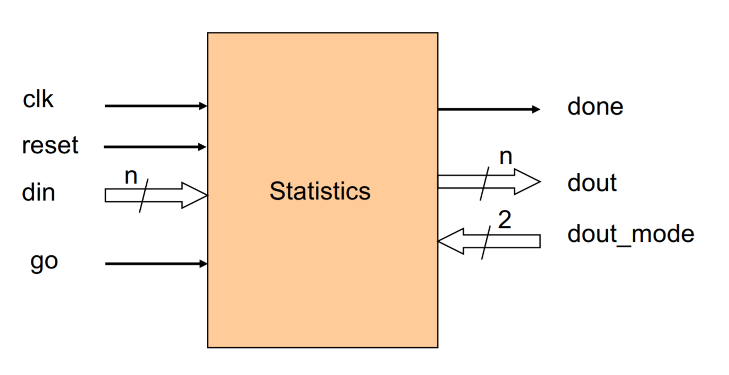
Exercise : Circuit Interface
Based on the Pseudocode, determine what functions input and output your design needs (clock, reset, inputs, outputs, control signals, state signals)

Slide 11
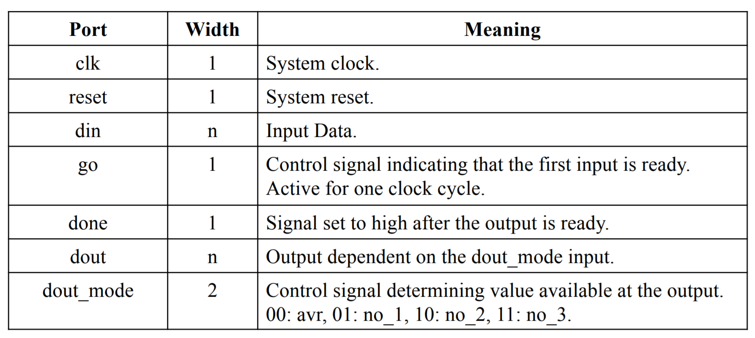
Exercise : Interface Table
Define the specification of your design clearly

Slide 12
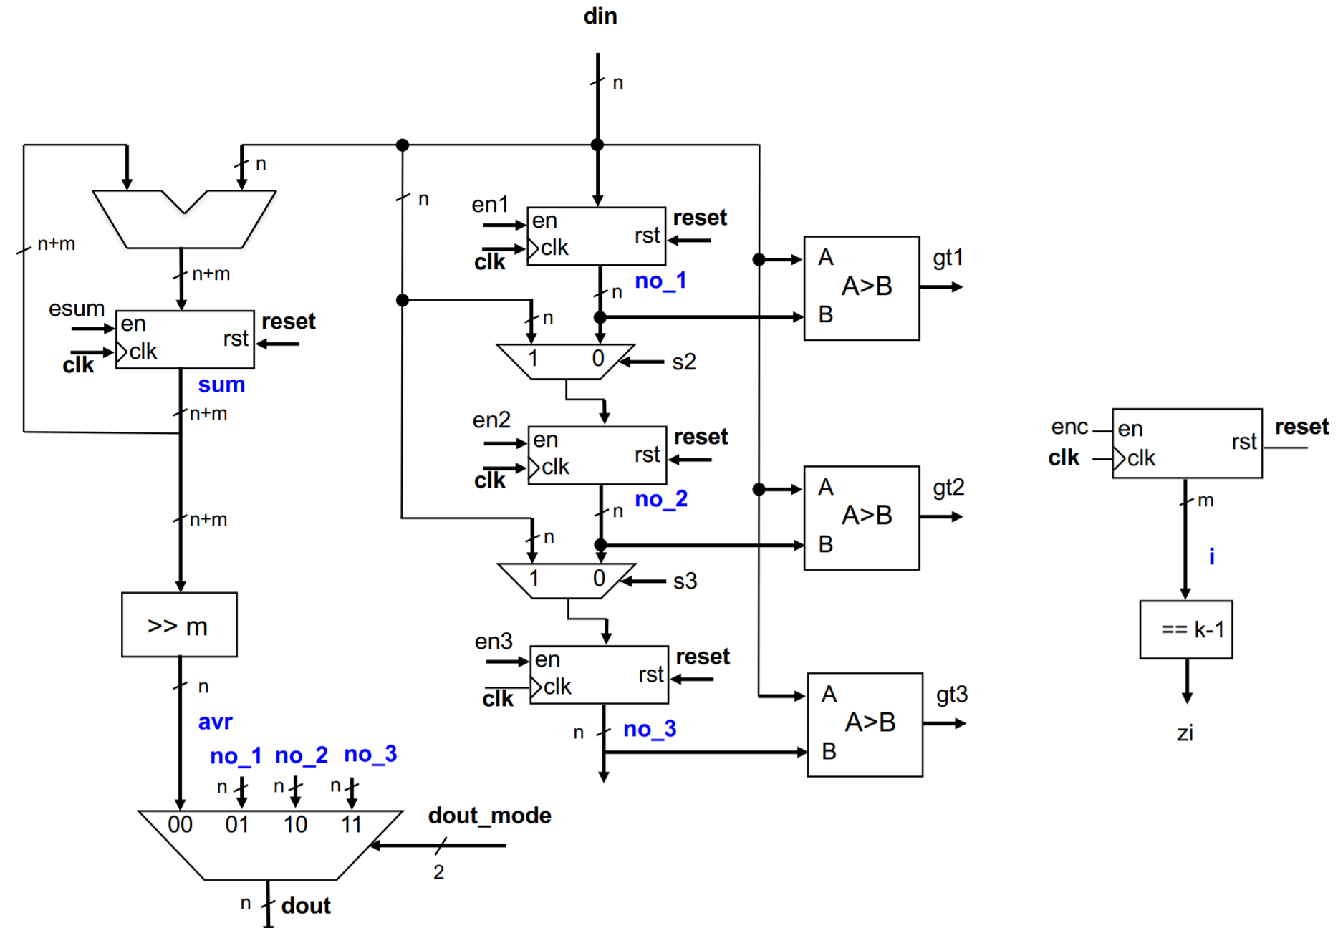
Exercise : Block diagram of the Datapath
Based on the Pseudocode, decide what functions you need in your data path (counter, comparator, shifter, multiplier, adder, … )
Determine the control and status signals that you need to control the functionality of datapath

Slide 13
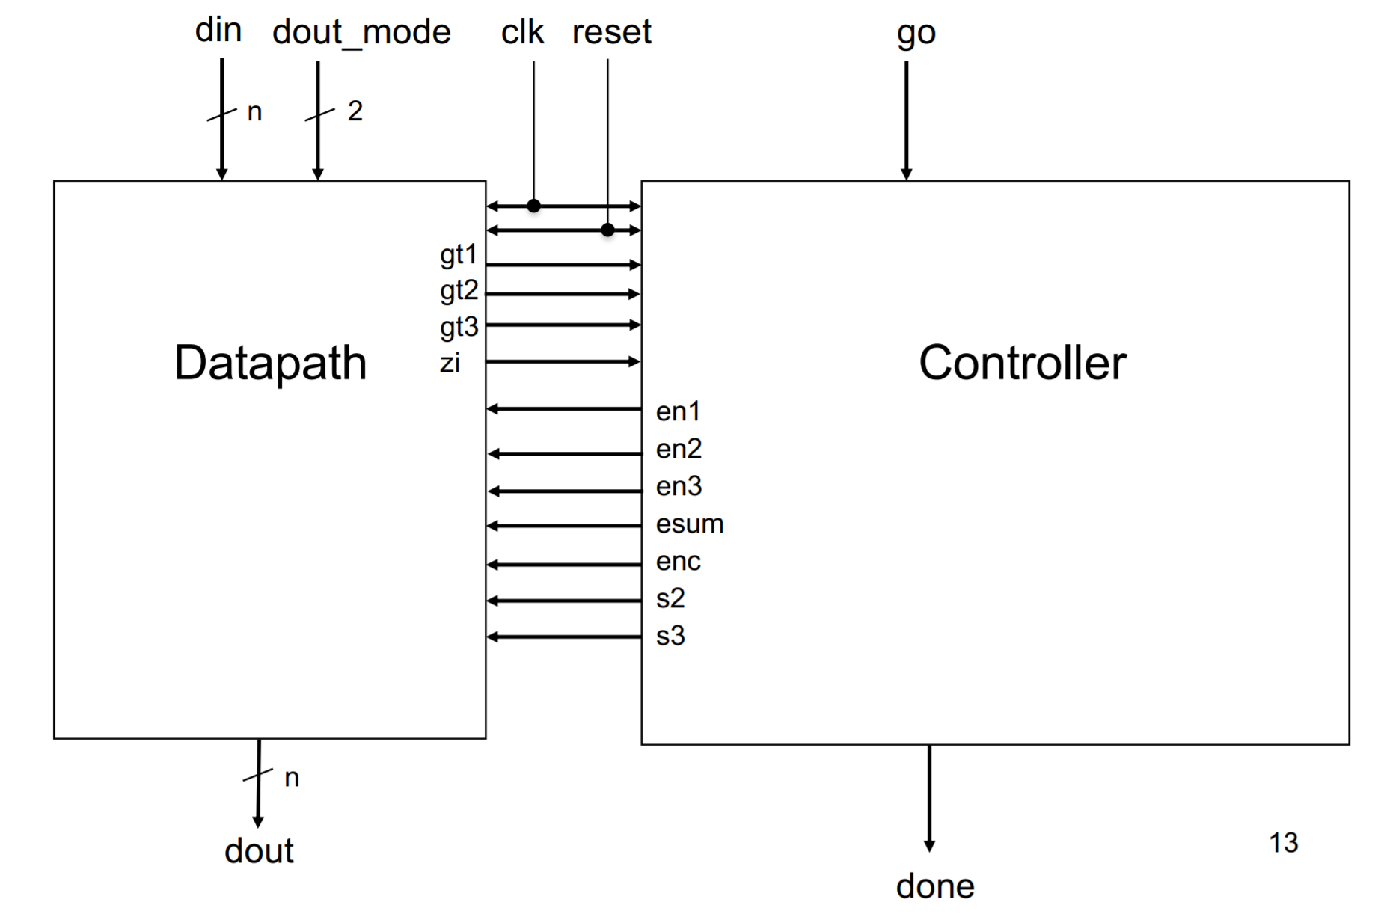
Exercise : Interface with the division into the Datapath and Controller
Connect datapath to controller

Slide 14
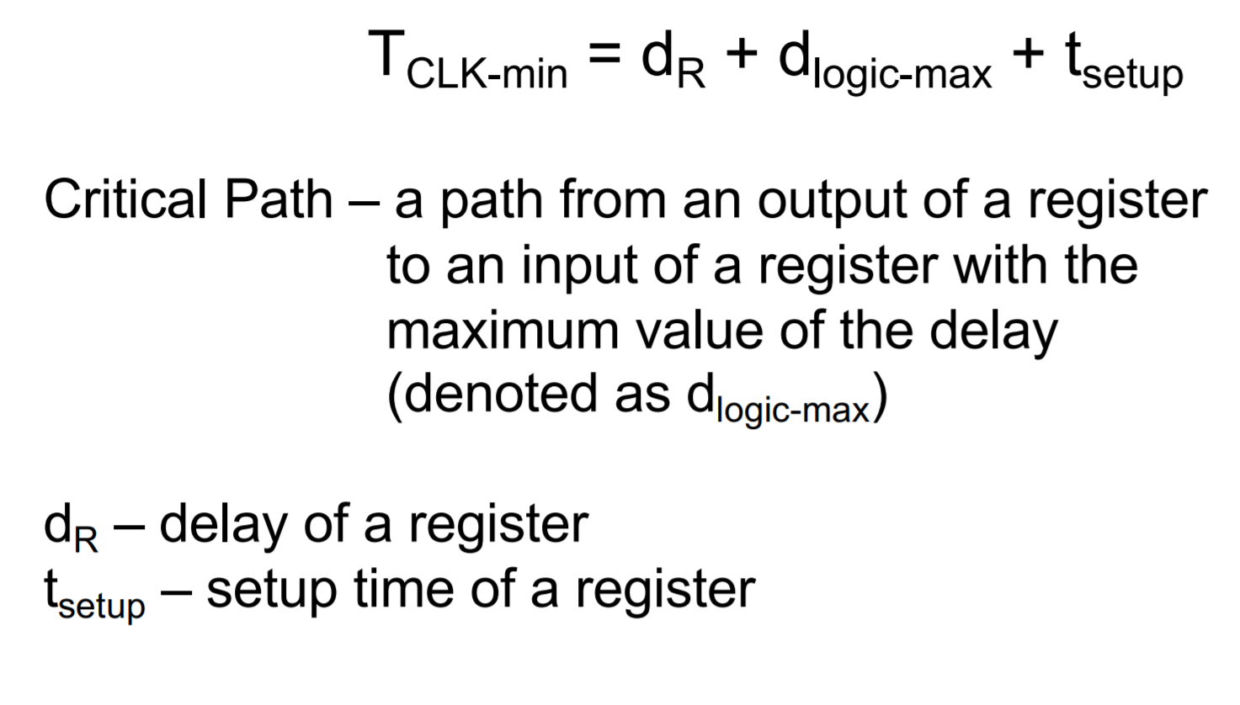
Timing Analysis- Critical Path

Slide 15
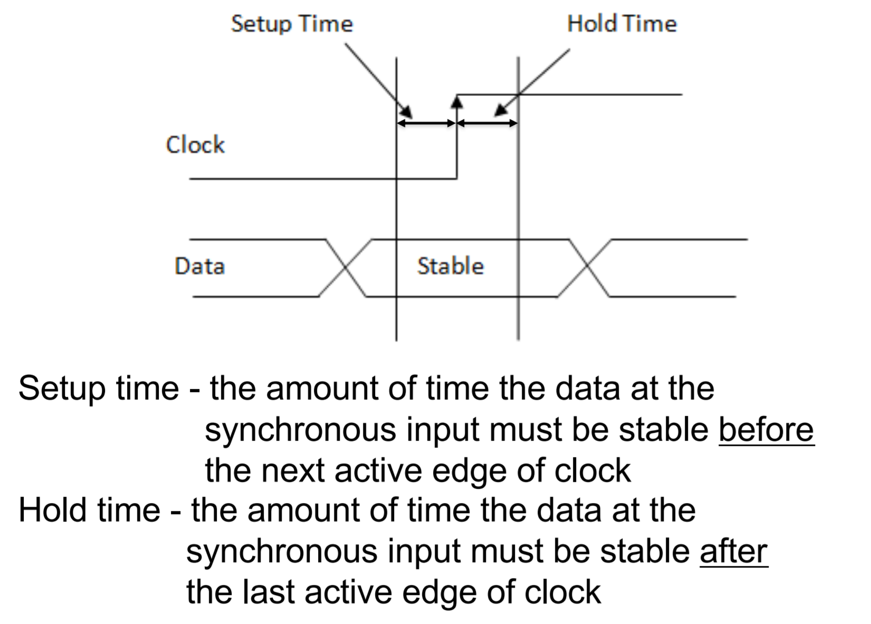
Setup & Hold Time of a Register

Slide 16
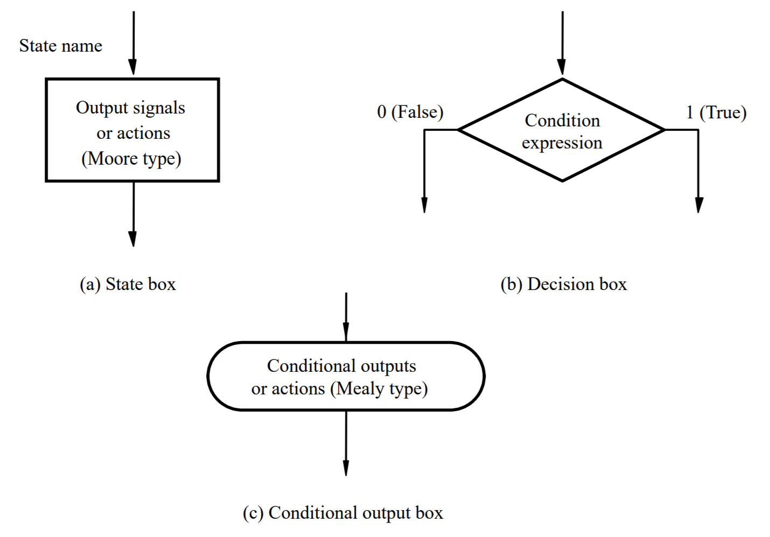
Elements used in ASM charts

Slide 17
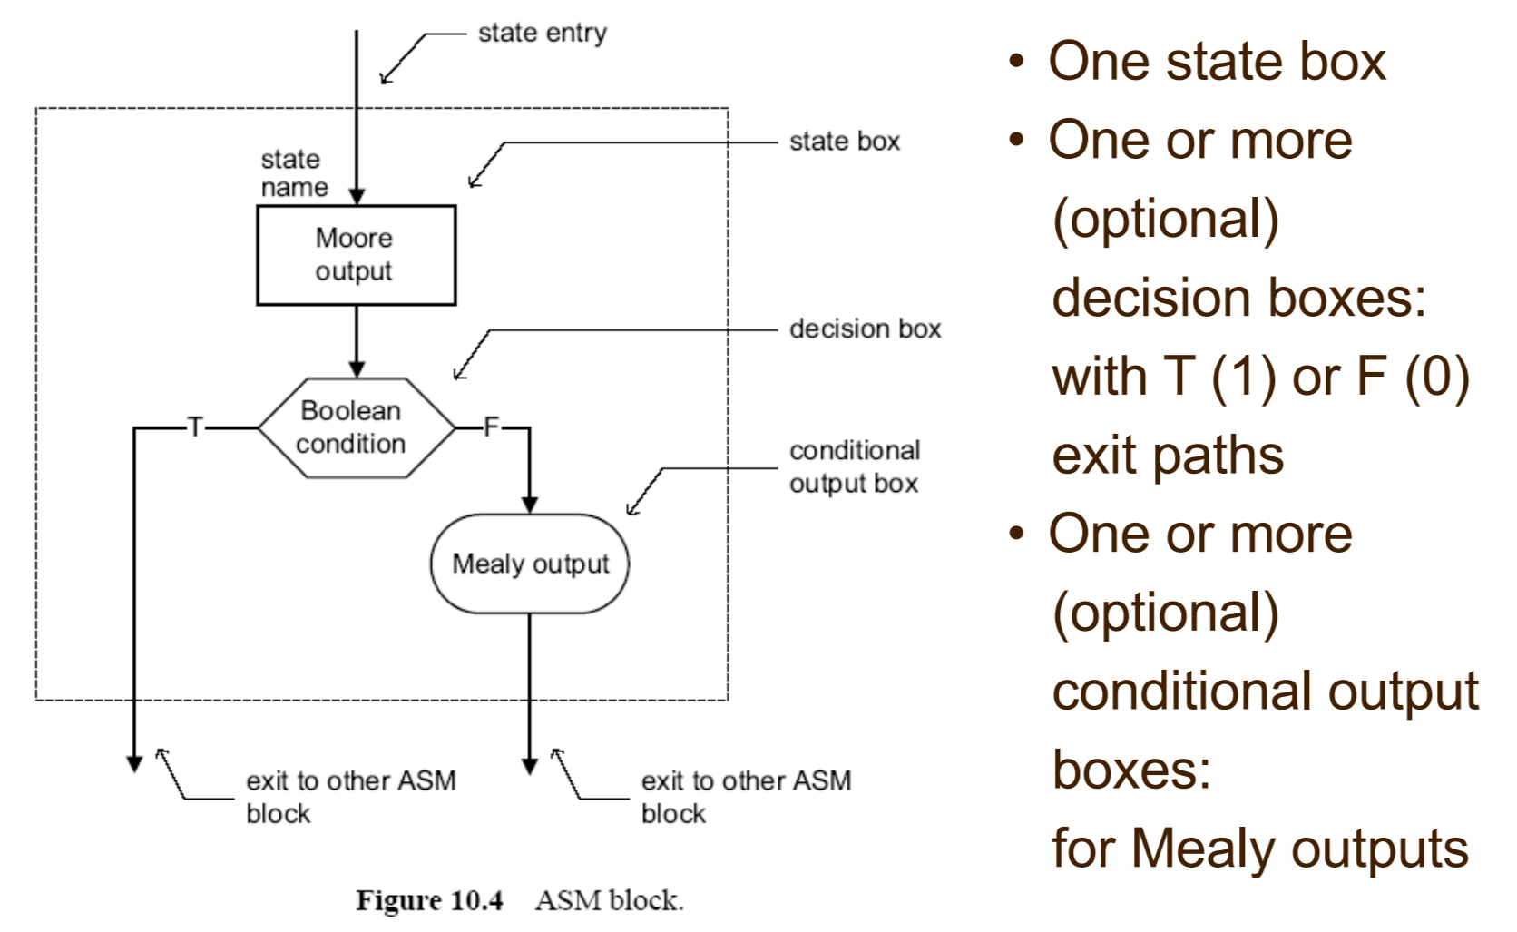
ASM Block

Slide 18
ASM Chart Rules
Difference between a regular flowchart and an ASM chart:
Transition governed by clock
Transition occurs between ASM blocks
Basic rules:
For a given input combination, there is one unique exit path from the current ASM block
Any closed loop in an ASM chart must include a state box

Slide 19
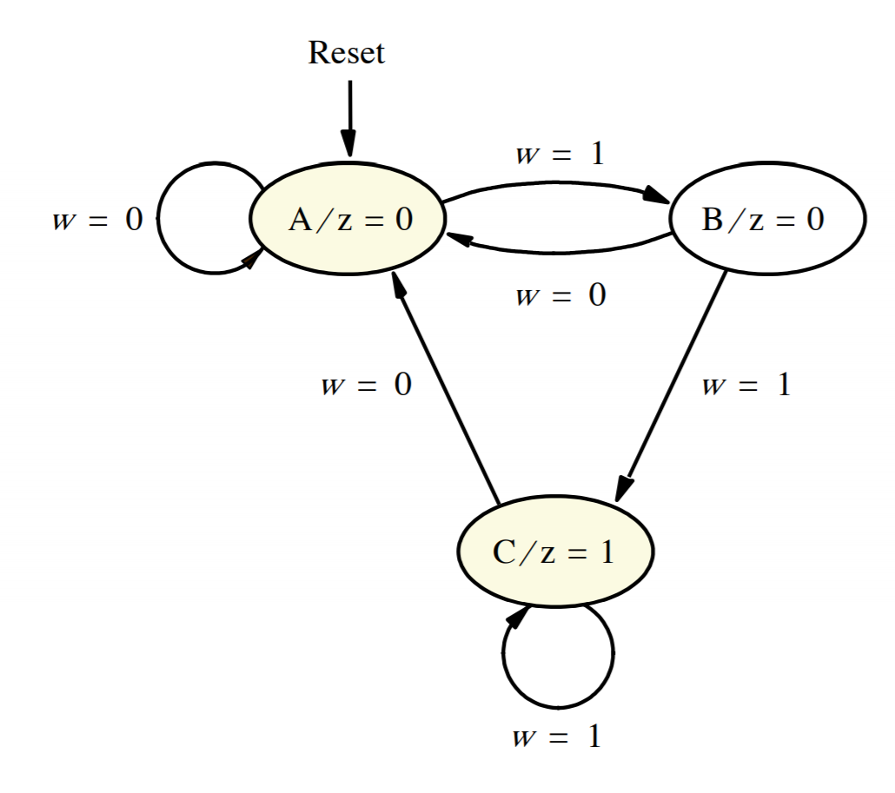
Example : State Diagram

Slide 20
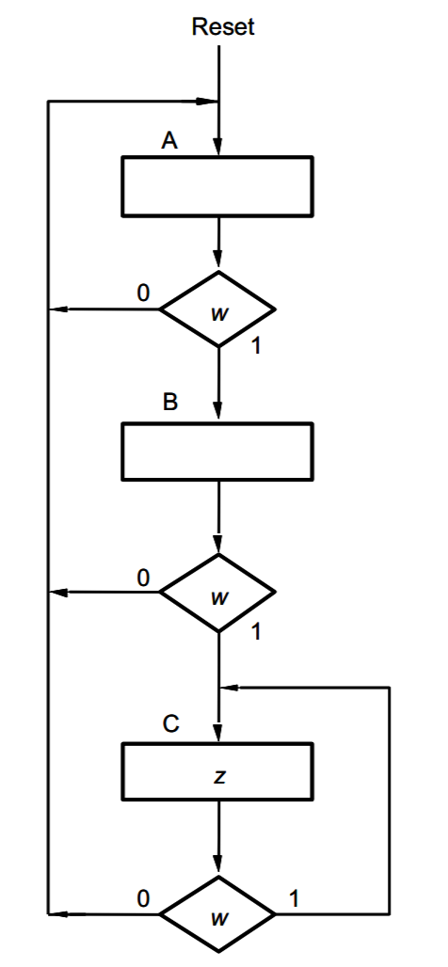
Example : ASM Chart

Slide 21
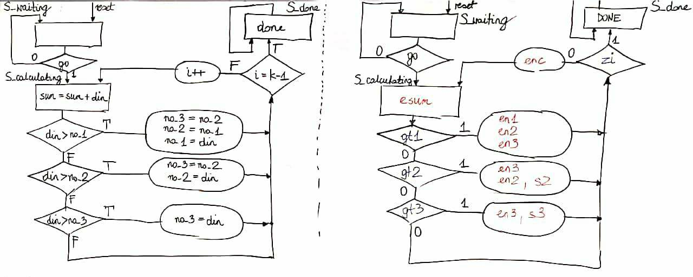
Exercise: Control Unit

Slide 22
AES
Check the Pseudocode
Design Datapath
Design Control Unit

Slide 23
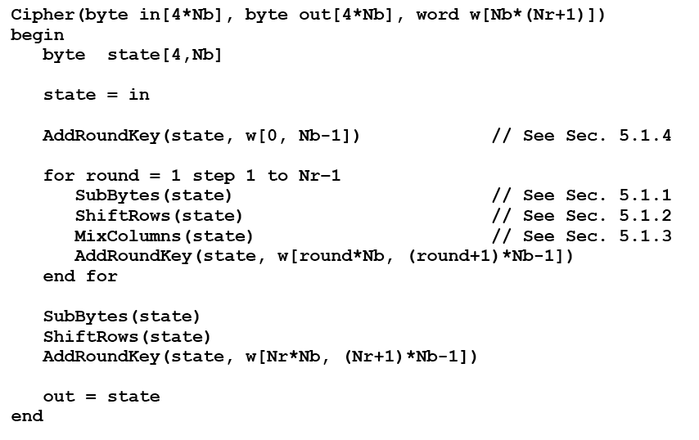
AES Encryption Pseudocode

Slide 24
Symbol

Slide 25
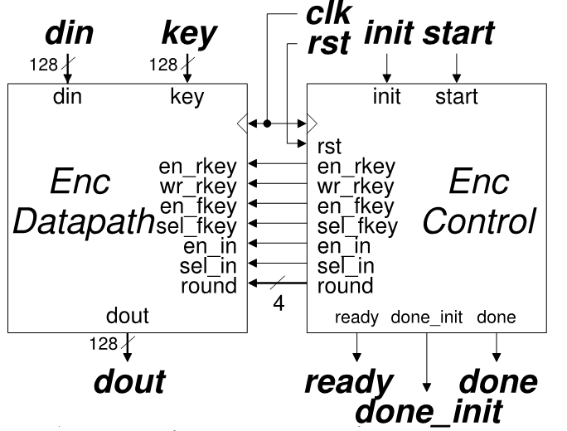
AES_Enc: Interface with the Division into the Datapath and Controller
Note: Bold line represents a 128-bit bus unless specified otherwise

Slide 26
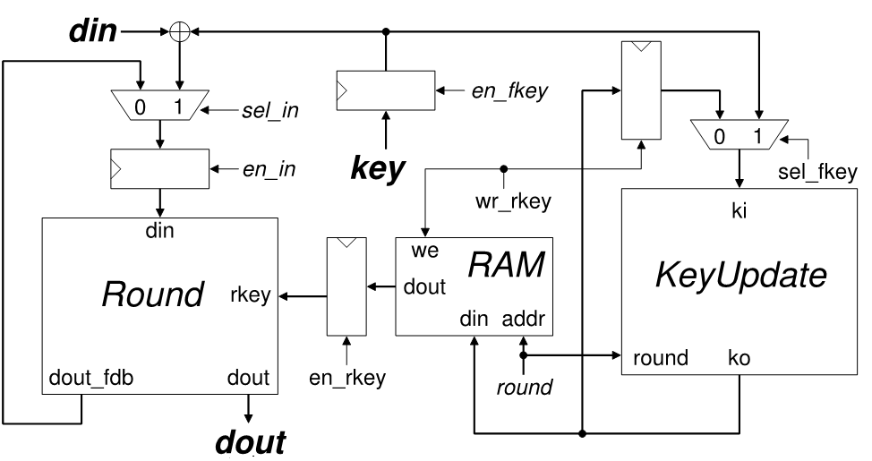
AES Datapath
Note: Bold line represents a 128-bit bus unless specified otherwise

Slide 27
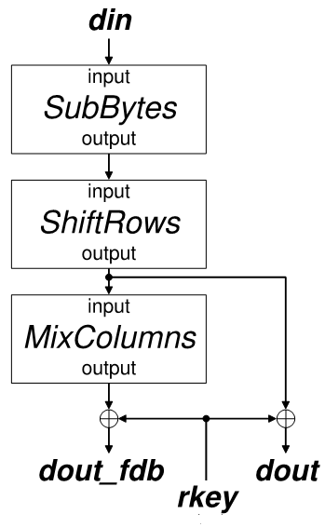
Round Block Diagram
Note: Bold line represents a 128-bit bus unless specified otherwise

Slide 28
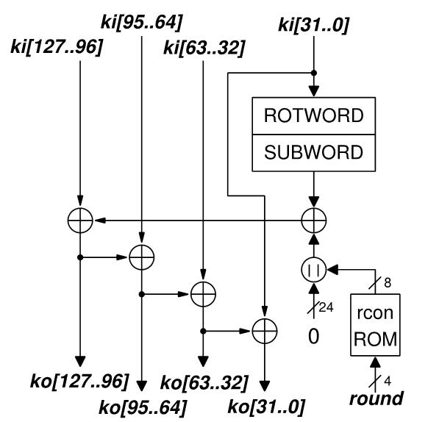
KeyUpdate Block Diagram
Note: All buses are 32-bit wide unless specified otherwise

Slide 29
Control Unit
Bold line represents a 128-bit bus unless specified otherwise

Slide 30
Thank you

