Slide 1
Basics of Memory

Slide 2
Performance Considerations
Main bottlenecks
CPU-GPU data transfers
Global memory access
Memory access
Latency hiding
Occupancy
Memory coalescing
Data reuse
Shared memory usage
SIMD (Warp) Utilization: Divergence
Other considerations
Atomic operations: Serialization
Data transfers between CPU and GPU
Overlap of communication and computation
Notes:
the typical drawbacks or bottlenecks of the processor-centric systems and the reason for that is that the data resides far from the cuda cores from the GPU course and this data might reside either on the host memory or on the global memory of the GPU. these long latency operations are the access to the global memory. in order to be efficient in this latency-hiding mechanism, we need to have enough warps in the GPU pipeline, and that is called occupancy. In the access to global memory is also important to take advantage as much as possible of the cache lines that we bring from the global memory and that's essentially what we call coalescing the memory accesses. in order to take advantage of the data reused, we will take it into account when we access the shared memory usage.

Slide 3
Memory Access

Slide 4
Memory Layout of a Matrix in C
M_{0,0}
M_{1,0}
M_{2,0}
M_{3,0}
M_{0,1}
M_{1,1}
M_{2,1}
M_{3,1}
M_{0,2}
M_{1,2}
M_{2,2}
M_{3,2}
M_{0,3}
M_{1,3}
M_{2,3}
M_{3,3}
M
M_{0,0}
M_{1,0}
M_{2,0}
M_{3,0}
M_{0,1}
M_{1,1}
M_{2,1}
M_{3,1}
M_{0,2}
M_{1,2}
M_{2,2}
M_{3,2}
M_{0,3}
M_{1,3}
M_{2,3}
M_{3,3}
Slide credit: Hwu & Kirk
Notes:
in cuda, we have the same memory layout as in c is matrices or two-dimensional matrices, for example, are typically stored in a row-major layout

Slide 5
The DRAM Subsystem The Top-Down View

Slide 6
DRAM Subsystem Organization
Channel
DIMM
Rank
Chip
Bank
Row/Column
Notes:
the DRAM system organized it's in this top-down organization. we can start from the memory channels which are actually the channels that connect the CPU processor or the GPU to the memory itself. the memory is going to be composed typically by DIMM, but by memory modules inside these memory modules, we have one or two ranks typically. these ranks are composed of memory chips, and inside the memory chips we have memory banks, and then the banks are like two-dimensional organizations of memory cells of different cells and are organized into rows and columns.

Slide 7
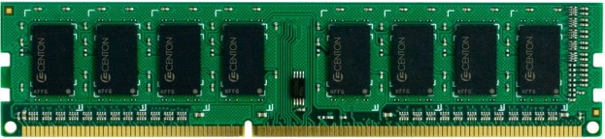
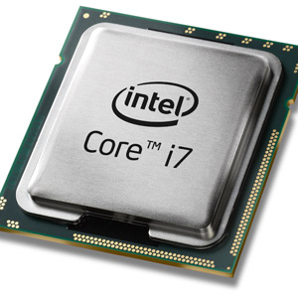
The DRAM Subsystem
“Channel”
DIMM (Dual in-line memory module)
Processor
Memory channel
Memory channel
Notes:
the CPU or the GPU with the memory beams and these memory channels are accessible from the memory controllers of the processors. each memory controller can handle one memory channel or more than one memory channel. and then connected to each memory channel. we may have one DIMM or maybe several DIMM, we have like two DIMMs per memory channel.

Slide 8
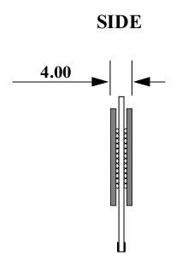
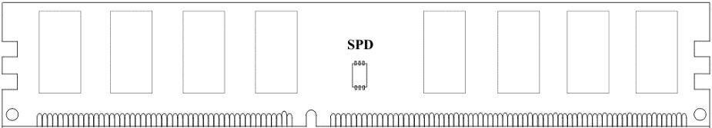
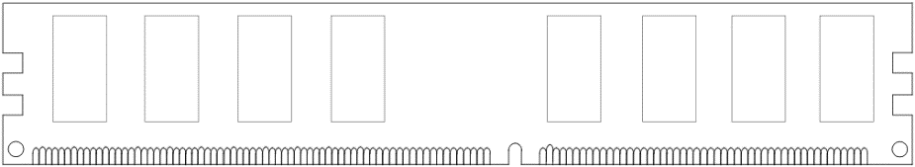
Breaking down a DIMM (module)
DIMM (Dual in-line memory module)
Side view
Front of DIMM
Back of DIMM
Rank 0: collection of 8 chips
Rank 1
Notes:
if we go closer to them to the DIMM to this dual inline memory, we see that it has two sides, and on these two sides we normally have a few chips. each of these sites corresponds to what we call a rank in this specific example. rank zero is a collection of eight chips same as rank one.

Slide 9
Breaking down a Rank
. . .
Chip 0
Chip 1
Chip 7
Rank 0
<0:63>
<0:7>
<8:15>
<56:63>
Data <0:63>
Notes:
there are eight chips and every time that we want to read one cache line or one element from this memory, we would be accessing all these chips at the same time, and bringing out some bits of the corresponding words, or the corresponding cache lines. bits zero to seven are accessed in chip zero, bits eight to fifteen are accessed in chip one, and so on.

Slide 10
Breaking down a Chip
8 banks
Chip 0
Bank 0
<0:7>
<0:7>
<0:7>
...
<0:7>
<0:7>
Notes:
take a look at the internals of one chip we'll see that there are different banks, and these banks can be addressed by using certain bits of the memory address but depending on these bits of the memory address, we would be accessing a different bank

Slide 11

Inside a DRAM Chip
Bitline
Wordline
Subarray
(2D Array of DRAM Cells)
DRAM Cells
Wordline
Access
Transistor
Bitline
Sense Amplifiers
Row Buffer
Storage
Capacitor
DRAM Bank
DRAM Chips
DRAM Module
8
Notes:
if we look at the internals of one bank, these banks are composed by several different sub-arrays that are like 2d arrays of different cells. we have sense amplifiers that are going to be used to amplify the values that we put in the bit line, and all these sense amplifiers together these sense amplifiers in each subarray are what we call the local row buffer. we can take a closer look at each of the different cells and we see that each direct cell is composed by a storage capacitor and an access transistor. the access transistor is controlled by the worldline and this access transistor can provide the connection between the storage capacitor, and the bit line for either reading the data that resides in the capacitors or writing data.

Slide 12
DRAM Cell Operation
wordline
½ V_{DD}
access
transistor
bitline
storage
capacitor
1. ACTIVATE (ACT)
2. READ/WRITE
3. PRECHARGE (PRE)
enable
sense
amplifier
9
Notes:
the dram cell operation different cell operation consists of three main steps, the first is activate, the second step is read or write, and the final step is pre-charge

Slide 13
DRAM Burst
Accessing data in different bursts (rows)
Need to access the array again
Accessing data in the same burst (row)
No need to access the array again, just the multiplexer
Accessing data in the same burst is faster than accessing data in different bursts
Timeline:
Timeline:
Slide credit: Izzat El Hajj
Notes:
we want to access data that resides in different parts or in different rows what that means is that we will have to wait a certain latency. when we access data from the same bursts or the same row, things can be much faster, can be much lower latency because after having paid the long latency of opening a new row we can access several elements or similar cache lines one after the other. we are saving a large amount of time in comparison to the other case where we have consecutive accesses to different bursts or different rows. so accessing data in the same bursts is faster than accessing data in different parts.

Slide 14
Recall: Memory Banking
Memory is divided into banks that can be accessed independently; banks share address and data buses (to minimize pin cost)
Can start and complete one bank access per cycle
Can sustain N concurrent accesses if all N go to different banks
Bank
0
Bank
1
Bank
2
Bank
15
MDR
MAR
MDR
MAR
MDR
MAR
MDR
MAR
Data bus
Address bus
CPU
Picture credit: Derek Chiou

Slide 15
Multiple Banks (Interleaving) and Channels
Multiple banks
Enable concurrent DRAM accesses
Bits in address determine which bank an address resides in
Multiple independent channels serve the same purpose
But they are even better because they have separate data buses
Increased bus bandwidth
Enabling more concurrency requires reducing
Bank conflicts
Channel conflicts
How to select/randomize bank/channel indices in address?
Lower order bits have more entropy
Randomizing hash functions (XOR of different address bits)
Notes:
we can have multiple channels connected to these channels, as channel level parallels so multiple banks enable concurrent dram access. and bits in the address determine which bank and address resides in, because when we have multiple channels, we also have multiple databases, and that means increased bus bandwidth. however, these ideas of enabling more concurrency by using more banks or using channels also have to be careful because we may end up happening bank conflicts or channel conflicts. we will have to wait until the previous accesses to the same bank or to the same channel have been completed before we can start new access. however, there are ways of dealing with this one way is, for example, changing the data layout that we have in memory. in order to reduce potential conflicts and be able to access more data concurrently. there are also other ways for example using low-order bits that have normally more entropy so which means the accesses are going to be more scattered. this way we can expect that lower amount of conflicts. there are solutions that randomize the accesses to the memories by using hash functions. these have hash functions for example can be implemented by XOR of different bits of the address.

Slide 16
Latency Hiding with Multiple Banks
With one bank, time still wasted in between bursts
Latency can be hidden by having multiple banks
Need many threads to simultaneously access memory to keep all banks busy
Achieved with having high occupancy in GPU cores (SMs)
Similar idea to hiding pipeline latency in the core
Slide credit: Izzat El Hajj
Notes:
when we have multiple banks we can better hide the latency because we can read values, data from different banks while we are paying the latency of opening rows in different banks. if we have a single bank, we have to wait long latency until we open one row, then we access several columns in this row, then we have to open another row and then we access several columns in that row. we will take full advantage of this possibility of having multiple banks when we have multiple threads accessing memory, and that happens when the occupancy in the gpu cores or sms is large enough.

Slide 17
Memory Coalescing (I)
When threads in the same warp access consecutive memory locations in the same burst, the accesses can be combined and served by one burst
One DRAM transaction is needed
Known as memory coalescing
If threads in the same warp access locations not in the same burst, accesses cannot be combined
Multiple transactions are needed
Takes longer to service data to the warp
Sometimes called memory divergence
Slide credit: Izzat El Hajj
Notes:
When threads in the same warp access consecutive memory locations in the same burst, the accesses can be combined and served by one burst, the one DRAM transaction is needed which is known as memory coalescing.If threads in the same warp access locations are not in the same burst, accesses cannot be combined, multiple transactions are needed, and takes longer to service data to the warp, which is sometimes called memory divergence.

Slide 18
Memory Coalescing (II)
When accessing global memory, we want to make sure that concurrent threads access nearby memory locations
Peak bandwidth utilization occurs when all threads in a warp access one cache line (or several consecutive cache lines)
Not coalesced
Coalesced
Md
Nd
Thread 1
H
T
D
Thread 2
I
W
WIDTH
Slide credit: Hwu & Kirk
Notes:
when accessing global memory, we want to make sure that component threads access nearby memory locations, and that's the way of achieving big bandwidth utilization. when threats belonging to the same warp access one single cache line or several consecutive cache lines that depends on what's the size of the elements the words, that each thread in the warp wants to access, and also what's the size of the cache lines. but that's essentially the idea we will maximize the bandwidth to the global memory if the threads that belong to the same warp access data that resides nearby.

Slide 19
Uncoalesced Memory Accesses
Access direction in Kernel code
M_{0,0}
M_{1,0}
M_{2,0}
M_{3,0}
M_{0,1}
M_{1,1}
M_{2,1}
M_{3,1}
M_{0,2}
M_{1,2}
M_{2,2}
M_{3,2}
M_{0,3}
M_{1,3}
M_{2,3}
M_{3,3}
Time Period 2
…
T₁
T₂
T₃
T₄
Time Period 1
T₁
T₂
T₃
T₄
M
M_{0,0}
M_{1,0}
M_{2,0}
M_{3,0}
M_{0,1}
M_{1,1}
M_{2,1}
M_{3,1}
M_{0,2}
M_{1,2}
M_{2,2}
M_{3,2}
M_{0,3}
M_{1,3}
M_{2,3}
M_{3,3}
Slide credit: Hwu & Kirk
Notes:
this is an example of uncoalesced memory accesses where this is the access direction in kernel code. we are going to assign different threads to these different rows, thread 1 or thread 0 goes all over this row yellow row, the next thread goes all over this red row.

Slide 20
Coalesced Memory Accesses
Access direction in Kernel code
M_{0,0}
M_{1,0}
M_{2,0}
M_{3,0}
M_{0,1}
M_{1,1}
M_{2,1}
M_{3,1}
M_{0,2}
M_{1,2}
M_{2,2}
M_{3,2}
M_{0,3}
M_{1,3}
M_{2,3}
M_{3,3}
Time Period 1
Time Period 2
…
T₁
T₂
T₃
T₄
T₁
T₂
T₃
T₄
M
M_{0,0}
M_{1,0}
M_{2,0}
M_{3,0}
M_{0,1}
M_{1,1}
M_{2,1}
M_{3,1}
M_{0,2}
M_{1,2}
M_{2,2}
M_{3,2}
M_{0,3}
M_{1,3}
M_{2,3}
M_{3,3}
Slide credit: Hwu & Kirk
Notes:
however, we could distribute the computation in a coalesced way that the access direction. in the kernel code is by vertical row and what that would mean is that in the first time period, the four threads are accessing four consecutive elements belonging to row the yellow row, and in the next time period, they access four consecutive elements in the red row and so on.

Slide 21
AoS vs. SoA
Array of Structures vs. Structure of Arrays
Sung+, “DL: A data layout transformation system for heterogeneous computing,” INPAR 2012
Gómez-Luna+, “Ch.8: Application Use Cases: Platform Atomics. Heterogeneous System Architecture,” 2016
Notes:
Array of Structures vs. Structure of Arrays

Slide 22
CPUs Prefer AoS, GPUs Prefer SoA
Linear and strided accesses
GPU
CPU
AMD Kaveri A10-7850K
Sung+, “DL: A data layout transformation system for heterogeneous computing,” INPAR 2012
Gómez-Luna+, “Ch.8: Application Use Cases: Platform Atomics. Heterogeneous System Architecture,” 2016
Notes:
we measured the bandwidth for different strides which means accesses consecutive accesses or accesses of consecutive threads of networking threats would be done with a certain stride, with a certain distance depending on what's the structure size.

Slide 23
Use Shared Memory to Improve Coalescing
Md
Nd
Original
H
Access
T
D
I
Pattern
W
WIDTH
Copy into
scratchpad
memory
Md
Nd
Tiled
Access
Pattern
Perform
multiplication
with scratchpad
values
Slide credit: Hwu & Kirk
Notes:
but not in all cases we would be able to perform coalesce accesses that will depend on how we need to access the memory. We can use shared memory to improve coalescing

Slide 24
Data Reuse
Same memory locations accessed by neighboring threads
for (int i = 0; i < 3; i++){
for (int j = 0; j < 3; j++){
sum += gauss[i][j] * Image[(i+row-1)*width + (j+col-1)];
}
}
Notes:
in order to compute each output pixel what we are doing is the convolution of one filter, and we perform compute the convolution of the filter and the elements that are the pixels that are under the filter. if we compute the output pixel corresponding to this position we would be reusing some of the pixels that we needed for the computation of this pixel.

Slide 25
Data Reuse: Tiling
To take advantage of data reuse, we divide the input into tiles that can be loaded into shared memory
__shared__ int l_data[(L_SIZE+2)*(L_SIZE+2)];
…
Load tile into shared memory
__syncthreads();
for (int i = 0; i < 3; i++){
for (int j = 0; j < 3; j++){
sum += gauss[i][j] * l_data[(i+l_row-1)*(L_SIZE+2)+j+l_col-1];
}
}
Notes:
the way of taking advantage of these data reuses is by using type tiling or blocking. that essentially means dividing in this case the input image into tiles loading these styles into the shared memory and then computing by using the values that we have in share memory.

Slide 26
Shared Memory
Shared memory is an interleaved (banked) memory
Each bank can service one address per cycle
Typically, 32 banks in NVIDIA GPUs
Successive 32-bit words are assigned to successive banks
Bank = Address % 32
Bank conflicts are only possible within a warp
No bank conflicts between different warps
Notes:
Shared memory is an interleaved memory and each bank can service one address per cycle. typically, the way that one specific element is mapped onto the banks is by applying this expression. so address module 32 will give us the exact bank where a specific address resides. there will be bank conflicts whenever we have two threads belonging to the same warp that need to access data in the same bank but there are no bank conflicts between different warps.

Slide 27
Use Shared Memory to Improve Coalescing
Md
Nd
Original
H
Access
T
D
I
Pattern
W
WIDTH
Copy into
scratchpad
memory
Md
Nd
Tiled
Access
Pattern
Perform
multiplication
with scratchpad
values
Slide credit: Hwu & Kirk
Notes:
we may have bank conflicts when we access shared memory and that's actually something to take into account as well when we use tiles in shared memory.

Slide 28
Atomic Operations

Slide 29
Atomic Operations (I)
CUDA provides atomic instructions on shared memory and global memory
They perform read-modify-write operations atomically
Arithmetic functions
Add, sub, max, min, exch, inc, dec, CAS
int atomicAdd(int*, int);
Bitwise functions
And, or, xor
Datatypes: int, uint, ull, float (half, single, double)*
Return value (old value)
Pointer to shared memory or global memory
Value to add
* Datatypes for different atomic operations in https://docs.nvidia.com/cuda/cuda-c-programming-guide/index.html#atomic-functions
Notes:
cuda provides atomic operations since almost the beginning on shared memory and all global memory there are different atomic operations, some of them executing arithmetic functions or bitwise operations. They perform read-modify-write operations atomically. there are also bitwise operations and different data types.

Slide 30
Atomic Operations (II)
Atomic operations serialize the execution if there are atomic conflicts
t_{conflict}
t_{base}
t_{base}
No atomic conflict = concurrent updates
Atomic conflict = serialized updates
Shared memory
Shared memory
Notes:
Atomic operations serialize the execution if there are atomic conflicts. If there is no atomic conflict which means concurret updates. And atomic conflict is serialized updates.

Slide 31
Uses of Atomic Operations
Computation
Atomics on an array that will be the output of the kernel
Example
Histogram, reduction
Synchronization
Atomics on memory locations that are used for synchronization or coordination
Example
Counters, locks, flags…
Use them to prevent data races when more than one thread need to update the same memory location
Notes:
atomic operations are pretty useful for computation where the atomics are directly used on elements of an array that will be the output of the kernel. atomic operations can also be used for synchronization when the atomic operations on memory locations are that are used for synchronization or coordination. Use them to prevent data races when more than one thread need to update the same memory location.

Slide 32
Image Histogram
Histograms are widely used in image processing
Some computation before voting in the histogram may be needed
Parallel threads frequently incur atomic conflicts in image histogram computation
For (each pixel i in image I){
Pixel = I[i] // Read pixel
Pixel’ = Computation(Pixel) // Optional computation
Histogram[Pixel’]++ // Vote in histogram bin
}
Notes:
Histograms are widely used in image processing, which means some computation before voting in the histogram may be needed and parallel threads frequently incur atomic conflicts in image histogram computation.

Slide 33
Asynchronous Data Transfers between CPU and GPU

Slide 34
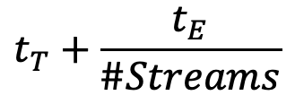
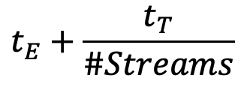
Asynchronous Transfers between CPU & GPU
Computation divided into #Streams
D input data instances, B blocks
#Streams
D/#Streams data instances
B/#Streams blocks
Estimates
Default stream
Several streams
$$t_{E}+\frac{t_{T}}{\#Streams}$$
$$t_{T}+\frac{t_{E}}{\#Streams}$$
t_{E} >= t_{T} (dominant kernel)
t_{T} > t_{E} (dominant transfers)
Notes:
Computation is divided such that if D data instances need B blocks to be processed… The kernel is therefore #Streams times launched.
CUDA literature gives only two rough estimates, but does not give any hint of the optimal number of streams in which a given data set should be preferably divided.
in order to perform the overlap what we are going to do is dividing the transfers and the computation into a certain number of strings. so if we are using four streams uh in for each stream we are going to compute on d data instances and we are going to use b thread blocks so what that means is that instead of having to transfer the whole input data instances. when we are using a certain number of streams we see a couple of raw estimates that will give you an idea of what's going to be the overall execution time. in case we have a dominant kernel which means that the execution time of the kernel is greater or equal to the data transfer time, or when we have dominant transfers where the transfer time is higher than the execution time of the kernel. in one case we will have the kernel hiding most of the data transfers, while in the other case, we'll have the data transfers hiding most of the execution of the kernel.

Slide 35
Use Case: Video Processing
Applications with independent computation on different data instances can benefit from asynchronous transfers
For instance, video processing
Gomez-Luna+, “Performance Models for Asynchronous Data Transfers on Consumer Graphics Processing Units,”
JPDC, 2012
Notes:
A number b of blocks per frame executes.
Data transfers are overlapped with computation. Thus, some time can be saved.
video processing in a known stream execution we need to transfer the whole video or the whole sequence of a video to the GPU memory, and only after that start the computation on these frames by the thread blocks or whatever number of thread blocks that we need to use in this kernel with the string execution. we can partition the video sequence into different chunks. we can transfer the chunks as soon as one chunk is in the GPU memory. we can compute on it and at the same time transfer the subsequent frames and save a lot of time to the use of streams.

