Slide 1


Performance Analysis of Computing Systems
1

Slide 2
Outline
Introduction
Performance Analysis Methodology
Metrics
Evaluation Techniques
Workloads
Visualization
Tools

Slide 3
Outline
Introduction
Performance Analysis Methodology
Metrics
Evaluation Techniques
Workloads
Visualization
Tools

Slide 4
Role of Computing Systems
Notes:
The use of computers on a regular basis in our life is very important. Technically in daily life computer is used to convert raw facts and data into meaningful information and knowledge.
You can understand and analyze the importance of computers by seeing a revolution in online business, online education, online communication, and internet banking. To store, access, manipulate, calculate, analyze data, and information we use hardware devices and software applications.
All our daily life activities are based on such online services and products. Ignoring performance in safety critical systems can lead to catastrophe such as what happened for space shuttle Challenger.

Slide 5
Systems Performance Analysis
Notes:
In computer systems, we have different domains. System can be an individual software application, it can be a hardware device, or we can have a distributed system which is a group of computes connected to each other.
Generally, performance is the amount of work accomplished by a system. In a computing system, performance analysis means to analyze and measure the accuracy, efficiency and speed of executing computer program in order to enhance the performance.

Slide 6
How can System Performance Analysis Help?
Notes:
By using the information provided from performance analysis, we can design a system with higher performance and lower cost. It also helps us to be ensure that system is working as it is designed for.

Slide 7
Example problems that PA can help solve
Notes:
Performance analysis can be used to solve many problems when we want to design or select a system. One of the most usage of performance analysis is in system tuning. When a system has many parameters, determining the optimal value of those parameters cannot be done in designing phase as they may be dependent to the environment of systems. Therefore, we need the performance analysis to find the optimal values. Moreover, we can find the bottleneck of systems. For example, it can answer following questions: does the system need more, cpu, Memory, or storage?
By having this information in hand, we can performa the capacity planning in datacenters. And for example predict how much more computing resources for new users. All these information can be gathered by doing the performance analysis.

Slide 8
Examples problems that PA can help solve
Notes:
Other than the usual resource

Slide 9
What is involved in PA?

Slide 10
Outline
Introduction
Performance Analysis Methodology
Metrics
Evaluation Techniques
Workloads
Visualization
Tools

Slide 11
Basic Terms

Slide 12
Definitions

Slide 13
Steps in Performance Analysis

Slide 14
Steps in Performance Analysis

Slide 15
Steps in Performance Analysis

Slide 16
Outline
Introduction
Performance Analysis Methodology
Metrics
Evaluation Techniques
Workloads
Visualization
Tools

Slide 17
Outcome for Any Service

Slide 18
Notations of Performance

Slide 19
Metrics in Multi-User System

Slide 20
Commonly Used Performance Metrics

Slide 21
Response Time

Slide 22
Productivity-related Metrics

Slide 23
Productivity-related Metrics

Slide 24
Productivity-related Metrics

Slide 25
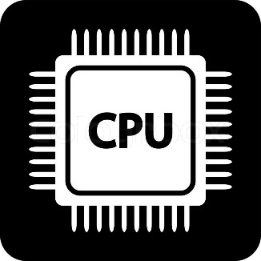

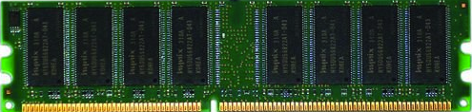
Why Focusing on Memory?
Processors
and caches
Main Memory
Storage (SSD/HDD)
The memory is a power and performance bottleneck in most of computing systems
More cores result in more pressure on the memory
Applications are increasingly data intensive
Our expectation:
Infinite Bandwidth
Infinite capacity
Zero latency
Zero cost
Notes:
From architecture point of view, the memory system is responsible for a large fraction of overall system power and performance. Today, More processing cores are sharing the memory, and therefore it increases the demand for memory capacity and bandwidth.
On the applications front, most of workloads such as machine learning applications are expected to be memory intensive.
Besides, we always expect more from the memory: we want zero latency and infinite bandwidth, infinite capacity, all at zero cost

Slide 26
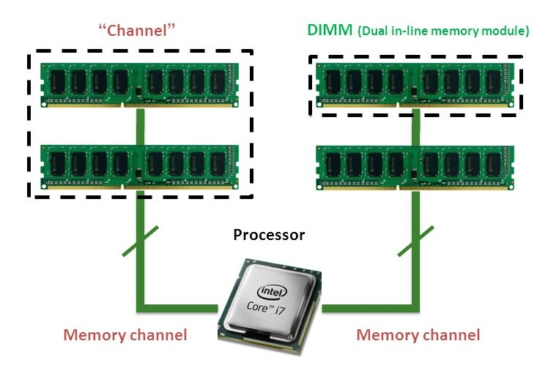
DRAM Frequency and Channel
Notes:
In this slide, I briefly introduce dram frequency and channel.
This table shows an example of DDR3 DRAM. When I say dram frequency, I mean The front side bus frequency. Actually this number is double of actual bus frequency because of dual data rate. And also in ddr3, the bus frequency is 4 times of cell array frequency.
The right figure shows a dual channel memory system. Actually I want to say that the number of channels is not equal to the number of dim (dual in line memory module)s .
The number of channels depends on the configuration of memory modules on memory slots.
And the goal of channels are to increase the bandwidth of access to memory.

Slide 27
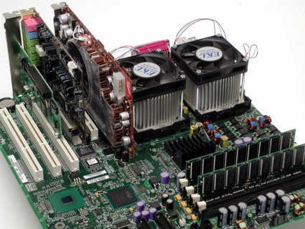


Memory Analysis
Bandwidth = Channels × Frequency × Width
Notes:
Memory configuration of a server directly impacts its power and performance.
The extent of this impact depends on the performance sensitivity of applications to memory parameters..
Based on this equation, the bandwidth of memory is depends on the configuration of memory like number of channels and frequency. Hence, we evaluate the performance of our workloads regarding these memory parameters

Slide 28
Reliability and Availability Metrics

Slide 29
Ratio Games

Slide 30
Ratio Games - example

Slide 31
Ratio Games - example

Slide 32
Ratio Games - example

Slide 33
Ratio Games - example

Slide 34
Outline
Introduction
Performance Analysis Methodology
Metrics
Evaluation Techniques
Workloads
Visualization
Tools

Slide 35
Evaluation Techniques

Slide 36
Tracing a Real System

Slide 37
Measuring a Prototype

Slide 38
System Simulation

Slide 39
System Modeling

Slide 40
3 Rules of Validation

Slide 41
Outline
Introduction
Performance Analysis Methodology
Metrics
Evaluation Techniques
Workloads
Visualization
Tools

Slide 42
Terminology

Slide 43
Benchmarks Characteristics

Slide 44




Workloads
HiBench

Slide 45
Outline
Introduction
Performance Analysis Methodology
Metrics
Evaluation Techniques
Workloads
Visualization
Tools

Slide 46
Types of Variables

Slide 47
Guidelines for Good Charts

Slide 48
Guidelines for Good Charts

Slide 49
Guidelines for Good Charts

Slide 50
Minimize Ink

Slide 51
Common Mistakes

Slide 52
Common Mistakes

Slide 53
Common Mistakes

Slide 54
Outline
Introduction
Performance Analysis Methodology
Metrics
Evaluation Techniques
Workloads
Visualization
Tools

Slide 55

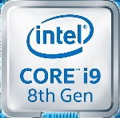
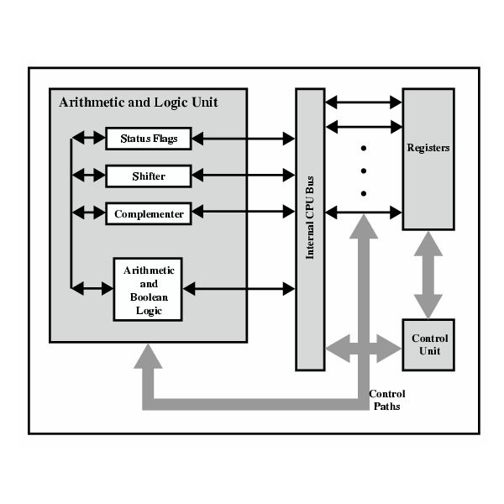
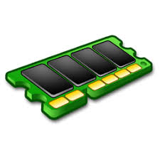
Modern Computers System
System
Socket
Core
Memory
IO HUB
CORE
CORE
CORE
Core
Memory
IO HUB
Memory
L3 Cache
IO HUB
Uncore
IMC
Intel IO
Clock
Intel QPI
Memory
IO HUB

Slide 56
Categorizing the level of abstractions
Levels of Information extraction:
System level
information of individual components at coarse-grained time span
Low level
information regarding each component at a fine-grained time-span
Microarchitectural dependent (IPC, cache miss rate, branch miss prediction)
Microarchitectural-independent

Slide 57




Popular Tools
Intel VTune
Intel Advisor
MICA
Perf
PCM
System-level information
Low-level Microarchitecture- Independent information
Low-level Microarchitecture- Dependent information
Low-level Uncore information

Slide 58
Dstat
Tools available on the Linux OS includes:
vmstat, netstat, iostat, ifstat and mpstat
DSTAT tool is developed to encompass all the aforementioned tools for generating Linux system resource statistics and replace all the tools mentioned above
Joins information from vmstat, netstat, iostat, ifstat and mpstat tools
Displays statistics simultaneously
Orders counters and highly-extensible
Supports summarizing of grouped block/network devices
Displays interrupts per device
Works on accurate timeframes, no timeshifts when a system is stressed
Supports colored output, it indicates different units in different colors
Shows exact units and limits conversion mistakes as much as possible
Supports exporting of CSV output to Gnumeric and Excel documents

Slide 59
Perf and Intel PCM
Perf is a low-level monitoring tool that can instrument CPU performance counters
major shortcoming of tools such as perf is that they cannot report the uncore
The uncore is the part of the processor that contains the integrated memory controller and the Intel QuickPath interconnect to the other processors
Perf
PCM
Intel PCM (Processor Counter Monitor) is an application programming interface (API) and a set of tools based on the API to monitor performance and energy metrics of Intel processors such as Xeon, Atom and Xeon Phi. PCM works on Linux, Windows, Mac OS X, FreeBSD and DragonFlyBSD operating systems. This API provided by Intel can address the shortcomings of the perf tool.

Slide 60
MICA
MICA
A major pitfall of a microarchitecture dependent workload characterization methodology is that it can hide underlying inherent program behavior.
MICA tool was developed by architecture community for micro-architecture independent characterization of applications. MICA is a Pin tool which allows the user to collect a number of program characteristics such as Instruction mix, Instruction-level parallelism, Register traffic, Working-set size, Data stream strides, and Branch predictability to quantify runtime program behavior. These characteristics are not independent of the instruction set architecture (ISA) and the compiler

Slide 61
Intel Vtune
Quickly Find and Fix Performance Bottlenecks
Performance Analysis for Applications & Systems
Intel® VTune™ Profiler takes the guesswork out of how best to improve performance in software deployed across CPUs and multiple accelerator architectures, including GPUs and FPGAs.
It does this by
Analyzing your code
Collecting key profiling data
Presenting its findings through a powerful interface that simplifies interpretation and helps you focus on the most effective software optimizations from computation and threading to memory and storage.

Slide 62
Intel Advisor
A prototyping tool that allows users to analyze their code and determine the costs and benefits of adding various threading models on Intel processors.
Works on code written in C, C++, and Fortran.
Can model parallelism using OpenMP, Intel Thread Building Blocks, and Intel Cilk Plus
Provide guidance to help codes get better vectorization, which is becoming increasingly important with wide vector units in modern processors.
A graphical user interface (GUI)
Accessed with the advixe-gui
Begin by creating a new project, entering the executable path and arguments, and setting other options. Once the Advisor project is created, run through the threading and/or vectorization workflows
A command line (CL) interface
Accessed with the advixe-cl commands.
Command line can be available on DevCloud.

Slide 63
When do you use Intel Vtune VS Advisor?
Intel Vtune
What’s your cache hit ratio?
Which loop/function is consuming most time overall?(bottom-up)
Are you stalling often? IPC?
Are you keeping all the threads busy?
Are you hitting remote NUMA?
When do you maximize your BW?
Intel Advisor
Which wevtor ISA are you using?
Flow of execution (callstacks)
What is your vectorization efficiency?
Can you safely force vectorization?
Inlining? Data type conversion?
Roofline

Slide 64

Questions
Thank you!

