Slide 1

FARMER WEATHER PREDICTION SYSTEM
By:
NAJMA AHMED ABDIRAHMAN
INSTITUTION: DEDAN KIMATHI UNIVERSITY OF TECHNOLOGY
STUDENT: NAJMA AHMED ABDIRAHMAN
REG NO:C025-01-1030/2018
SUPERVISOR: MR. PATRICK NDUNDU

Slide 2
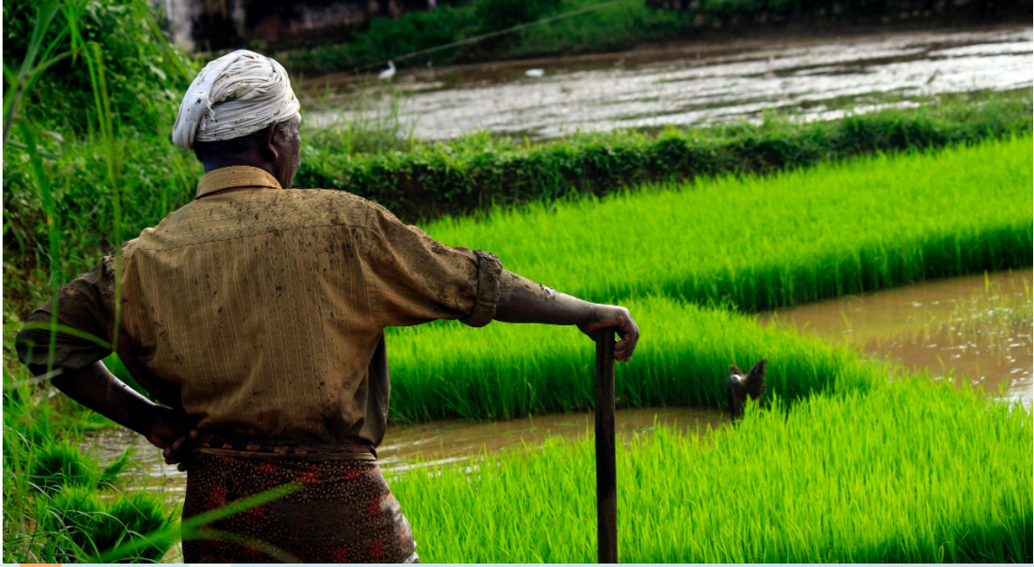
ABSTRACT
It is necessary to get a weather information in our day life for farmers.
My weather forecasting website application which forecasts for 3 county with forecasts that now update every20 minutes. Information includes forecast for next3 month duration.
To create a weather prediction system to predict weather condition a duration of three months .
The application adopts an agile system development methodology.

Slide 3
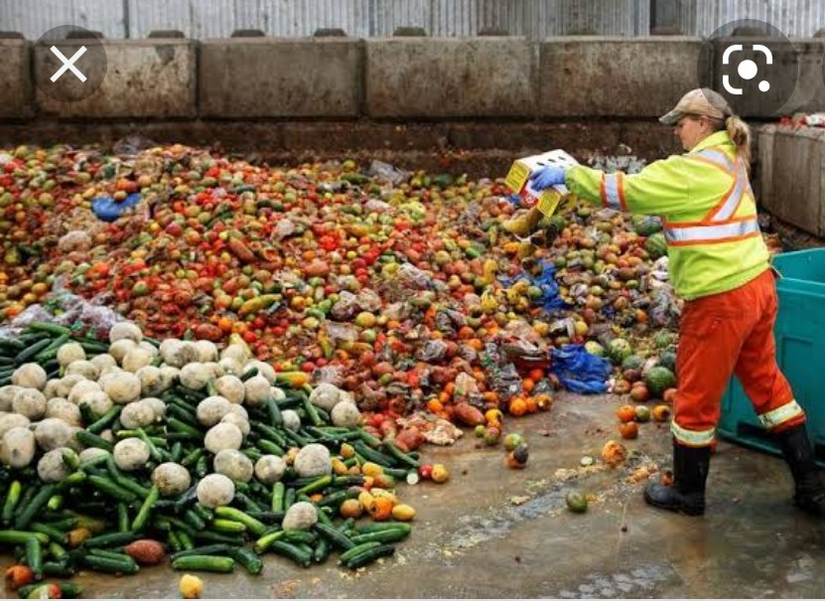
PROBLEM STATEMENT
Recent research has shown that most farmers are experiencing poor farm harvests due to inadequate information on weather analytics during the planting season. .
Lack of information on best farming practices and the best timing in terms of climate conditions have resulted into low farm produce.
There is need for an accurate weather prediction system that can be used to guide farmers on the crops to grow at specific times in their locality.

Slide 4
OBJECTIVES
Main Objective
To create a weather prediction system to predict weather condition a three months duration .
Specific objectives
At the end of the project, the system should complete the following:
To register and authenticate farmers.
To create a platform to capture location and duration
To create a machine learning model to predict the temperature and precipitation of nyeri ,nankuki and embu
To create a relational database to store the farmer generated data in well-organized schemes

Slide 5
Methodology
This refers to the system of methods or procedures used in sampling and collecting data required for a particular research.
It is also the application of the principles of the data collection methods and procedures in any field of knowledge.
This section describes fact finding techniques such as observation, questionnaires and interviews to be used in research.
It also contains the methods of software development which I will be using ,Agile development model. The methodology allows quicker response to change arising from the development of the project.

Slide 6
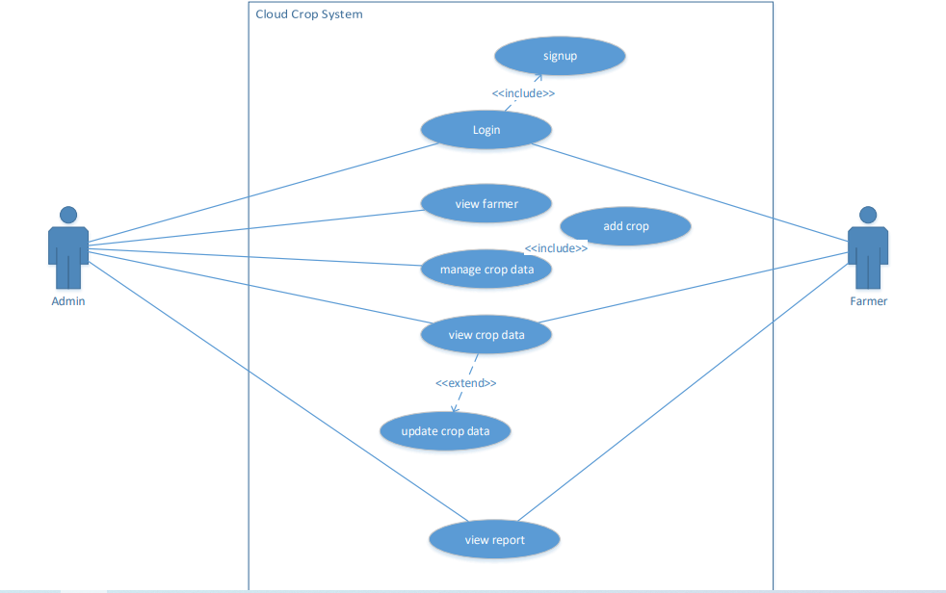
System analysis and design use case diagram

Slide 7
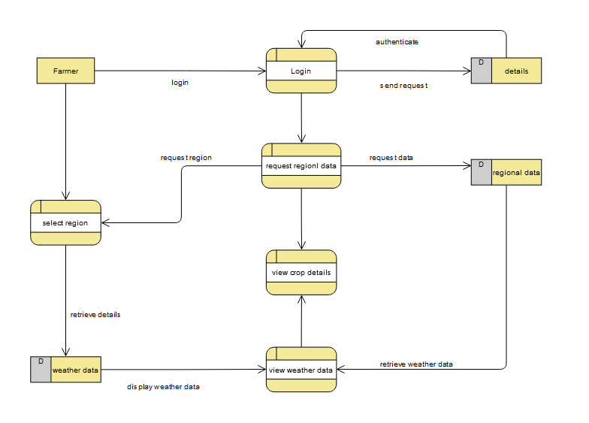
Level1 DFD(context diagram) for farmer

Slide 8
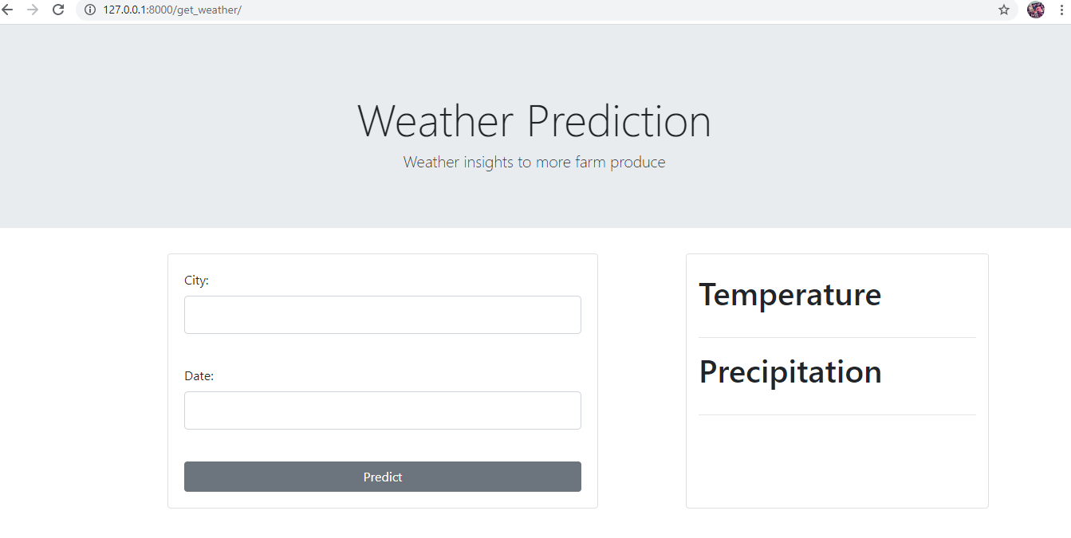
Implementations and test

Slide 9
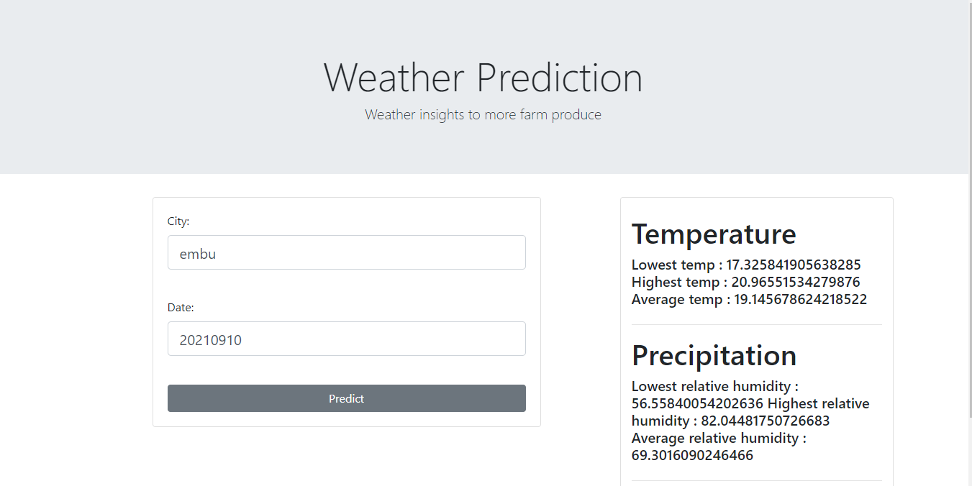

Slide 10
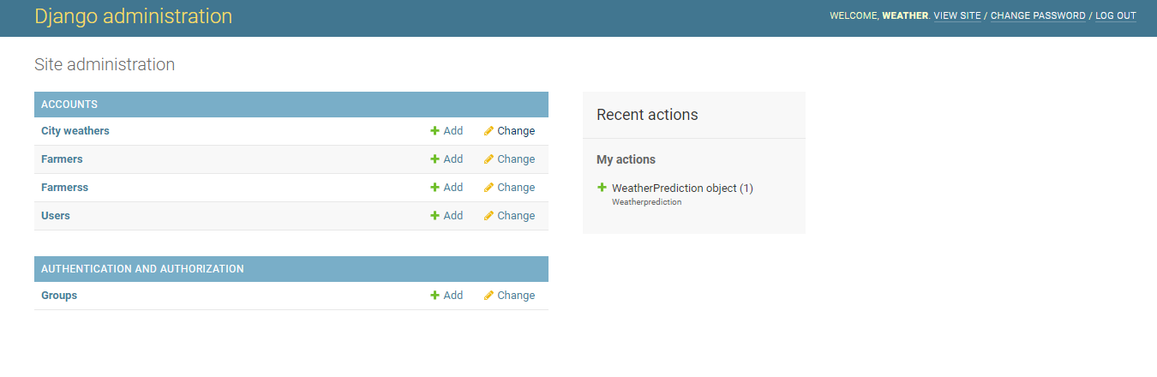

Slide 11
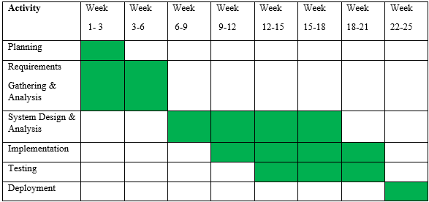
Schedule

Slide 12
References
Hart, C. (2018). Doing a Literature Review. London: Sage Publishing.
Kassie, M., Stage, J., Diiro, G., Muriithi, B., Muricho, G., Ledermann, S. T., ... & Khan, Z. (2018). Push–pull farming system in Kenya: Implications for economic and social welfare. Land use policy, 77, 186-198.
Quickscrum: https://www.quickscrum.com/Article/ArticleDetails/2030/5/What-Is-Iterative-Software-Development Point, T. (2018). SDLC. Retrieved from Tutorial Point: https://www.tutorialspoint.com/sdlc/sdlc_iterative_model.htm
Powell-Morse, A. (2016, December 15). Blog. Retrieved from A: https://airbrake.io/blog/sdlc/iterative-model

