Slide 1
SODA Foundation
the path to data autonomy
VMware NBP
Title
Author

Slide 2
Introduction
VMware is one of the most important and widely used virtualization platforms.
NBP for VMware will help to integrate SODA capabilities to VMware platforms.
Planned VMware NBP and Purpose
NBP | Purpose
NGC (Next Generation Client)Plugin . | Provide provision from vSphere web client to integrate storage and monitor status of resources.
VASA(vSphere APIs for Storage Awareness) Provider* | Provide the capabilities recognition of storage arrays to vSphere vCenter.
VRO(vRealize Orchestrator) Plugin | Automate complex IT tasks for storage management.
SRA(Storage Replication Adapter) Plugin* | Cooperate with VMware SRM to provide the VMs protection by using array-based replication.
vROps(vRealize Operations) Plugin* | Provide integrated performance, capacity and configuration monitoring capabilities for storage arrays.
vRLog(vRealize Log Insight) Plugin* | Provide intuitive, actionable dashboards, sophisticated analytics for storage arrays.
*These plugin will be available after daito release

Slide 3
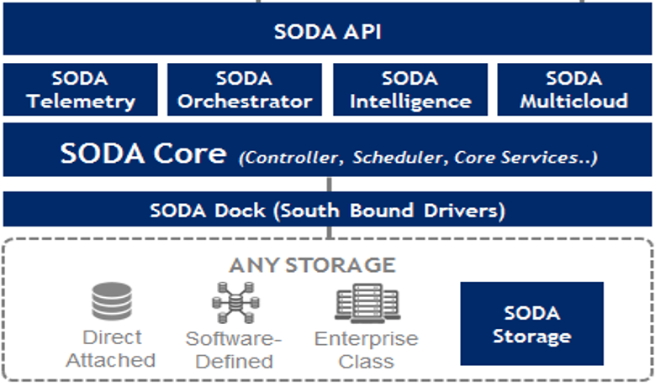
Architecture
ESX servers
…
vCenter server
Vmware Clients (Vsphere web client/vRO/SRA/vROPS
SODA VMware Plugin
control path
data path

Slide 4
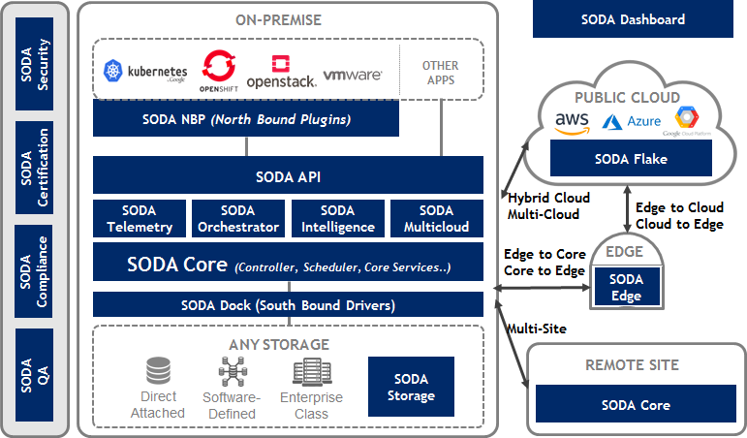

Slide 5
NGC Plugin
Enables VMware administrators to independently and centrally manage SODA/Thirdparty storage resources within the VMware environment. Plug-in provides integrated storage management for your VMware infrastructure, including storage discovery, health information, capacity management, provisioning datastore, backup and recovery.
Features
SAN
NAS*
Add/Delete storage platform
Show Volume and Pool information
Data store creation/deletion
Mount/Unmount volume
Backup and recover
Extend datastore*
Add/Delete Storage platform
Show pool and share information
Data store creation/deletion
Backup and recover
Extend/reduce datastore
*Will be available only after Daito release

Slide 6
NGC : Documentation
Design spec :
Compilation Guide:
Presentation :
User guide : <To be available with Daito relaese>
NGC Demo
NGC : Demo

Slide 7
VRO Plugin
Enable VMware vRealize Orchetrator client to orchestrate storage management tasks of OpenSDS or any thirdparty storage platform. The system will include VMware-integrated workflows that enable automation of storage provisioning and protection operations .
Features
In Daito
Post Daito
Register Storage Platform
Unregister Storage Platform
Create Volume
Delete Volume
Attach Volume
Expand Volume
Create Datastore
Delete RDM
Expand Datastore
Add RDM to VM
Volume Snapshot
Disk Exists in ESXi
Delete Datastore

Slide 8
VRO : Documentation
Design spec:
Compilation Guide:
User guide : <To be available with Daito release>
<To be available with Daito release>
VRO : Demo

Slide 9

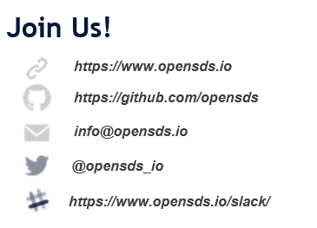
Thank You
SODA Foundation is getting formed. Hence, the vision, goals, architecture and other details in this slides may undergo changes. No claim or warranties on the contents of this presentation

