Slide 1
EA Man-Day Utilization Overview (2025)
To evaluate whether a sustainable project utilization of 80–85% is achievable for the team.

Slide 2
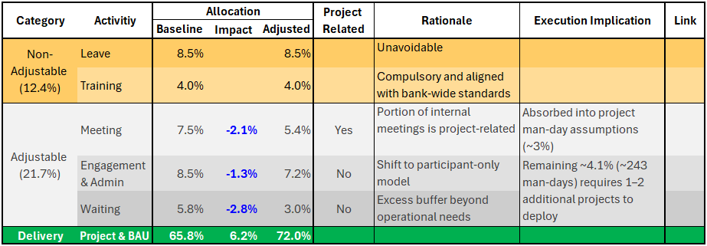
Summary : EA Utilization
Objective : Evaluate if 80-85% project utilization is achievable.
Data from Jun 25 to Dec 25 (7 months)
Allocation Criteria
Assumptions
Conclusion : 80-85% target not realistic; sustainable range 68-72%
Notes:
Quantify realistic utilization uplift by optimizing adjustable activities.

Slide 3
Appendix

Slide 4
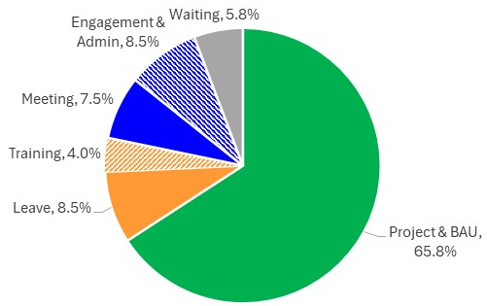
Utilization Breakdown: Non-Adjustable vs Adjustable Activities
Basis for assessing achievable project utilization
Non-Adjustable (12.5%)
  Leave : 8.5%
  Training (Compulsory) : 4.0%
Adjustable (21.8%)
  Meeting : 7.5%
  Engagement & Admin : 8.5%
  Waiting / Buffer : 5.8%
Only adjustable activities provide potential headroom for utilization improvement.
Back to Summary
Notes:
Project utilization must be assessed after compulsory time is deducted.
Improvements can only come from adjustable categories, not core obligations.

Slide 5
Non-Adjustable Activities : Leave & Training (12.5%)
Leave (8.5%)
Leave at 8.5%, aligned with HR policy and labor standards.
Training (4%)
Training is a compulsory activity required to sustain productivity and skill relevance.
Average training time is 43 hours per year, slightly above bank average (41 hours).
This remains below the global benchmark by DJSI (~50 hours).
Training is appropriately sized and not excessive
Back to Summary

Slide 6
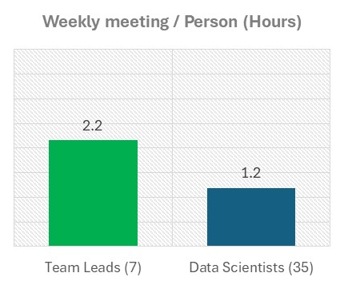
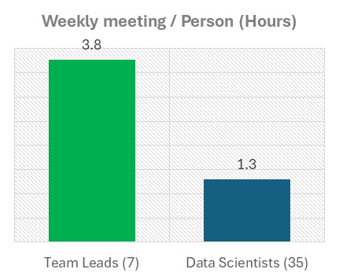
Adjustable Activities : Meeting (7.5%)
Management & General (3.3%)
Internal & Team (4.2%)
Total : ~1.3 hours/week
Total : ~1.7 hours/week
Covers management, and portfolio meetings.
Team Leads spend more time in meetings due to leadership and coordination responsibilities.
This level is appropriate given functional requirements.
Includes internal updates, and one-on-one meetings.
~50% of internal meetings are project-related, which can be recognized as productive delivery time.
~2.1% of capacity can be reclassified and added back to Project & BAU utilization (~3% increase in project man-day assumptions).
Workload is deemed appropriate
Potential reduction: 2.1%
Back to Summary

Slide 7
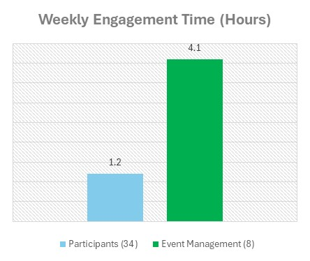
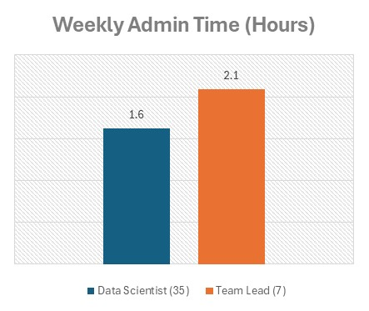
Adjustable Activities : Engagement & Admin work (8.5%)
Engagement (4.4%)
Administrative Work (4.1%)
Event management responsibilities are the primary driver of workload.
EA leads and manages engagement activities driving ~3× higher time spend for manager compared to participants.
A participant-only model would reduce engagement utilization from 4.4% to 3.1% (~30% reduction).
Time reporting requires a baseline of ~0.5 hours per week.
This translates to ~1.0 hour (DS) and ~1.5 hours (TL) per week for coordination activities (e.g. IT, Budget, Training)
The level of hours is necessary to support coordinating role from both DS and TL.
Achievable reduction: 1.3%
Workload is already optimized
Back to Summary

Slide 8
Adjustable Activities : Waiting / Buffer (5.8%)
Industry Standard
Current Position
Capacity buffer is not idle time. It absorbs unplanned demand, dependency delays, and rework inherent in analytical work
Industry guidance suggests a 15–20% buffer for knowledge-intensive roles to maintain delivery and resilience. (1)
Current buffer of ~5.8% is below industry norms.
Team utilization remains high, with no evidence of underutilized projects.
On average, 80% of the team operates with a buffer of ~3%, indicating a tight operating model.
2.8% of buffer can be redeployed into project man-days
Reference : (1) kpidepot.com, Forbes, tracklabs.in, SearchLib
Achievable reduction: 2.8%
Back to Summary

Slide 9
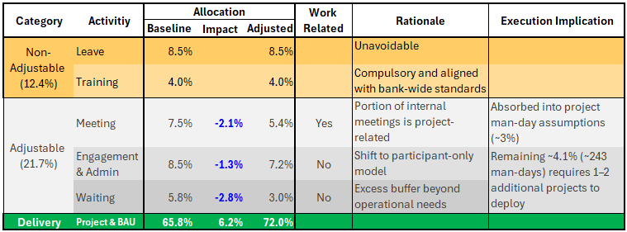
Utilization Scenarios: Impact on Project & BAU Capacity
Alternative 1 : Operational Streamlining
  Impact
Total reduction of 6.2% from non-core activities
Results in Project & BAU utilization increasing from 65.8% → 72.0% (9.4% uplift)
Execution implication
~2.1% can be absorbed into existing project man-day assumptions (raising utilization to ~68%)
Remaining 4.1% (~243 man-days) requires 1–2 additional projects to fully deploy
Alternative 2 : Excluding Leave
Project & BAU utilization increases to 78.7%
Assumption:
Utilization data from Jun 25 to Dec 25 (7 months)
Utilization allocated to Project & BAU changes based on increases or reductions in other activity categories.
Back to Summary

Slide 10
เกณฑ์การจัดประเภท
กลุ่ม | ประเภท | เงื่อนไข | ตัวอย่าง
Meeting | Management Meeting | ประชุมกับพี่โต้แต่ไม่มี BU
 |  | ประชุมกับพี่โต้พร้อมกับ BU ยกเว้นคนที่ present ให้ลง MD ใน project | Application & Transaction Fraud Meeting (Bi-Weekly) ~ 1 ชม. Digital & Internal Fraud (Bi-Weekly) ~ 1 ชม.
 |  | ประชุมกับทีม Portfolio โดยมีพี่ลักและพี่โต้ | DAI Bi-weekly update by Pillar ~ 1 ชม.
 | Internal Meeting | One-on-one กับ Team Lead | Bi-Weekly หรือทุกเดือน ~ 0.5 ชม.
 |  | ประชุมทีมกับพี่นุช | EA Leadership (Weekly) ~ 1 ชม. Data Insight (Weekly) ~ 1 ชม. อัปเดตงาน (Bi-Weekly) ~ 0.5 ชม.
 | General Meeting | ประชุมกับ Portfolio ก่อนเข้าไปพบพี่โต้
Engagement |  | คนจัดกิจกรรม หรือ เข้าร่วมกิจกรรม ให้ใส่ ลง Engagement ทั้งหมด
Admin |  | งานกลางของฝ่าย งาน transfer ระหว่าง คนเก่า คนใหม่ คนออก งานลงเวลา man-day | IT-Co, Budget-Co, Training-Co
Project |  | Slide ที่ใช้ present พี่โต้ในโครงการใด Internal meeting ที่เกี่ยวข้องกับ project ประชุมอัปเดตงานใน working team ของ project
Back to Summary

