Slide 1
EA Man-Day Utilization Overview (2025)
To evaluate whether a sustainable project utilization of 80–85% is achievable for the team.

Slide 2
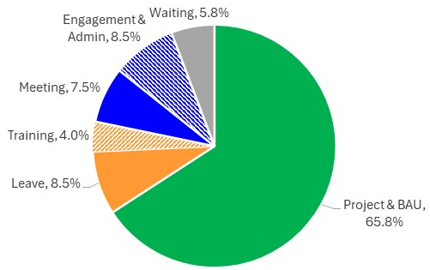
Utilization Breakdown: Compulsory vs Adjustable Activities
Basis for assessing achievable project utilization
Compulsory (12.5%)
  Leave (non-adjustable) : 8.5%
  Training : 4.0%
Adjustable (21.8%)
  Meeting : 7.5%
  Engagement & Admin : 8.5%
  Waiting / Buffer : 5.8%
Only adjustable activities provide potential headroom for utilization improvement.

Slide 3
Approach to Assess Achievable Utilization
To evaluate whether 80–85% project utilization is achievable, we apply the following approach
Alternative 1 : Operational Streamlining
Quantify realistic utilization uplift by optimizing adjustable activities.
Alternative 2 : Excluding Leave
Illustrate the maximum utilization if leave were excluded from the utilization calculation

Slide 4
Compulsory Activities : Training (4%)
Training is a compulsory activity required to sustain productivity and skill relevance.
Average training time is 43 hours per year, slightly above bank average (41 hours).
This remains below the global benchmark by DJSI (~50 hours).
Training is appropriately sized and not excessive

Slide 5
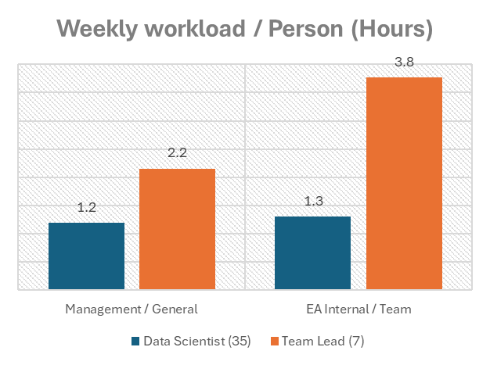
Adjustable Activities : Meeting (7.5%)
Structurally required and limited adjustability
Team Leads spend more time in meetings due to leadership and coordination responsibilities.
After review, meeting time averages ~3.1 hours per week.
This level is appropriate given functional requirements.
Meeting workload is not adjustable.

Slide 6
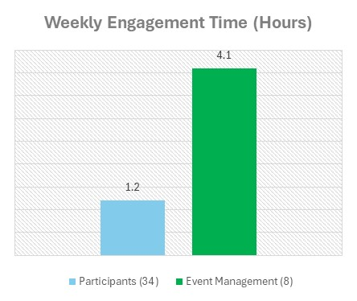
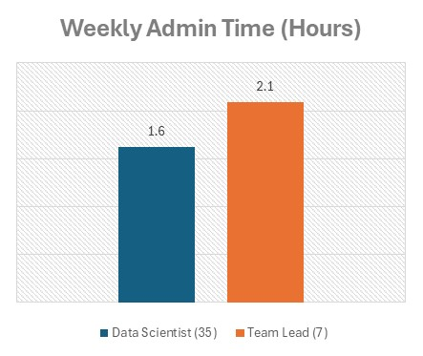
Adjustable Activities : Engagement & Admin work (8.5%)
Engagement (4.4%)
Administrative Work (4.1%)
Event managers spend ~3× more time more than participants.
A participant-only model would reduce engagement utilization from 4.4% to 3.1% (~30% reduction).
Time reporting requires a baseline of ~0.5 hours per week.
This translates to ~1.0 hour (DS) and ~1.5 hours (TL) per week for coordination activities (IT, Budget, Training)
This level is appropriate given functional requirements.
Achievable reduction: 1.3%

Slide 7
Adjustable Activities : Waiting / Buffer (5.8%)
Capacity buffer represents time not pre-allocated to planned delivery work.
“Industry guidance suggests a 15–20% buffer for knowledge-based roles.” (kpidepot.com, Forbes, tracklabs.in, SearchLib)
Current buffer of ~5.8% is below industry norms.
Waiting / Buffer levels do not indicate inefficiency.

Slide 8
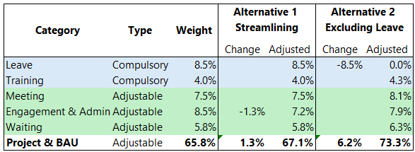
Utilization Scenarios: Impact on Project & BAU Capacity
Assumption: Utilization allocated to Project & BAU changes based on increases or reductions in other activity categories.
Alternative 1 : Operational Streamlining
Total reduction of 1.3%
Project & BAU utilization increases from 65.8% → 67.1%
Alternative 2 : Excluding Leave
Project & BAU utilization increases to 73.3%

Slide 9
Appendix

Slide 10
เกณฑ์การจัดประเภท
กลุ่ม | ประเภท | เงื่อนไข | ตัวอย่าง
Meeting | Management Meeting | ประชุมกับพี่โต้แต่ไม่มี BU
 |  | ประชุมกับพี่โต้พร้อมกับ BU ยกเว้นคนที่ present ให้ลง MD ใน project | Application & Transaction Fraud Meeting (Bi-Weekly) ~ 1 ชม. Digital & Internal Fraud (Bi-Weekly) ~ 1 ชม.
 |  | ประชุมกับทีม Portfolio โดยมีพี่ลักและพี่โต้ | DAI Bi-weekly update by Pillar ~ 1 ชม.
 | Internal Meeting | One-on-one กับ Team Lead | Bi-Weekly หรือทุกเดือน ~ 0.5 ชม.
 |  | ประชุมทีมกับพี่นุช | EA Leadership (Weekly) ~ 1 ชม. Data Insight (Weekly) ~ 1 ชม. อัปเดตงาน (Bi-Weekly) ~ 0.5 ชม.
 | General Meeting | ประชุมกับ Portfolio ก่อนเข้าไปพบพี่โต้
Engagement |  | คนจัดกิจกรรม หรือ เข้าร่วมกิจกรรม ให้ใส่ ลง Engagement ทั้งหมด
Admin |  | งานกลางของฝ่าย งาน transfer ระหว่าง คนเก่า คนใหม่ คนออก งานลงเวลา man-day | IT-Co, Budget-Co, Training-Co
Project |  | Slide ที่ใช้ present พี่โต้ในโครงการใด Internal meeting ที่เกี่ยวข้องกับ project ประชุมอัปเดตงานใน working team ของ project

