Slide 1

Бази от данни - практикум
Тема 36 – Музикален магазин
Радослава Христова

Slide 2
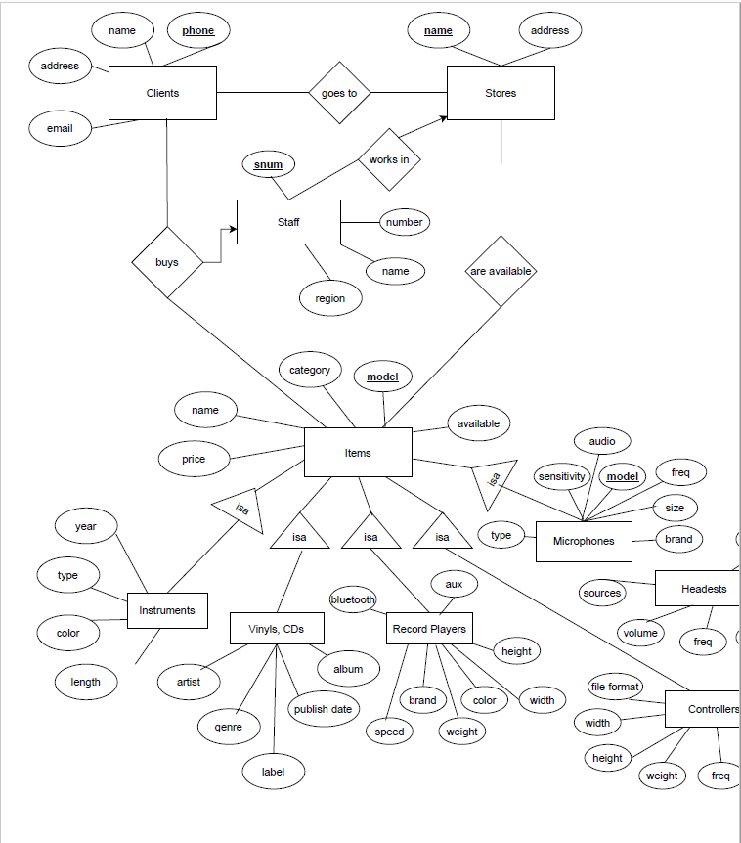
E/R диаграма на модела

Slide 3
Релационни схеми
− Items(model, category, available, name, price)
− ItemsInstruments(model, year, type, color, length)
− ItemsVinylsCDs(model, artist, album, pdate, label, genre)
− ItemsRecordPlayers(model, aux, bluetooth, brand, speed, color, weight, height)
− ItemsControllers(model, functions, fformat, width, height, freq)
− ItemsMicrophones(model, type, sensitivity, audio, freq, size, brand)
− ItemsHeadsets(model, sources, volume, cabel_t, jack, freq)

Slide 4
Релационни схеми
− Clients(phone, name, address, email)
− Stores(name, address)
− Staff(snum, number, name, region, sname)
− AreAvailable(sname,model)
− GoesTo(cphone, sname)
− Buys(cphone, model, snum)

Slide 5
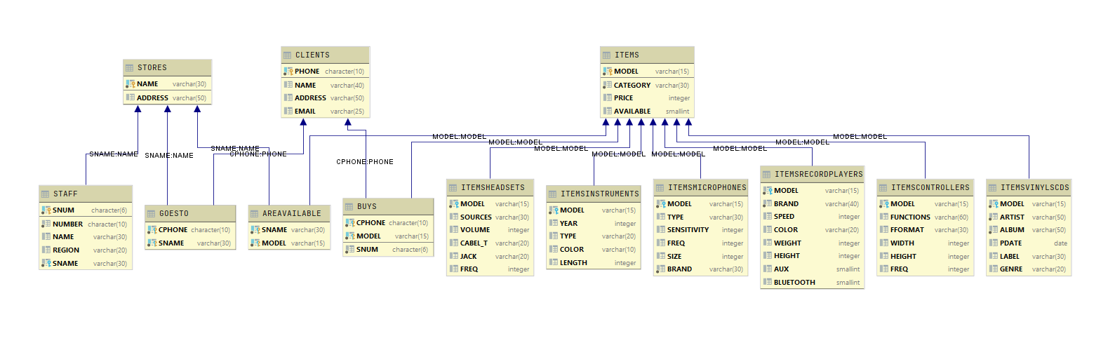
Схема на базата от данни

Slide 6
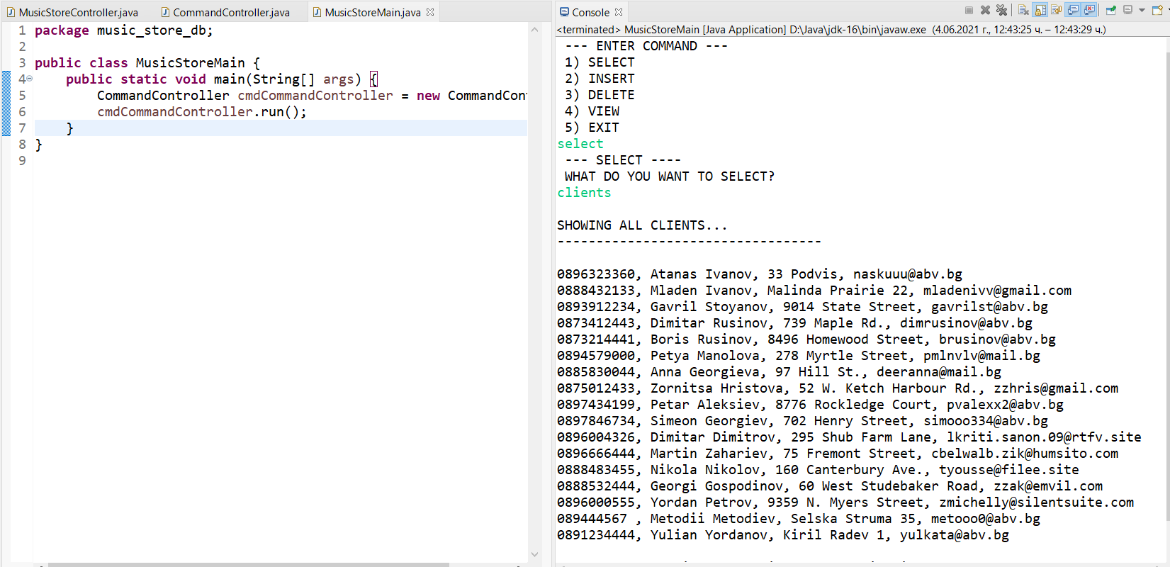
Приложение за достъп до базата

