Slide 1


Multi-Class Diabetes Risk Prediction for Resource-Constrained African Healthcare Settings
Symptom-Based Early Detection System
El Yadah Ibyigize Kalisimbi, Mohamed Alpha, Bitonda Tuyizere Elie, Matia Mulumba Mukasa
Carnegie Mellon University Africa | AI4E Fall 2025

Slide 2

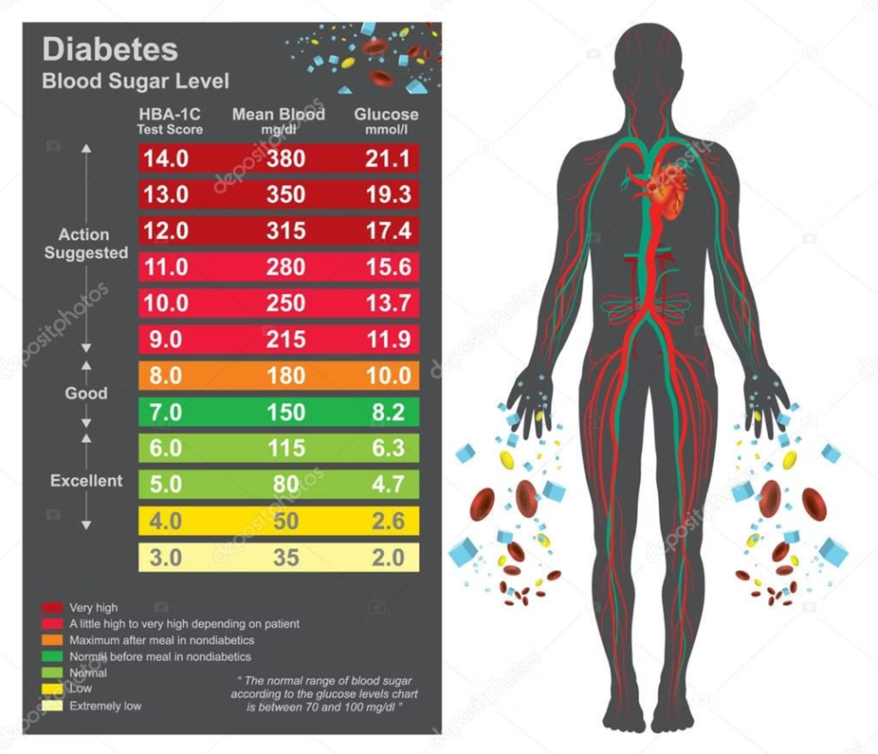
Problem Statement & Motivation
⚠️ The Challenge
💡 Our Solution
537M
AI-powered risk assessment using accessible health metrics.
ADULTS WITH DIABETES
90%
TYPE 2 DIABETES CASES
$966B
HEALTHCARE COST
¹ IDF Diabetes Atlas (2021). Diabetes prevalence in sub-Saharan Africa.

Slide 3
Data Description & Initial Analysis
📊 Dataset Overview
📈 Feature Distribution Analysis
Multiple datasets for training
Key features: BMI, Age, Glucose, BP
Advanced preprocessing with engineering
Balanced approach using SMOTE
🔍 Key Insights
BMI strongly correlates with diabetes
Age shows non-linear patterns
Glucose is strongest predictor

Slide 4
Methodology & Initial Experiments
🔬 ML Pipeline
📊 Model Performance Comparison
Data Preprocessing: Scaling, encoding
Feature Engineering: BMI categories, interactions
Class Balancing: SMOTE technique
Model Training: Multiple algorithms with tuning

Slide 5
Current Progress & Next Steps
✅ Completed Features
🎯 Next Steps
Interactive Web Interface using Gradio
Multiple ML Models with tuning
SHAP Integration for interpretability
Advanced Visualizations and analysis
Health Recommendations system
Model validation with additional datasets
Performance optimization and deployment
User interface enhancements
Clinical validation studies
Integration with healthcare systems
🌐 Live Demo Ready
92%
Complete web-based prediction interface with real-time risk assessment.
MODEL ACCURACY

Slide 6
References & Acknowledgments
¹ IDF Diabetes Atlas (2021). Diabetes prevalence in sub-Saharan Africa.
² Anand, S., & Bärnighausen, T. (2008). Human resources and health outcomes. The Lancet, 364(9445), 1603-1609.
³ Kahn, R., et al. (2010). Age at initiation and frequency of screening to detect type 2 diabetes. Ann Intern Med, 138(3), 212-218.
⁴ Knowler, W. C., et al. (2002). Reduction in the incidence of type 2 diabetes with lifestyle intervention. NEJM, 346(6), 393-403.
🙏 Thank You
⁵ Kaggle Multi-Class Diabetes Dataset (2023). Available at: kaggle.com/datasets/yasserhessein/multiclass-diabetes-dataset
Questions & Discussion
Towards accessible healthcare for all African communities
⁶ Chawla, N. V., et al. (2002). SMOTE: Synthetic minority oversampling technique. Journal of AI Research, 16, 321-357.

