Slide 1


Health-Net AI
Multi-Class Diabetes Risk Prediction for Resource-Constrained African Healthcare Settings
Mohamed Alpha • El Yadah Ibyigize Kalisimbi
Bitonda Tuyizere Elie • Matia Mulumba Mukasa
Carnegie Mellon University Africa | AI for Engineers

Slide 2
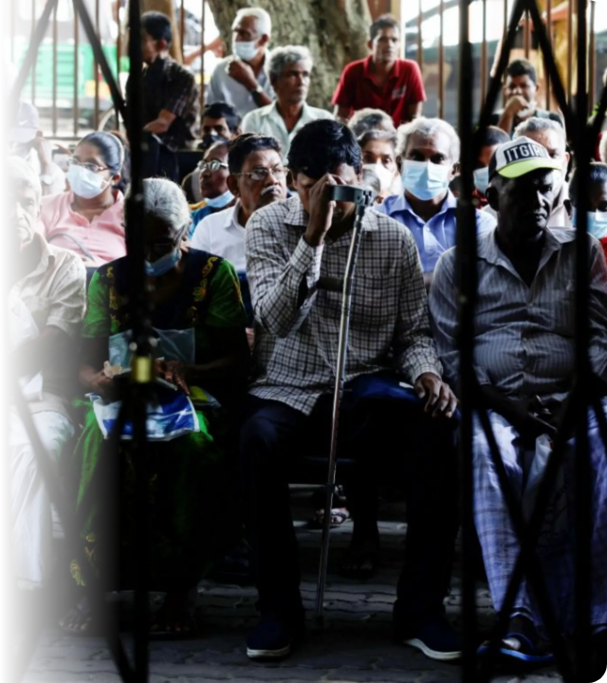
The Silent Epidemic
A Crisis in Numbers
Sub-Saharan Africa faces a projected 134% increase in diabetes cases by 2045, the highest globally [1].
70% Undiagnosed: Due to lack of accessible screening [2].
Infrastructure Gap: Only 1 doctor per 10,000 people [3].
•
Cost Barrier: Lab tests ($19) vs. Avg Health Spend ($100/yr) [3].
•
•

Slide 3






Introducing Health-Net AI
Multi-Class
Symptom-Based
SMS Integrated
Identifies Pre-Diabetic patients, enabling intervention that reduces progression by 58% [6].
Uses basic clinical metrics (BMI, BP, Age) instead of expensive lab tests like HbA1c [4].
Low-cost ($1/mo) deployment via SMS for areas with limited internet connectivity [4].

Slide 4


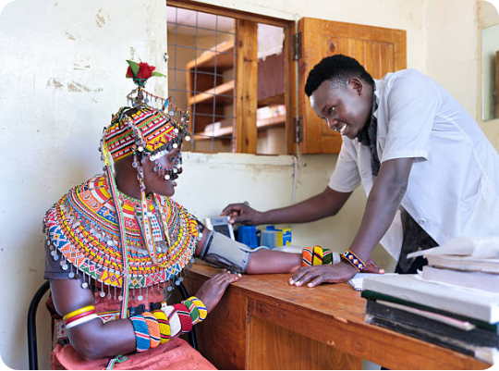
Tailored for African Phenotypes
Why Western Models Fail
Type 2 diabetes manifests differently in African populations:
•
Younger Onset age compared to global averages.
•
Lower BMI phenotype [14].
Our Approach: Algorithms trained specifically on local data to capture these critical nuances.

Slide 5


Methodology & Data
Data Strategy
Addressing Imbalance
264 Patient Records
Features: Age, BMI, BP, Glucose, etc.
The Challenge
Dataset was heavily skewed towards 'Normal' cases.
Feature Engineering
Added Metabolic Score & TG/HDL Ratio to capture complex risk factors.
The Solution
Applied SMOTE (Synthetic Minority Over-sampling Technique) to training data to ensure robust learning [7].

Slide 6
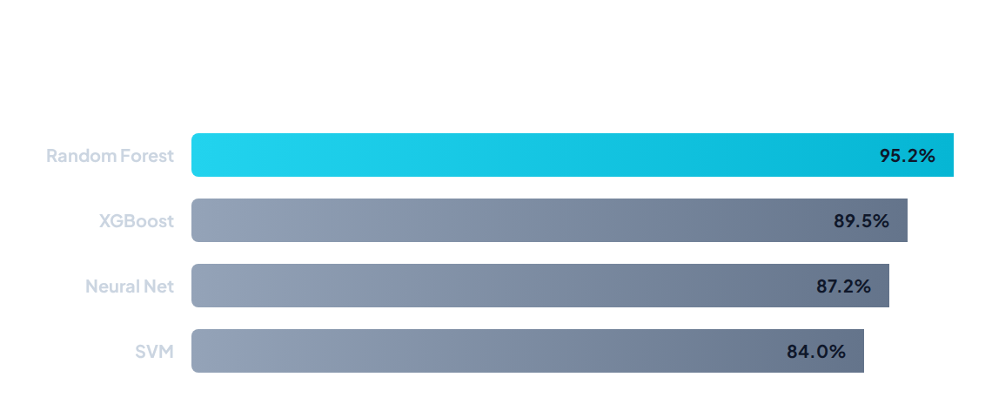
Model Comparison Results
Random Forest achieved superior accuracy, specifically in identifying the critical "Pre-Diabetic" class.

Slide 7


Dual-User Interface System
Patient Interface
•
Self-Screening: Simple questionnaires.
•
Accessibility: Local languages (Swahili, Hausa) & SMS support.
Practitioner Interface
•
Decision Support: Clinical risk stratification.
Efficiency: Rapid triaging of high-risk cases.
•

Slide 8






Future Directions
Geographic Expansion
EHR Integration
Clinical Trials
Connect Health-Net AI directly with Electronic Health Records for seamless data flow.
Conduct prospective studies to validate real-world impact on patient outcomes.
Validate with larger datasets across diverse African regions to improve generalizability.

Slide 9

PROTOTYPE DEMO

Slide 10
References
[1] IDF Diabetes Atlas 2021.
[6] Knowler et al., "Reduction in incidence of type 2 diabetes," NEJM 2002.
[2] WHO Africa, "Diabetes prevention challenges," 2023.
[7] Chawla et al., "SMOTE: Synthetic Minority Over-sampling," 2002.
[3] Manne-Goehler et al., "Care of patients with type 2 diabetes across Africa," 2020.
[8] Zou et al., "Predicting diabetes with ML," 2018.
[4] Labrique et al., "mHealth in Sub-Saharan Africa," 2014.
[14] Atun et al., "Diabetes in sub-Saharan Africa," Lancet 2017.
[5] Ebrahim et al., "Machine learning for diabetes in Ethiopia," 2023.
[19] Abid et al., "Gradio," 2019.

Slide 11

Q&A

