Slide 1
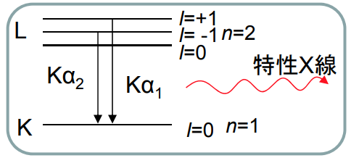
HeIb-HeIa
=1.869 eV
HeIIa-HeIa
=19.596 eV
XeIa-HeIa
=-12.781 eV
XeIa-HeIa
=-11.648 eV
Date: 2025/05/07
Photon Sources |  | He Iα | He Iβ | He IIα | Xe Iα (³P₁) | Xe Iα (¹P₁) | AlKα_{1,2} | MgKα_{1,2}
Source transition |  | 1s2p(¹P₁) ➔1s² | 1s3p(¹P₁) ➔1s² | 2p(²P_{3/2}) ➔1s² | 5p⁵6s (³P₁)➔5p⁶ | 5p⁵6s (¹P₁)➔5p⁶ | K-L₂ and K-L₃ | K-L₂ and K-L₃
Intensity (% of the total intensity) |  | Strongest of He | 6 % of He Iα | 6 % of He Iα | Strongest of Xe Iα | 18 % of Xe Iα | - | -
Photon energy |  | 21.218 eV | 23.087 eV | 40.814 eV | 8.437 eV | 9.570 eV | 1486.65 eV | 1253.64 eV
Photon linewidth |  | <1 meV | <1 meV | <1 meV | <1 meV | <1 meV | 850 meV | 680 meV
Kinetic energy at E_{F} (eV) | PE02 | 16.95 | (18.82) | (36.55) | 4.17 (4.17) | (5.30)
 | PE05 | 16.95 | (18.82) | (36.55) | 4.17 (4.17) | (5.30)
 | PE10 | 16.96 | (18.83) | 36.56 (36.56) | 4.19 (4.18) | (5.31)
 | PE20 |  |  | 36.56
 | PE100 |  |  |  |  |  | 1482.08 | 1249.10
 | PE200
太字…実測スペクトルのFittingで求めた値
(細字)…HeIaの値を基準にして、励起光エネの差分から算出した値

Slide 2
Date: 2024/09/29
Photon Sources |  | He Iα | He Iβ | He IIα | Xe Iα (³P₁) | Xe Iα (¹P₁) | AlKα_{1,2} | MgKα_{1,2}
Source transition |  | 1s2p(¹P₁)➔1s² | 1s3p(¹P₁)➔1s² | 2p(²P_{3/2})➔1s | 5p⁵6s (³P₁)➔5p⁶ | 5p⁵6s (¹P₁)➔5p⁶ | K-L₂ and K-L₃ | K-L₂ and K-L₃
Intensity (% of the total intensity) |  | Strongest of He | 6 % of He Iα | 6 % of He Iα | Strongest of Xe Iα | 18 % of Xe Iα | - | -
Photon energy |  | 21.218 eV | 23.087 eV | 40.814 eV | 8.437 eV | 9.570 eV | 1486.65 eV | 1253.64 eV
Photon linewidth |  | <1 meV | <1 meV | <1 meV | <1 meV | <1 meV | 850 meV | 680 meV
Kinetic energy at E_{F} (eV) | PE02
 | PE05 | 16.98 | 18.85 | 36.58
 | PE10 | 16.99 | 18.88 | 36.58
 | PE20 | 17.01 | 18.88 | 36.60
 | PE100
 | PE200

