Slide 1
Sales & Financial Dashboard
Task 3 – Interactive Dashboard Summary
Name: Naki Qureshi
Date: 7th August 2025

Slide 2
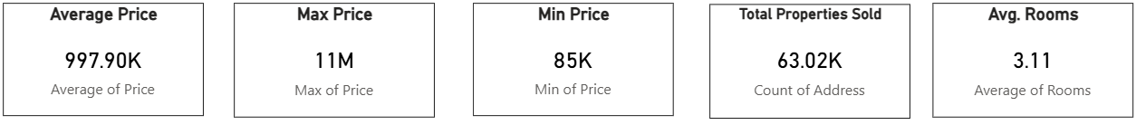
Key Performance Indicators (KPIs)
- Total Sales
- Average Price
- Total Listings
These KPIs are presented using card visuals to help stakeholders quickly understand the overall metrics.

Slide 3
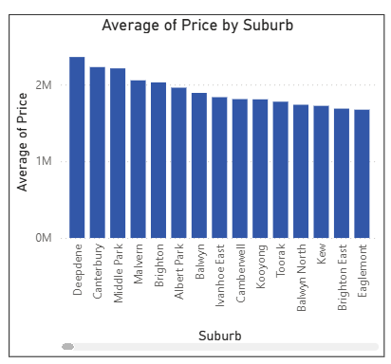
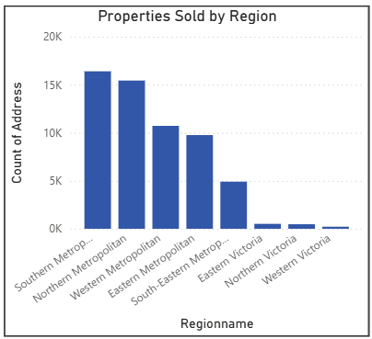
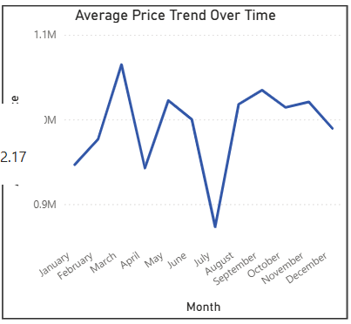
Visuals & Insights
1. Average Price by Suburb:
- Highest in Eastern Metropolitan
2. Property Count by Region:
- Most listings in Western Metropolitan
3. Price Trend Over Time:
- Steady growth from 2016 to 2017

Slide 4
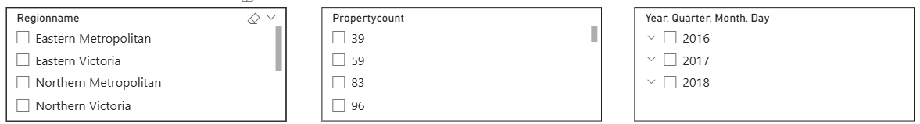
Filters and Slicers
- Region
- Property Type
- Year
These slicers allow users to interact with the dashboard and analyze data from various angles.

Slide 5
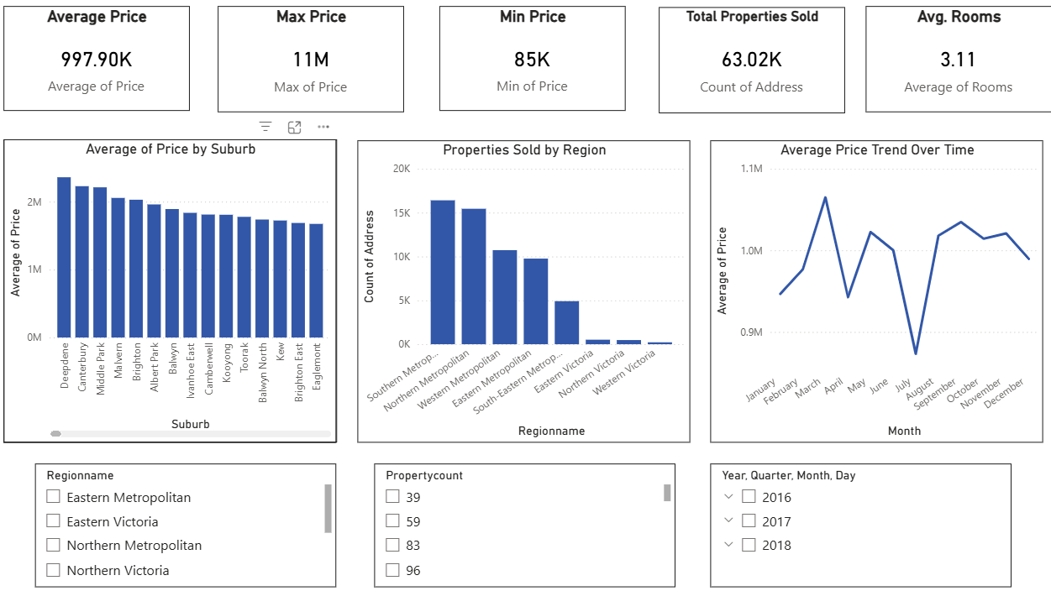
Design & Navigation
- Consistent blue-gray color theme
- Minimalistic layout for clarity
- Navigation buttons or tabs (optional) to move between KPI, visual, and insights sections

Slide 6
Key Takeaways
- Western Metropolitan has the highest number of listings
- Houses (Type 'h') are the most expensive
- Property prices show consistent growth over time

