Slide 1

A Real-time Emotion Recognition from Speech using Gradient Boosting
Group No: 8
Course teacher: Annajiat Alim Rasel
Nafia Akter | 21266025 | Md Jahid Hasan | 22166035
Fahmida Zaman Labini | 21266026 | S.M Nazmul Hassan | 18301171
Mashuk Arefin Pranjol | 17201094 | Md. Nakib Rahaman | 18301203
Mohammad Al-amin | 18301259 | Mohammad Sakib Hossain | 18341001
Course Name: NLP CSE712 + CSE431

Slide 2
INTRODUCTION

Slide 3
Related Works And Databases
Related Works:
* MFCC, entropy and spectral entropy, ZCR (zero crossing rate), pitch, energy, formants and etc.
* Emphasis on pitch and energy
* Calculated derivation and Statistical Features such as mean, standard deviation, etc. to increase accuracy.
* Support Vector Machine (SVM), Gradient Boosting, K-Nearest Neighbor (KNN), Random Forest and Neural Network.
Databases:
RAVDESS:
* It contains 7356 files including calm, neutral,happiness, sad, anger, fear, disgust and surprise emotions.
* 24 Subjects: 12 male and 12 female
* American English
* 192 audio files
* Anger, Happiness, Neutral and Sadness
SAVEE:
* 4 male actors
* Seven emotions
* British English
* 180 audio of 3 male actors
* Anger, Happiness, Neutral and Sadness

Slide 4
Feature Extraction
Feature Normalization
A technique which is used to extract features from raw data.
Audio features (Zero crossing rate (ZCR), energy, entropy of energy etc) Extraction
In this paper, mid-term features are considered. Mean and SD are calculated.
A technique of rescaling the value to a specific range
In this work, normalization happened by mean subtraction and its dividation by SD.
Rescaled data used for training systems.

Slide 5
GRADIENT BOOSTING
Gradient boosting classifier
Why is gradient boosting used?

Slide 6
SVM CLASSIFIER
#What is SVM based classifier ?
# How its work in the research paper ?

Slide 7

KNN: k-nearest neighbors algorithm
KNN used for both classification and regression.
Unlike SVM, KNN typically saves the whole dataset (features) and does not require training.
A distance measure must be determined to discover the K instances in the training data that are the most comparable to the new input.
The most common distance measure used in this system is the Euclidean distance.
Euclidean distance (q, p) =
q,p = two points in Euclidean n-space
qi,pi = Euclidean vectors, starting from the origin of the space (initial point)

Slide 8
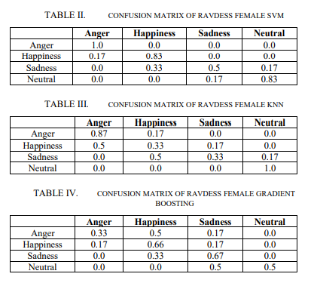
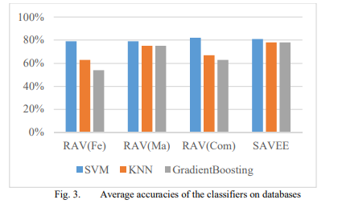
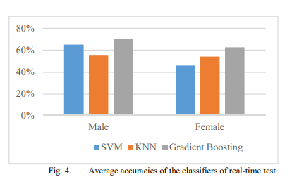
Result
Classifier used - Gradient Boosting, SVM, KNN.
Method used to show the result - Confusion Matrix and graphs.
Tested for - Average accuracy of the classifier for both real-time test and without real-time test.

Slide 9
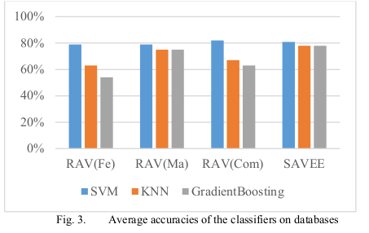
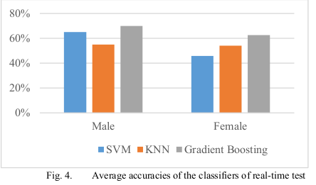
Analysis:-
Datasets: 4 types are used; RAVDESS (male/ female/ combined) & SAVEE
In RAVDESS (male/ female/ combined), SVM & KNN perform better in anger & neutral cases whereas Gradient Descent is better in happiness and sadness. In SAVEE, All Classifiers perform almost equivalent to each other.
In real time test, Gradient Descent is performing significantly well in both male and female cases.

Slide 10
CONCLUSION

