Slide 1
Computer Fundamental
Lecture 3
By
Nakib Aman Turzo
Lecturer, Department of CSE
Varendra University

Slide 2
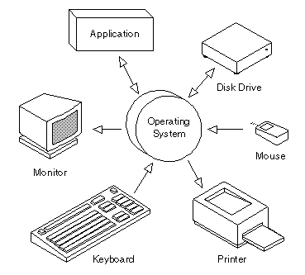
What is Operating System
The OS is one kind of system software that controls the system' s hardware and interacts with the user and application software.

Slide 3
Types of Operating Systems
Operating system s can be organized into four major types:
real-time,
single-user/single-tasking,
single-user/multi-tasking, and
multi-user/multi-tasking.

Slide 4
Real-Time Operating Systems
A real -time operating system is a very fast, relatively small OS.
Real-time OSs are often also embedded OSs, when they are built into the circuitry of a device and are not loaded from a disk drive.
Example: eCos, VxWorks, RTLinux

Slide 5
Single-User/Single-Tasking Operating Systems
An operating system that allows a single user to perform just one task at a time is a single-user/single-tasking operating system.
Example: MS-DOS

Slide 6
Single-User/Multitasking Operating Systems
A single-user/multi tasking operating system is one that allows a single user to perform two or more functions at once.
It takes a special operating system to keep two or ore tasks running at once.
Example: Windows - 98, Android, Symbian, IOS.

Slide 7
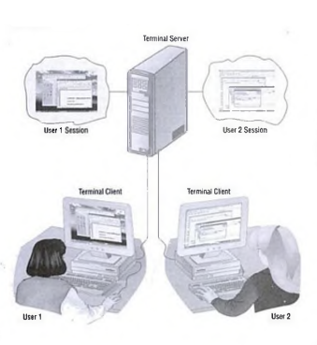
Multi-User/Multitasking Operating Systems
A multi-user/multitasking operating system is an operating system that allows multiple users to use programs that are simultaneously running on a single network server; called a terminal server.
Examples of multi-user OSs include UN IX, VMS, and mainframe operating sys­tems such as MVS.

Slide 8
Providing a User Interface
When we work on a computer; we see and use a set of items on the screen. Taken together; these items are called the user interface.
The two most common types of user interfaces are
graphical and
command line

Slide 9
Graphical User Interfaces
Most current operating systems, including all versions of Windows, the Macintosh operating system, OS/2, and some versions of UNIX and Linux, provide a Graphical User Interface (GUI).
so called because you use a mouse (or some other pointing device) to work with graphical objects such as windows, menus, icons, buttons, and other tools.

Slide 10
Graphical User Interfaces
These graphical tools all represent different types of commands; the GUI enables you to issue commands to the computer by using visual objects instead of typing commands.
This is one of the key advantages of a graphical user interface; it frees you from memorizing and typing text commands.

Slide 11
Enhancing an OS with Utility Software
Backup Utilities
Antivirus
Firewall
Intrusion Detection
Screen Savers

Slide 12
Virus
A virus is a parasitic program that can delete or scramble files or replicate itself until the host disk is full.
computer viruses can be transmitted in numerous ways
downloading files over the Internet or
reusing old diskettes that may be infected.

Slide 13
Antivirus
An antivirus utility can examine the contents of a disk or RAM for hidden viruses and files that may act as hosts for virus code.
Effective antivirus products not only detect and remove viruses; they also help you recover data that has been lost because of a virus.

