Slide 1
Computer Fundamental
Lecture 7
By
Nakib Aman Turzo
Lecturer, Department of CSE
Varendra University

Slide 2
Introduction to Database Systems

Slide 3
Course Overview
Several main topics
Database systems
Data models
Database design
SQL
Transactions
Concurrency
Administration

Slide 4
Why Study Databases?
Databases are useful
Many computing applications deal with large amounts of information
Database systems give a set of tools for storing, searching and managing this information

Slide 5
What is a Database?
“A set of information held in a computer”
Oxford English Dictionary
“One or more large structured sets of persistent data, usually associated with software to update and query the data”
Free On-Line Dictionary of Computing
“A collection of data arranged for ease and speed of search and retrieval”
Dictionary.com

Slide 6
Databases
Web indexes
Library catalogues
Medical records
Bank accounts
Stock control
Personnel systems
Product catalogues
Telephone directories
Train timetables
Airline bookings
Credit card details
Student records
Customer histories
Stock market prices
Discussion boards
and so on…

Slide 7
Database Users
End users
Use the database system to achieve some goal
Application developers
Write software to allow end users to interface with the database system
Database Administrator (DBA)
Designs & manages the database system
Database systems programmer
Writes the database software itself

Slide 8
Database Management Systems
A database is a collection of information
A database management system (DBMS) is the software than controls that information
Examples:
Oracle
DB2 (IBM)
MS SQL Server
MS Access
Ingres
PostgreSQL
MySQL

Slide 9
What the DBMS does
Provides users with
Data definition language (DDL)
Data manipulation language (DML)
Data control language (DCL)
Often these are all the same language
DBMS provides
Persistence
Concurrency
Integrity
Security
Data independence
Data Dictionary
Describes the database itself

Slide 10
File Based Systems
File based systems
Data is stored in files
Each file has a specific format
Programs that use these files depend on knowledge about that format
Problems:
No standards
Data duplication
Data dependence
No way to generate ad hoc queries
No provision for security, recovery, concurrency, etc.

Slide 11
Relational Systems
Information is stored as tuples or records in relations or tables
There is a sound mathematical theory of relations
Most modern DBMS are based on the relational model
The relational model covers 3 areas:
Data structure
Data integrity
Data manipulation
More details in the next lecture…

Slide 12
Table
“A table is the primary unit of physical storage for data in a database.”¹
Usually a database contains more than one table.

Slide 13
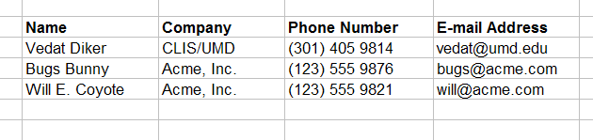
Table

Slide 14
A Database with Multiple Tables
[1]
Publishers
Books
Customers
Authors
Inventory
Orders
1) Stephens, R.K. and Plew. R.R., 2001. Database Design. SAMS, Indianapolis , IN. (with slight changes by V.G.D.)

Slide 15
Table
Customers

Slide 16
Field (Column)
Customers
a field

Slide 17
Record (Row)
Customers
a record

Slide 18
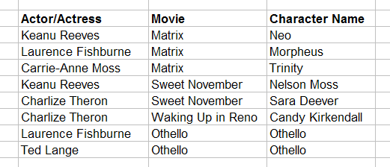
Primary Key
Roles (Performances)
primary key fields
A primary key can consist of more than one field.

Slide 19
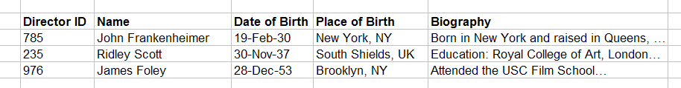
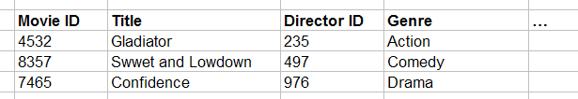
Foreign Key
primary key field
parent table
Directors
relationship
child table
Movies
foreign key field

Slide 20
Relationship Types
One-to-one
One-to-many
Many-to-many

Slide 21
Data Types
Alphanumeric (Text, Memo)
Numeric (Number, Currency, etc.)
Date/Time
Boolean (Yes/No)

Slide 22
Entity
“An entity is a business object that represents a group, or category of data.”¹
Do we know a similar concept?
1) Stephens, R.K. and Plew. R.R., 2001. Database Design, pp. 21. SAMS, Indianapolis , IN.

Slide 23
Attribute
“An attribute is a sub-group of information within an entity.”¹
Do we know a similar concept?
1) Stephens, R.K. and Plew. R.R., 2001. Database Design, pp. 21. SAMS, Indianapolis , IN.

Slide 24
Relationship
A relationship is a link that relates two entities that share one or more attributes.
Do we know a similar concept?

Slide 25
Database Types
Flat-file
Hierarchical
Network
Relational
Object-oriented
Object-relational

