Slide 1
Computer Fundamental
Lecture 2
By
Nakib Aman Turzo
Lecturer, Department of CSE
Varendra University

Slide 2
Classifications of Computers
Computers differ based on their data processing abilities.
They are classified according to –
purpose,
data handling
size

Slide 3
Classification according to purpose
Computers differ based on their data processing abilities. They are classified according to purpose, data handling and functionality.
General purpose computers are designed to perform a range of tasks. They have the ability to store numerous programs, but lack in speed and efficiency.
Specific purpose computers are designed to handle a specific problem or to perform a specific task.

Slide 4
Classification according to data handling
According to functionality, Type of computers are classified as
Analog Computer
Digital Computer
Hybrid Computer (Analog + Digital)

Slide 5
Classification according to size
Super Computer
Mainframe Computer
Mini Computer
Micro Computer (Personal Computer)
Workstations
For details Visit –
http://ecomputernotes.com/fundamental/introduction-to-computer/write-a-detailed-note-on-classification-of-computers

Slide 6
Main elements of a Computer
Hardware
Hardware refers to the physical elements of a computer.
Examples of hardware in a computer are the keyboard, the monitor, the mouse and the central processing unit.
Software
Software, commonly known as programs or apps, consists of all the instructions that tell the hardware how to perform a task.

Slide 7
Hardware vs Software
Software is capable of performing many tasks, as opposed to hardware which can only perform mechanical tasks that they are designed for.
Software provides the means for accomplishing many different tasks with the same basic hardware.
Hardware and software are interconnected, without software, the hardware of a computer would have no function.
Without the creation of hardware to perform tasks directed by software via the central processing unit, software would be useless.

Slide 8
Classification of software
System Software
Helps run the computer hardware and computer system itself.
System software is almost always pre-installed on your computer.
Application Software
Allows users to accomplish one or more tasks.
Some application software is pre-installed on most computer systems.

Slide 9
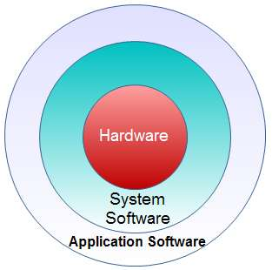
Layered view of the main elements of computer

Slide 10
System Software vs Application Software
System Software | Application Software
System Software works in the background. | Generally the user interacts with the application software.
It can run independently as it provides the platform for running the application software. | It can’t run independently because it is not able to run without the presence of system software.
The user makes use of system software for operating hardware of the computer. | The user makes use of application software to perform some specific task.
Example : Windows 10, Android KitKat, Mac OSX Mojave etc. | Example: Microsoft Office, Adobe Photoshop, VLC Player etc.

