Slide 1
Computer Fundamental
Lecture 1
By
Nakib Aman Turzo
Lecturer, Department of CSE
Varendra University

Slide 2
What is Computer?
Computer is an electronic device that is designed to work with Information.
The term computer is derived from the Latin term ‘computare’, this means to calculate or programmable machine.
Computer can not do anything without a Program.

Slide 3
Basic Components of Digital Computer -1
The basic components of a modern digital computer are: Input Device, Output Device, Central Processor Unit (CPU), mass storage device and memory.
Four Functions of Computer are :
Accepts data | Input
Processes Data | Processing
Produces Output | Output
Stores Results | Storage

Slide 4
Basic Components of Digital Computer -2
Input (Data): Input is the raw information entered into a computer from the input devices. It is the collection of letters, numbers, images etc.
Process: Process is the operation of data as per given instruction. It is totally internal process of the computer system.
Output: Output is the processed data given by computer after data processing. Output is also called as Result.

Slide 5
Units of a Basic Computer System - 1
Central Processing Unit (CPU)
Memory Unit
Control Unit
Input Unit
Output Unit
Arithmetic Logic
Unit

Slide 6
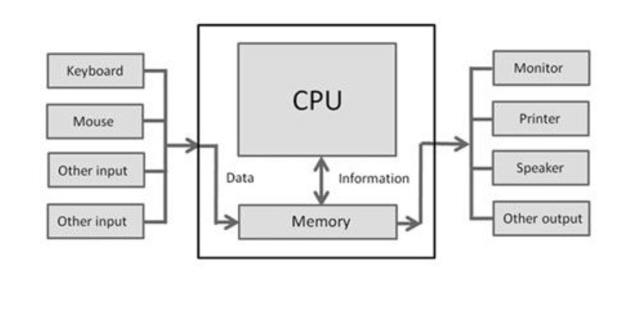
Units of a Basic Computer System - 2

Slide 7
Input Unit
Input unit is used for transfers’ raw Data and control signals into the information processing system by the user before processing and computation.
Example of Input unit devices: keyboard, mouse, scanner, joystick, MICR, Punched cards, Punched paper tape, Magnetic tape etc.

Slide 8
Output Unit
Output Unit receives information from the CPU and then delivers it the external storage or device in the soft or hard processed form.
The devices which are used to display output to the user are called output devices.
The Monitor or printer is common output device.

Slide 9
Memory Unit
Stores data, instructions, and intermediate results
Supplies information to other units when needed
Two types of memory:
Primary – directly accessible by CPU
Secondary – not directly accessible by CPU

Slide 10
Central Processing Unit
The main chip in a computer is the microprocessor chip, which is also known as the CPU (central processing unit).
Arithmetic logic unit (ALU)
Arithmetic Logical Unit is used for processing data after inputting data is stored into primary unit. The major operations of Arithmetic Logical Unit are addition, subtraction, multiplication, division, logic and comparison.
Control unit (CU)
It is like a supervisor, that checks ordaining operations or check sequence in which instructions are executed.

