Slide 1
Computer Fundamental
Lecture 5
By
Nakib Aman Turzo
Lecturer, Department of CSE
Varendra University

Slide 2
Introduction to Computer Networking (Part - 1)

Slide 3
Network
A network consists of two or more entities, or objects, sharing resources and information.

Slide 4
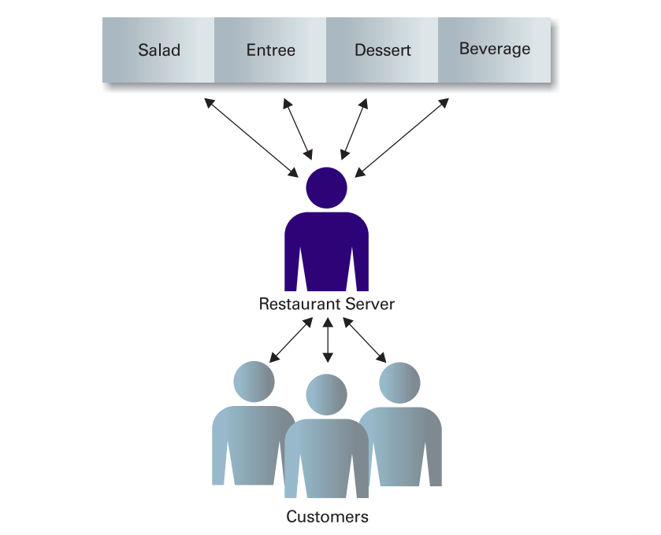
Networking Examples - 1

Slide 5
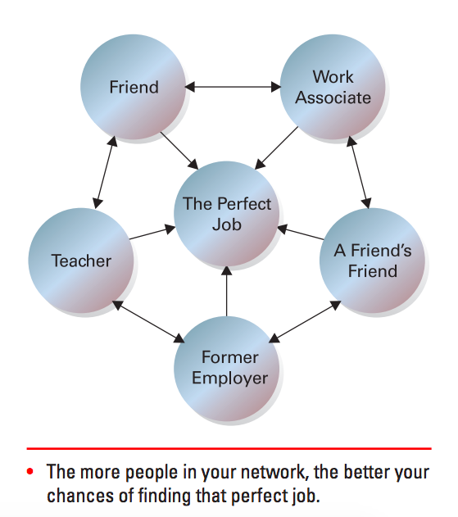
Networking Examples - 2

Slide 6
Computer Network
A computer network is a system in which multiple computers are connected to each other to share information and resources.

Slide 7
Computer Network Types
Networks are distinguished based on their geographical span.
Personal Area Network (PAN)
Local Area Network (LAN)
Metropolitan Area Network (MAN)
Wide Area Network (WAN)

Slide 8
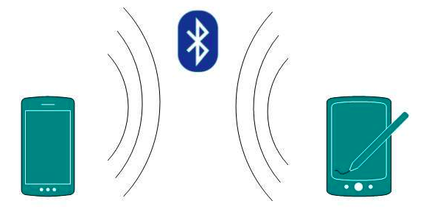
Personal Area Network
A Personal Area Network (PAN) is smallest network which is very personal to a user. PAN has connectivity range up to 10 meters.

Slide 9
Local Area Network - 1
A computer network spanned inside a building and operated under single administrative system is generally termed as Local Area Network (LAN).
LAN provides a useful way of sharing the resources between end users.

Slide 10
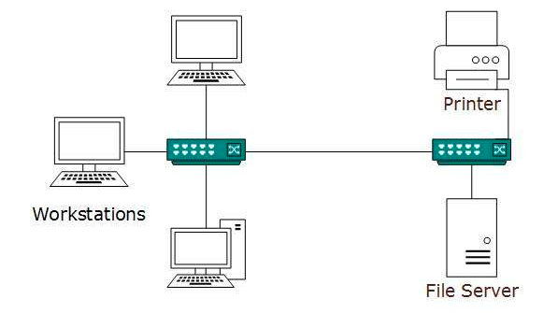
Local Area Network - 2

Slide 11
Metropolitan Area Network - 1
The Metropolitan Area Network (MAN) generally expands throughout a city such as cable TV network.
Backbone of MAN is high-capacity and high-speed fiber optics.
MAN works in between Local Area Network and Wide Area Network.

Slide 12
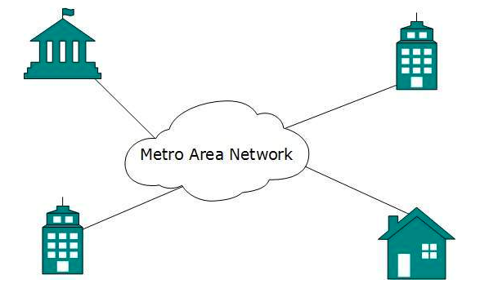
Metropolitan Area Network - 2

Slide 13
Wide Area Network - 1
Wide Area Network (WAN) covers a wide area which may span across provinces and even a whole country.
Generally, telecommunication networks are Wide Area Network.
Since they are equipped with very high speed backbone, WANs use very expensive network equipment.

Slide 14
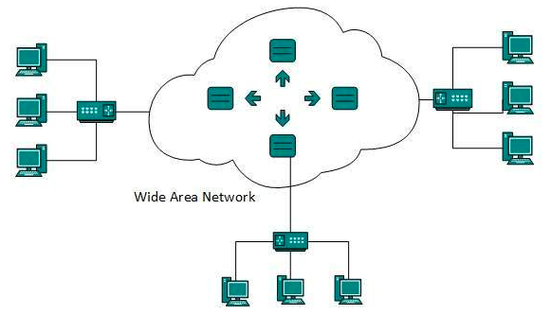
Wide Area Network - 2

