Slide 1
K-Means Clustring
Nakisa Tavakoli

Slide 2
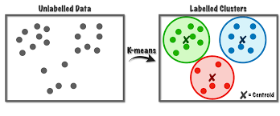
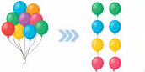
Introduction
K-means clustering is a popular unsupervised machine learning algorithm used to partition a dataset into KKK distinct, non-overlapping clusters. Each cluster is characterized by its centroid, which is the mean of the points within the cluster. The goal of K-means is to minimize the within-cluster variance, often referred to as the sum of squared distances between points and their corresponding centroids.

Slide 3
steps
Initialization: Choose K initial cluster centroids randomly from the dataset.
Assignment: Assign each data point to the nearest centroid based on the Euclidean distance.
Update: Recalculate the centroids as the mean of all data points assigned to each cluster.
Repeat: Repeat the assignment and update steps until the centroids do not change significantly or a maximum number of iterations is reached.

Slide 4
Choosing the Number of Clusters (K):
Choosing the right number of clusters is crucial for good clustering performance. Some common methods to determine the optimal number of clusters include:
Elbow Method: Plot the inertia for a range of K values and look for an "elbow" point where the rate of decrease slows.
Silhouette Score: Measures how similar a point is to its own cluster compared to other clusters. Higher silhouette scores indicate better-defined clusters.
Gap Statistic: Compares the total within intra-cluster variation for different numbers of clusters with their expected values under null reference distribution.

Slide 5
Key Concepts:
Centroid: The center of a cluster, calculated as the mean of the points within the cluster.
Inertia: The sum of squared distances from each point to its assigned centroid. Lower inertia indicates more compact clusters.
Convergence: The algorithm converges when the assignments no longer change, or the change in centroids falls below a threshold.

