Slide 1

SVM Algorithm
Nakisa Tavakoli

Slide 2
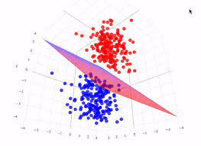
Support Vector Machine Algorithm
The Support Vector Machine (SVM) algorithm is a supervised machine learning model used for classification and regression tasks. It is particularly effective in high-dimensional spaces and situations where the number of dimensions exceeds the number of samples. The primary goal of SVM is to find the best separating hyperplane that divides the dataset into classes.
SVMs can be used for a variety of tasks, such as text classification, image classification, spam detection, handwriting identification, gene expression analysis, face detection, and anomaly detection. SVMs are adaptable and efficient in a variety of applications because they can manage high-dimensional data and nonlinear relationships.

Slide 3
Support Vector Machine Algorithm: Key Concepts of SVM
Hyperplane:
A hyperplane in an n-dimensional space is a flat affine subspace of n−1 dimensions. In a 2D space, it is a line; in a 3D space, it is a plane.
For a binary classification task, SVM aims to find the hyperplane that best separates the data points of the two classes.
Support Vectors:
Support vectors are the data points that are closest to the hyperplane. They are critical as they define the position and orientation of the hyperplane.
The distance from the hyperplane to the nearest data point of either class is called the margin. SVM tries to maximize this margin.

Slide 4

Support Vector Machine Algorithm: Key Concepts of SVM
Margin:
The margin is the distance between the hyperplane and the nearest data points from either class.
SVM aims to find the hyperplane that maximizes this margin, hence the term "maximum margin classifier."

Slide 5
Support Vector Machine Algorithm :How SVM Works
Linear SVM:
For linearly separable data, SVM finds a hyperplane that separates the data into two classes with the maximum margin.
Non-Linear SVM:
For data that is not linearly separable, SVM uses a technique called the kernel trick. The kernel trick transforms the input space into a higher-dimensional space where a linear separation is possible.
Common kernel functions include Polynomial, Radial Basis Function (RBF), and Sigmoid

Slide 6
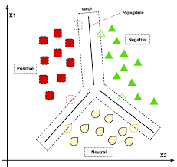
Support Vector Machine Algorithm
SVM is a supervised machine learning algorithm used for both classification and regression. Though we say regression problems as well it’s best suited for classification. The main objective of the SVM algorithm is to find the optimal hyperplane in an N-dimensional space that can separate the data points in different classes in the feature space. The hyperplane tries that the margin between the closest points of different classes should be as maximum as possible. The dimension of the hyperplane depends upon the number of features. If the number of input features is two, then the hyperplane is just a line. If the number of input features is three, then the hyperplane becomes a 2-D plane. It becomes difficult to imagine when the number of features exceeds three.

Slide 7

Support Vector Machine Algorithm: Kernel Functions
In Support Vector Machines (SVM), kernel functions play a crucial role in transforming the input data into a higher-dimensional space where it becomes easier to classify the data using a linear separator.
1. Linear Kernel
The linear kernel is the simplest type of kernel, used for linearly separable data.
Characteristics:
Suitable for linearly separable data.
Computationally efficient.
Often used when the number of features is very large compared to the number of samples.

Slide 8

Support Vector Machine Algorithm: Kernel Functions
2. Polynomial Kernel
The polynomial kernel represents the similarity of vectors (training samples) in a feature space over polynomials of the original variables.
Characteristics:
Suitable for non-linear data.
α\alphaα is a scaling factor, ccc is a constant term, and ddd is the degree of the polynomial.
Can model complex relationships.

Slide 9

Support Vector Machine Algorithm: Kernel Functions
3. Radial Basis Function (RBF) Kernel / Gaussian Kernel
The RBF kernel is one of the most widely used kernels in SVM, effective for non-linear data.
Characteristics:
Suitable for non-linear data.
γ\gammaγ determines the spread of the kernel.
Can handle the case when the relation between class labels and attributes is non-linear.

Slide 10

Support Vector Machine Algorithm: Kernel Functions
4. Sigmoid Kernel
The sigmoid kernel is also known as the hyperbolic tangent kernel and is derived from neural networks.
Characteristics:
Suitable for non-linear data.
α\alphaα and
c are parameters that need to be tuned.
Often used in neural networks and can simulate the behavior of perceptrons.

Slide 11

Support Vector Machine Algorithm: Kernel Functions
5. Laplacian Kernel
The Laplacian kernel is similar to the RBF kernel but uses the L1 distance instead of the L2 distance.
Characteristics:
Suitable for non-linear data.
Similar properties to the RBF kernel but can be more robust to outliers.

Slide 12

Support Vector Machine Algorithm: Kernel Functions
6. Bessel Kernel
The Bessel kernel uses Bessel functions to compute the similarity between data points.
Characteristics:
Suitable for specific types of data.
Requires domain-specific knowledge to set the parameters appropriately.
Less commonly used due to its complexity.

Slide 13
Support Vector Machine Algorithm: Kernel Functions
7. Spline Kernel
The spline kernel uses piecewise polynomials to compute the similarity between data points.
Characteristics:
Suitable for non-linear data.
Useful for data with smooth changes.
Can model more complex relationships than polynomial kernels.

Slide 14

Support Vector Machine Algorithm: Kernel Functions
8. ANOVA Kernel
The ANOVA kernel is based on the Analysis of Variance technique and is used for handling more complex data structures.
Characteristics:
Suitable for capturing interactions between features.
γ\gammaγ is a parameter that controls the spread of the kernel.
Effective for higher-dimensional data.

Slide 15

Support Vector Machine Algorithm: Kernel Functions
9. Exponential Kernel
The exponential kernel is similar to the RBF kernel but uses the exponential function with the L2 distance.
Characteristics:
Suitable for non-linear data.
Can be seen as a less smooth version of the RBF kernel.
Effective for certain types of non-linear patterns.

Slide 16
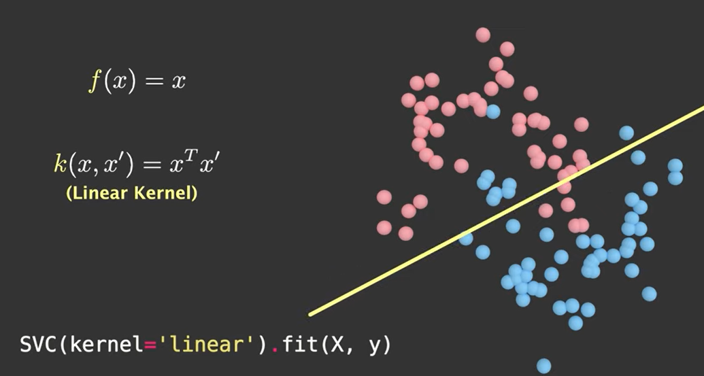
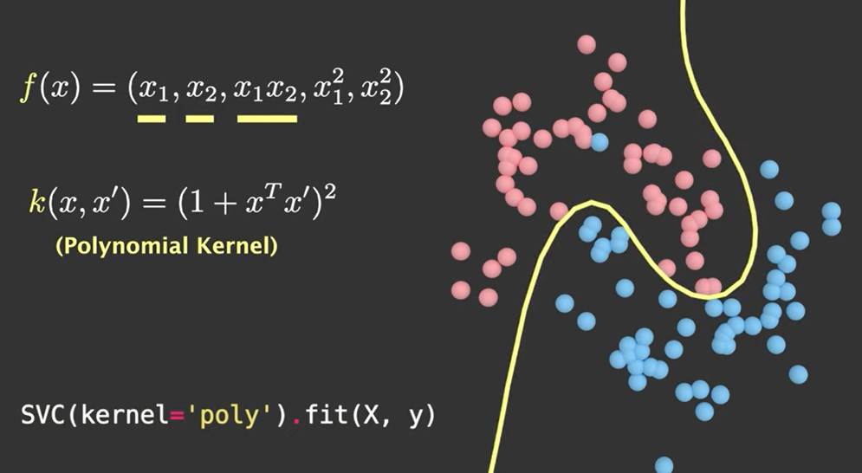
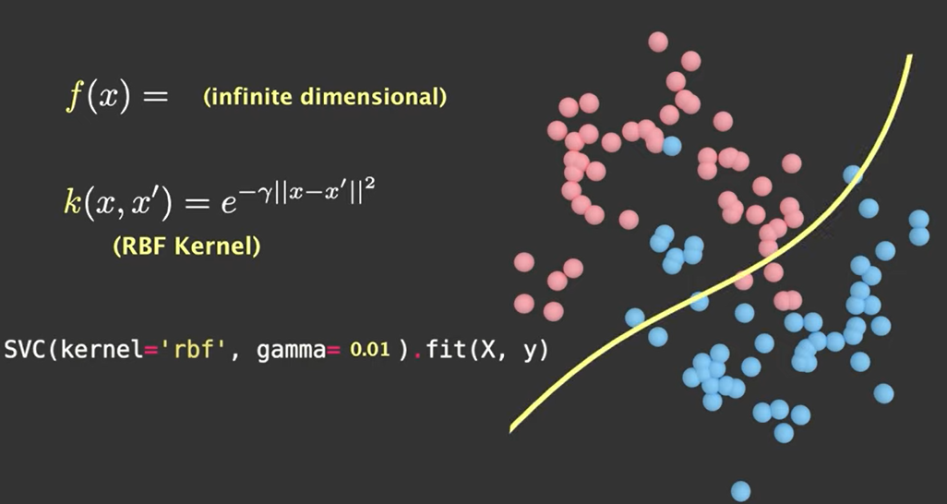
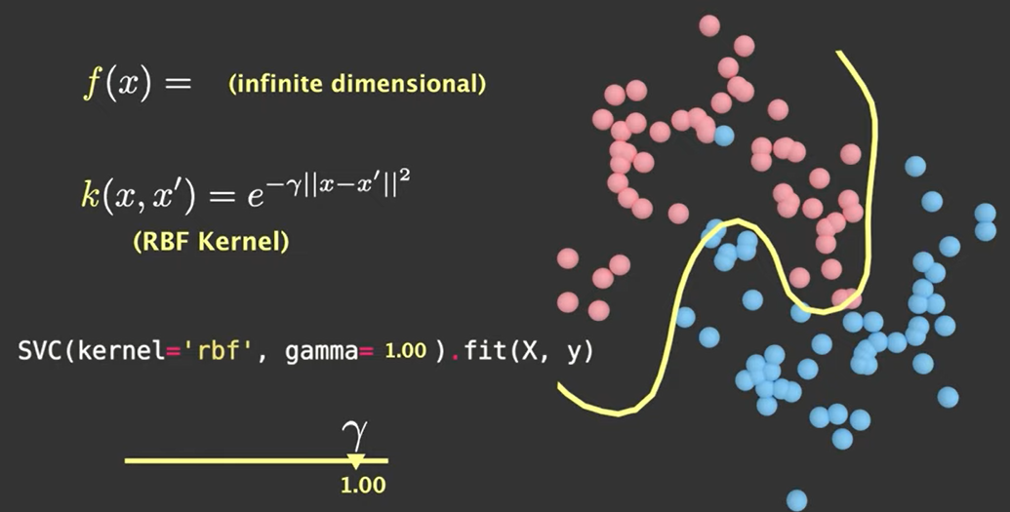

Slide 17
Support Vector Machine Algorithm: select Kernel Functions
Choosing the Right Kernel
The choice of kernel depends on the nature of the data and the specific problem at hand. Here are some guidelines for choosing the right kernel:
Linear Kernel: Use when the data is linearly separable or when there are a large number of features.
Polynomial Kernel: Use when the relationship between the features and the target variable is polynomial.
RBF Kernel: Use when the data is non-linearly separable and the decision boundary is complex.
Sigmoid Kernel: Use when you want to simulate the behavior of neural networks.
Specialty Kernels (Laplacian, Bessel, Spline, ANOVA, Exponential): Use when the specific kernel properties align well with the data characteristics and the problem requirements.

Slide 18
Support Vector Machine Algorithm: Advantages
Effective in High-Dimensional Spaces: SVMs are effective even in high-dimensional spaces, making them suitable for tasks with a large number of features, such as text classification or image recognition.
Versatile: SVMs support different kernel functions, allowing them to handle various types of data and learn complex decision boundaries.
Robust to Overfitting: SVMs perform well in situations where the number of features exceeds the number of samples. By maximizing the margin between classes, SVMs are less prone to overfitting.
Memory Efficient: SVMs only use a subset of training points (support vectors) to define the decision boundary, making them memory-efficient for large datasets.
Effective in Non-Linear Spaces: With the kernel trick, SVMs can efficiently handle non-linear data by transforming it into a higher-dimensional space where a linear separator can be found.
Global Optimum: SVMs are guaranteed to converge to the global optimum, given the absence of local minima, unlike neural networks.

Slide 19
Support Vector Machine Algorithm: Disadvantages
Sensitivity to Hyperparameters: SVMs have several hyperparameters (e.g., CCC for soft-margin SVM, kernel parameters) that need to be tuned for optimal performance. Selecting the right hyperparameters can be challenging and time-consuming.
Computationally Intensive: Training an SVM can be computationally intensive, especially for large datasets or complex kernel functions.
Memory Intensive: While SVMs are memory efficient during training, they require storing all support vectors in memory during prediction, which can be memory-intensive for large datasets.
Black Box Model: SVMs provide an optimal decision boundary without providing insight into the relationship between input features and the output. This lack of interpretability can be a disadvantage in some applications where understanding the model's behavior is important.
Limited Scalability: SVMs may not scale well to very large datasets due to their computational complexity and memory requirements. In such cases, other algorithms like logistic regression or decision trees may be more suitable.
Difficulty with Noisy Data: SVMs are sensitive to noisy data, as outliers can significantly affect the position and orientation of the decision boundary, leading to poor generalization.

Slide 20
GridSearch
GridSearchCV is a method in Scikit-Learn used for hyperparameter tuning of machine learning models. It is part of the model_selection module. The term "CV" stands for cross-validation, which is a technique used to evaluate the performance of a model on unseen data by splitting the dataset into multiple subsets (folds) and training the model on some folds while testing it on others.
GridSearchCV performs an exhaustive search over a specified grid of hyperparameters for a given estimator (machine learning model) and evaluates the performance of each combination using cross-validation. It is commonly used to find the optimal set of hyperparameters that results in the best model performance.

Slide 21
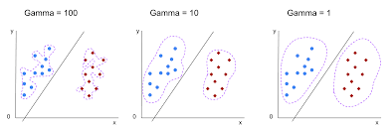
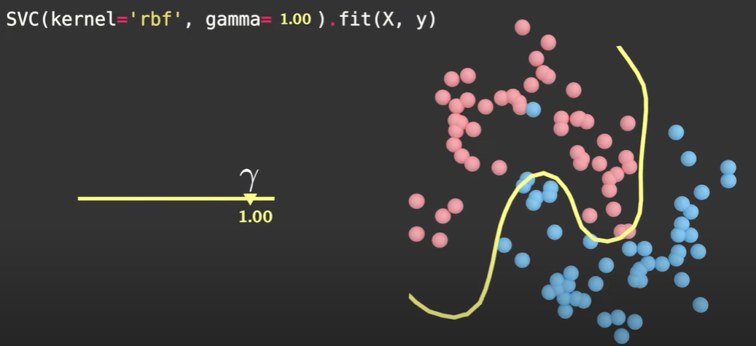
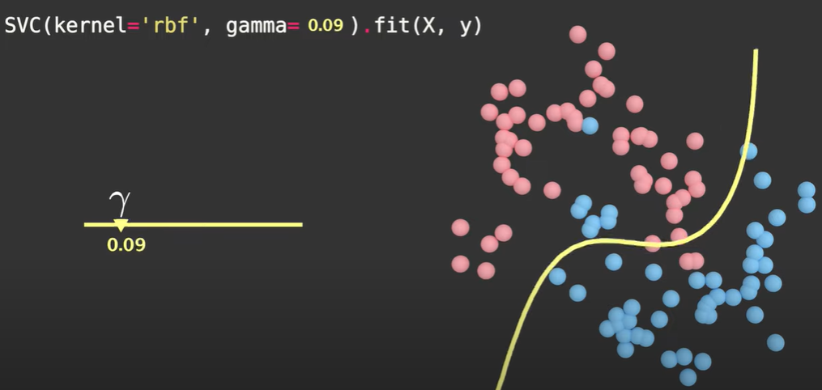
Gamma:
In the context of Support Vector Machines (SVM) with Radial Basis Function (RBF) kernel, the gamma parameter is crucial for controlling the shape of the decision boundary.

Slide 22
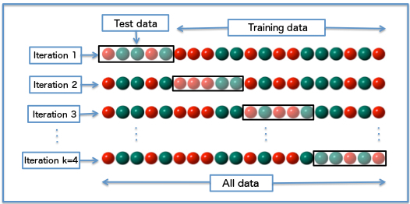
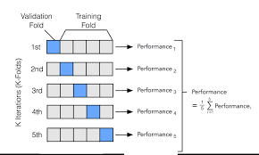
k-fold cross-validation
K-fold cross-validation is a technique used to evaluate the performance of a machine learning model by partitioning the dataset into KKK subsets or "folds." It helps to ensure that the model's performance is not dependent on a specific train-test split and provides a more robust estimate of its accuracy.

Slide 23
k-fold cross-validation
Benefits of K-Fold Cross-Validation:
More Reliable Estimates: By using multiple train-test splits, K-fold cross-validation provides a more reliable estimate of the model's performance compared to a single train-test split.
Efficient Use of Data: It uses all data points for both training and validation, ensuring that every data point is used for validation exactly once.
Reduces Overfitting: Helps in reducing overfitting by ensuring that the model's performance is validated on different subsets of the data.

