Slide 1

Breast cancer detection
Presented by RAMYA NAKKALA

Slide 2
INTRODUCTION Machine learning
Machine learning is a branch of artificial intelligence (AI) and computer science which focuses on the use of data and algorithms to imitate the way that humans learn, gradually improving its accuracy.
For example, we use Google Assistant that employs ML concepts, we take help from online customer support, which is also an example of machine learning, and many more.
Self Thinking
Computer
ai
AI
ML
Provides
Mathematical
Tool To AI

Slide 3
breast cancer : an overview
1. Breast cancer is a type of cancer that starts in the cells of the breast and primarily affects women.
2. It can have a significant impact on individuals, including physical, emotional, and financial consequences.
3. Early detection of breast cancer is crucial because it increases the chances of successful treatment and improves survival rates.
4. Machine learning plays a vital role in medical diagnostics by analyzing large amounts of data and identifying patterns that can help detect breast cancer at an early stage.
5. By leveraging machine learning algorithms, healthcare professionals can improve the accuracy of breast cancer detection, reduce false positives and false negatives, and provide personalized treatment recommendations, ultimately saving lives and improving patient outcomes.

Slide 4
Classification of machine leaning
Machine Learning
Supervised
Unsupervised
Classification
Regression
Clustering

Slide 5
Why I am using classification(logistic regression)
Classification is used because here we need to predict the type that Malignant (cancerous) or Benign(Non-cancerous)
Maligant is Cancerous that is 1
Benign is Non-Cancerous that is 0

Slide 6
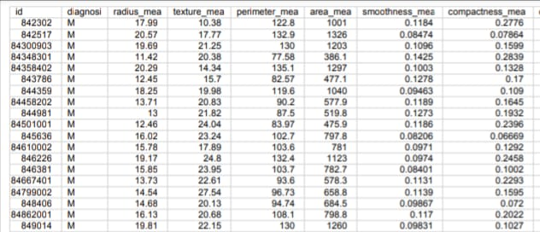
ANALYSING THE BREAST CANCER STEP 1: COLLECTING THE DATA
The Breast Cancer datasets is available machine learning repository maintained by the University of California, Irvine. The dataset contains 569 samples of malignant and benign tumor cells.
The first two columns in the dataset store the unique ID numbers of the samples and the corresponding diagnosis (M=malignant, B=benign), respectively.
The columns 3-32 contain 30 real-value features that have been computed from digitized images of the cell nuclei, which can be used to build a model to predict whether a tumor is benign or malignant.

Slide 7
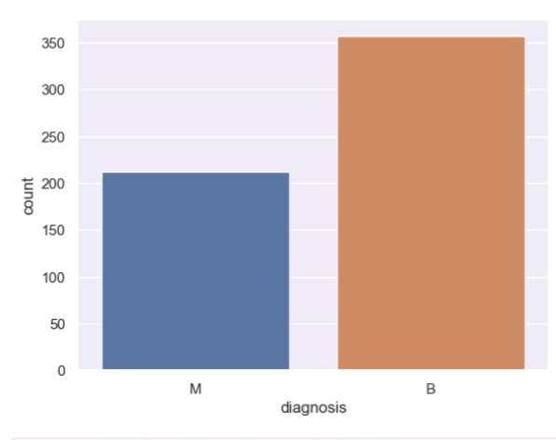
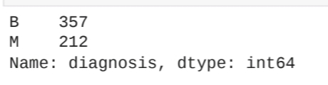
STEP 2: Exploring and preparing the data
Importing the data from drive
The Table() output indicates that 357 masses are Benign and while 212 are Malignat

Slide 8
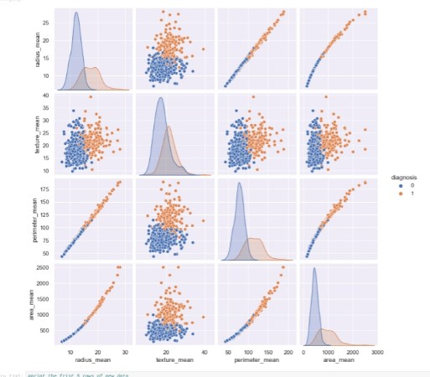
Visualization - 1
Do you notice any problematic
About the Data ?
Since there are standard values no need to do Normalization

Slide 9
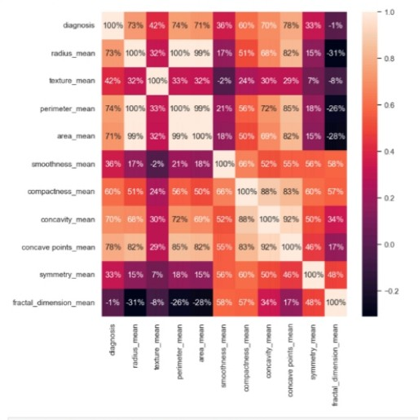
Visualization - 2
Visualizing the correlation
A vector X of numeric values,and for each value in X,
Subtracts the
Minimum value in X and divides by the range of values in X.

Slide 10

Data preparation – creating training and testing dataset
We will slipt the data set into test and train
If the preceding commands are confusing remember that data is extracted from dataframes using[row,coloumn]syntax.a blank value for the row or column value indicates that all the rows or coloumns should be included.Hence, the first line of code takes 75% and all coloums,and the second line takes 25% rows and all coloums

Slide 11

Step 3 – training a model on the data
Training models for breast cancer detection is performed to develop accurate and reliable algorithms that can assist in the early diagnosis and screening of breast cancer.
After training the accuracy of the training model is

Slide 12
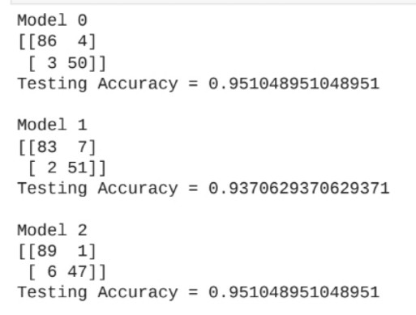
Step 4 – testing a model on the data
Testing models in breast cancer detection is performed to evaluate their performance and assess their accuracy, reliability, and generalizability before deploying them in real-world clinical settings.
Here the testing accuracy of the is performed by using four main points TP(true positive),FN(false negative),FP(false positive),TN(true negative)
Testing accuracy is performed by (TP + TN ) / (TP + FN + FP + TN)

Slide 13


