Slide 1

Nakka Sravanti
Final Project
3/21/2024 Annual Review

Slide 2

Project Title
KeyLogger
And
Security

Slide 3
Agenda:
Creating a keylogger, even for educational purposes, must be approached with great caution and responsibility.
Main Uses of Keykoggers:
Malicious Intent
Surveillance
Screen Logging
Credential Theft
Parental Monitoring
Law Enforcement Investigations

Slide 4

Problem Statement:
Develop a minimal Python keylogger for educational purposes to understand keylogging and its security implications, ensuring compliance with legal and ethical standards.

Slide 5
Project Overview:
Step 1: Project Planning
Define project objectives: Develop a keylogger for keystroke monitoring while prioritizing security measures.
Determine the target platform(s) and programming language(s): Consider Python for cross-platform compatibility.
Establish ethical guidelines and legal compliance measures to ensure responsible usage.

Slide 6
Step 2: Environment Setup
Choose Development Platform: Select a platform where you'll develop and run the keylogger. Common choices include Windows, macOS, and Linux.
Install Python: If not already installed, download and install Python from the official website (https://www.python.org/downloads/).
Ensure you're installing the latest stable version compatible with your operating system.
Install Required Libraries: Use pip, Python's package manager, to install the necessary library for keylogging. Open a terminal or command prompt and run:
pip install pynput
pip install simplejson

Slide 7
Step 4: Security Implementation
Implement authentication and authorization mechanisms to restrict access to logged data.
Step 5: Testing and Validation
Conduct thorough testing to ensure the keylogger functions as intended.
Step 6: Documentation and Deployment
Document the keylogger's functionalities, security measures, and usage guidelines.
“Develop a lightweight keylogger for monitoring user keystrokes, aimed at enhancing security and analyzing user behavior. Ensure strict adherence to legal and ethical guidelines to protect user privacy and prevent misuse.”

Slide 8
Who are the end users?
Parental Monitoring-Parents/Guardians
Employee Monitoring-Parents/Guardians
Law Enforcement and Security Agencies-Law Enforcement Agencies,Cybersecurity Professionals
Self Monitoring-Individuals
Educational Institutions-School Administrators
Researchers and Developers-Software Developers,Security Researchers
Compliance and Audit Professionals-Compliance Officers,Auditors
Ethical and Legal Considerations-User Consent,Data Privacy

Slide 9
Your Solution And Its Value Proposition:
Solution:
Don't click unwanted links or enable two step verification.
Before providing credentials ensure the address on the browser.
Don't connect to public wifi/any other untrusted network
Use updated antiviruses.
“So that develop keylogger,test it,take security measures and deploy it”.
Value Proposition:
Enhanced Security Monitoring: For Employers, For Parents
Law Enforcement and Investigations: Evidence Gathering, Security Testing
User Productivity and Self-Monitoring:Personal Tracking

Slide 10
The wow in my solution:
Enhanced Security and Privacy: Encrypted Logs, User Consent Mechanism
Advanced Keystroke Tracking: Detailed Event Capture
Scalable and Customizable
Ethical and Legal Compliance:Clear Documentation

Slide 11
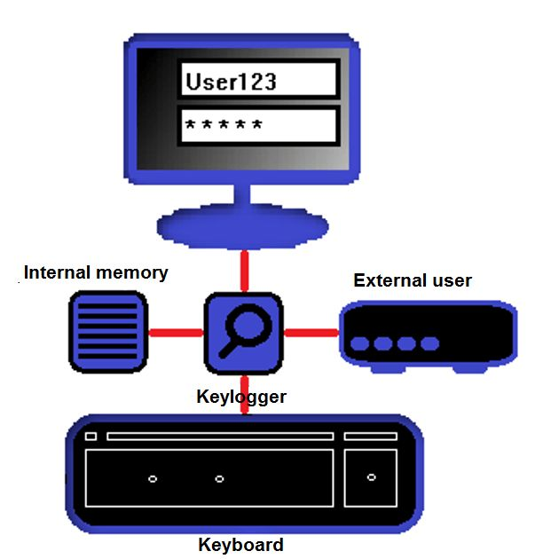
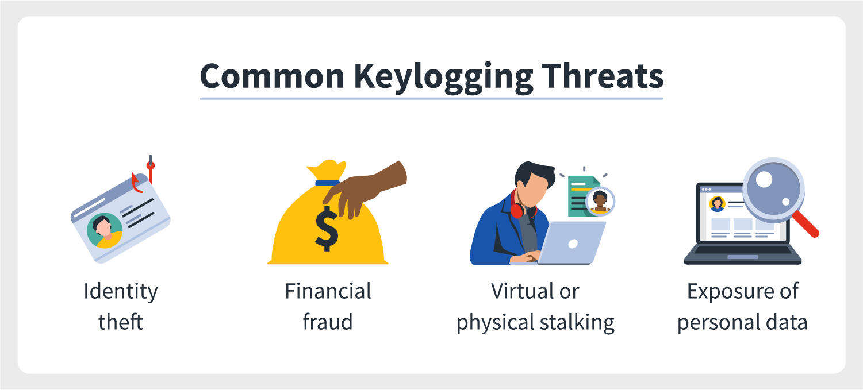
Modeling:
Data Modeling
System Architecture Security Measures
Pseudocode
Use Case Scenarios

Slide 12
Result:
The keylogger project delivers a valuable tool for security monitoring, parental control, and research purposes, while prioritizing ethical use and data privacy.
Its user-friendly interface, robust functionality, and adherence to security best practices make it a reliable solution for various stakeholders seeking to monitor and protect computer systems effectively.

